Slide 1
Chapter 4
Eating out

Slide 2
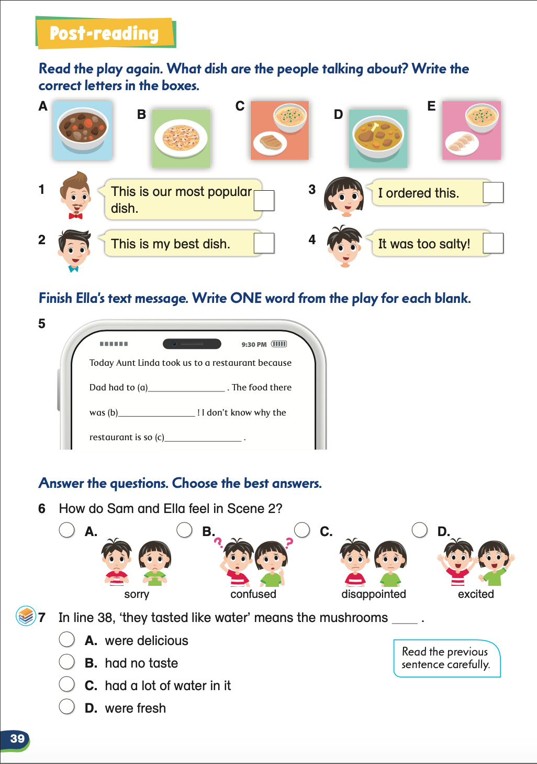

Slide 3
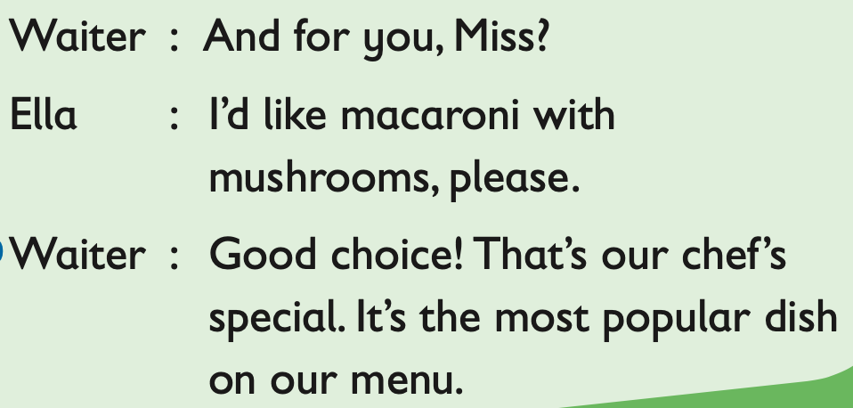
B

Slide 4
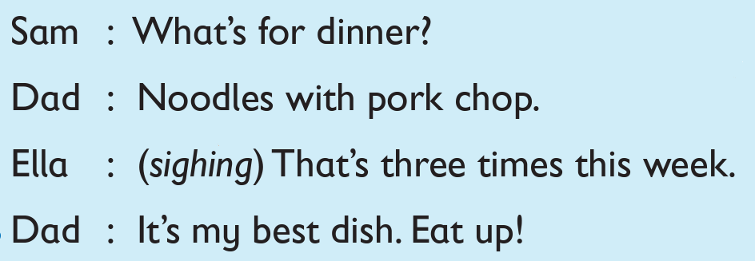
B
C

Slide 5
B
B
C

Slide 6
B
B
C
A

Slide 7
work

Slide 8
work
bland

Slide 9
work
bland
Since Ella thinks the restaurant is bad, she did not understand why others like it. The word we fill in must be a positive adjective.

Slide 10
work
bland
popular

Slide 11
✓

Slide 12
✓
What does bland mean?
It means there are not enough flavours.

Slide 13
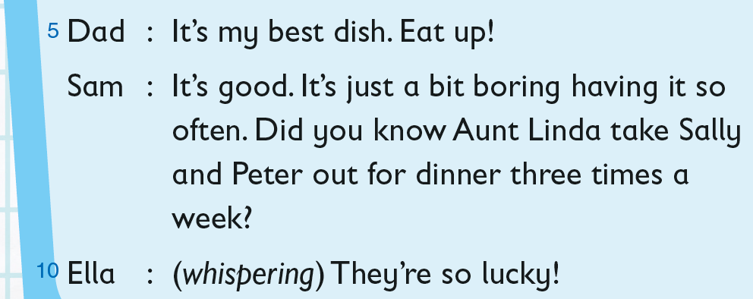
because Aunt Linda takes them out for dinner three times a week
We can get the answer by looking at the previous line of the key word ‘lucky’.

Slide 14
The End

Slide 15
Acknowledgments​ We are grateful to the following for permission to reproduce copyright photographs:​
Can Yesil. Shutterstock
HappyPictures. Shutterstock
Every effort has been made to trace copyright, but in the event of any accidental infringement, we shall be pleased to come to a suitable arrangement with the rightful owner.​

