Slide 1
Chapter 4
Be grateful

Slide 2
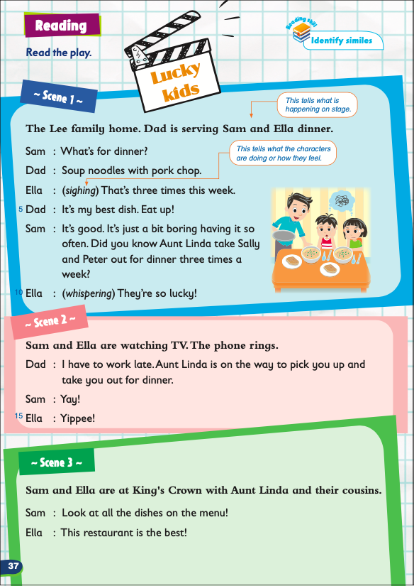
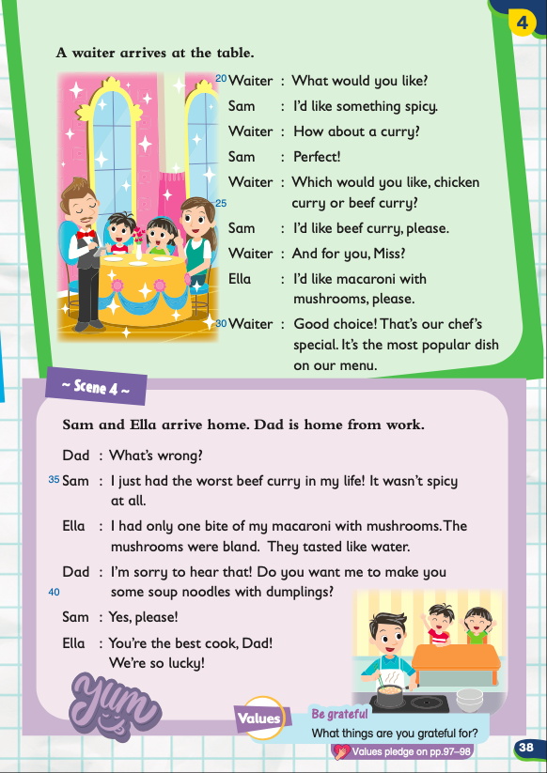

Slide 3
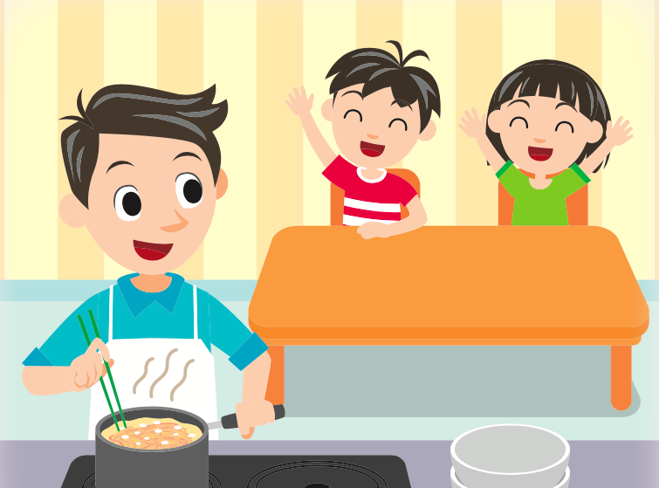
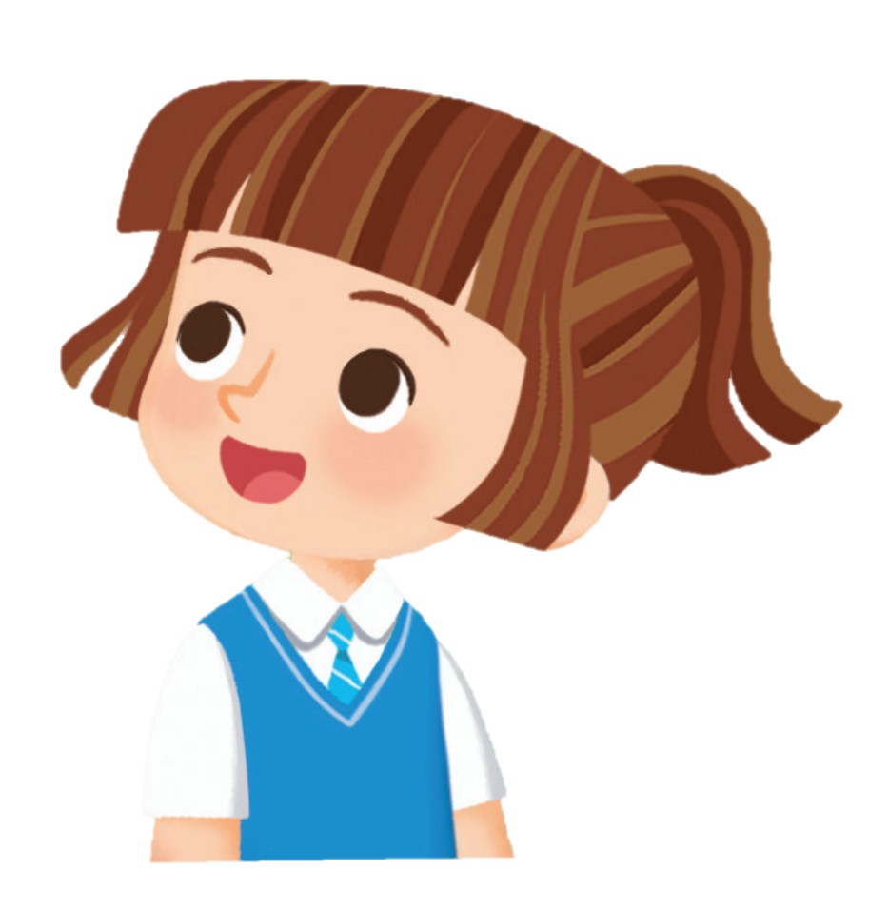
Be grateful
What things are you grateful for?
What?
have parents who prepare food for you
have parents who work hard to raise you
able to eat out

Slide 4
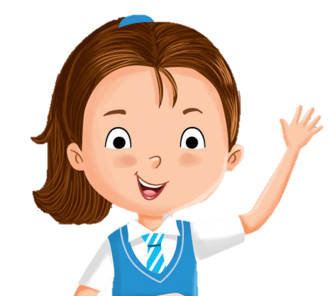
We should not take things for granted.
Take things as if they are gifted.
Let’s be grateful!

Slide 5
Not everybody has parents, family and friends. We should be grateful.
Here’s one thing we can do:
Write a list of ten things I am thankful for and show it to my parents.
Let’s look at an example!

Slide 6
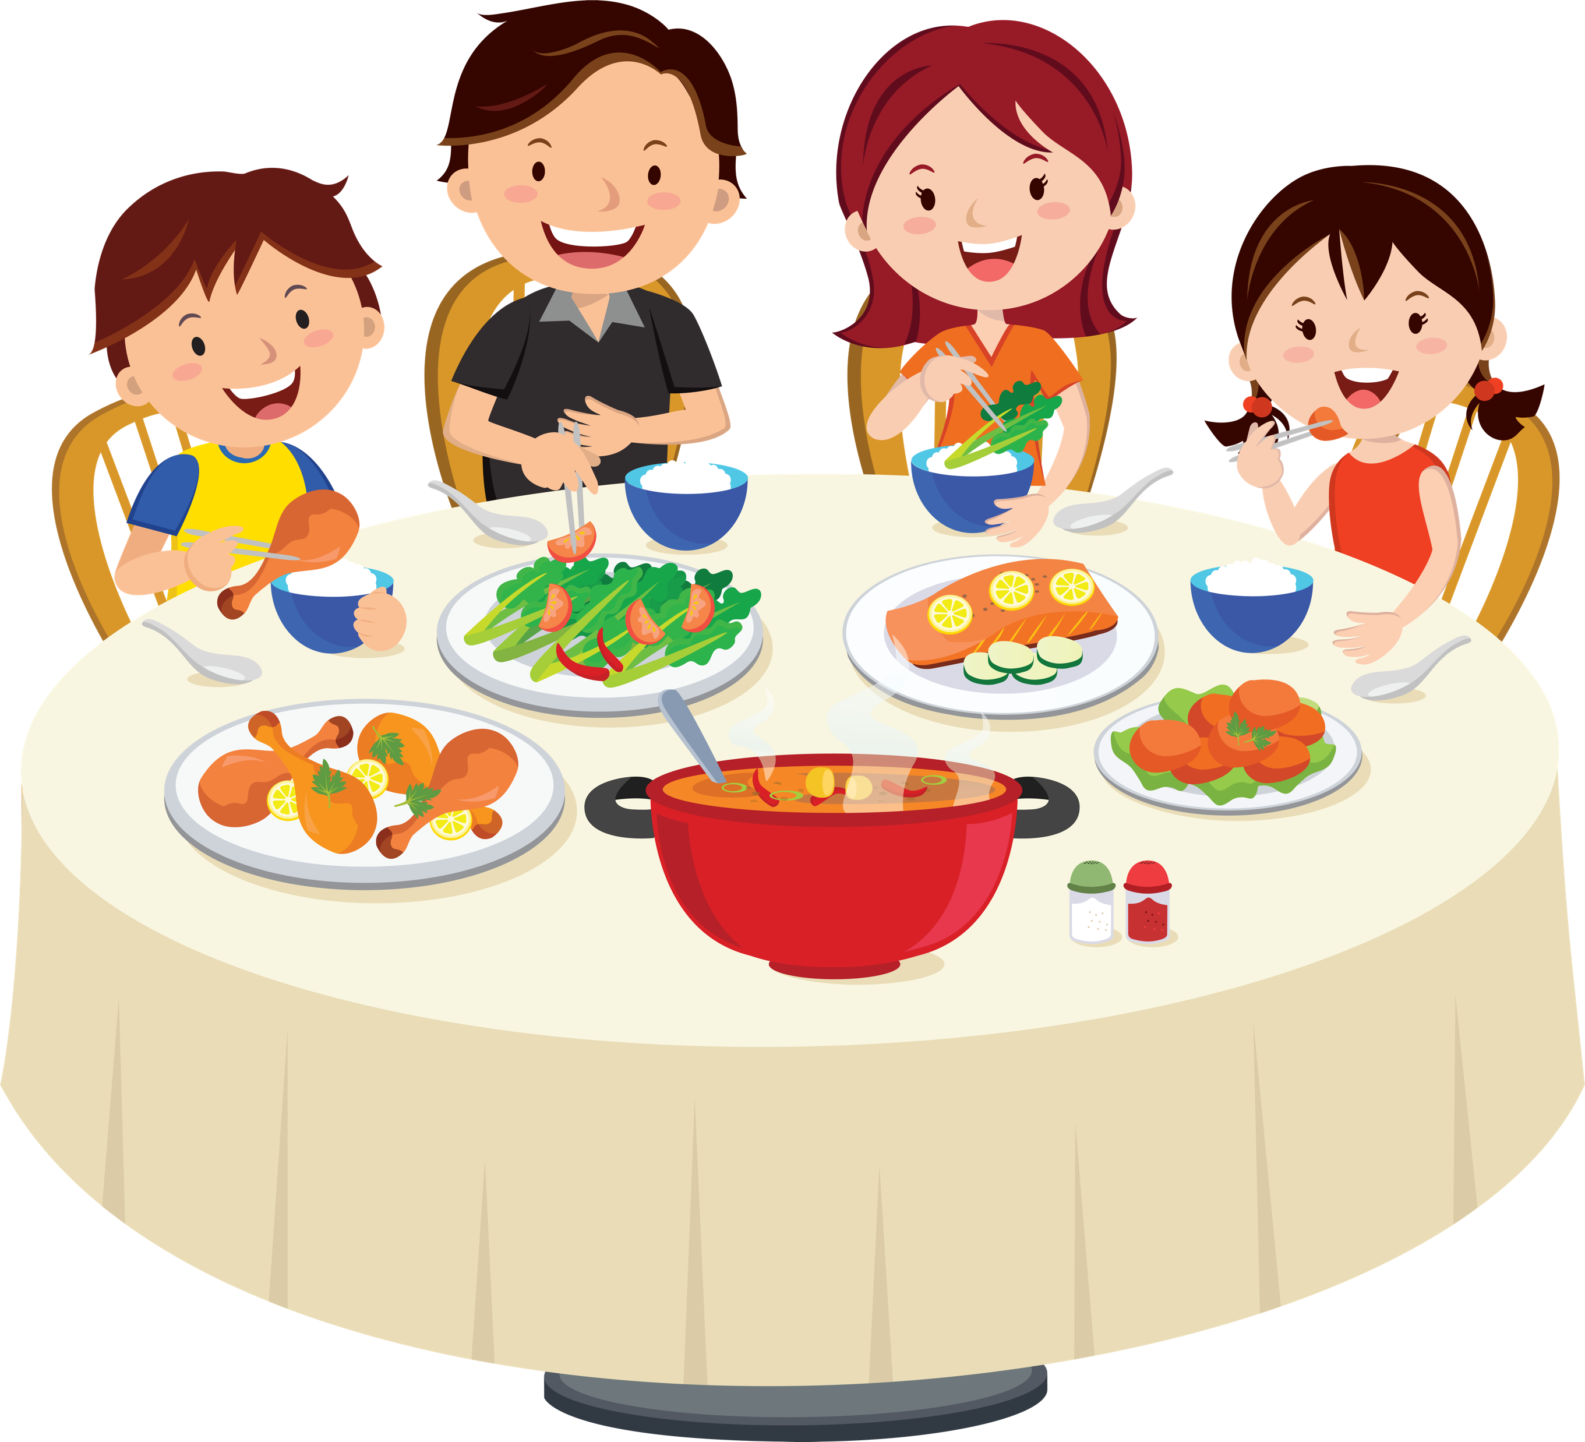
Jake’s family had a family gathering today.
He had such a wonderful time and he is now writing his gratitude diary.

Slide 7
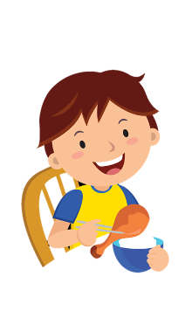
A gratitude diary is a diary where you write down the things you are grateful for.
Let’s take a look at Jake’s gratitude diary
and see what he is grateful for today.
Monday Sunny :)
I am grateful for having a father who tells funny jokes.
I am grateful for having a mother who makes delicious food.
I am grateful for having the chance to spend time with my family.

Slide 8
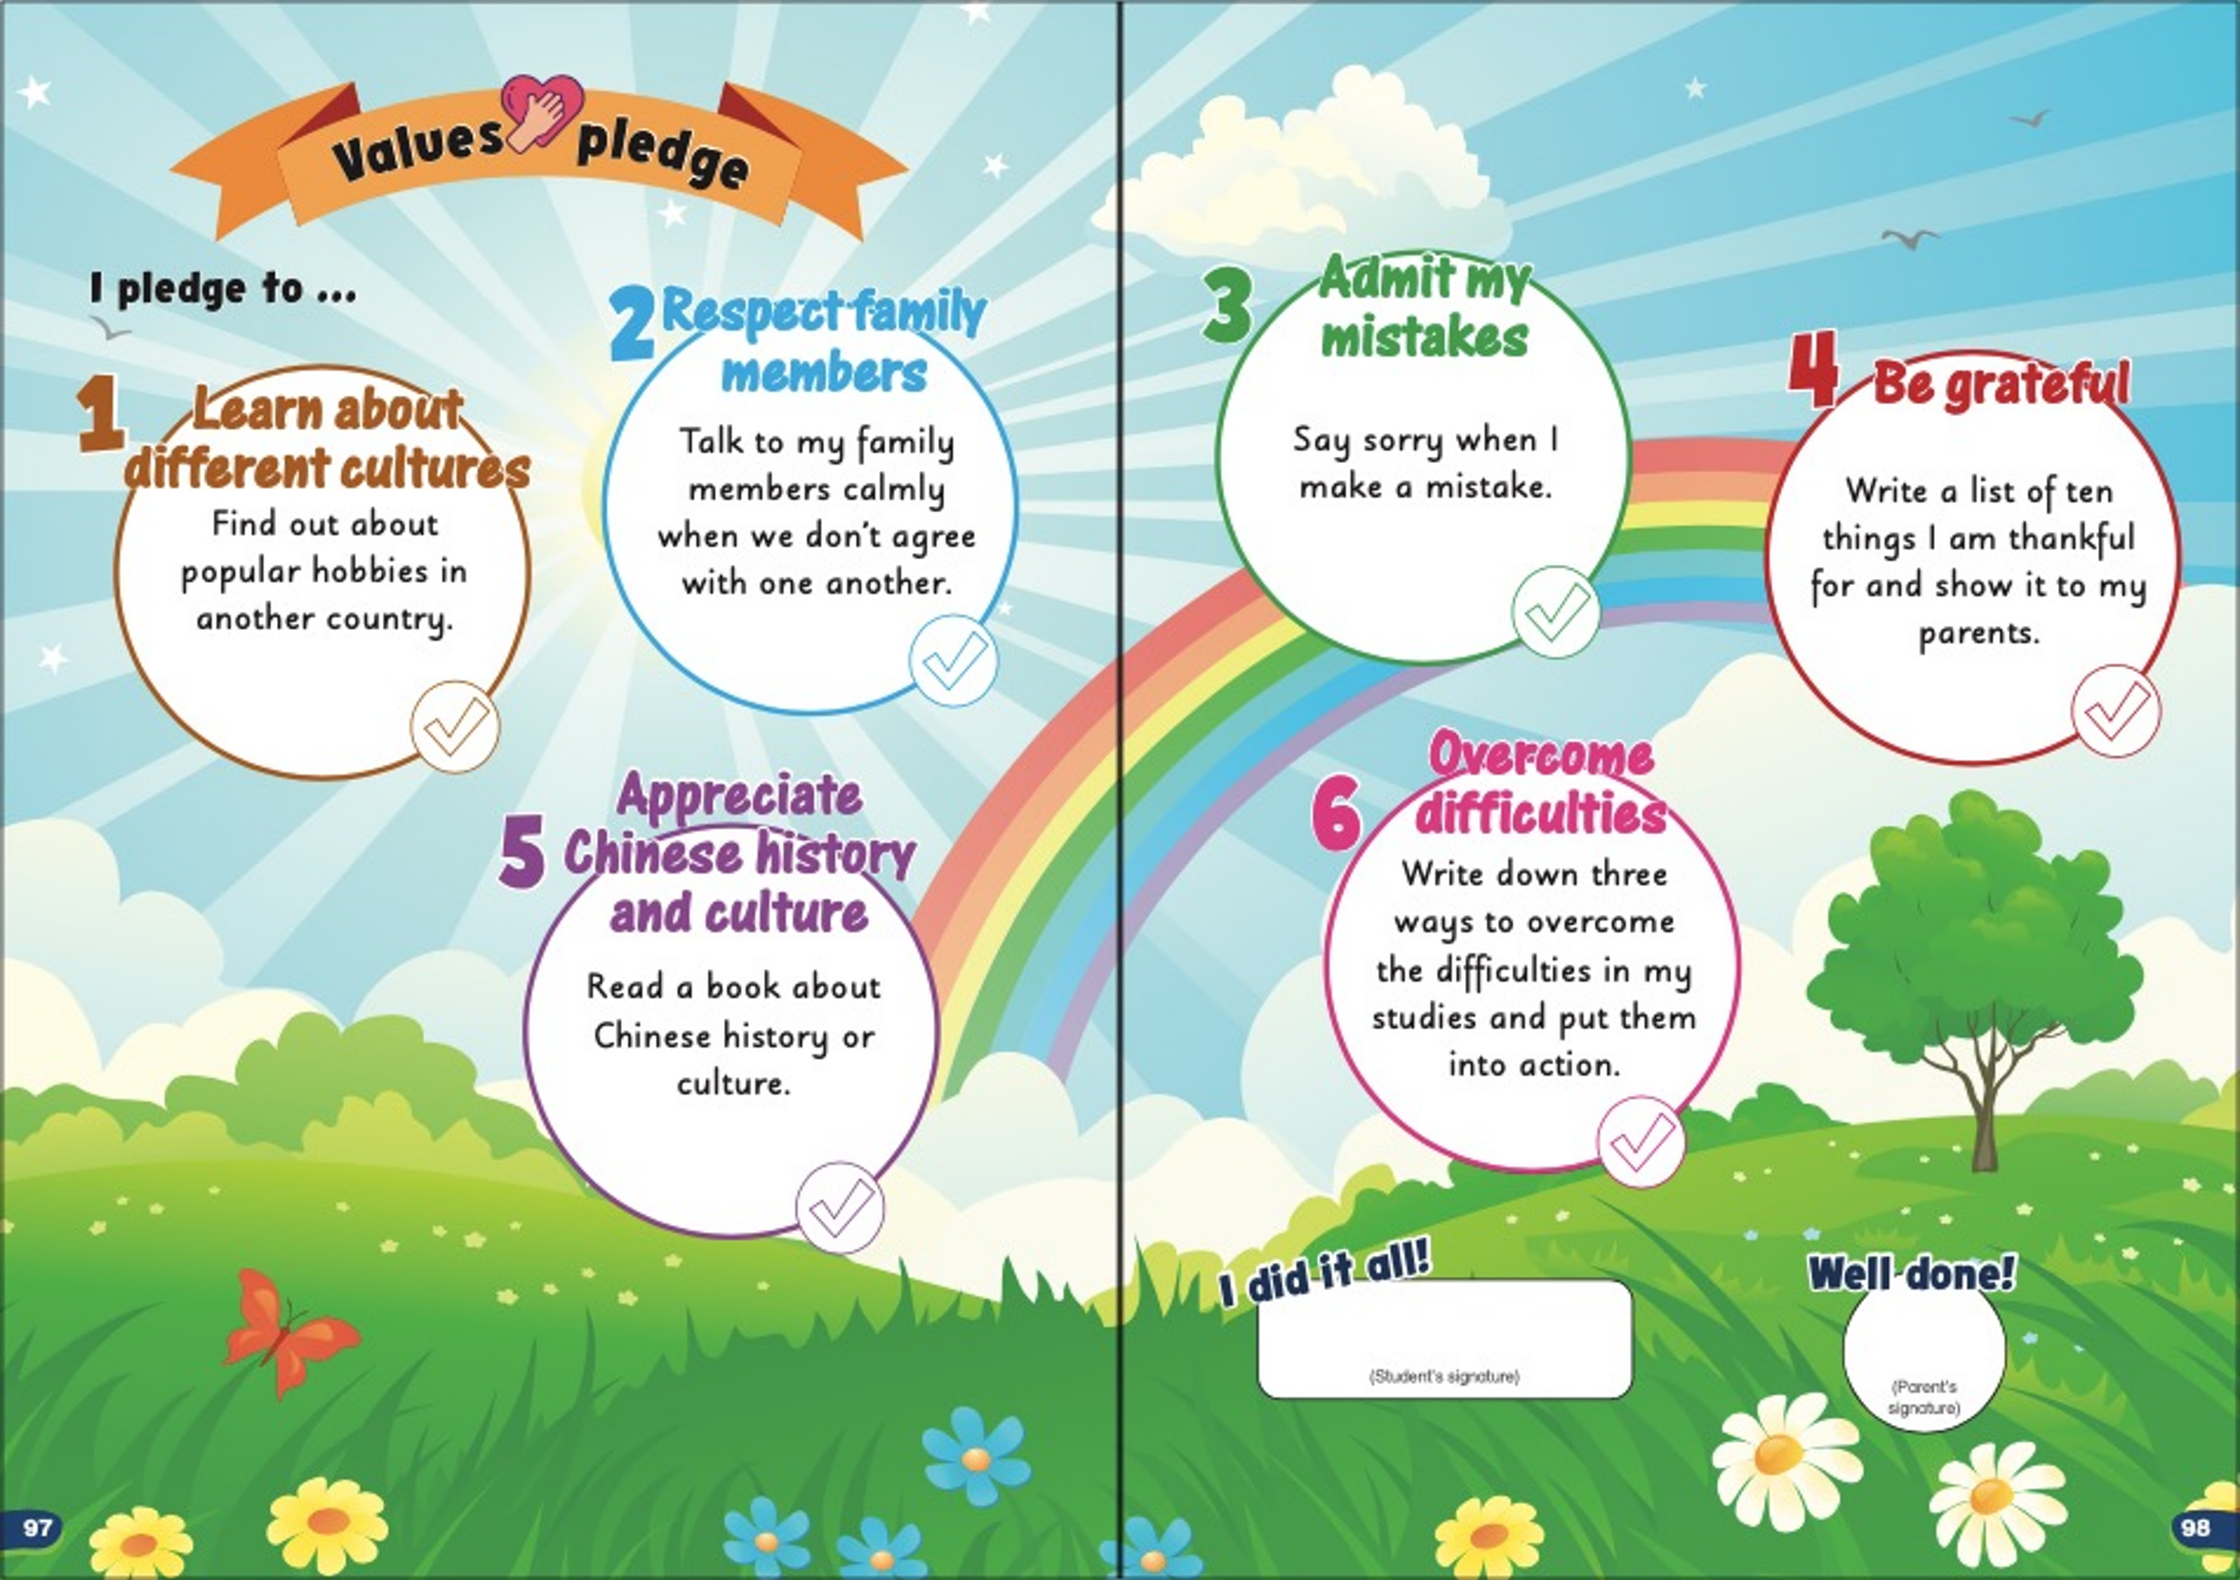
Not everybody has parents, family and friends. We should be grateful.
Here’s one thing we can do:
Write a list of ten things I am thankful for and show it to my parents.
After completing this little mission, don’t forget to check it off on the Values Pledge on pp. 97–98.

Slide 9
What are other things we can do to show that we are grateful?
Make a
gift or cook something for people who care about you
Say thank you to people we are thankful to
Write a grateful letter
Offer help to others just like how others
help you
Any other ideas?

Slide 11
Acknowledgments
We are grateful to the following for permission to reproduce copyright photographs:
graphic-line. Shutterstock
Every effort has been made to trace copyright, but in the event of any accidental infringement, we shall be pleased to come to a suitable arrangement with the rightful owner.

