Slide 1

Chapter 2
Respect other cultures

Slide 2
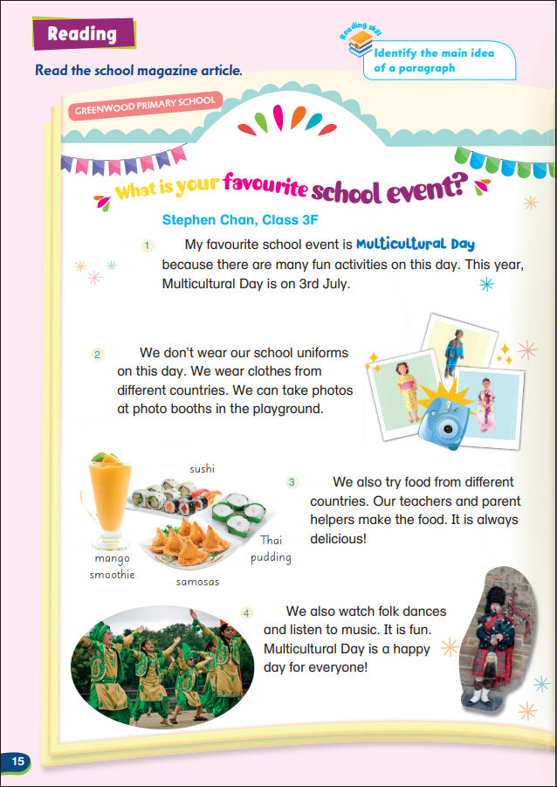
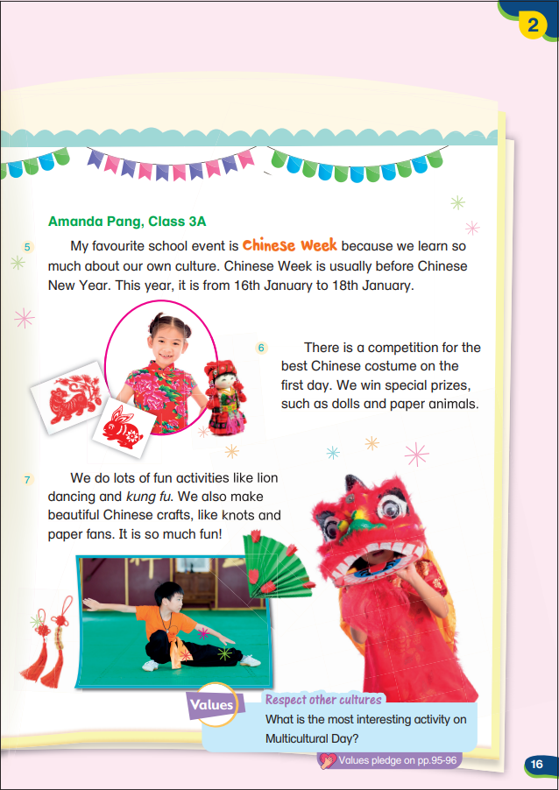

Slide 3


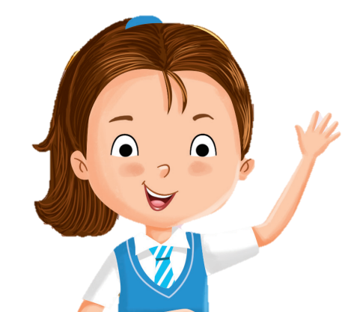
Respect other cultures
What is the most interesting activity on Multicultural Day?
wear clothes from different countries
Multicultural Day
Listen to music
No. of votes
No. of votes
take photos at photo booths
watch different folk dances
Let’s vote!
No. of votes
try food from different countries
No. of votes
No. of votes

Slide 4

Every culture is different and special in its own way.
We should respect other cultures!

Slide 5
Learning about different cultures helps us understand other people.
Here’s one thing we can do:
Find out one interesting thing about another culture and tell your friend.
Let’s look at an example!

Slide 6
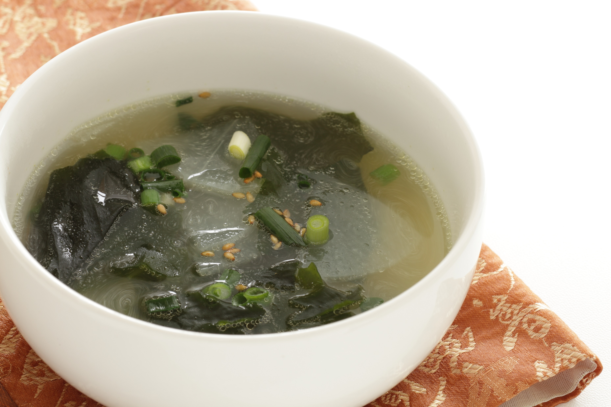
Do you know what this is?
It’s seaweed soup.

Slide 7
Koreans eat seaweed soup on their birthdays. It is a way to respect and remember their mothers’ love for them.

Slide 8
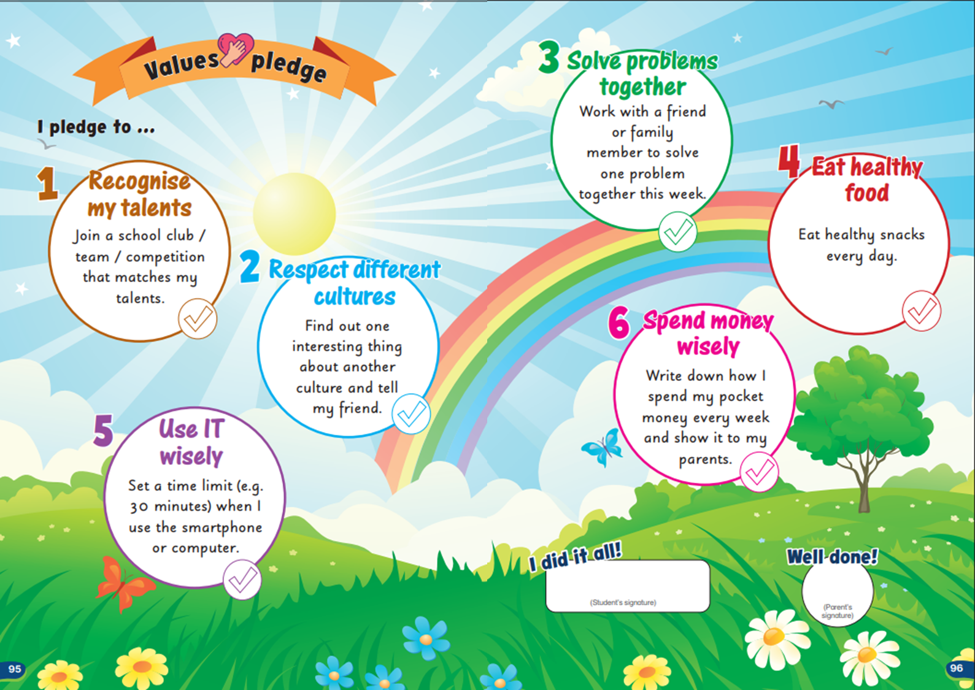
Learning about different cultures helps us understand other people.
Here’s one thing we can do:
Find out one interesting thing about another culture and tell your friend.
After completing this little mission, don’t forget to check it off on the Values Pledge on pp. 95–96.

Slide 9
What are other things we can do to learn about different cultures?
Listen to a folk song from another country
Talk to someone from another country
Try a new food from another culture
Learn to say ‘Hello’ in 3 new languages
Any other ideas?

Slide 11
Acknowledgments
We are grateful to the following for permission to reproduce copyright photographs:
jreika. Shutterstock
Every effort has been made to trace copyright, but in the event of any accidental infringement, we shall be pleased to come to a suitable arrangement with the rightful owner.

