Slide 1
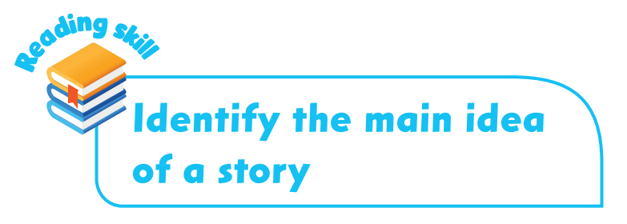
Chapter 4

Slide 2
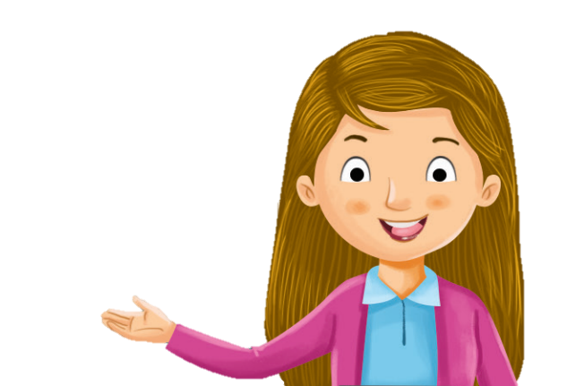
We’re going to talk about similes today.
So, what is a simile?
We use similes to compare one thing to another.

Slide 3
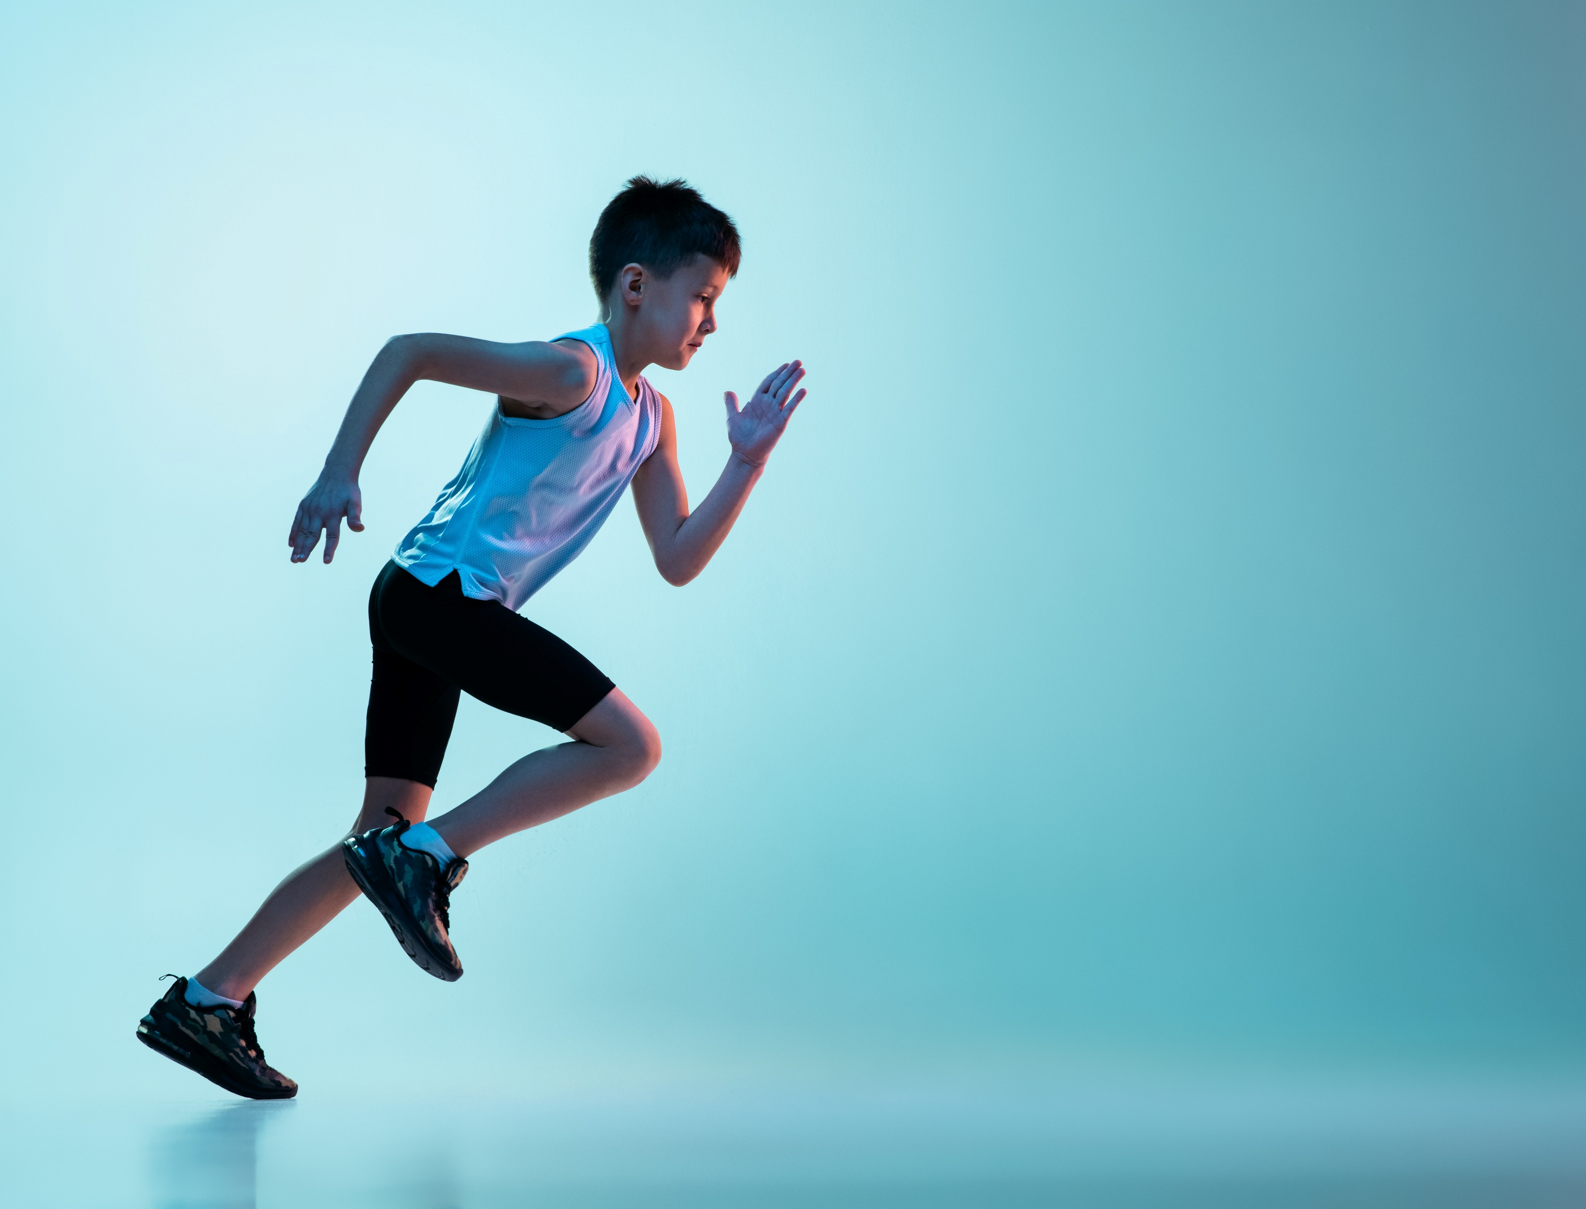
Let’s look at an example.
This is a simile.
Ben can run as fast as lightning.

Slide 4
What are we comparing here?
Ben can run as fast as lightning.

Slide 5
We are comparing Ben’s running to lightning.
Ben can run as fast as lightning.

Slide 6
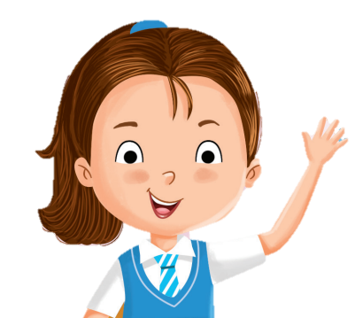
We want to say that Ben can run fast, but how fast?
Ben can run as fast as lightning.
Lightning is very fast!

Slide 7
Yes, Ben can run very, very fast!
Ben can run as fast as lightning.

Slide 8
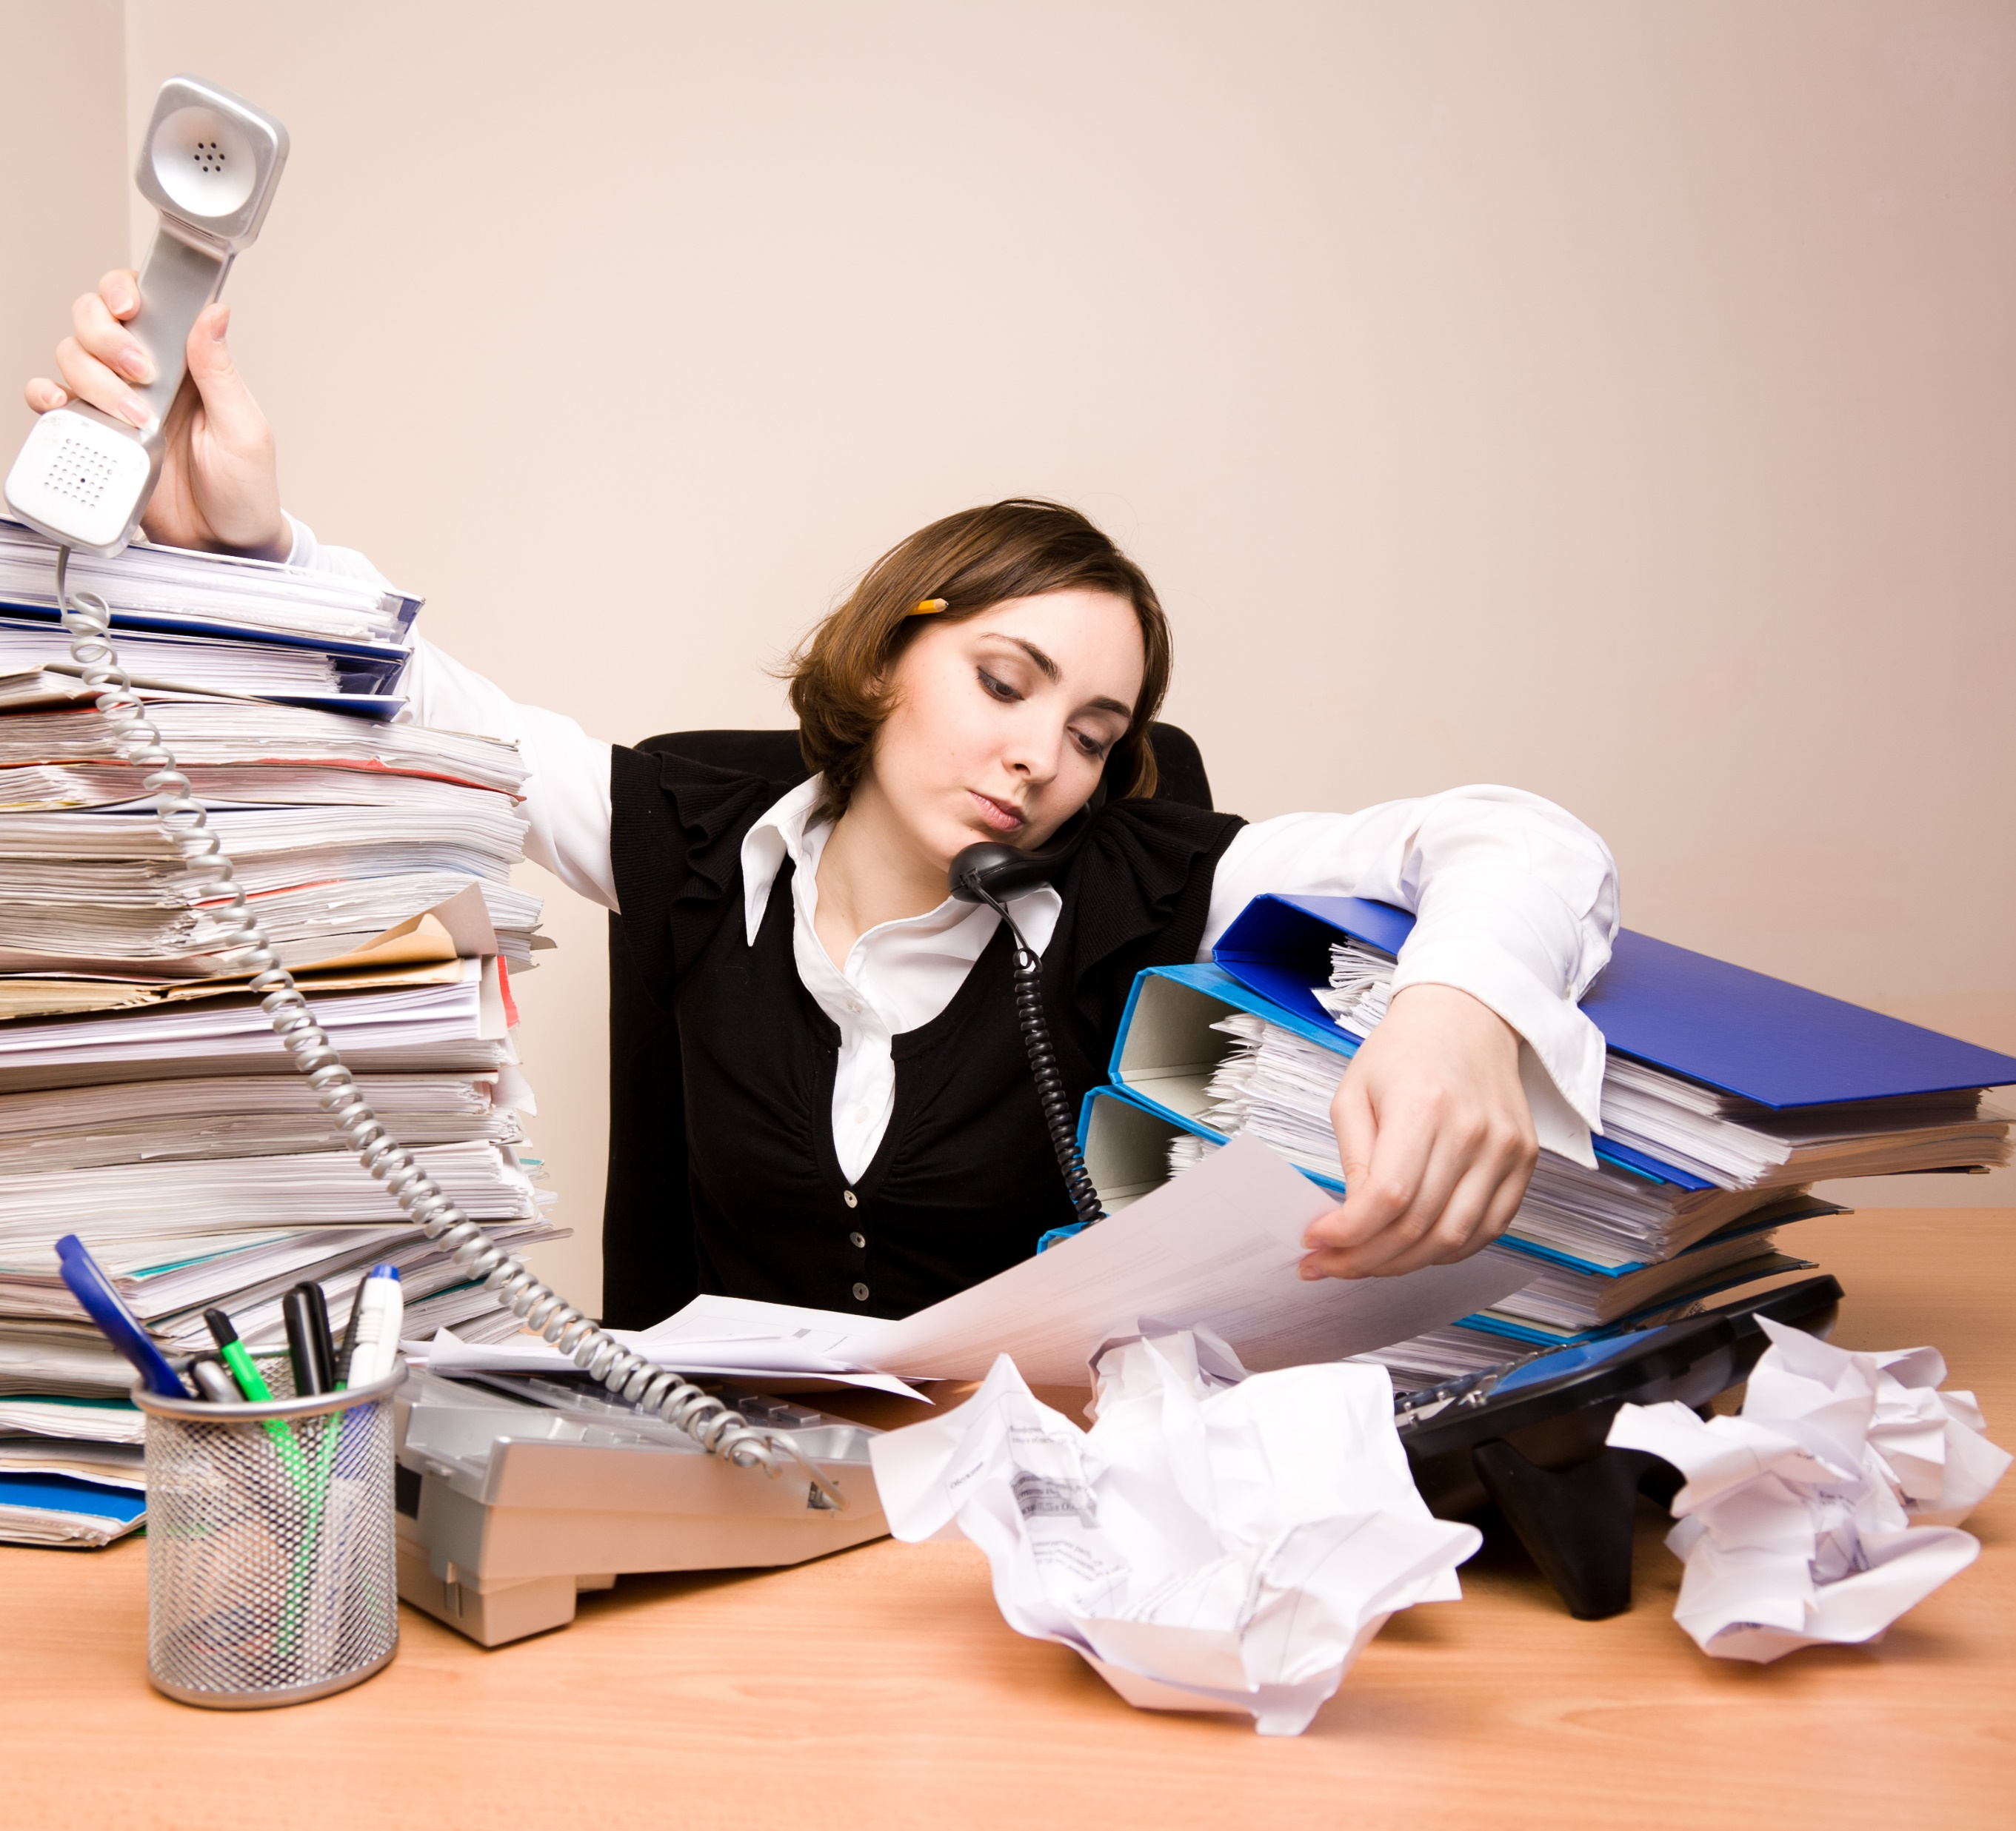
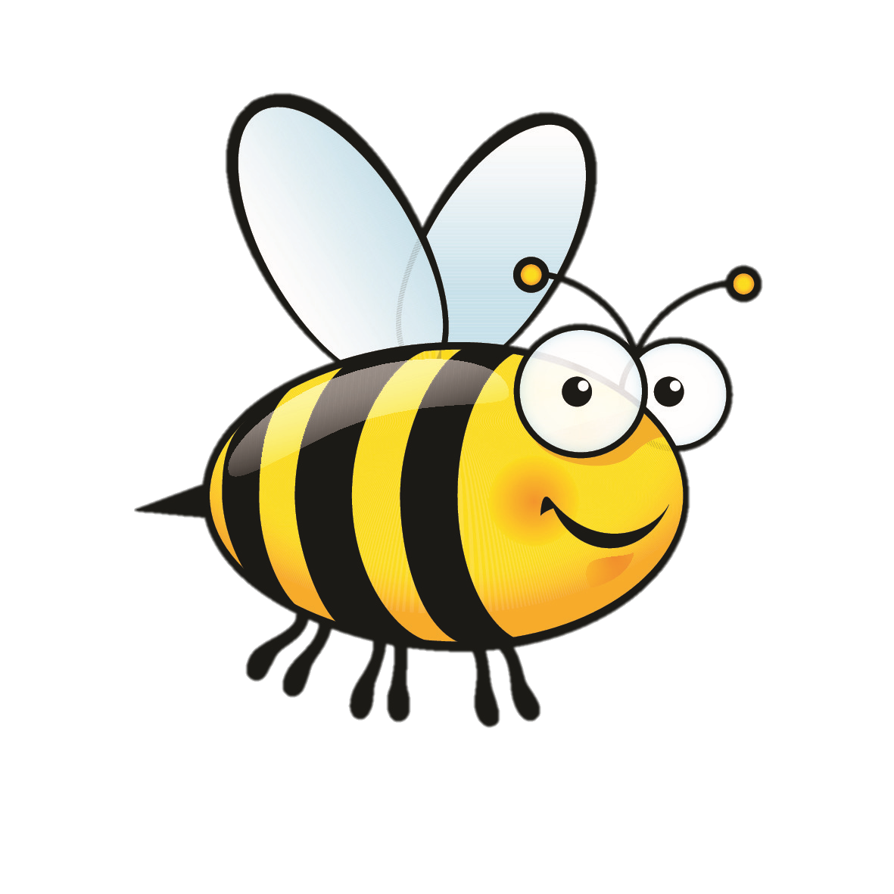
Here’s another example of a simile.
My mother is busy like a bee.

Slide 9
We are comparing how busy mum is to how busy bees are.
My mother is busy like a bee.
Hey, me too!
I’m very busy!

Slide 10
So, mum is not just busy. She is very busy!
My mother is busy like a bee.
Hey, me too!
I’m very busy!

Slide 11
Let’s take a look at these similes again.
Ben can run as fast as lightning.
My mother is busy like a bee.

Slide 12
We use the word ‘as’ or ‘like’ to compare one thing to another in similes .
Notice that we put ‘as’ before and after the adjective.
Ben can run as fast as lightning.
My mother is busy like a bee.

Slide 13
We use the word ‘as’ or ‘like’ to compare one thing to another in similes .
Ben can run as fast as lightning.
My mother is busy like a bee.
We use similes to make our writing more vivid and interesting!

Slide 14
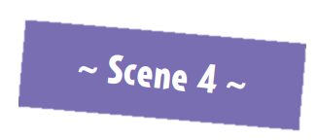
Here’s an example from the reading passage.
It’s a simile!

Slide 15
Let’s look at an example from the reading passage.
‘They’ refers to ‘mushrooms’.

Slide 16
What is the writer comparing the mushrooms to?
The mushrooms tasted like water.

Slide 17
How does water taste like?
The mushrooms tasted like water.
Water doesn’t have any taste!

Slide 18
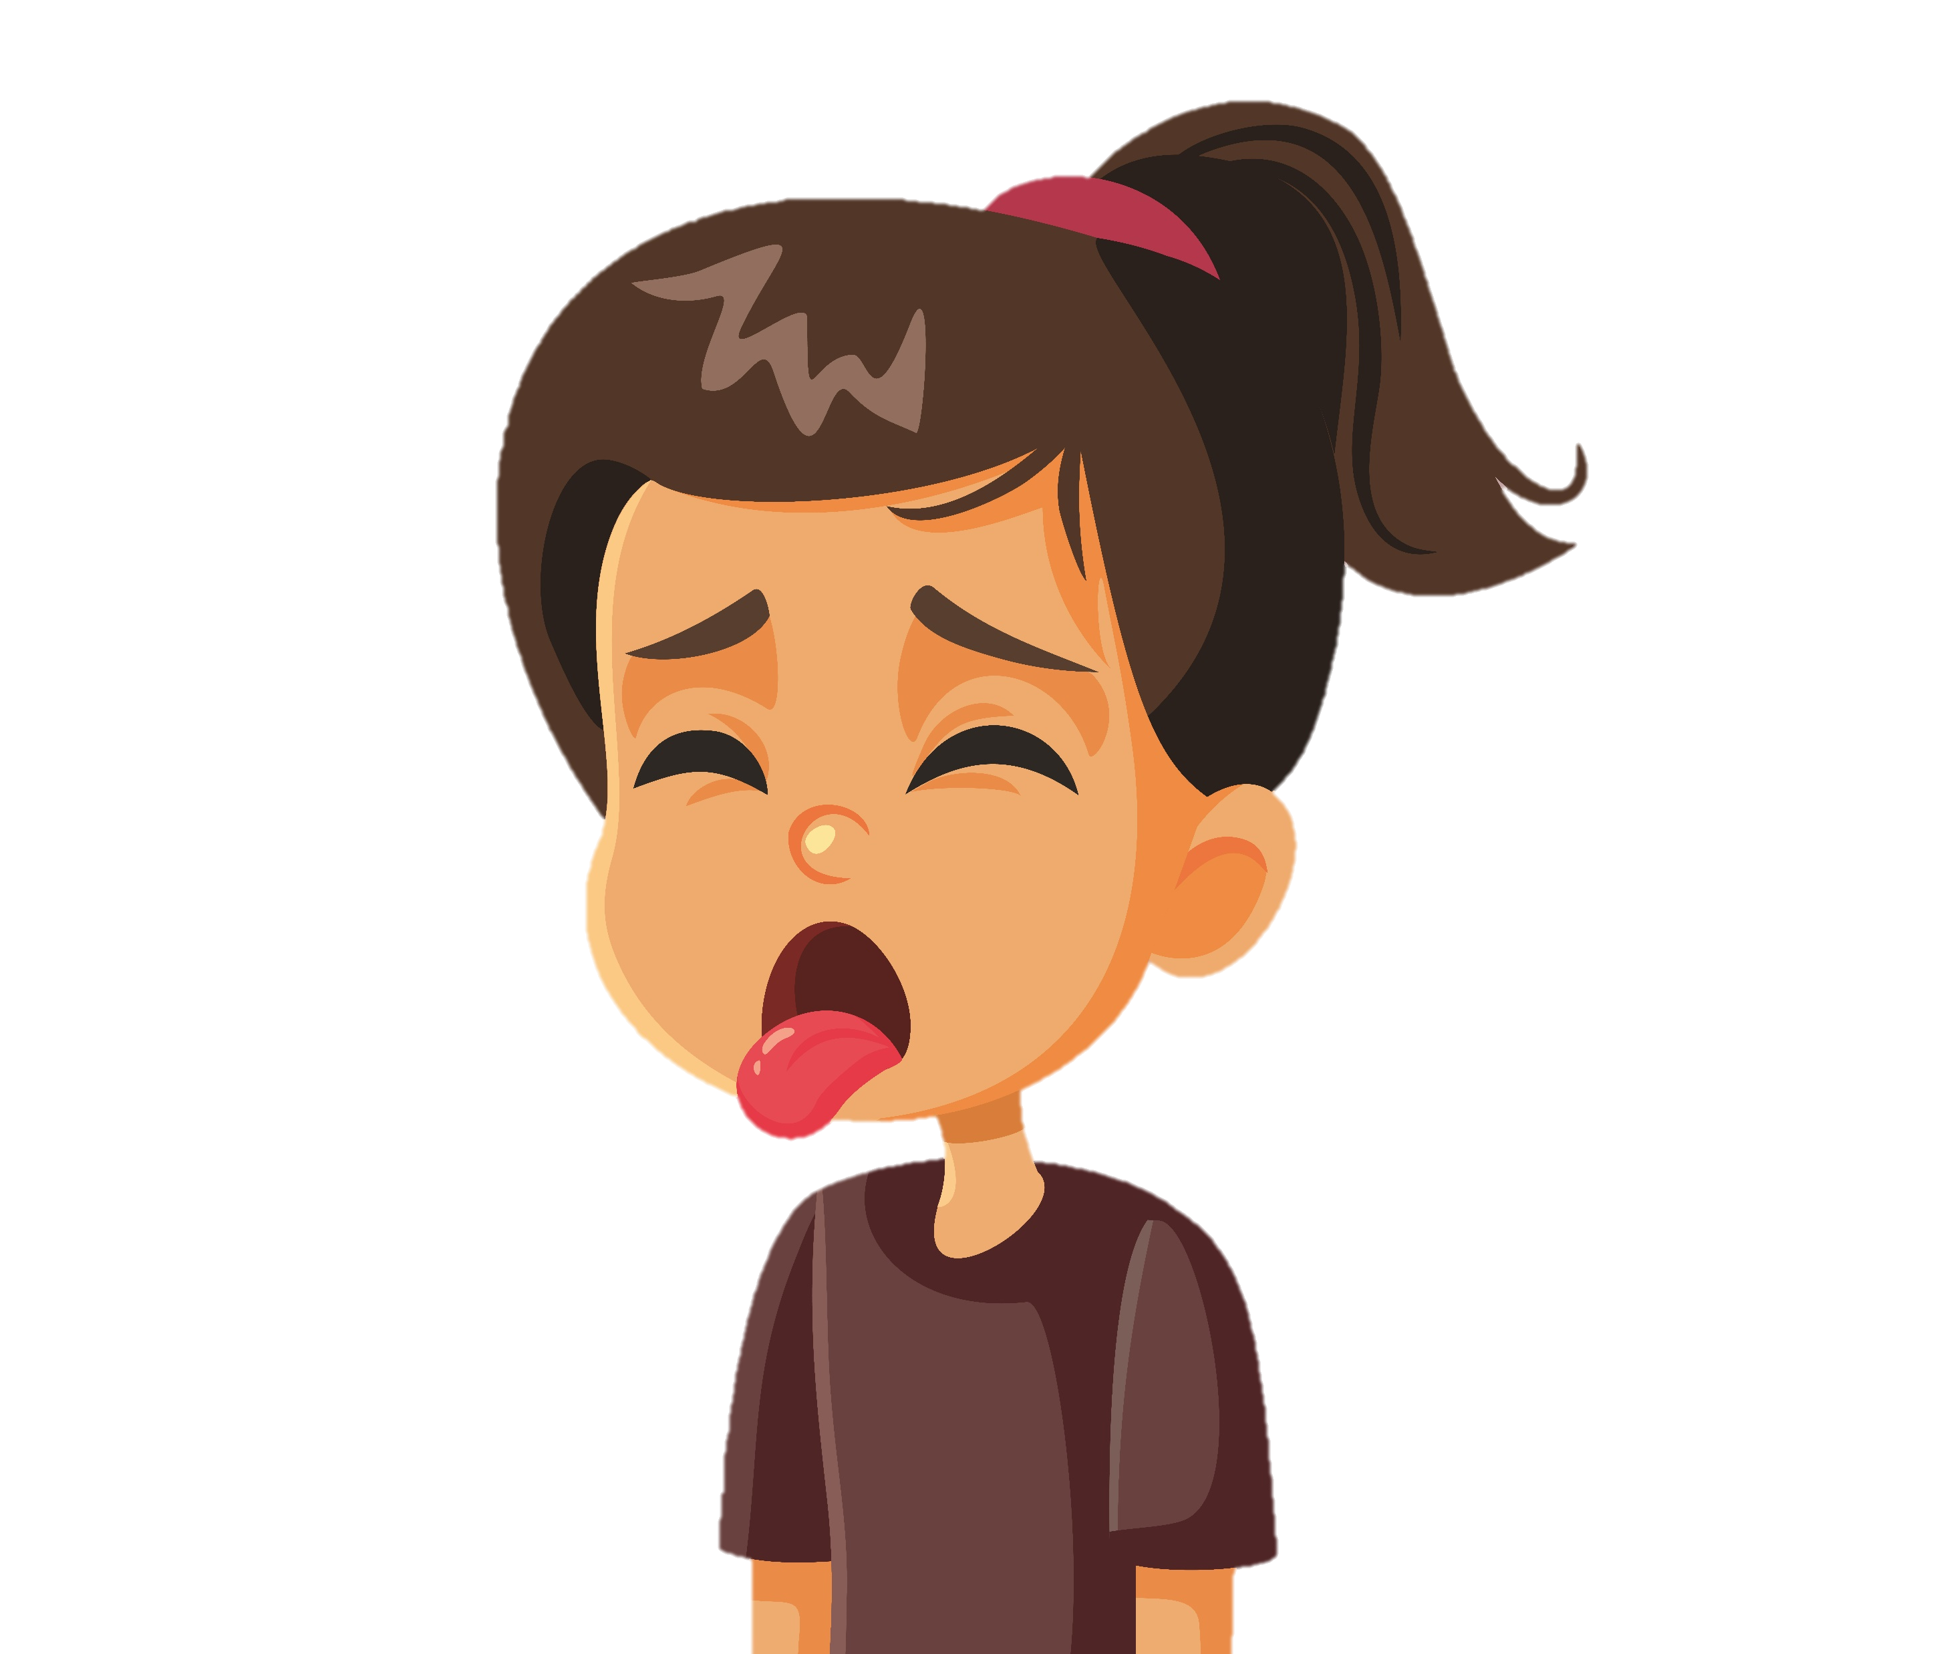
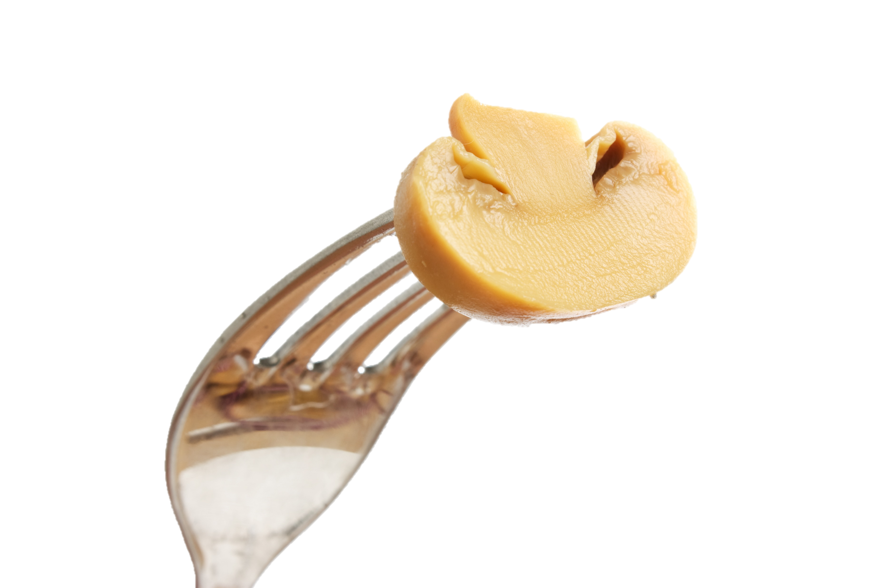
Right! So the writer wants to say that the mushrooms have no or very little taste.
The mushrooms tasted like water.
Yuck! The mushrooms have no taste!

Slide 19
Here’s a little challenge!

Slide 20
Are these sentences similes?
1. Timmy is as brave as a lion.
2. The cookies are crunchy.
3. Emma climbs like a monkey.
4. The rabbit and puppy are cute.

Slide 21
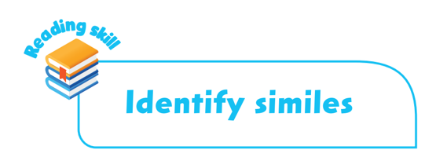
What we learned today:
We use similes to compare one thing to another.
We use ‘as’ or ‘like’ in similes.
Similes make our writing more vivid and interesting.

Slide 23
Acknowledgments
We are grateful to the following for permission to reproduce copyright photographs:
Aldiki Gustiyan. Shutterstock
Anton Vierietin. Shutterstock
Glovatskiy. Shutterstock
Duda Vasilii. Shutterstock
Midorie. Shutterstock
Nicoleta Ionescu. Shutterstock
Laborant. Shutterstock
Every effort has been made to trace copyright, but in the event of any accidental infringement, we shall be pleased to come to a suitable arrangement with the rightful owner.

