Slide 1
Chapter 4
Eating out

Slide 2
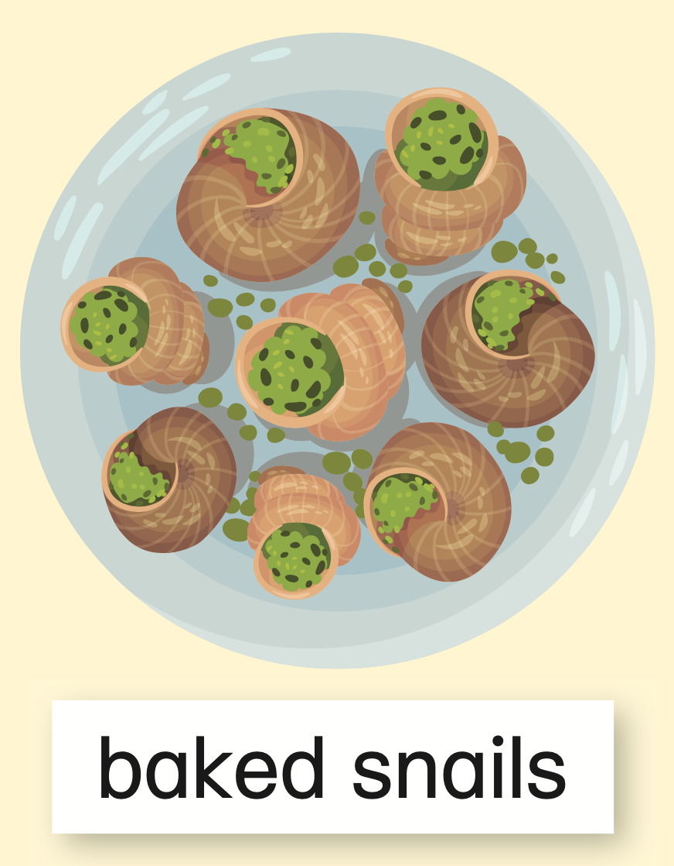

Slide 3
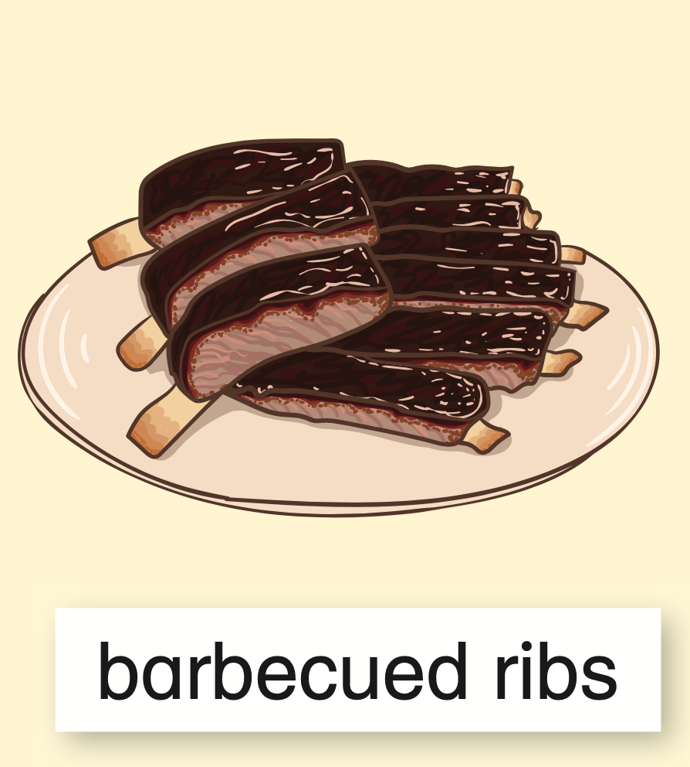
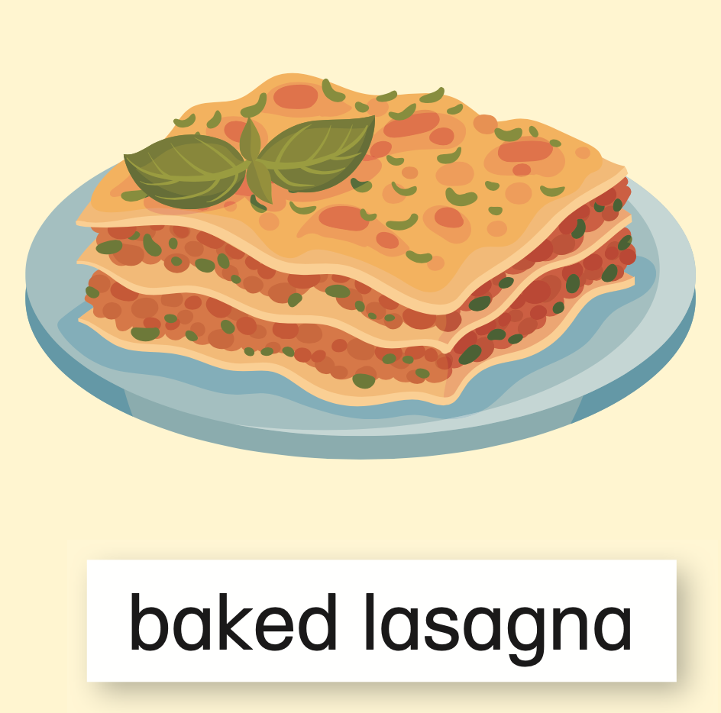

Slide 4
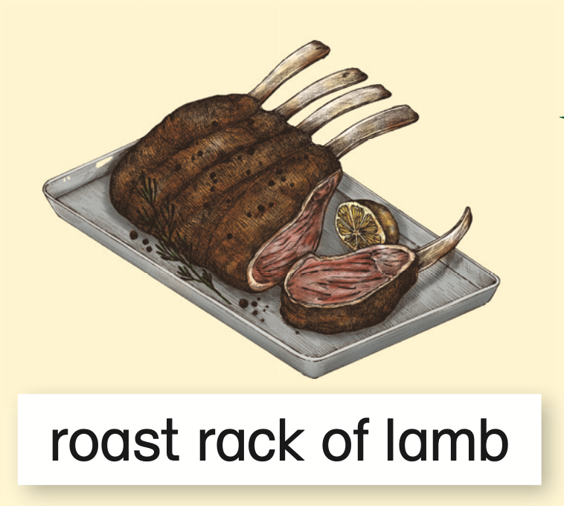
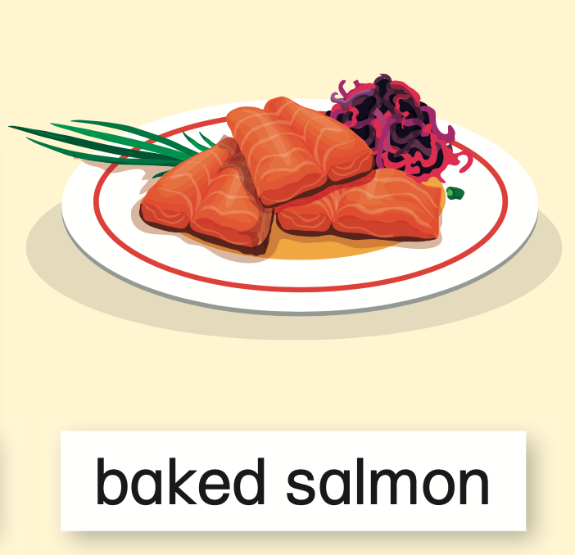

Slide 5
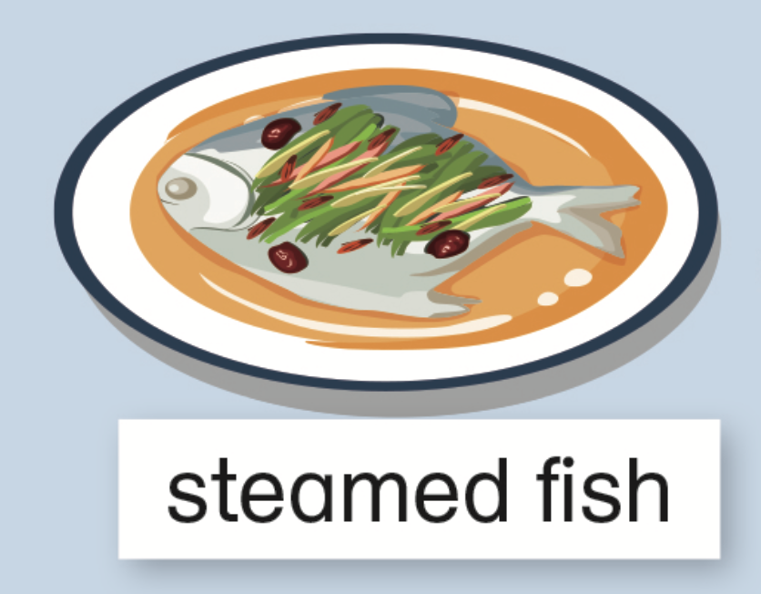
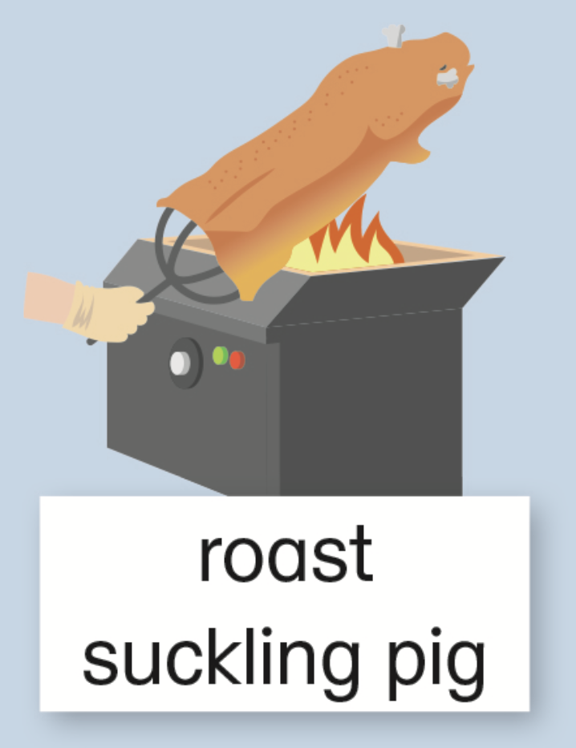
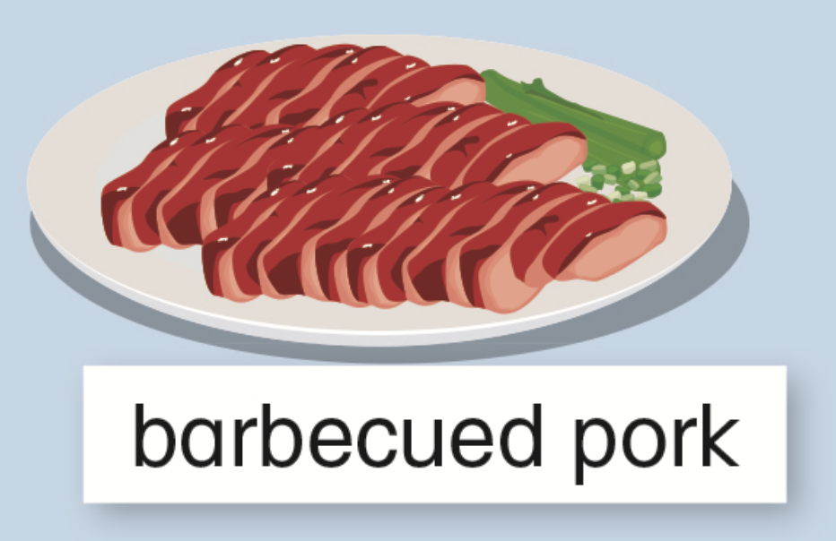

Slide 6
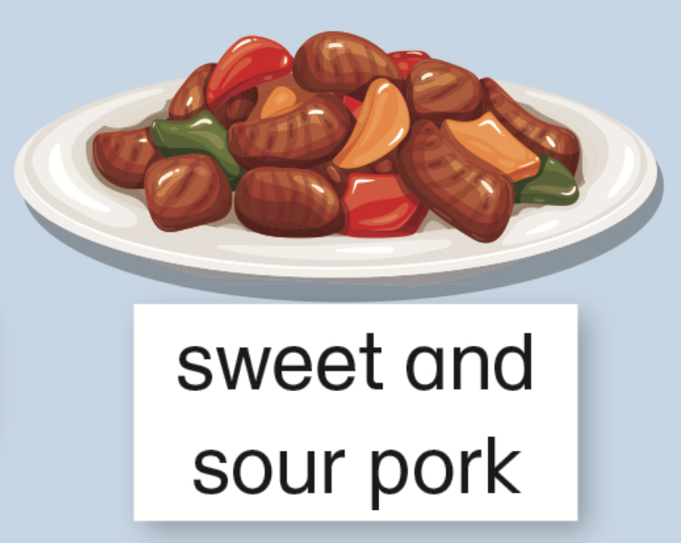
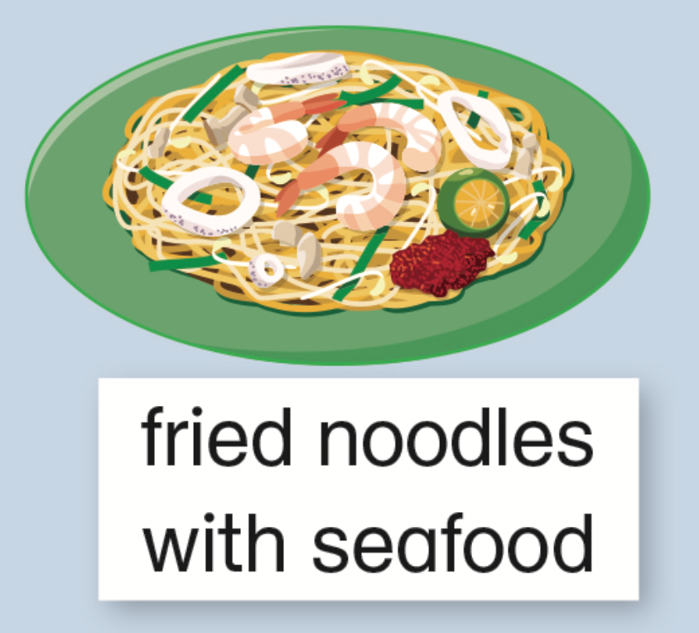
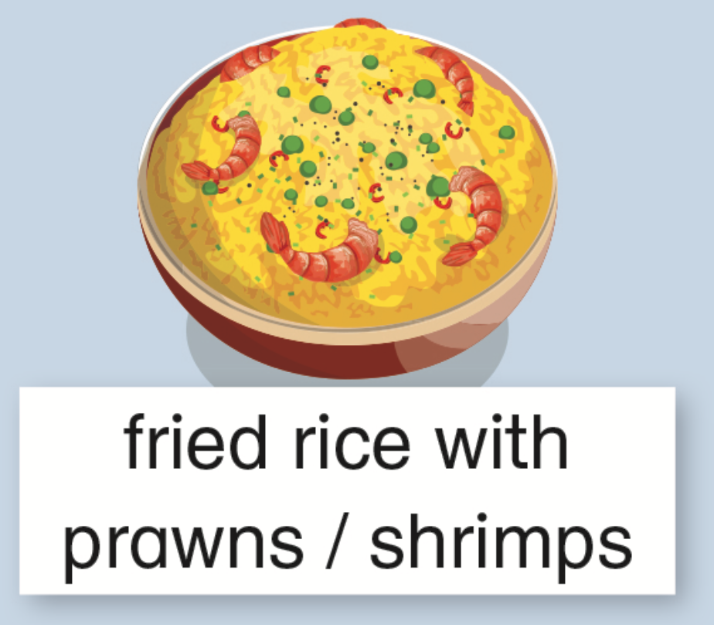

Slide 7
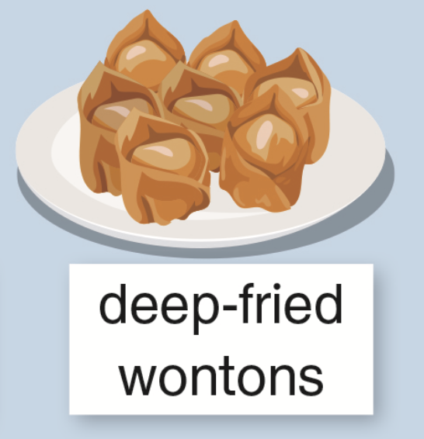
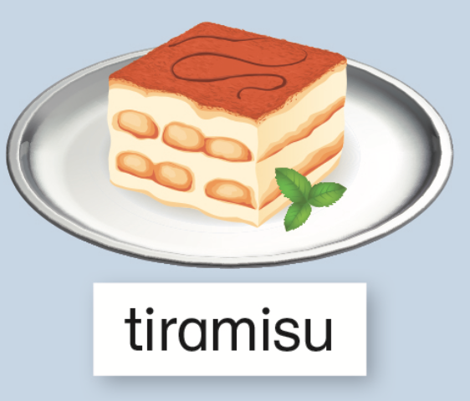

Slide 8
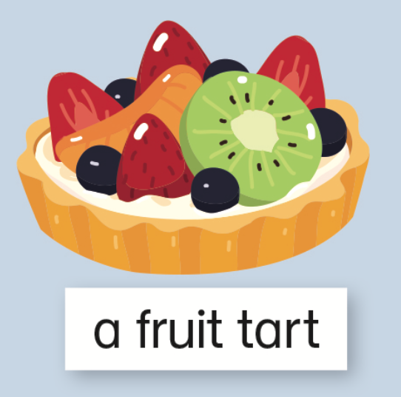
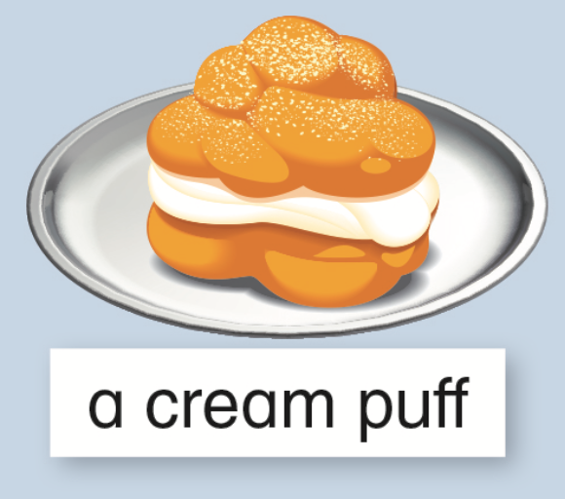

Slide 9
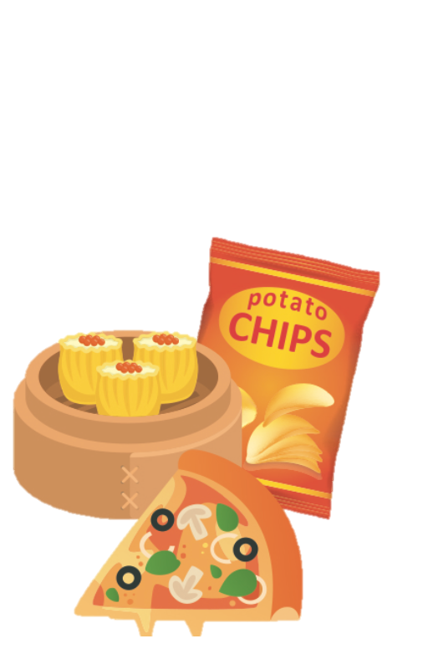
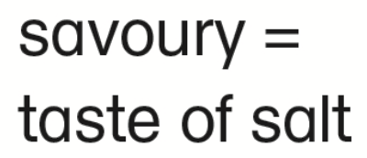
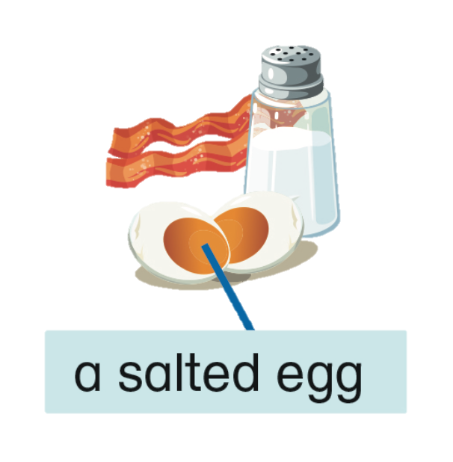

Slide 11
Acknowledgments​ We are grateful to the following for permission to reproduce copyright photographs:​
Anastasia Petrova. Shutterstock
Marie Nimrichterova. Shutterstock
HappyPictures. Shutterstock
LinaOro, Shutterstock
Hennadii H. Shutterstock
Rawpixel.com. Shutterstock
Vector Tradition. Shutterstock
Phantom Pug. Shutterstock
HappyPictures. Shutterstock
BigEyes925. Shutterstock
Maneerat_Ao. Shutterstock
Victoria Sergeeva. Shutterstock
enerimil. Shutterstock
Debahuti Bhattacharya. Shutterstock
KHCHENG. Shutterstock
FoodieMama. Shutterstock
Jabirki Art. Shutterstock
mylisa. 123rf.com
modgiez. Shutterstock
BeataGFX. Shutterstock
Alongkorn Sanguansook. Shutterstock
mything. Shutterstock
Ade Widiantara. Shutterstock
Aksana Chubis. 123rf.com
stockshoppe. 123rf.com
AnzhelikaP. Shutterstock
Macrovector. Shutterstock
Wise ant. Shutterstock
mary_stocker. Shutterstock
Debanjan Basak. Pearson India Education Services Pvt. Ltd
unturtle. Shutterstock
Dancake. Shutterstock
Volha Shaukavets. Shutterstock
dfan1. Shutterstock
Every effort has been made to trace copyright, but in the event of any accidental infringement, we shall be pleased to come to a suitable arrangement with the rightful owner.​

