Slide 1
Chapter 4
Answer Key

Slide 2
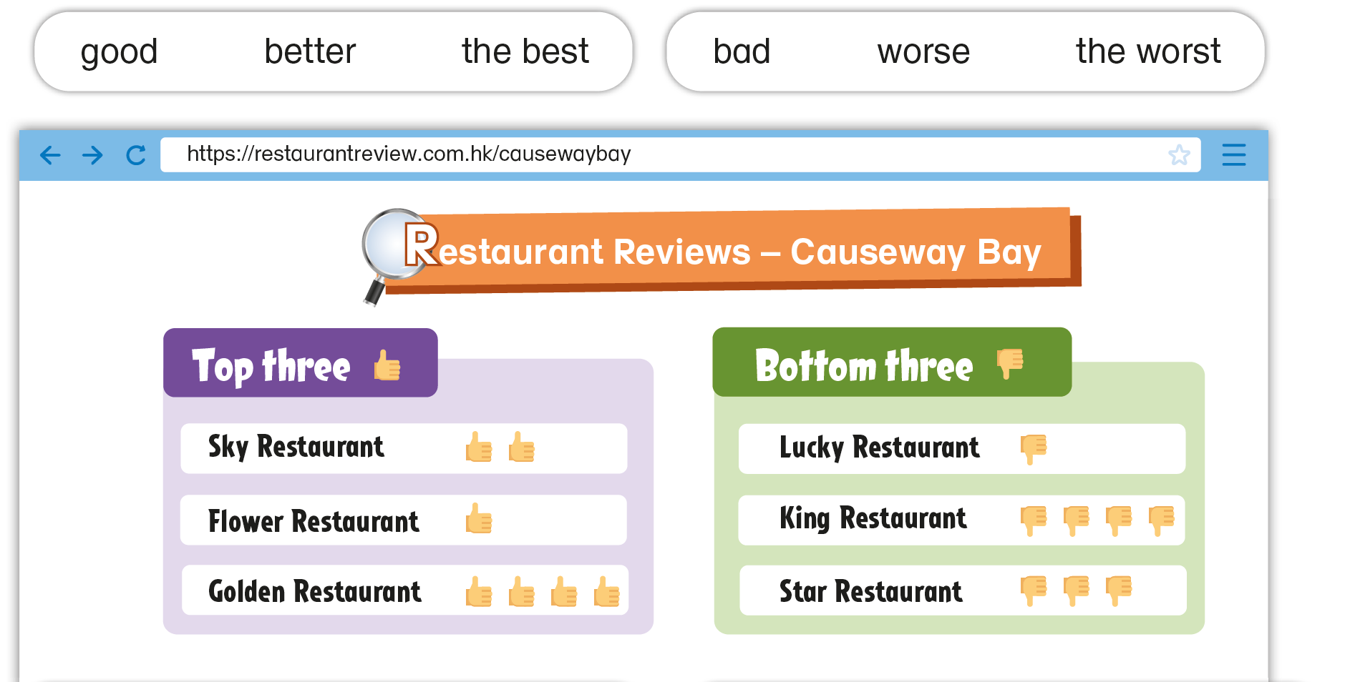
The children are looking at reviews of restaurants in Causeway Bay on the Internet. Finish what they say.

Slide 3
The children are looking at reviews of restaurants in Causeway Bay on the Internet. Finish what they say.
Sky Restaurant, Flower Restaurant and Golden Restaurant are all good. Sky Restaurant is ___________ Flower Restaurant. Golden restaurant is _________ restaurant in Causeway Bay. I’d like to go there.
better than
the best

Slide 4
The children are looking at reviews of restaurants in Causeway Bay on the Internet. Finish what they say.
Lucky Restaurant, King Restaurant and Star Restaurant are all _____ . Star Restaurant is ___________
_______________ . King Restaurant is ____________________________
______ . I wouldn’t like to go there.
bad
worse than
Lucky Restaurant
the worst restaurant in Causeway
Bay

Slide 6
Acknowledgments
We are grateful to the following for permission to reproduce copyright photographs:
FoxyImage. Shutterstock
Every effort has been made to trace copyright, but in the event of any accidental infringement, we shall be pleased to come to a suitable arrangement with the rightful owner.

