Slide 1
Chapter 4
Answer Key

Slide 2
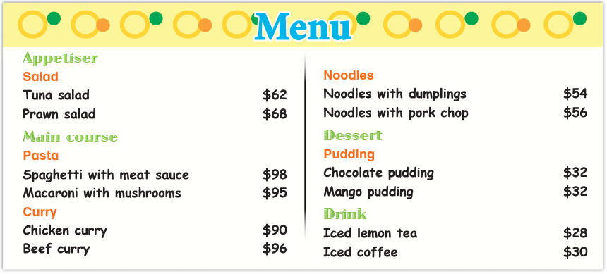
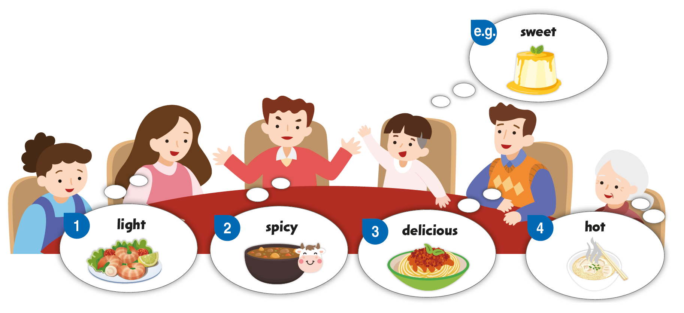
The Fong family are looking at the menu. What would they like to eat? Finish what they say.

Slide 3
Here is the example.
What would you like?
I’d like some pudding. It’s sweet.
Which would you like, chocolate pudding or mango pudding?
I’d like mango pudding.

Slide 4
Now you try.

Slide 5
The Fong family are looking at the menu. What would they like to eat? Finish what they say.
What would you like?
I’d like some salad. It’s healthy.
Which would you like, tuna salad or prawn salad?
I’d like prawn salad.

Slide 6
The Fong family are looking at the menu. What would they like to eat? Finish what they say.
What would you like?
I’d like some curry. It’s spicy.
Which would you like, chicken curry or beef curry?
I’d like beef curry.

Slide 7
The Fong family are looking at the menu. What would they like to eat? Finish what they say.
What would you like?
I’d like some pasta. It’s delicious.
Which would you like, spaghetti with meat sauce or macaroni with mushrooms?
I’d like spaghetti with meat sauce .

Slide 8
The Fong family are looking at the menu. What would they like to eat? Finish what they say.
What would you like?
I’d like some noodles. It’s hot.
Which would you like, noodles with dumplings or noodles with pork chop?
I’d like noodles with dumplings.

Slide 10
Acknowledgments
We are grateful to the following for permission to reproduce copyright photographs:
FoxyImage. Shutterstock
Every effort has been made to trace copyright, but in the event of any accidental infringement, we shall be pleased to come to a suitable arrangement with the rightful owner.

