Slide 1
Chapter 2
Ask about today’s date

Slide 2
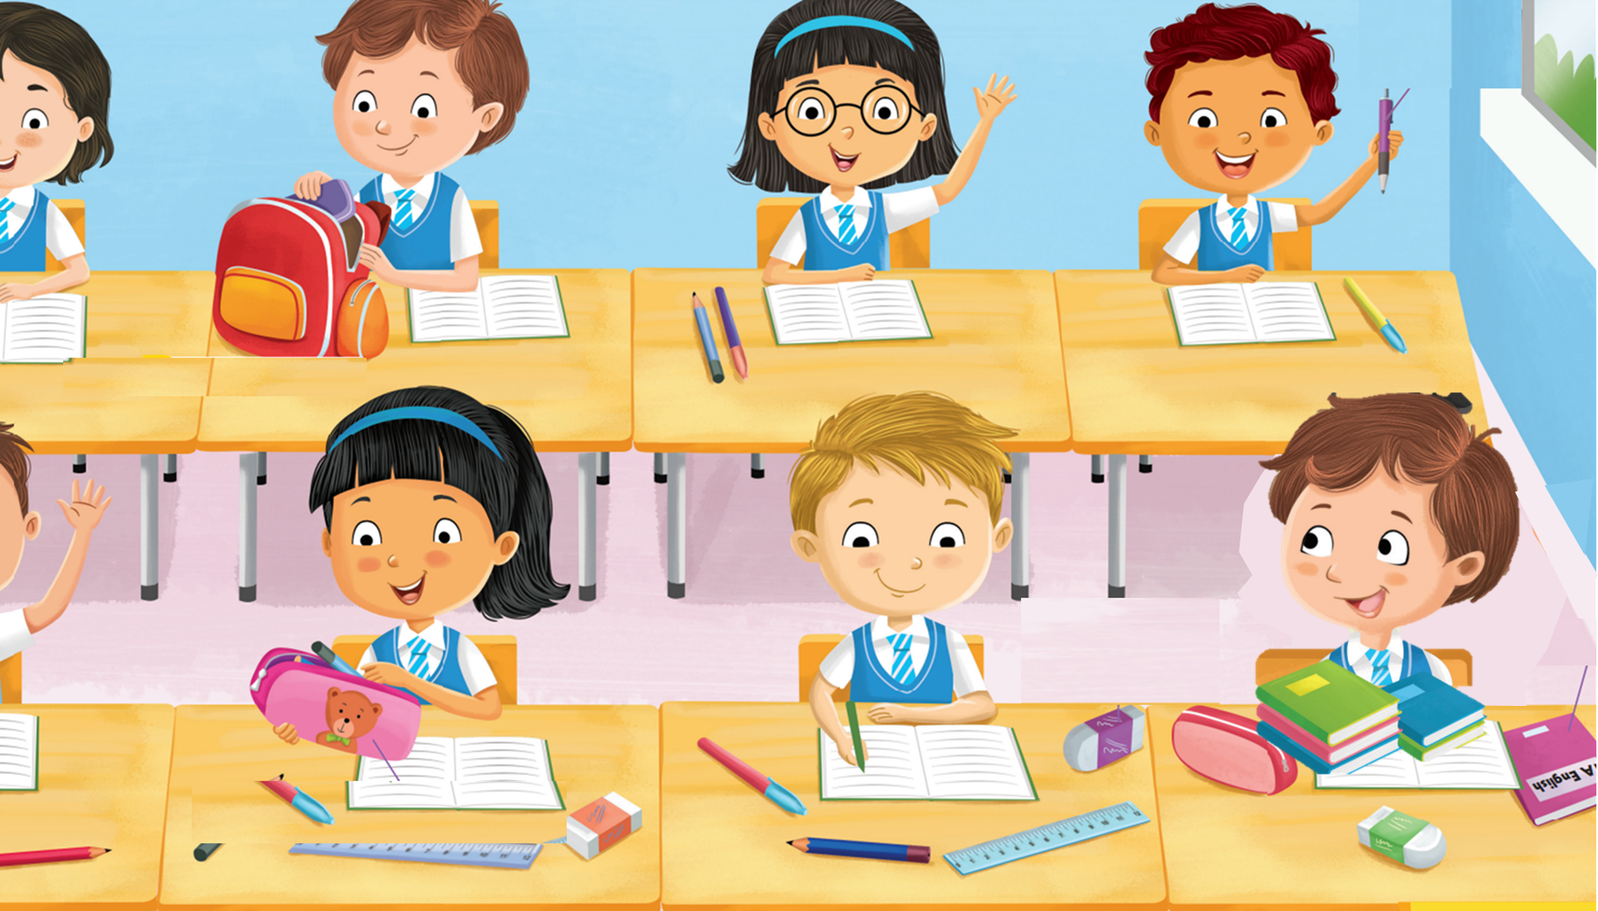
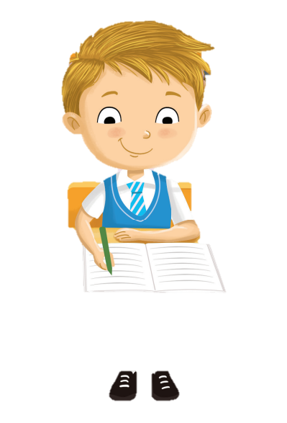
Sam is trying to write in his handbook.

Slide 3
Oops! He can’t remember today’s date!

Slide 4
What date is it today?

Slide 5
It’s the twentieth of September.

Slide 6
Is it Monday today?

Slide 7
No, it’s Tuesday today.

Slide 8
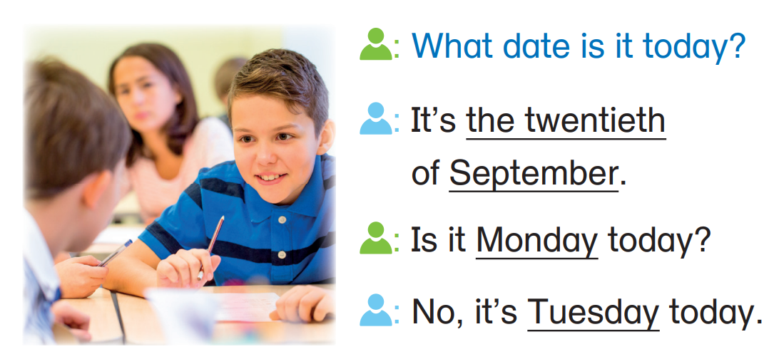

Slide 9
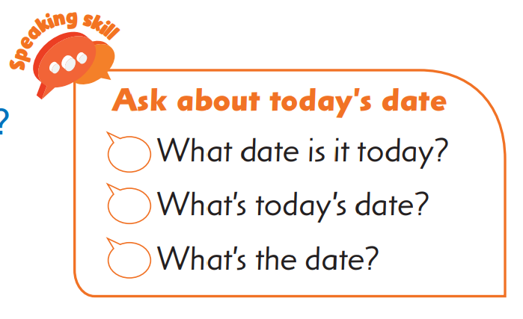
Learn the skill
Practise the skill

Slide 10
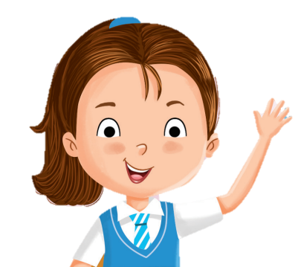
There is more than one way to ask about today’s date.
Learn the skill
Practise the skill

Slide 11
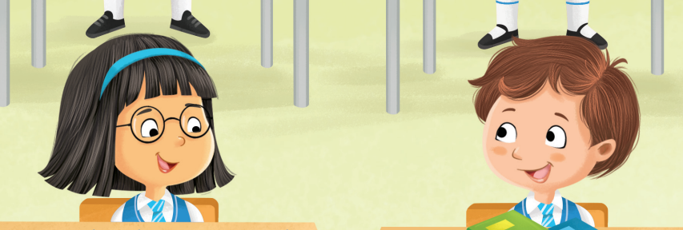
What date is it today?
It’s the third of June.
Learn the skill
Practise the skill

Slide 12
What’s today’s date?
It’s the third of June.
Learn the skill
Practise the skill

Slide 13
What’s the date?
It’s the third of June.
Learn the skill
Practise the skill

Slide 14
Let’s practise the skill now!
Learn the skill
Practise the skill

Slide 15
Do it together!
Act out the conversation. Use the given information.
A:
B: A:
B:
(choose another way to ask the question)
Learn the skill
Practise the skill

Slide 16
Do it together!
Act out the conversation. Use the given information.
A:
B: A:
B:
What’s today’s date?
Learn the skill
Practise the skill

Slide 17
Do it together!
Act out the conversation. Use the given information.
A:
B: A:
B:
What’s today’s date?
(3rd June)
Learn the skill
Practise the skill

Slide 18
Do it together!
Act out the conversation. Use the given information.
A:
B: A:
B:
What’s today’s date?
It’s the third of June.
Learn the skill
Practise the skill

Slide 19
Do it together!
Act out the conversation. Use the given information.
A:
B: A:
B:
What’s today’s date?
It’s the third of June.
(Thursday)
Learn the skill
Practise the skill

Slide 20
Do it together!
Act out the conversation. Use the given information.
A:
B: A:
B:
What’s today’s date?
It’s the third of June.
Is it Thursday today?
Learn the skill
Practise the skill

Slide 21
Do it together!
Act out the conversation. Use the given information.
A:
B: A:
B:
What’s today’s date?
It’s the third of June.
Is it Thursday today?
(Friday)
Learn the skill
Practise the skill

Slide 22
Do it together!
Act out the conversation. Use the given information.
A:
B: A:
B:
What’s today’s date?
It’s the third of June.
Is it Thursday today?
No, it’s Friday today.
What if today’s really Thursday?
Learn the skill
Practise the skill

Slide 23
Do it together!
Act out the conversation. Use the given information.
A:
B: A:
B:
What’s today’s date?
It’s the third of June.
Is it Thursday today?
Yes, it is!
Learn the skill
Practise the skill

Slide 24
Well done!
Let’s get into pairs and practise more!
Learn the skill
Practise the skill

Slide 25
Your turn!
Act out the conversation. Use today’s date.
Choose a way to ask the question.
(day)
Use today’s date.
(month)
Monday
Tuesday
Wednesday
Thursday
Friday
Saturday
Sunday
(or) Yes, it is.
Learn the skill
Practise the skill

