Slide 1
Chapter 2
Answer Key

Slide 2
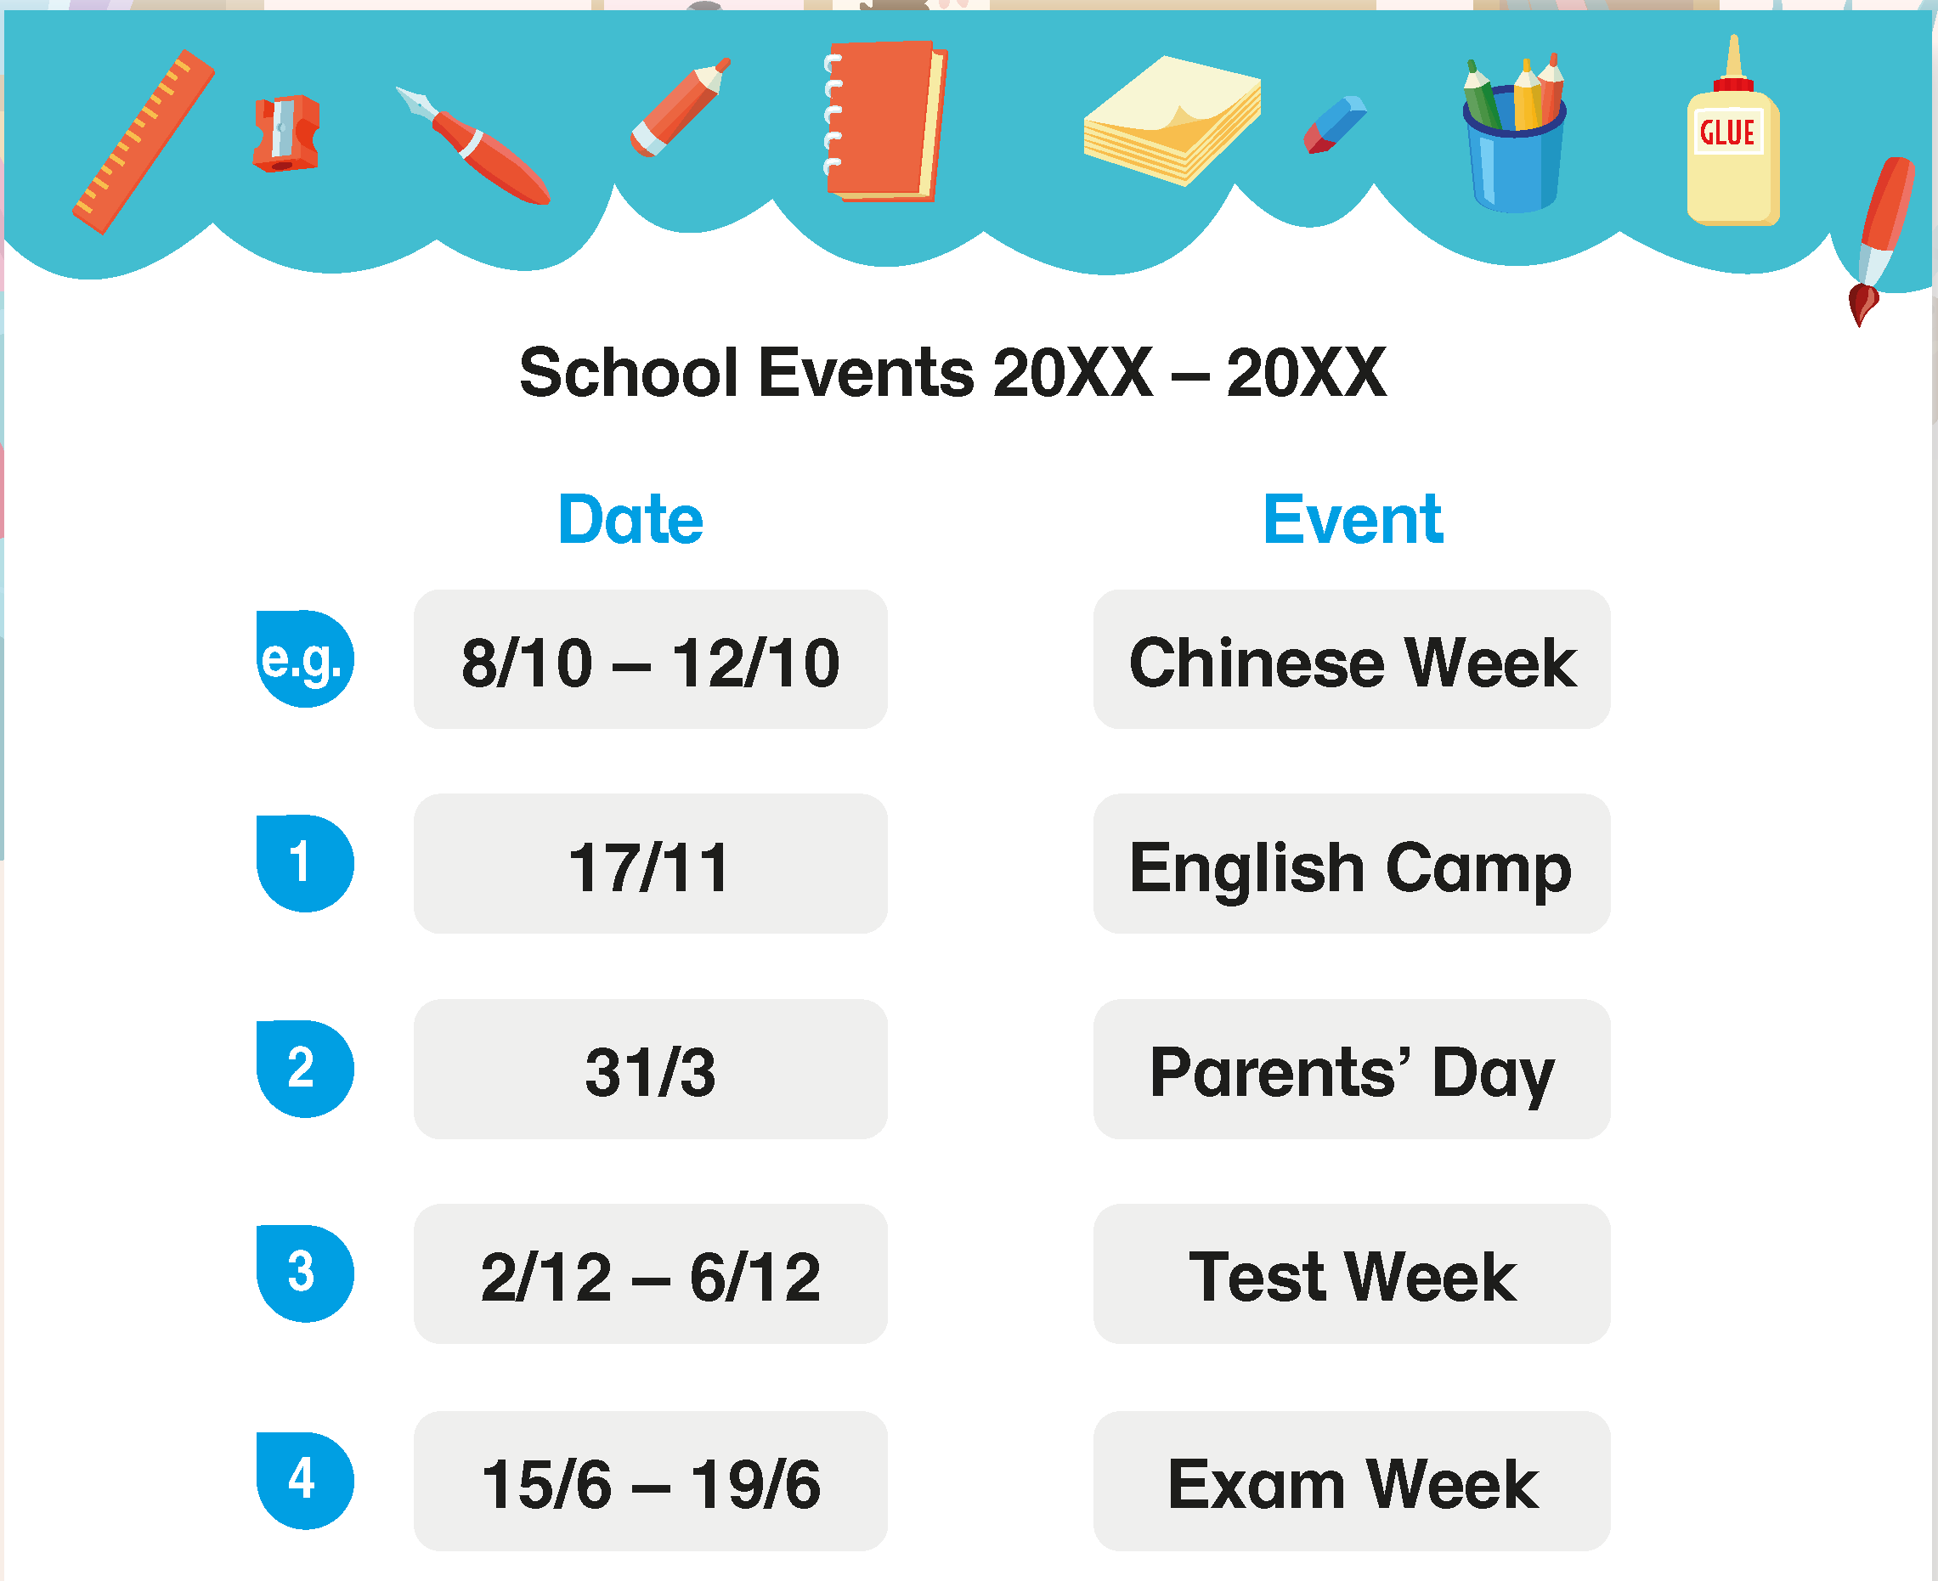
Sally is telling Jacky the dates of some special school events. Finish what she says.

Slide 3
Here is the example.

Slide 4
Sally is telling Jacky the dates of some special school events. Finish what she says.

Slide 5
Now you try.

Slide 6
Sally is telling Jacky the dates of some special school events. Finish what she says.
English Camp is on the seventeenth of November.

Slide 7
Sally is telling Jacky the dates of some special school events. Finish what she says.
Parents’ Day is on the thirty-first of March.

Slide 8
Sally is telling Jacky the dates of some special school events. Finish what she says.
Test Week is from the second of December to the sixth of December.

Slide 9
Sally is telling Jacky the dates of some special school events. Finish what she says.
Exam Week is from the fifteenth of June to the nineteenth of June.

Slide 11
Acknowledgments
We are grateful to the following for permission to reproduce copyright photographs:
FoxyImage. Shutterstock
Every effort has been made to trace copyright, but in the event of any accidental infringement, we shall be pleased to come to a suitable arrangement with the rightful owner.

