Slide 1
Mmm, tasty!

Slide 2
Pre-reading
Let’s read an article about science today!
Pre-reading
Let’s read
Questions

Slide 3
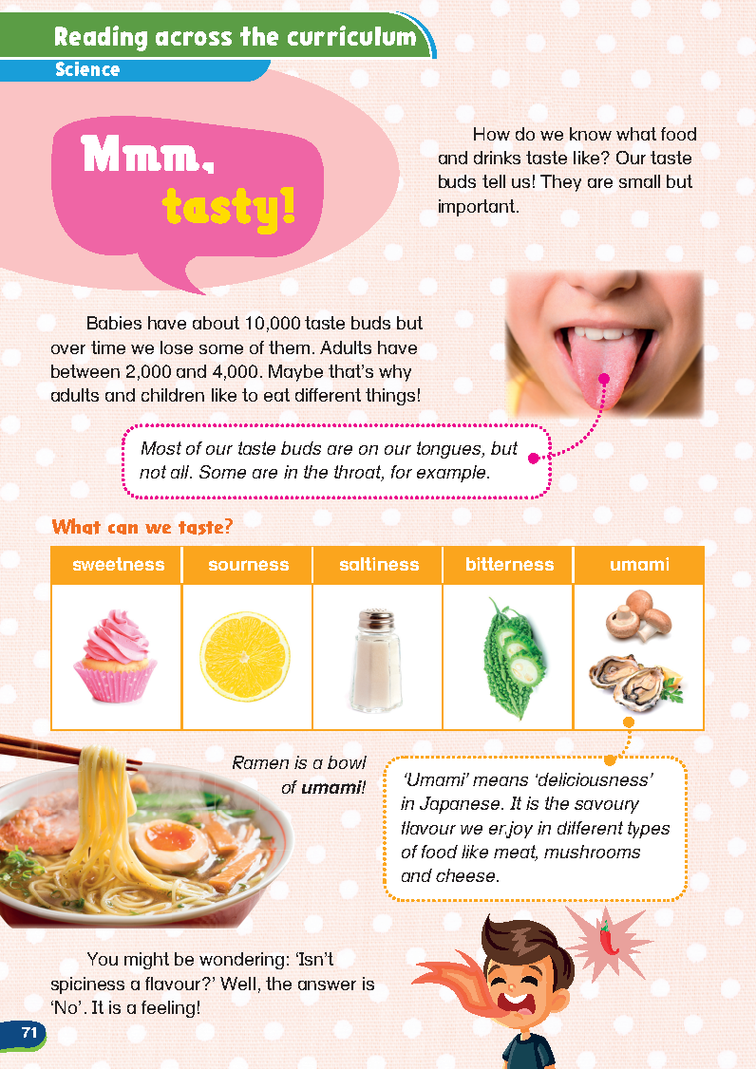
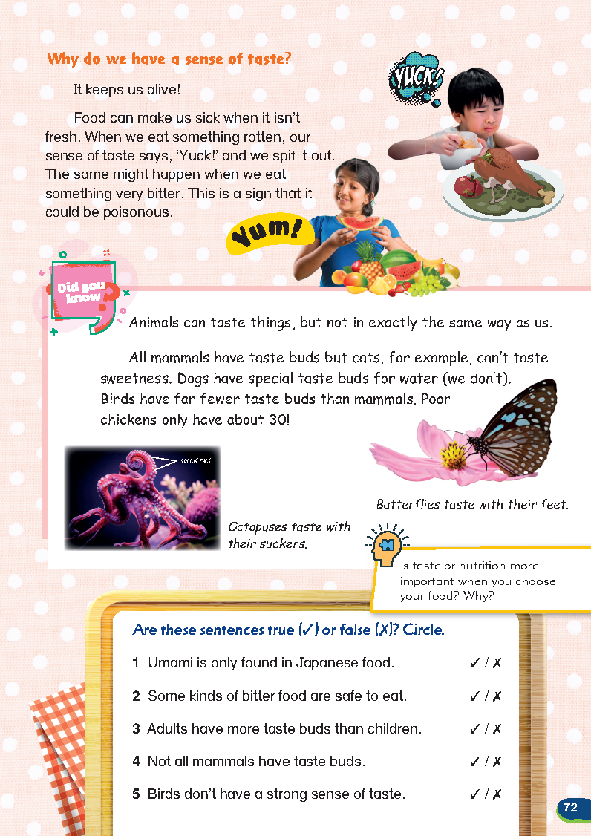
This is the article we’re reading today.
Pre-reading
Let’s read
Questions

Slide 4
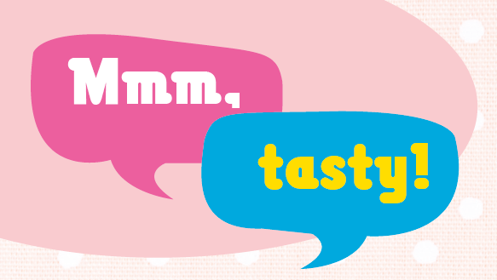
Can you read the title of this article?
What is this article about?
Pre-reading
Let’s read
Questions

Slide 5
Look at this ramen. Yum!
Pre-reading
Let’s read
Questions

Slide 6
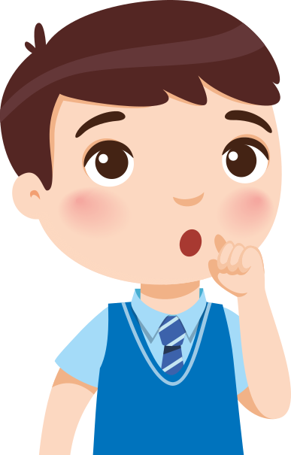
Look at this ramen. Yum!
Will we learn how to make tasty ramen in this article?
Pre-reading
Let’s read
Questions

Slide 7
This article talks about …
It talks about our sense of taste!
Pre-reading
Let’s read
Questions

Slide 8
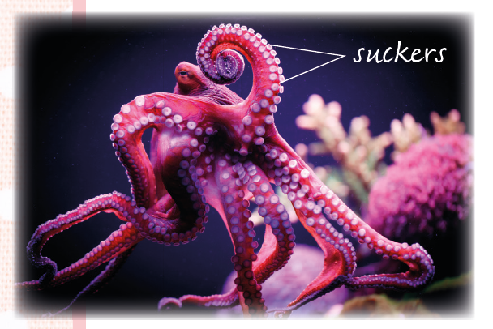
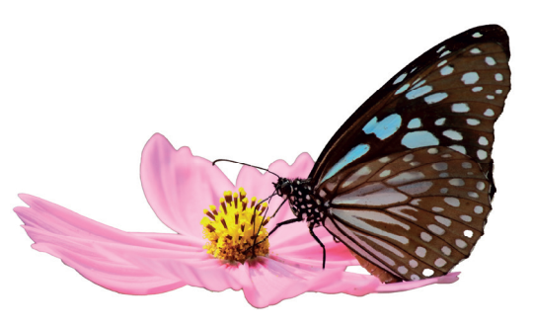
Do you think animals can taste things?
Pre-reading
Let’s read
Questions

Slide 9
Let’s start reading to find out!
Pre-reading
Let’s read
Questions

Slide 10
Let’s read!
Let’s read the article in detail.
Pre-reading
Let’s read
Questions

Slide 11
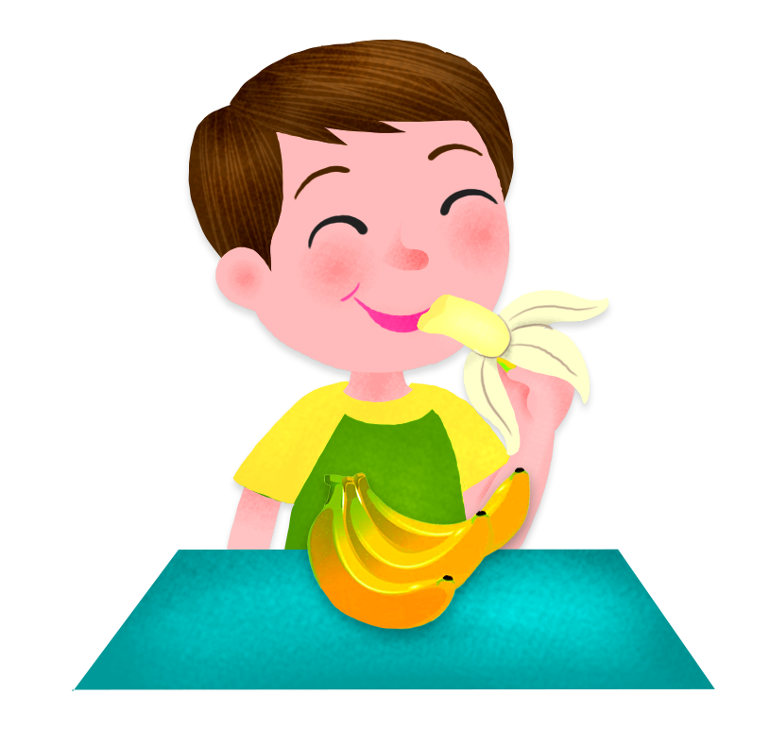
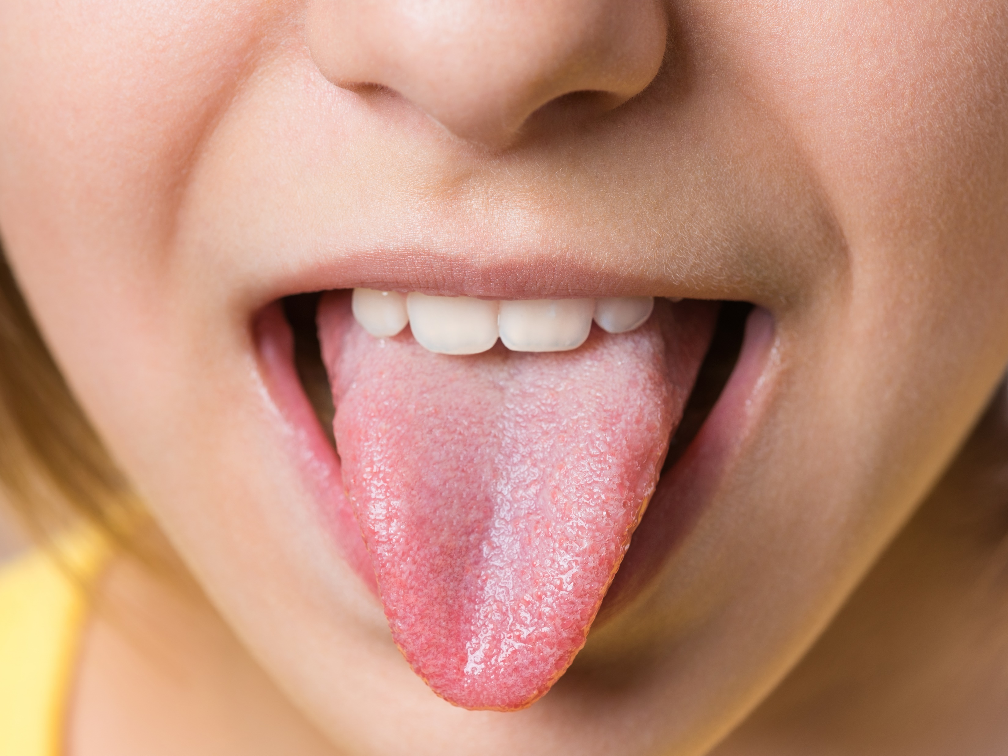
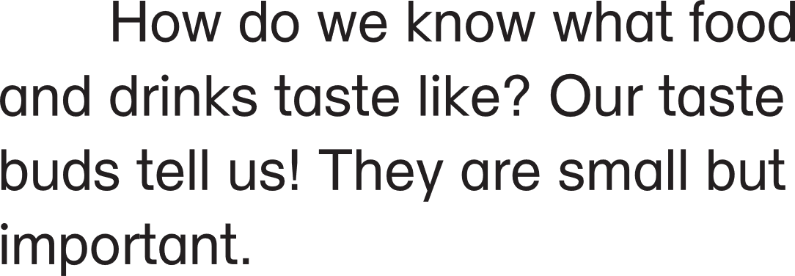
How many taste buds do we have?
Pre-reading
Let’s read
Questions

Slide 12
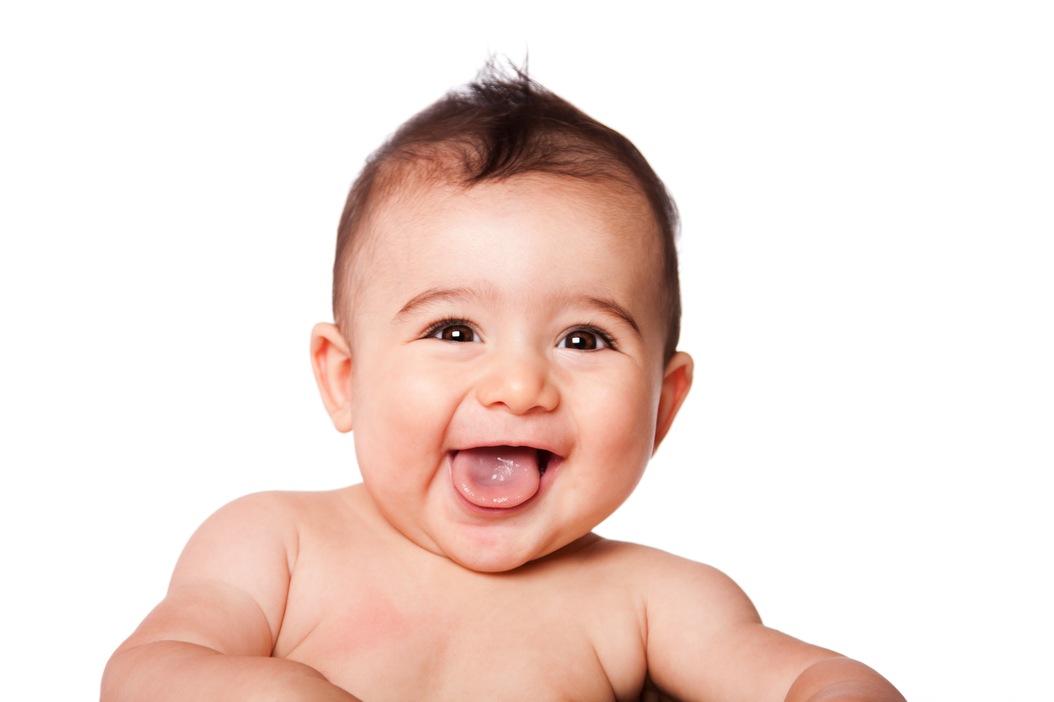
How many taste buds do we have?
10,000 taste buds
2,000-4,000 taste buds
Pre-reading
Let’s read
Questions

Slide 13
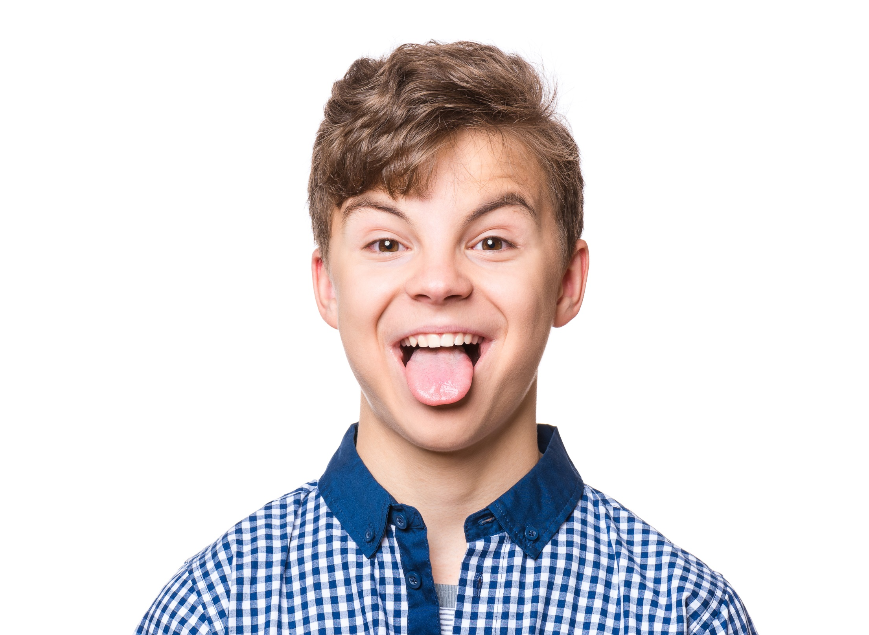
Where are our taste buds?
Most of our taste buds are on our tongues, but not all. Some are in the throat, for example.
Pre-reading
Let’s read
Questions

Slide 14
Pre-reading
Let’s read
Questions

Slide 15
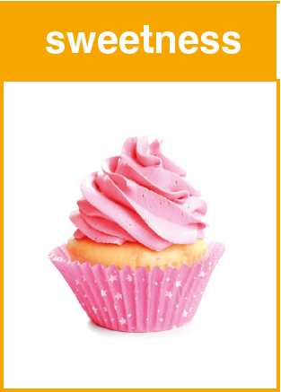
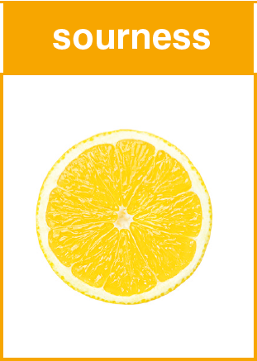
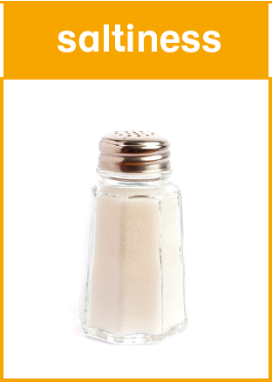
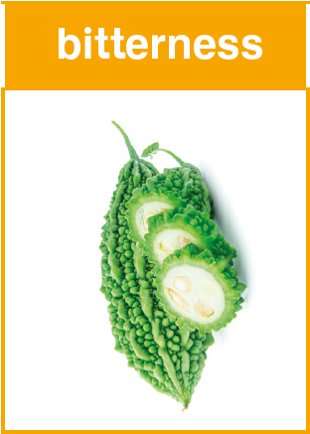
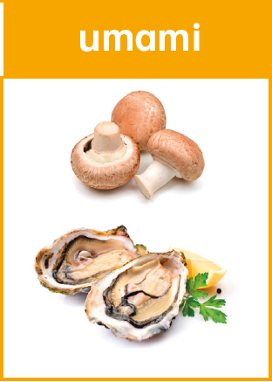
What food give these tastes?
mushrooms
a cupcake
a lemon
bitter melons
salt
oysters
Pre-reading
Let’s read
Questions

Slide 16
What is an umami taste?
mushrooms
cupcake
lemon
bitter melon
salt
bitter melons
oysters
Pre-reading
Let’s read
Questions

Slide 17
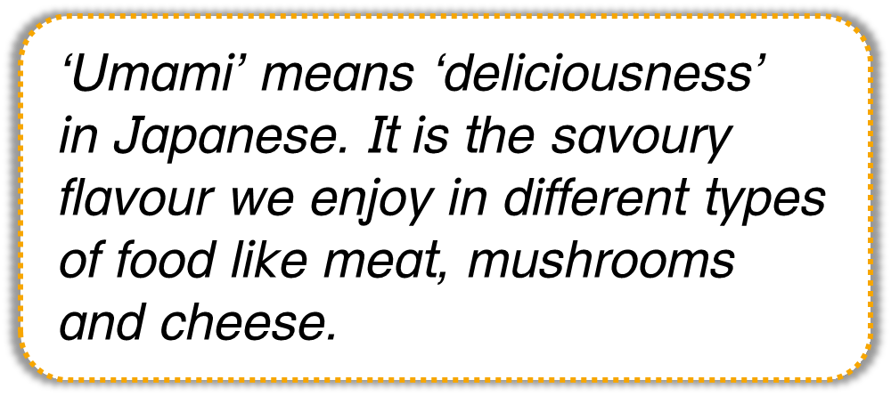
What is an umami taste?
‘Umami’ means ‘deliciousness’ in Japanese. It is the savoury flavour we enjoy in different types of food like meat, mushrooms and cheese.
Pre-reading
Let’s read
Questions

Slide 18
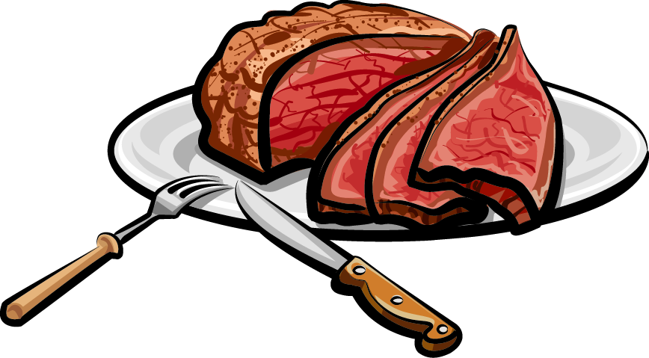
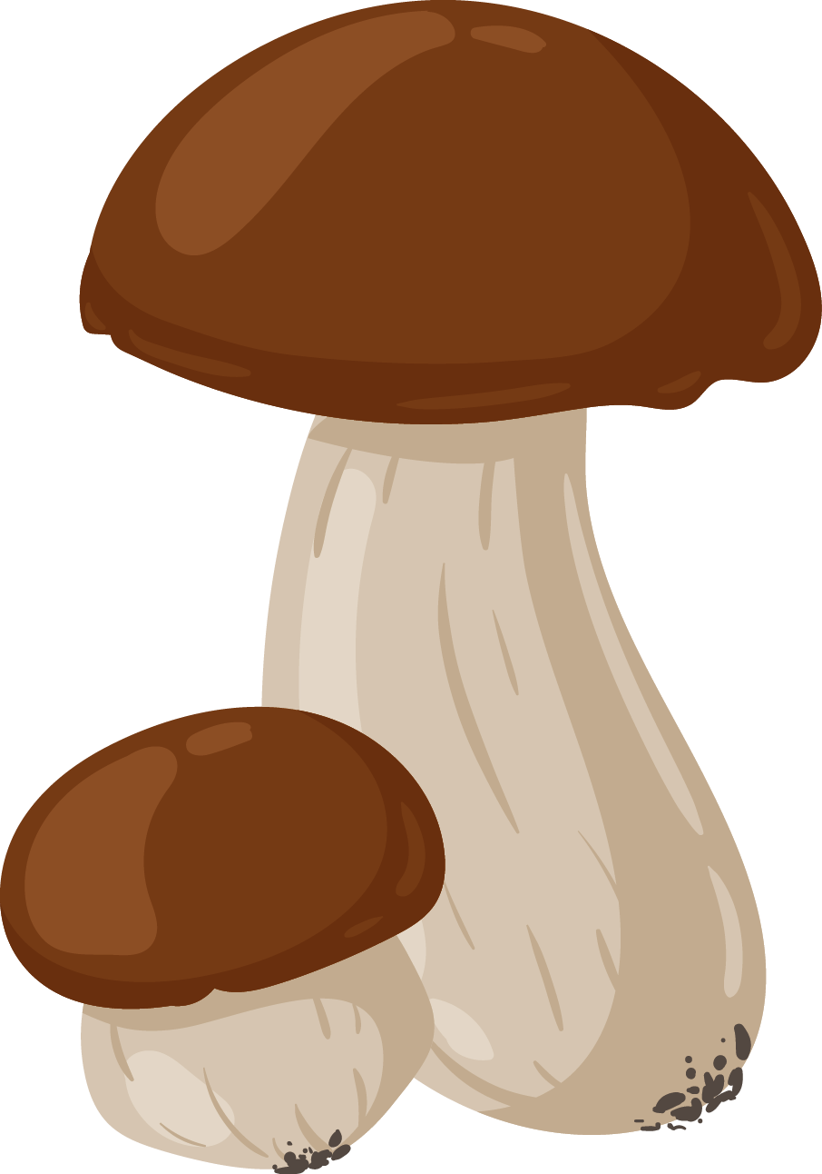
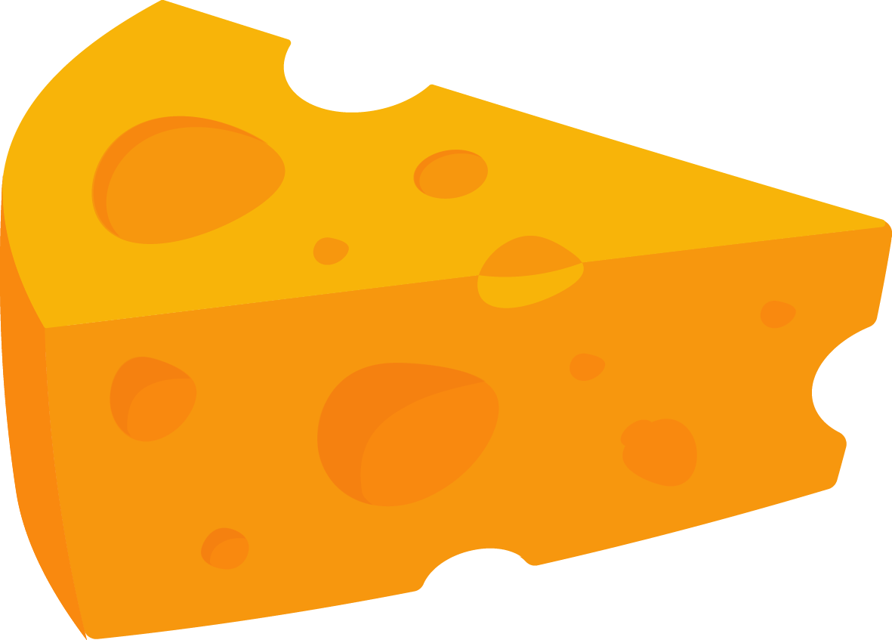
What food has an umami taste?
oysters
Pre-reading
Let’s read
Questions

Slide 19
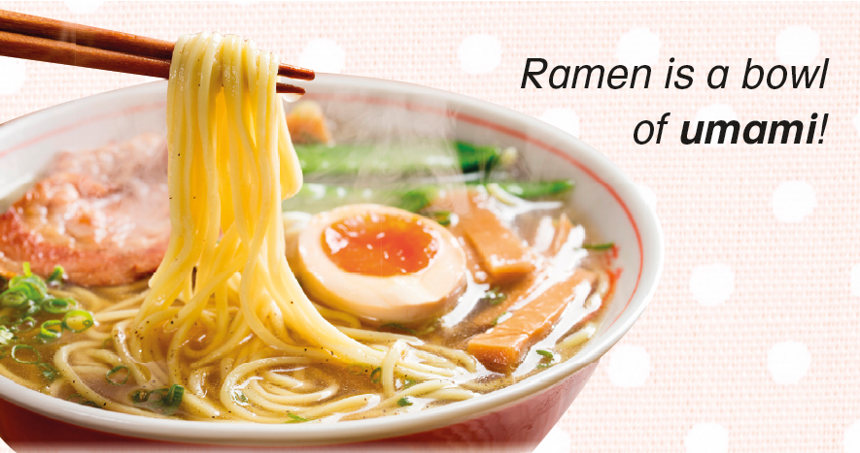
What food has an umami taste?
oysters
Pre-reading
Let’s read
Questions

Slide 20
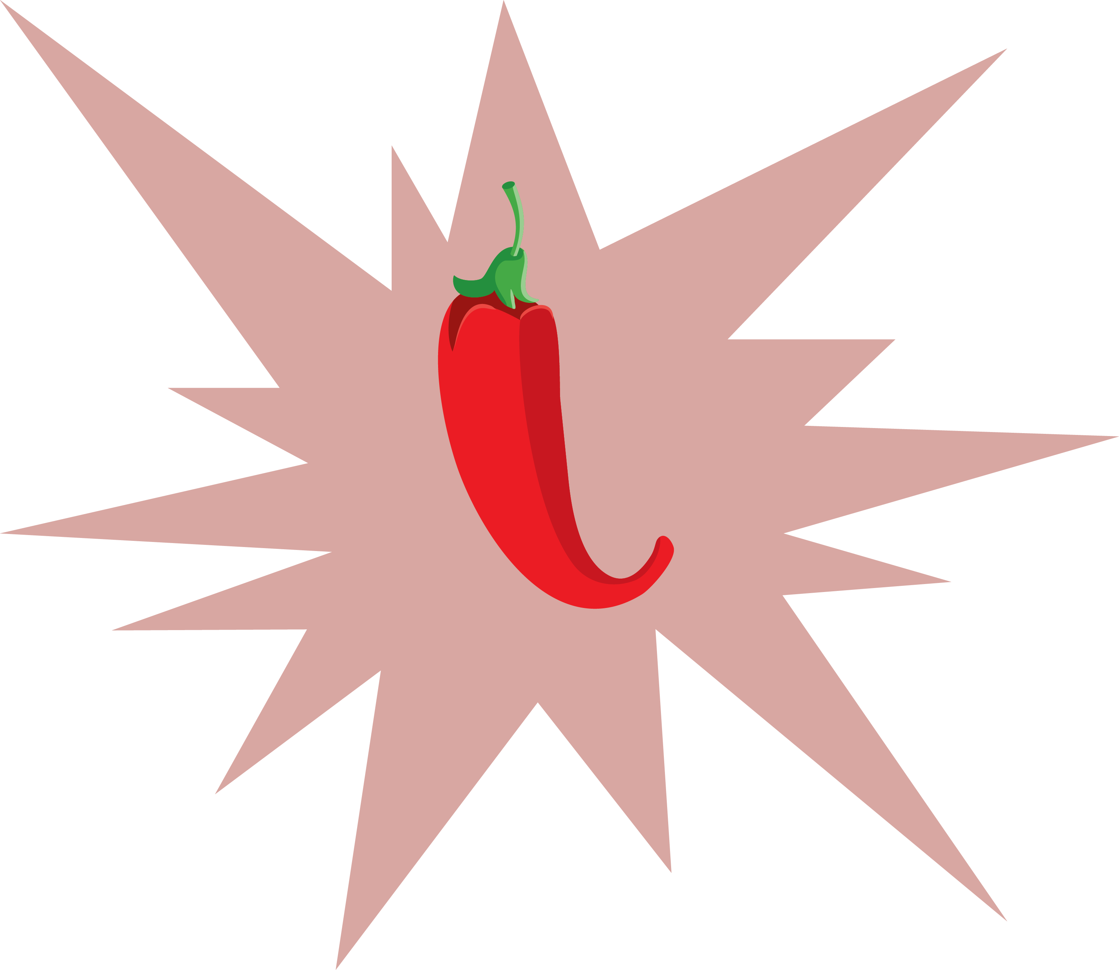
Pre-reading
Let’s read
Questions

Slide 21
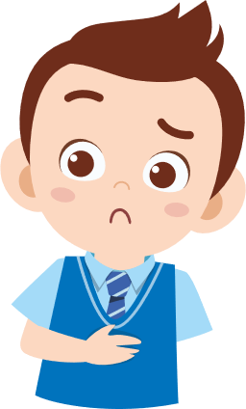
Why do we have a sense of taste?
Pre-reading
Let’s read
Questions

Slide 22
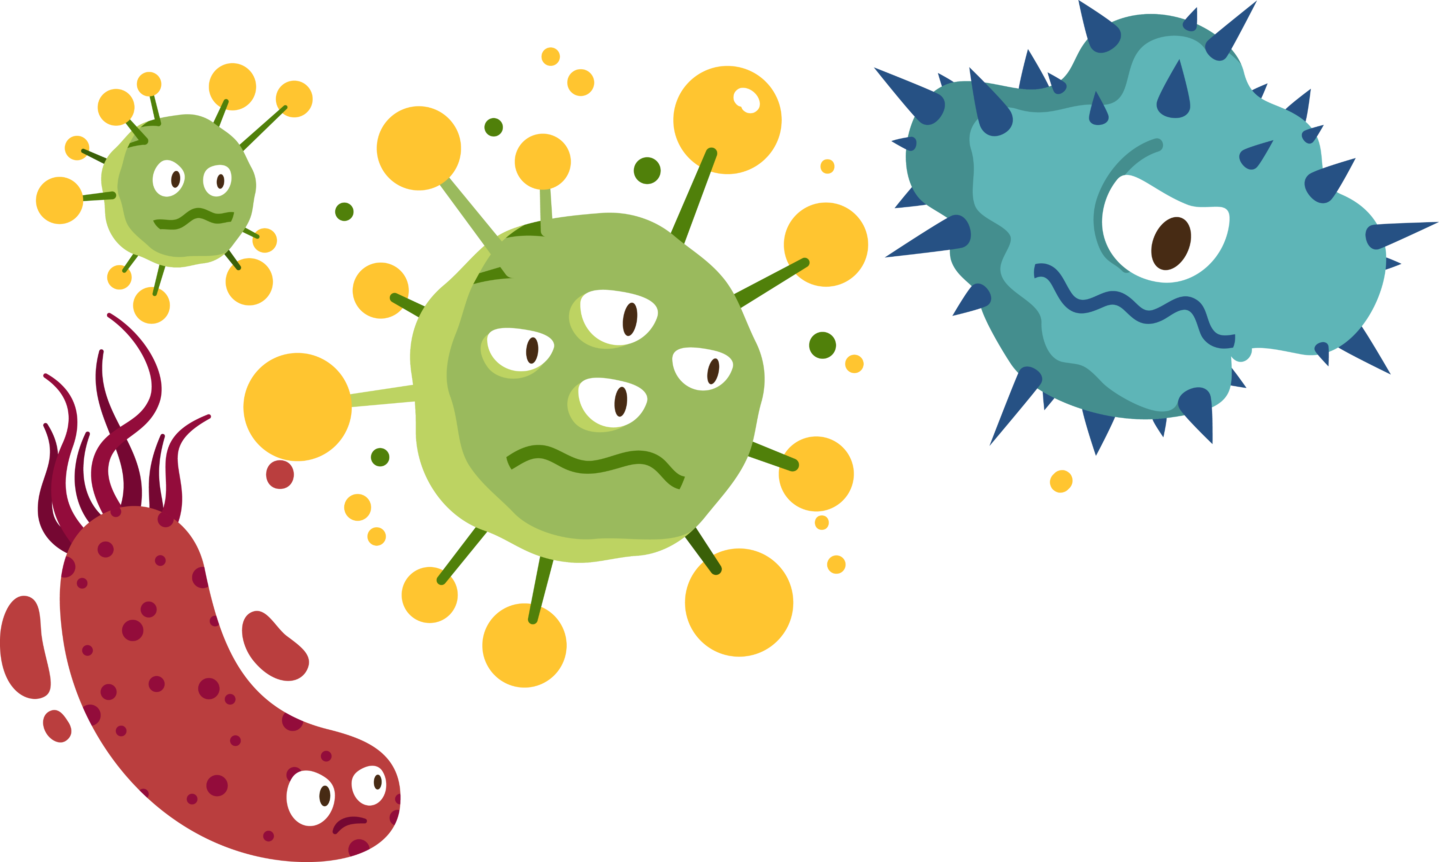
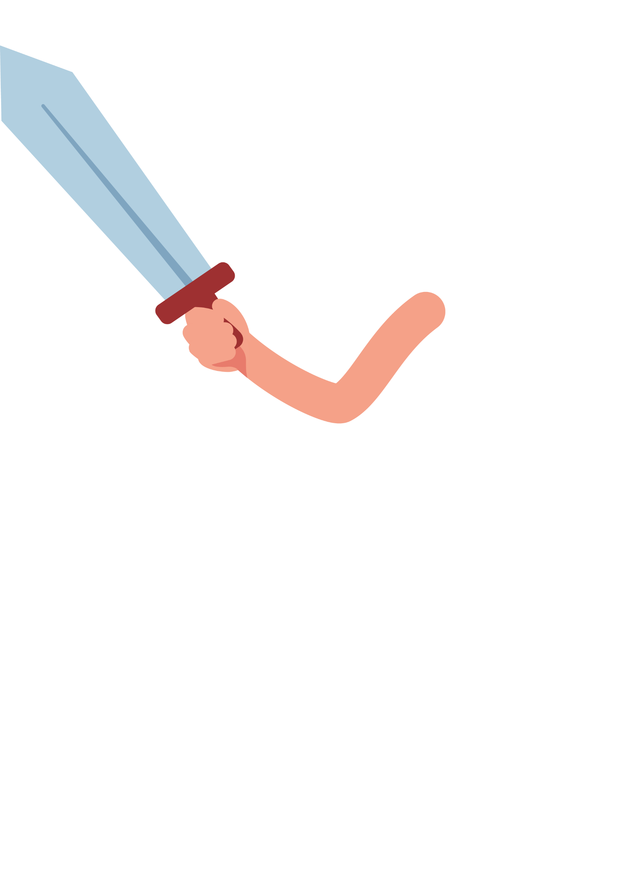
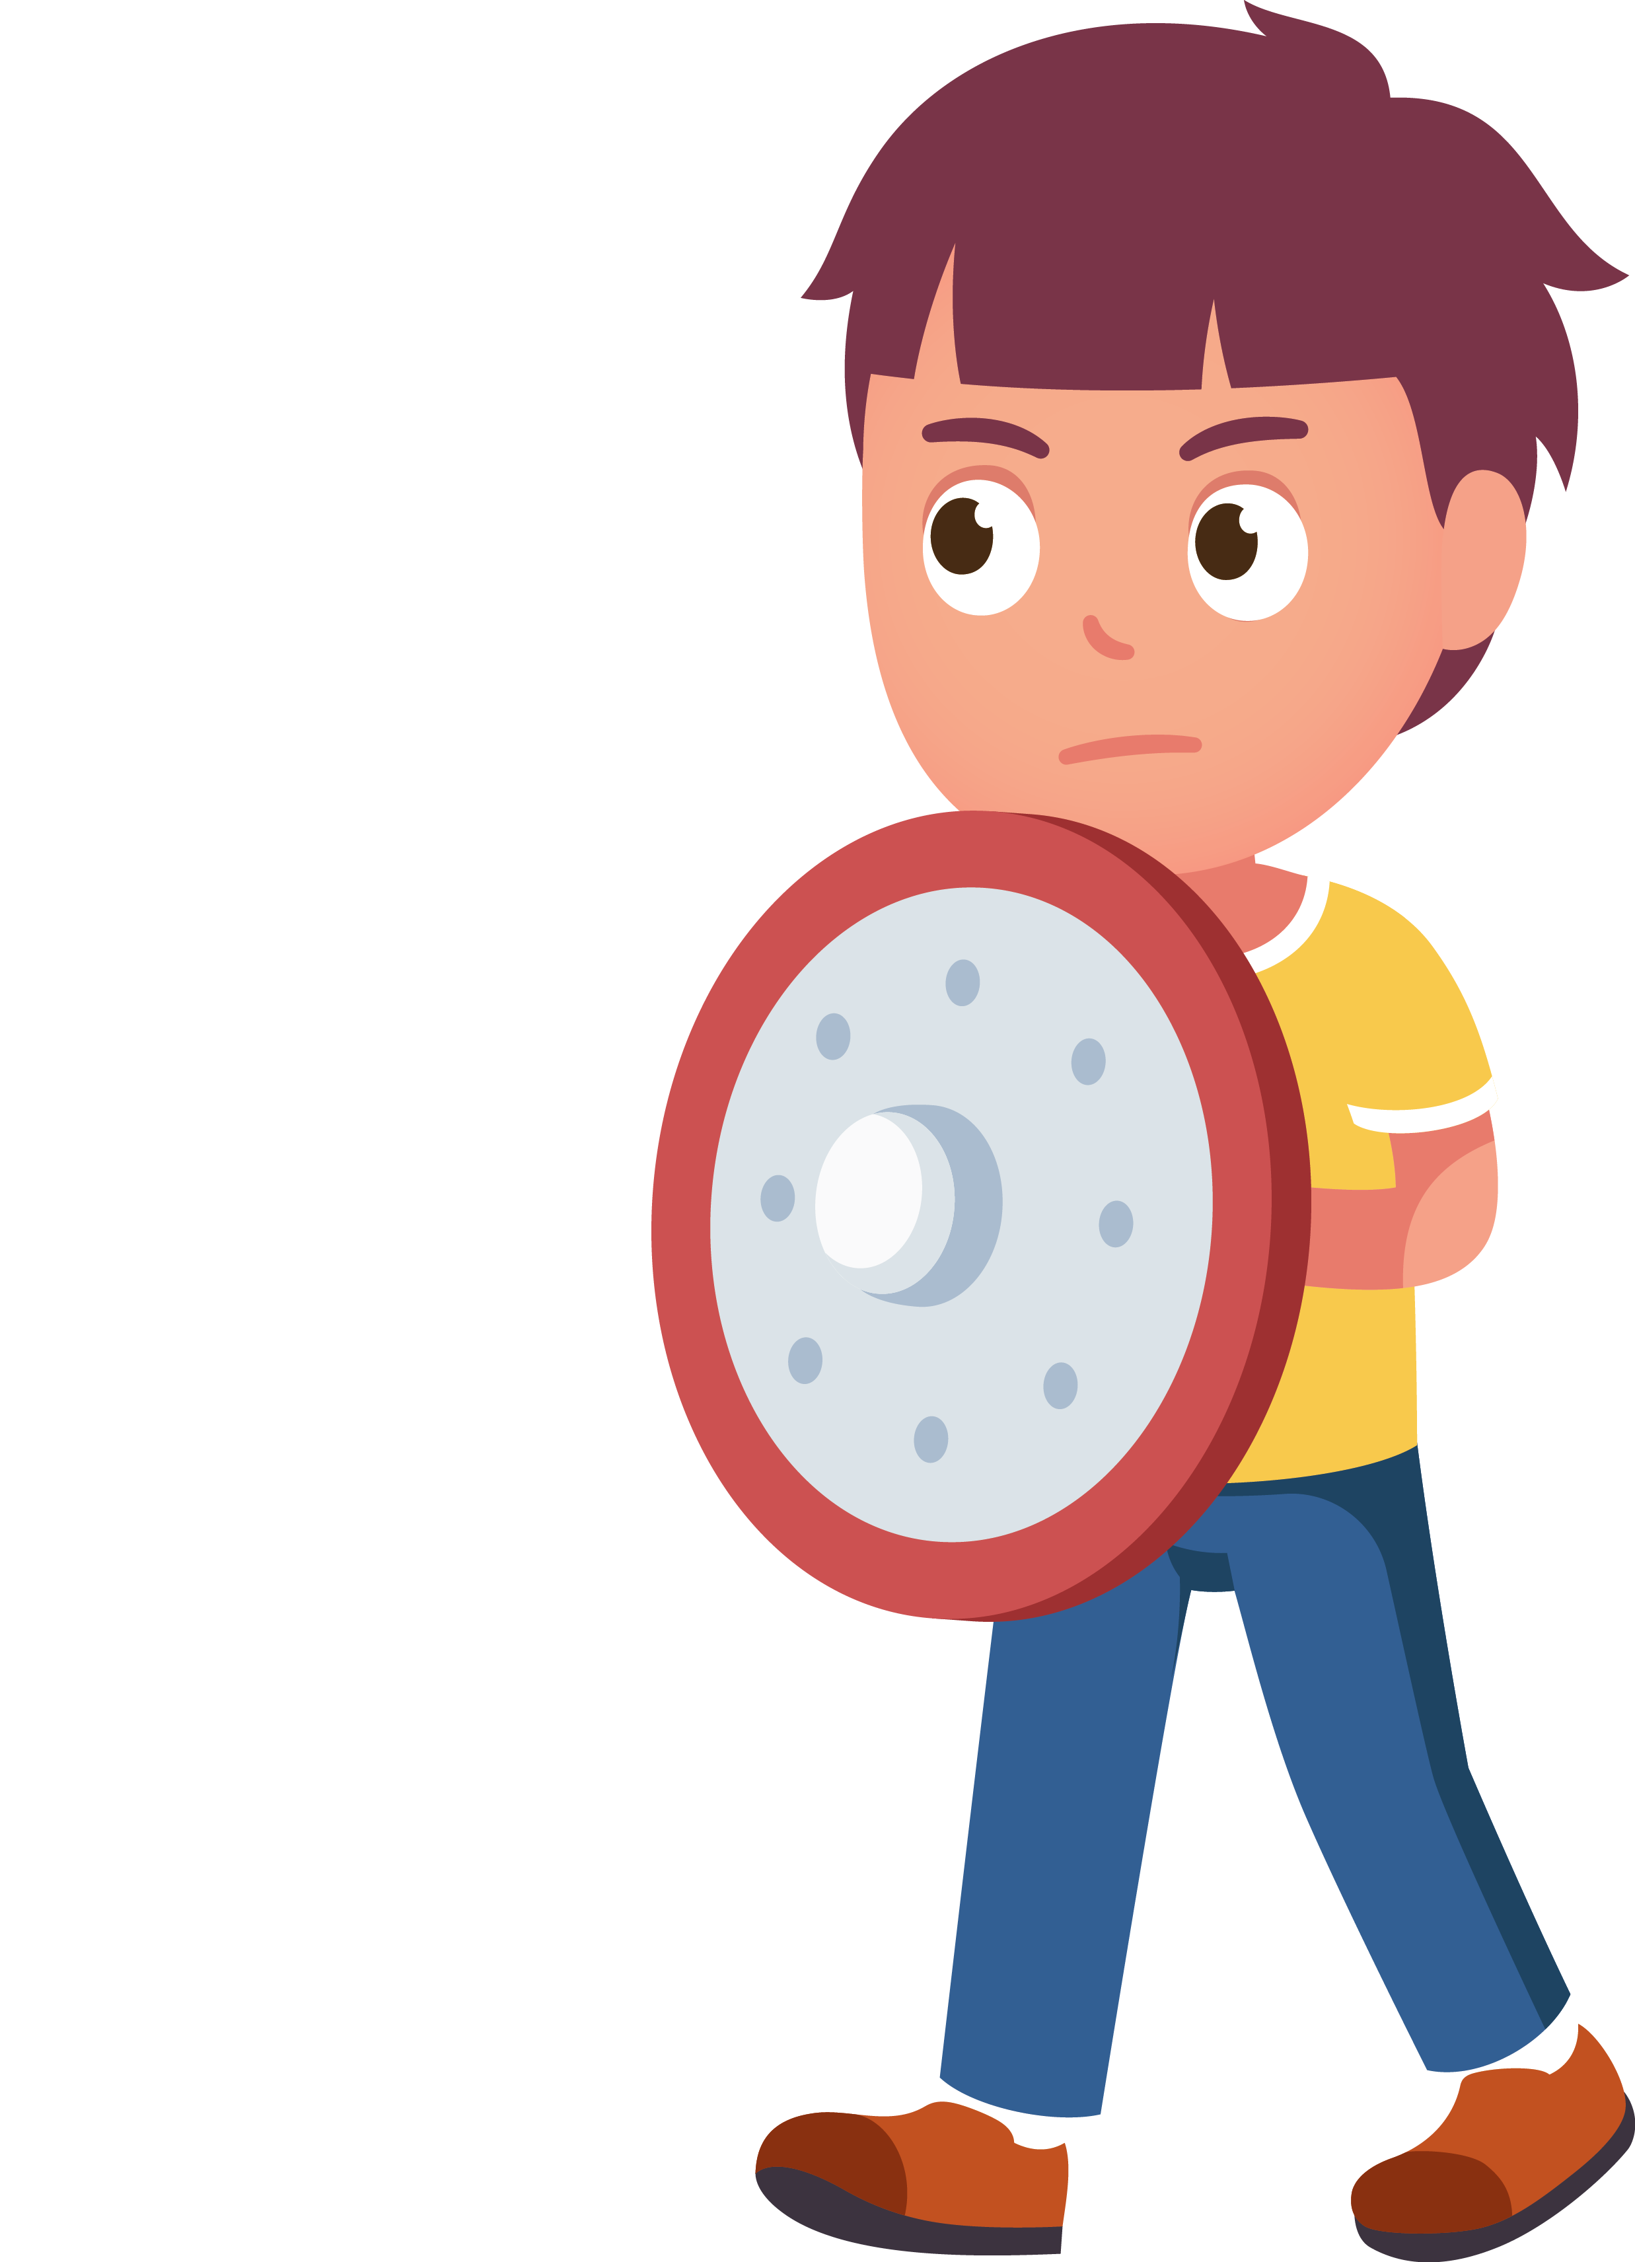
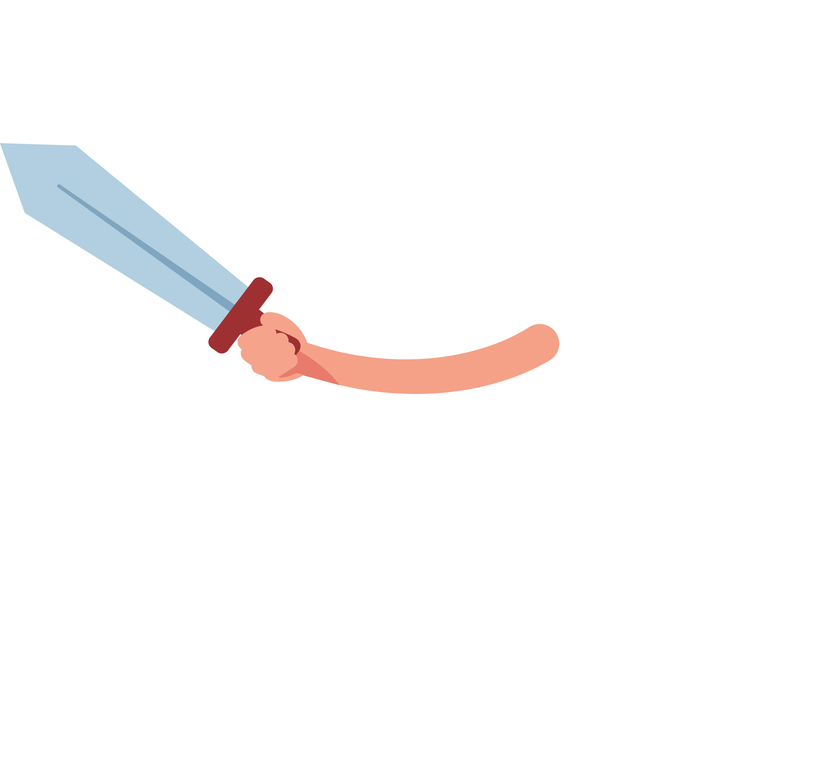
It keeps us alive!
sense of taste
sense of taste
Pre-reading
Let’s read
Questions

Slide 23
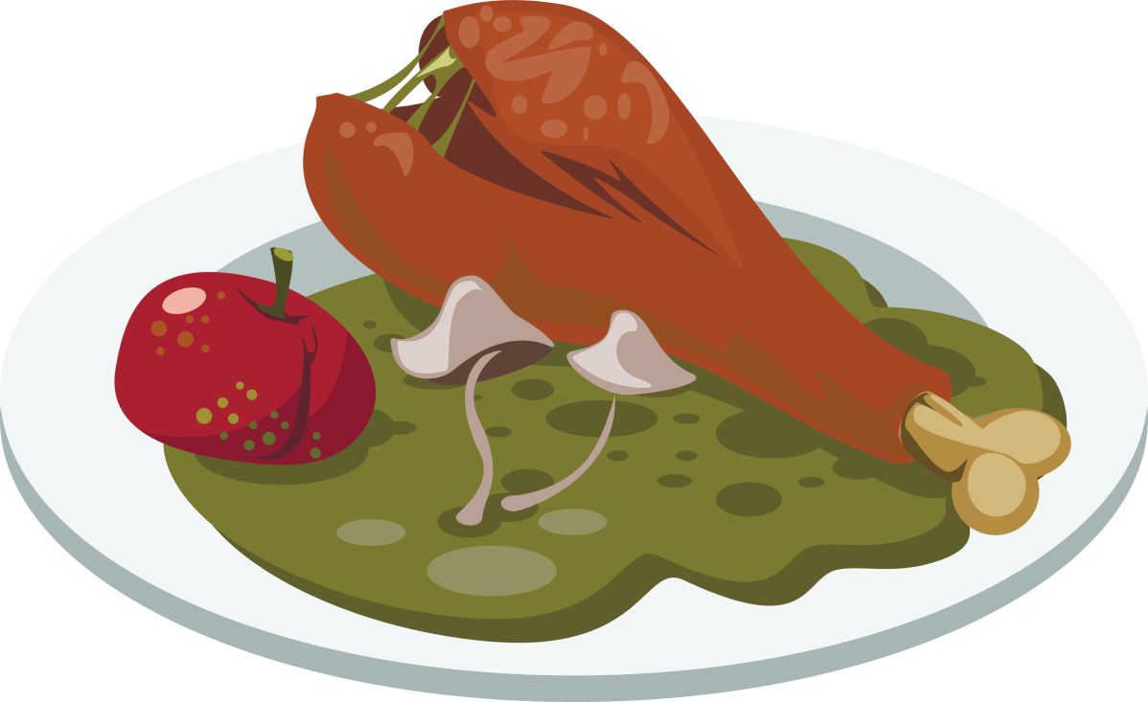
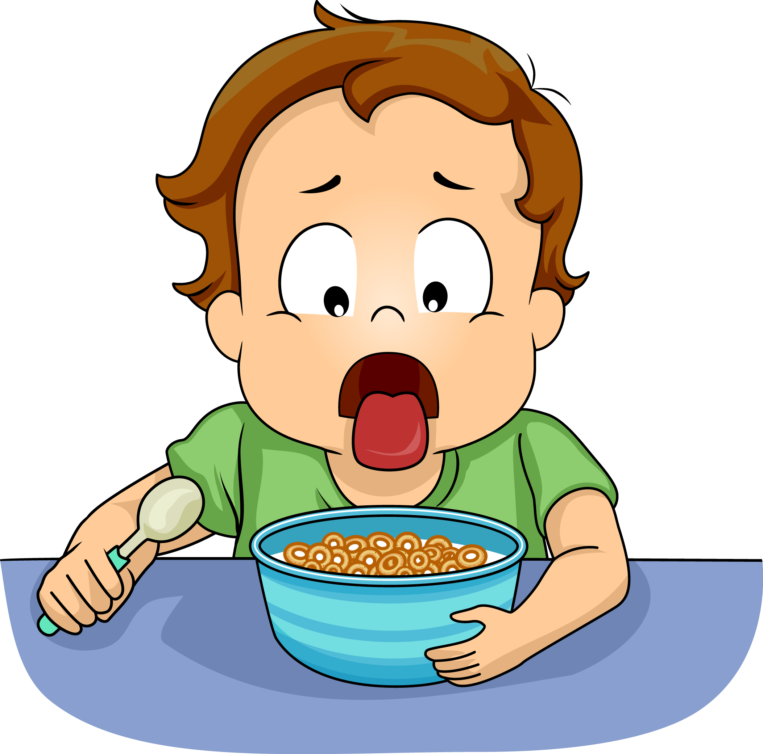
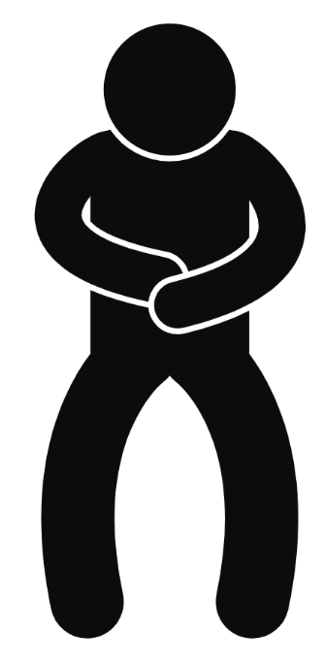
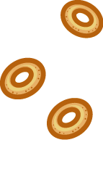
It keeps us alive!
Food can make us sick when it isn’t fresh. When we eat something rotten, our sense of taste says, ‘Yuck!’ and we spit it out.
Pre-reading
Let’s read
Questions

Slide 24
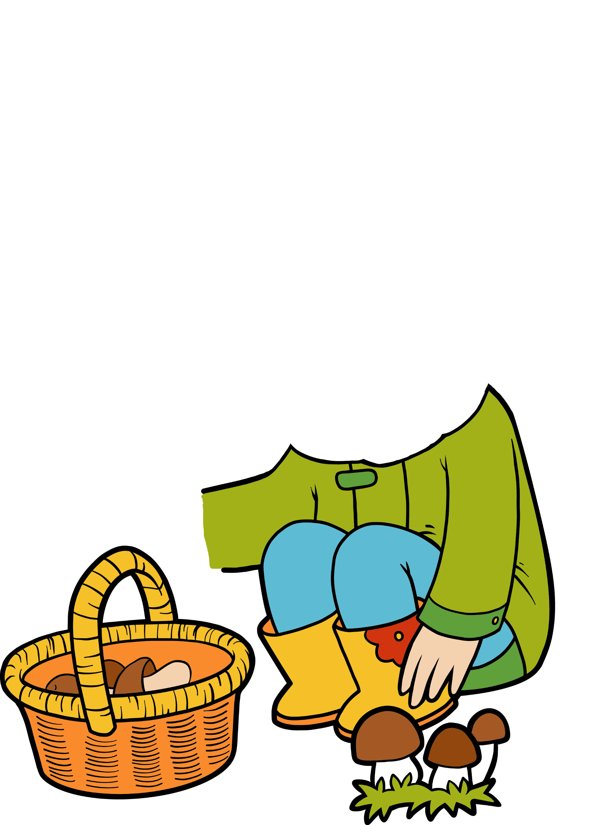
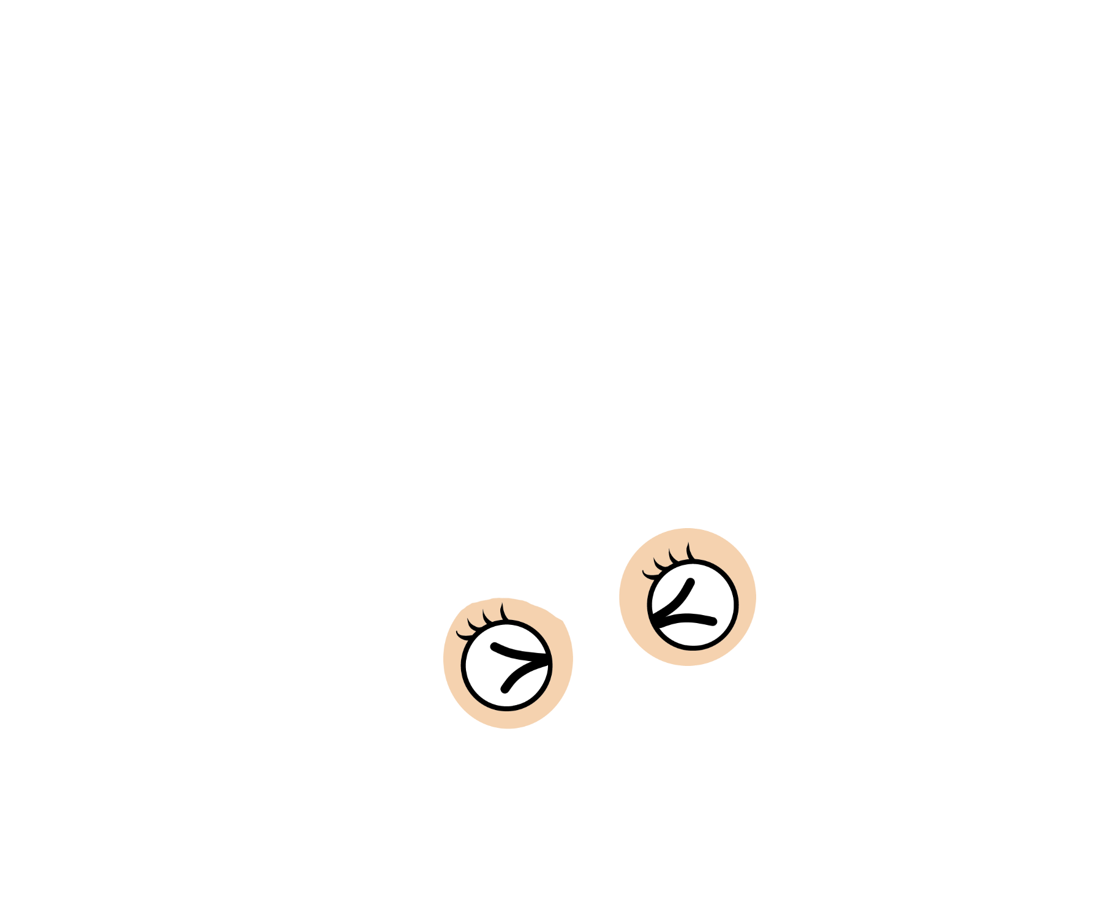
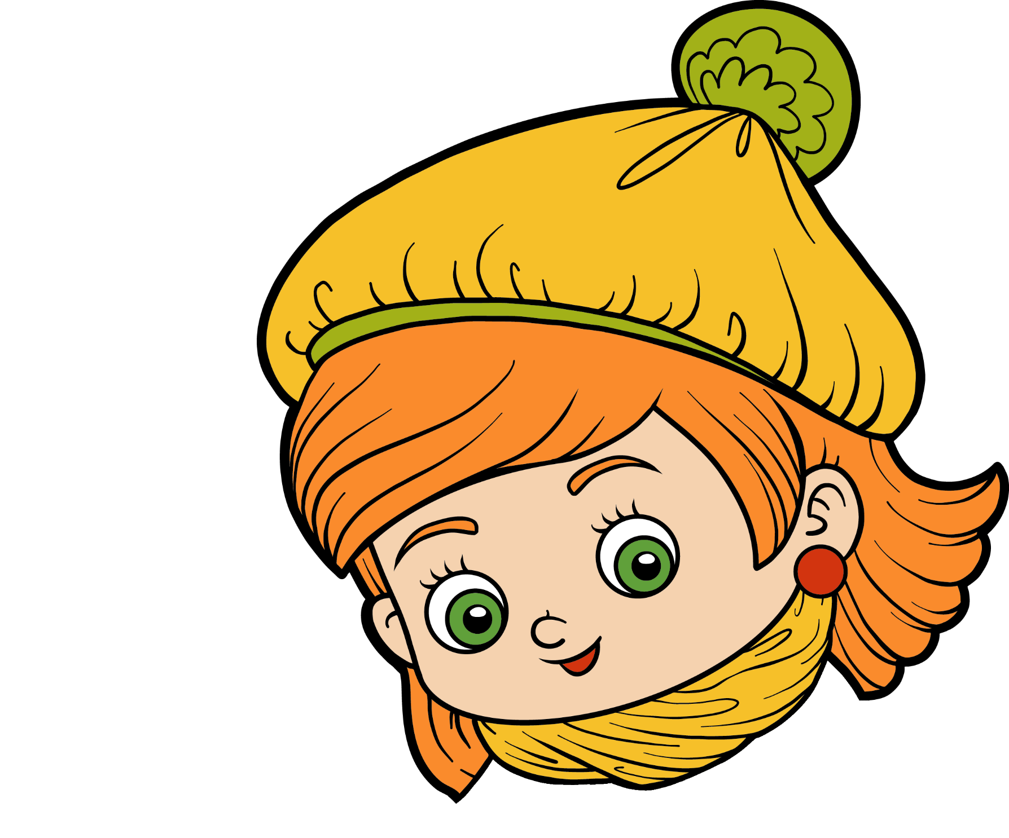
It keeps us alive!
Food can make us sick when it isn’t fresh. When we eat something rotten, our sense of taste says, ‘Yuck!’ and we spit it out. The same might happen when we eat something very bitter. This is a sign that it could be poisonous.
Pre-reading
Let’s read
Questions

Slide 25
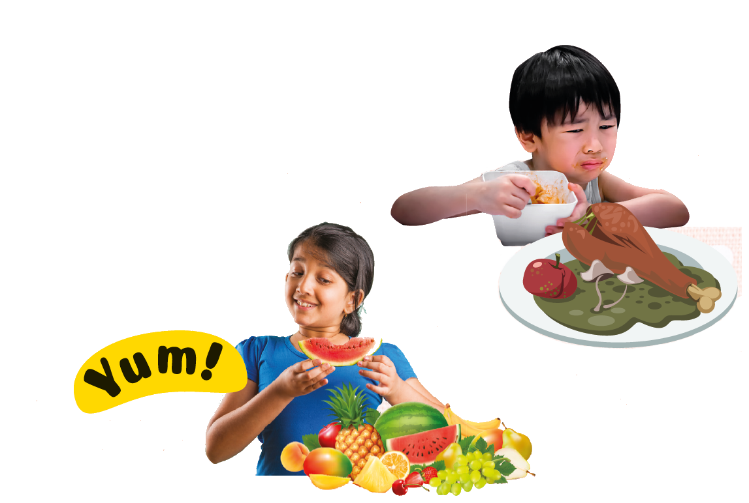
When do our sense of taste give us a warning?
Pre-reading
Let’s read
Questions

Slide 26
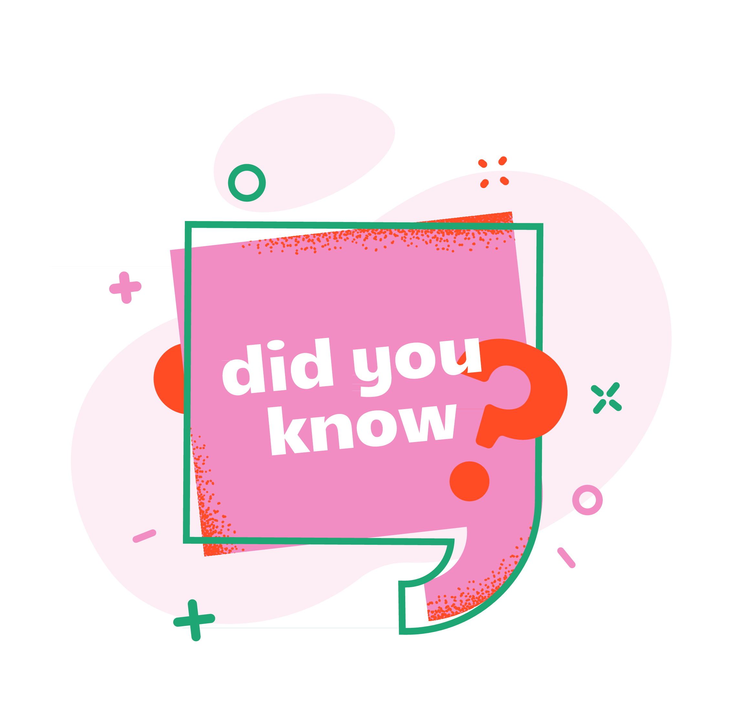
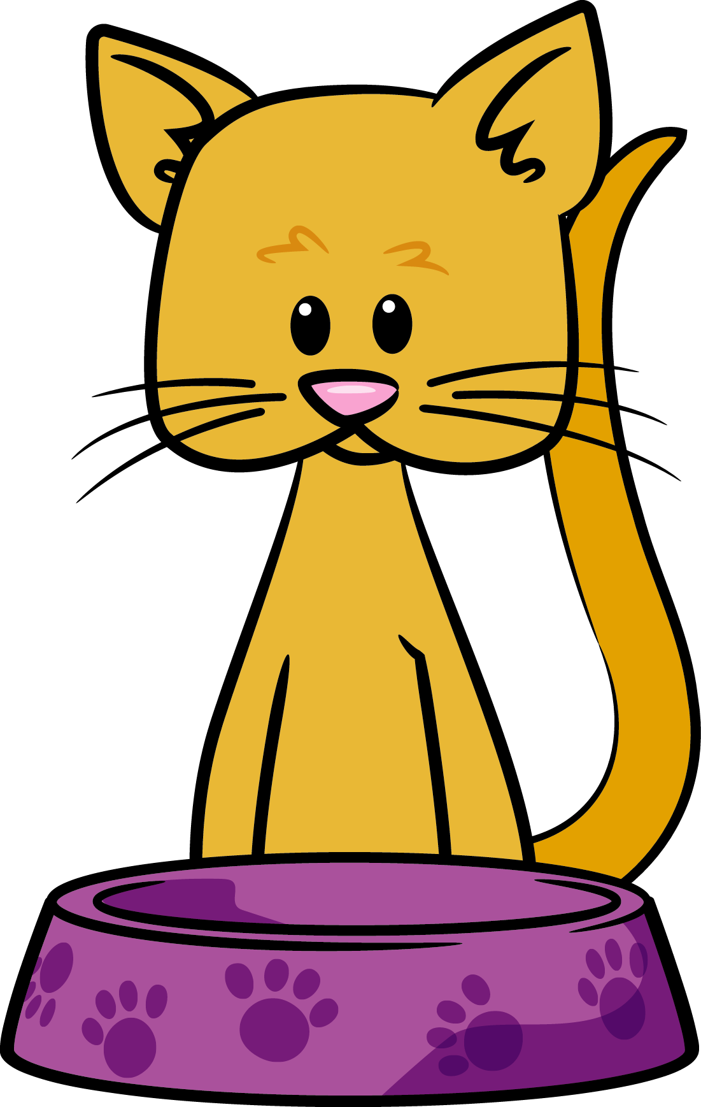
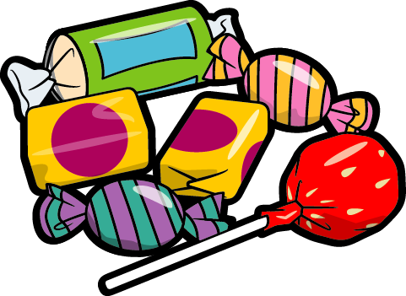
Do animals also have a sense of taste?
Animals can taste things, but not in exactly the same way as us. All mammals have taste buds but cats, for example, can‛t taste sweetness. Dogs have special taste buds for water (we don‛t). Birds have far fewer taste buds than mammals. Poor chickens only have about 30!
Pre-reading
Let’s read
Questions

Slide 27
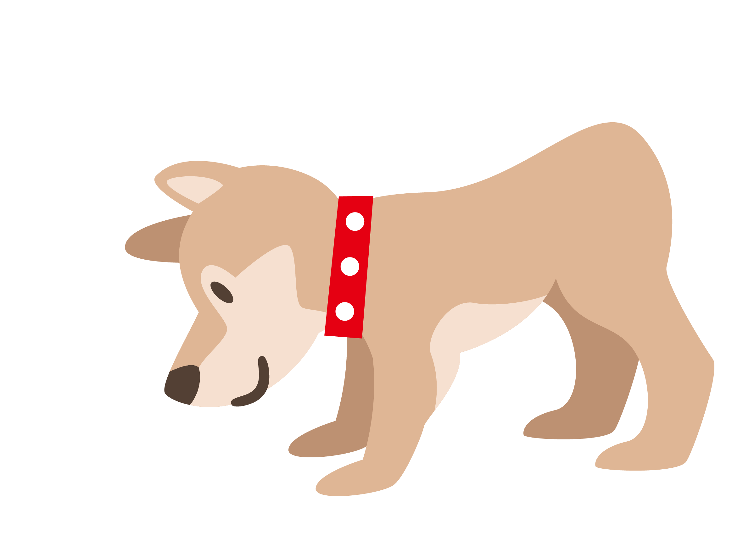
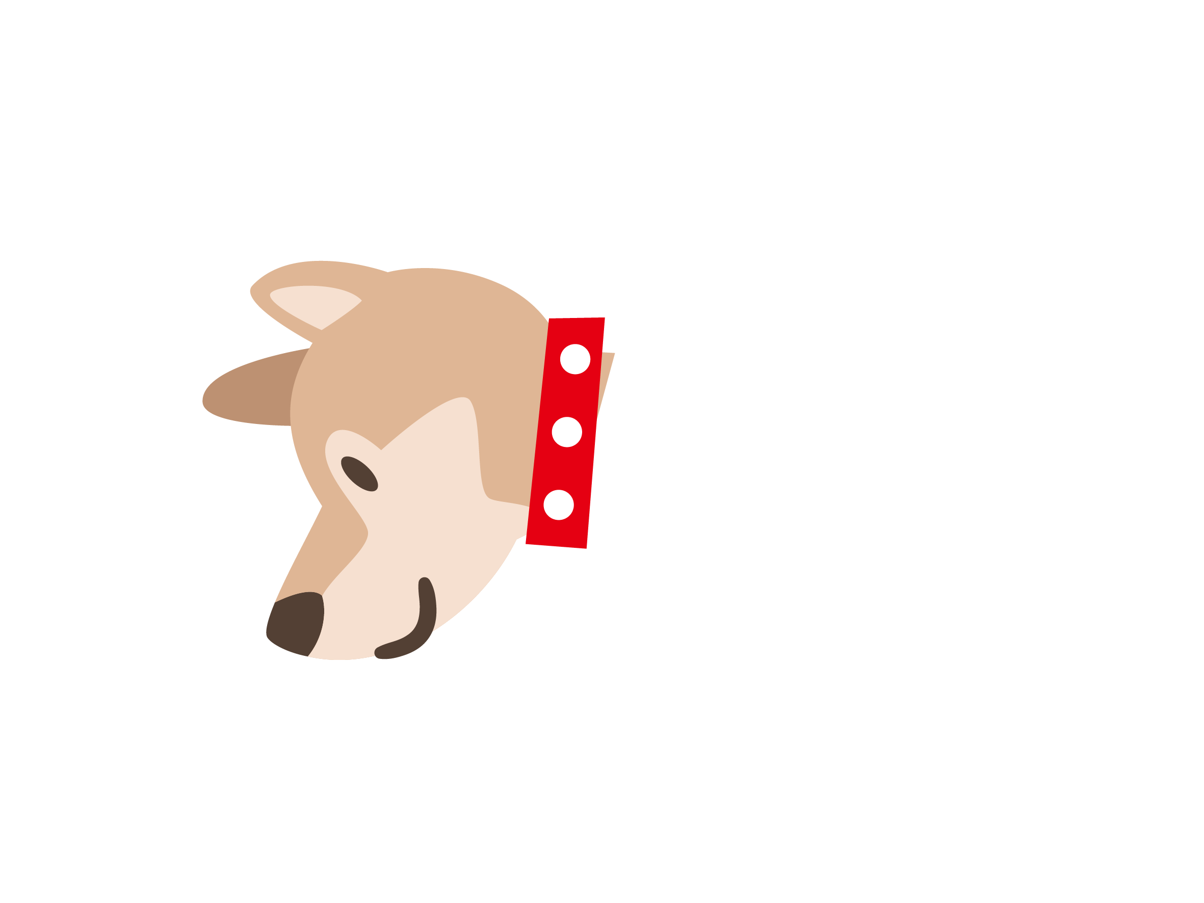
Do animals also have a sense of taste?
Animals can taste things, but not in exactly the same way as us. All mammals have taste buds but cats, for example, can‛t taste sweetness. Dogs have special taste buds for water (we don‛t). Birds have far fewer taste buds than mammals. Poor chickens only have about 30!
Pre-reading
Let’s read
Questions

Slide 28
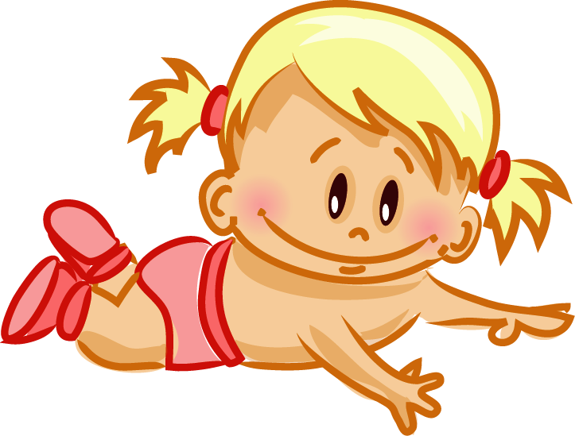
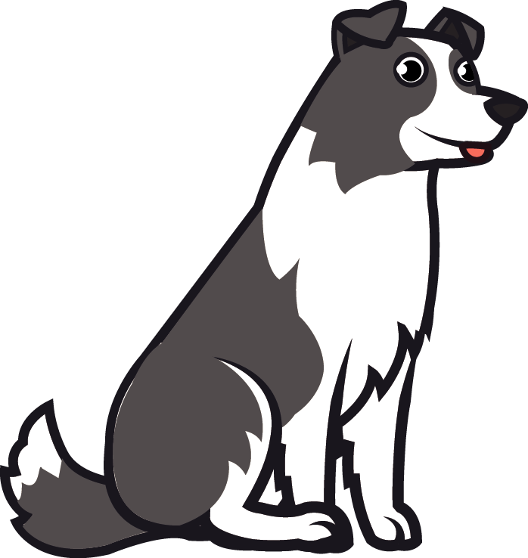
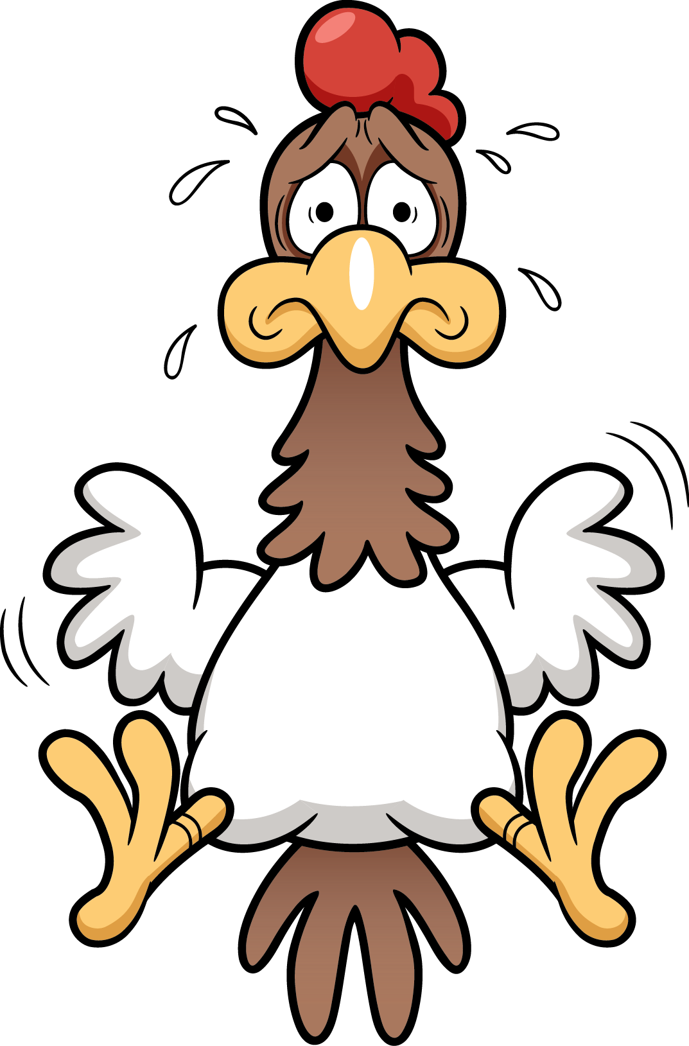
Do animals also have a sense of taste?
Animals can taste things, but not in exactly the same way as us. All mammals have taste buds but cats, for example, can‛t taste sweetness. Dogs have special taste buds for water (we don‛t). Birds have far fewer taste buds than mammals. Poor chickens only have about 30!
10,000 taste buds
1,700 taste buds
30 taste buds
Pre-reading
Let’s read
Questions

Slide 29
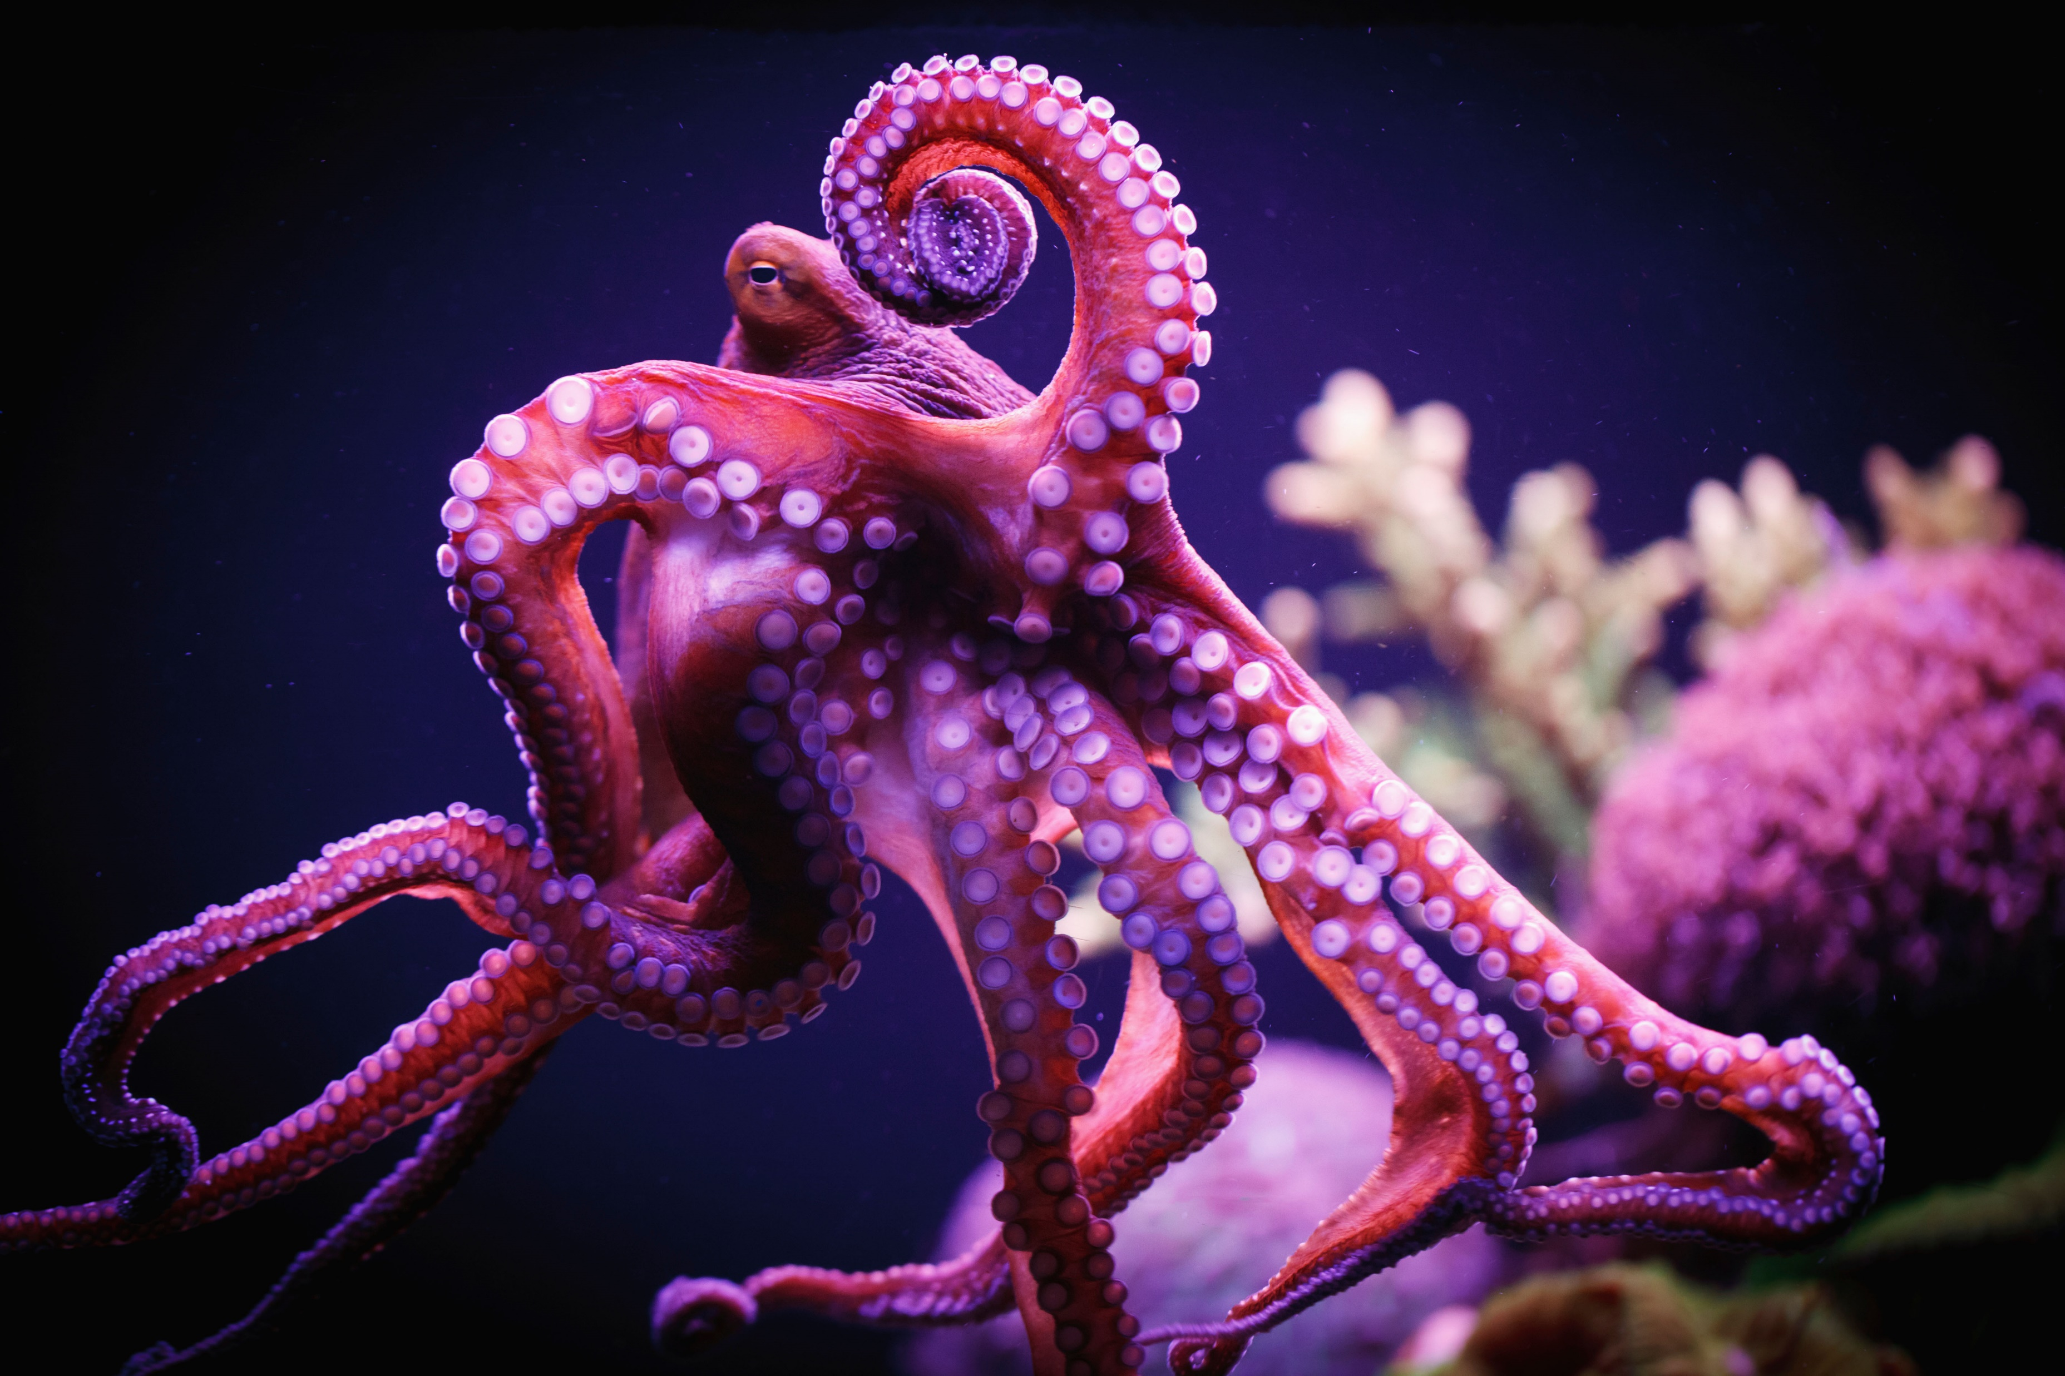
Do animals also have a sense of taste?
suckers
Octopuses taste with their suckers.
Pre-reading
Let’s read
Questions

Slide 30
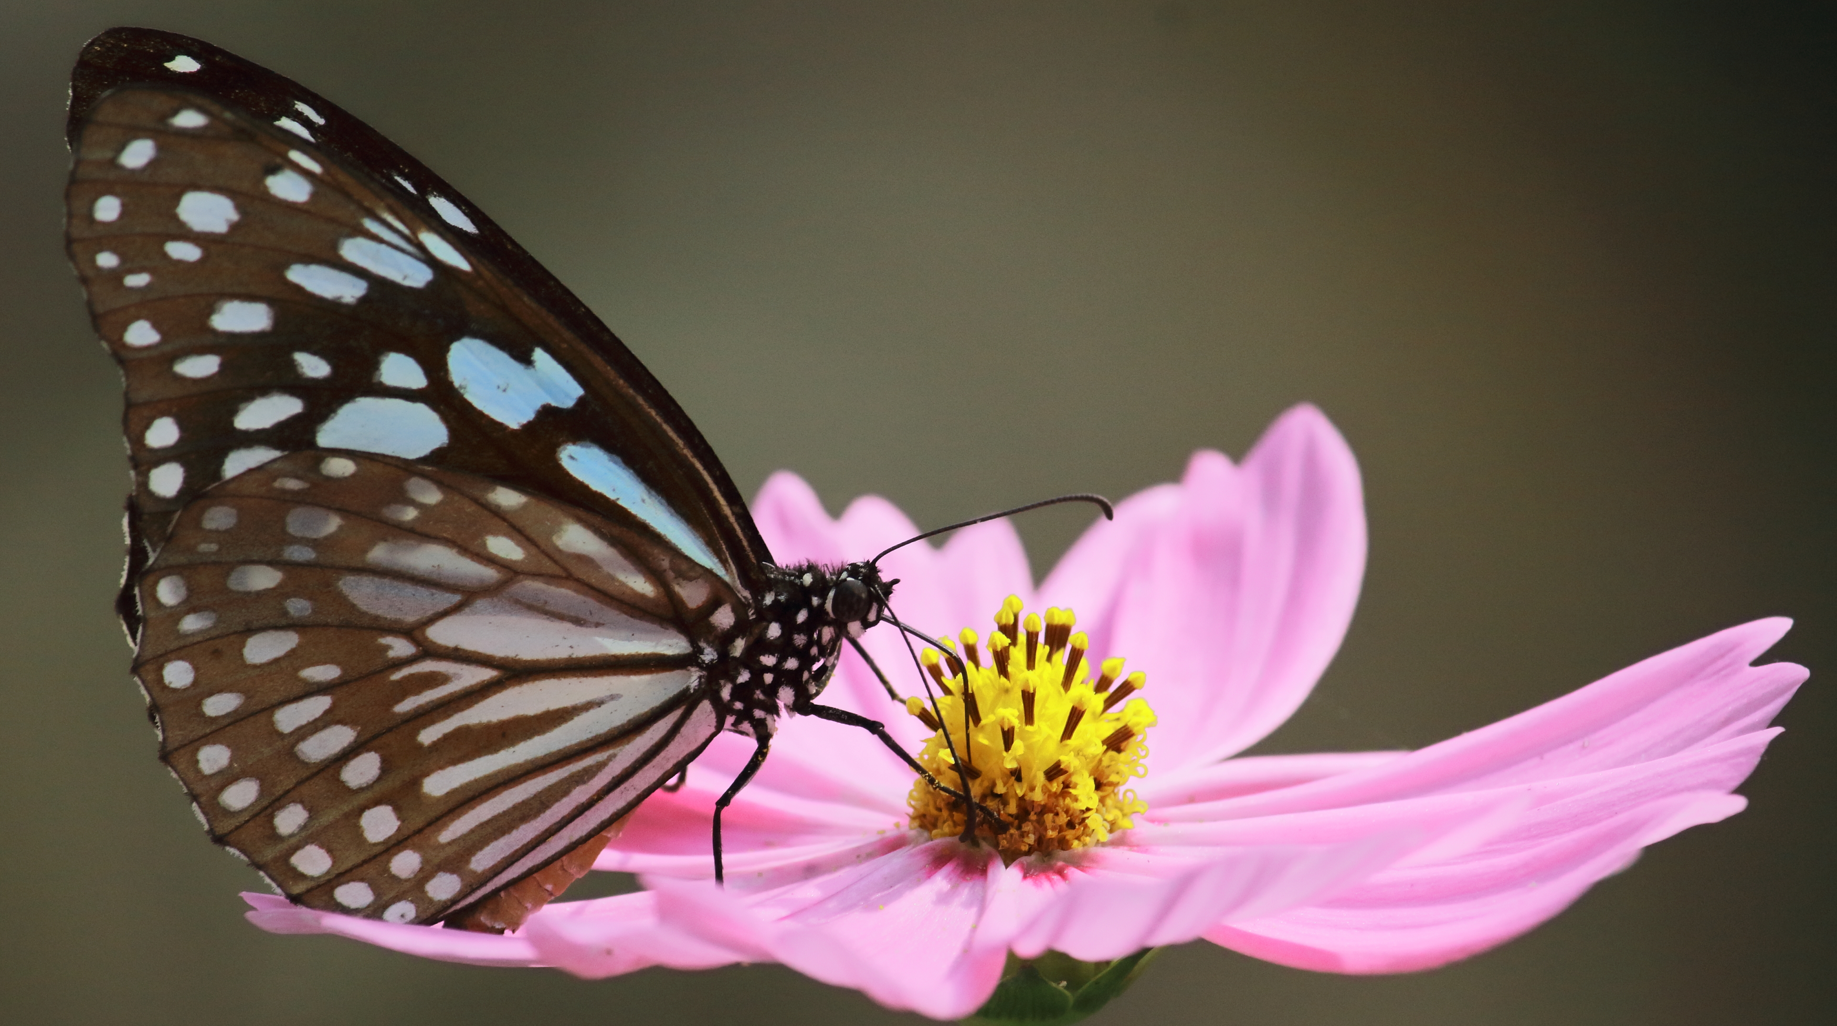
Do animals also have a sense of taste?
PLET_2E_SB_4A_P_RaC_B_ 072f - shutterstock_1925396519
suckers
Butterflies taste with their feet.
Pre-reading
Let’s read
Questions

Slide 31
Questions
Can you answer these questions?
Pre-reading
Let’s read
Questions

Slide 32
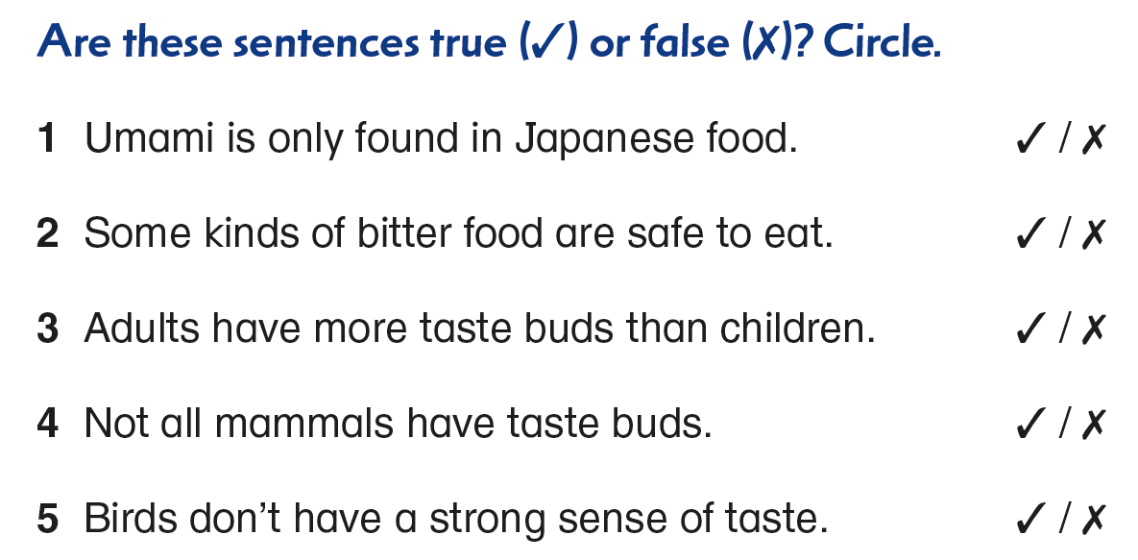
‘Umami’ is a Japanese word, but it is not only found in Japanese food.
Pre-reading
Let’s read
Questions

Slide 33
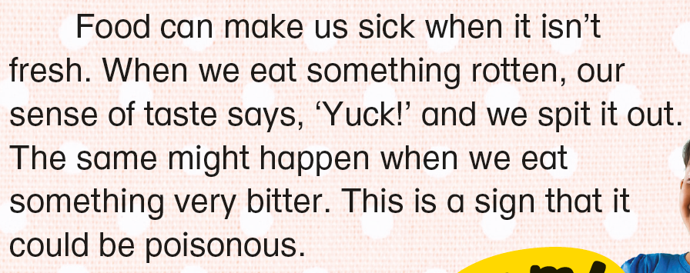
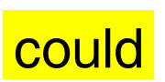
Bitterness may or may not be a sign of poison. For example, bitter melons are safe to eat.
could
bitter melons
= may
Pre-reading
Let’s read
Questions

Slide 34
Adults have fewer taste buds than children.
Pre-reading
Let’s read
Questions

Slide 35
All mammals have taste buds.
Pre-reading
Let’s read
Questions

Slide 36
Birds don’t have many taste buds, so they don’t have a strong sense of taste.
Pre-reading
Let’s read
Questions

Slide 37
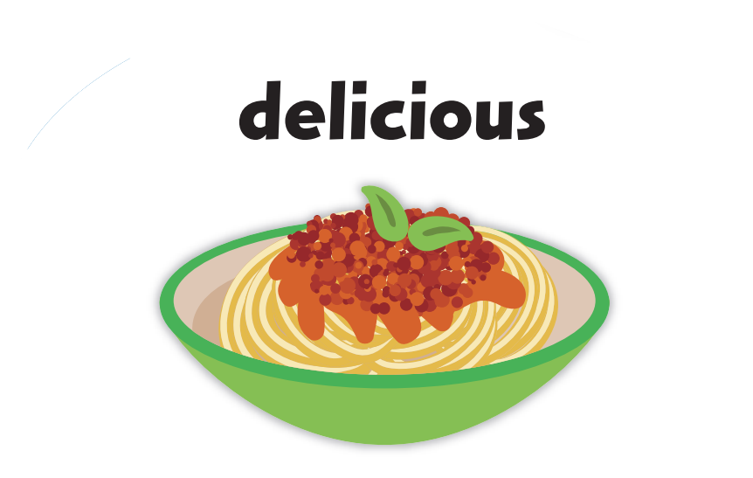
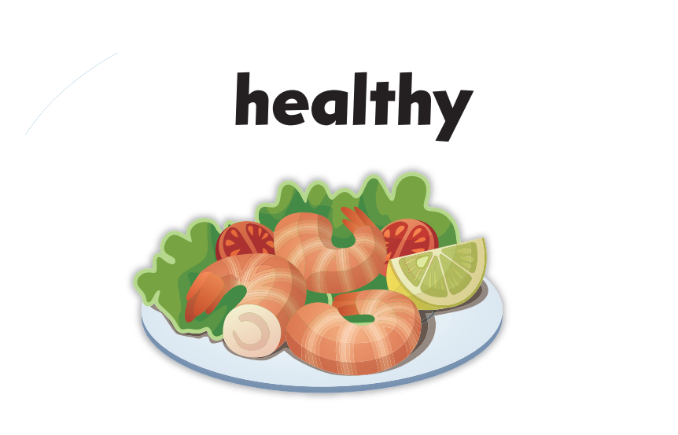
PLET_2E_SB_4A_P_RaC_B_ 072f - shutterstock_1925396519
suckers
or
?
Pre-reading
Let’s read
Questions

Slide 39
Acknowledgments
We are grateful to the following for permission to reproduce copyright photographs and illustrations:
acidmit. Shutterstock
Africa Studio. Shutterstock
Agung Setya Nugraha. Shutterstock
All For You. Shutterstock
ankomando. 123RF
ann131313. Shutterstock
bill-2. Shutterstock
Binh Thanh Bui. Shutterstock
BNP Design Studio. Shutterstock
Colorfuel Studio. Shutterstock
Design Pics Inc / Alamy Stock Photo
ecco. Shutterstock
grey_and. Shutterstock
HikoPhotography. Shutterstock
Iconic Bestiary. Shutterstock
klyaksun. Shutterstock
Krakenimages.com. Shutterstock
Ksenya Savva. Shutterstock
Leremy. Shutterstock
matkub2499. Shutterstock
Mironova Iuliia. Shutterstock
my.ordinarty. Shutterstock
Nicoleta Ionescu. Shutterstock
NtgSib. Shutterstock
olegtoka. Shutterstock
Paul Hakimata Photography. Shutterstock
PDQ Digital Media Solutions Ltd. Pearson Education Ltd
Peter Lang. Shutterstock
Sarawut Padungkwan. Shutterstock
Seika Chujo. Shutterstock
Spayder pauk_79. Shutterstock
StockImageFactory.com. Shutterstock
timquo. Shutterstock
TINA NIZOVA. Shutterstock
VaLiza. Shutterstock
Virinaflora. Shutterstock
WinWin artlab / Shutterstock
yatate. Shutterstock
Every effort has been made to trace copyright, but in the event of any accidental infringement, we shall be pleased to come to a suitable arrangement with the rightful owner.

