Slide 1
The Four Great Inventions of China

Slide 2
Paper making, printing, gunpowder and the compass are the Four Great Inventions of ancient China. How much do you know about them?

Slide 3
Step 1: Research
Step 2: Plan and create
Step 3: Present

Slide 4
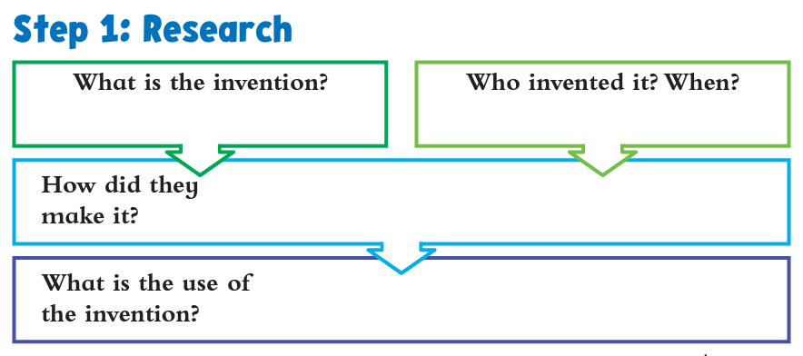
1: Research
2: Plan and create
3: Present

Slide 5
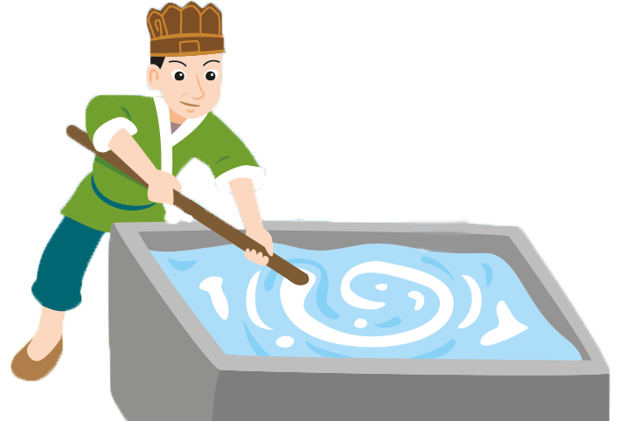
Paper making
1: Research
2: Plan and create
3: Present

Slide 6
Who invented paper making and when is it invented?
Paper making
In the Han Dynasty,
Cai Lun invented a new papermaking method.
1: Research
2: Plan and create
3: Present

Slide 7
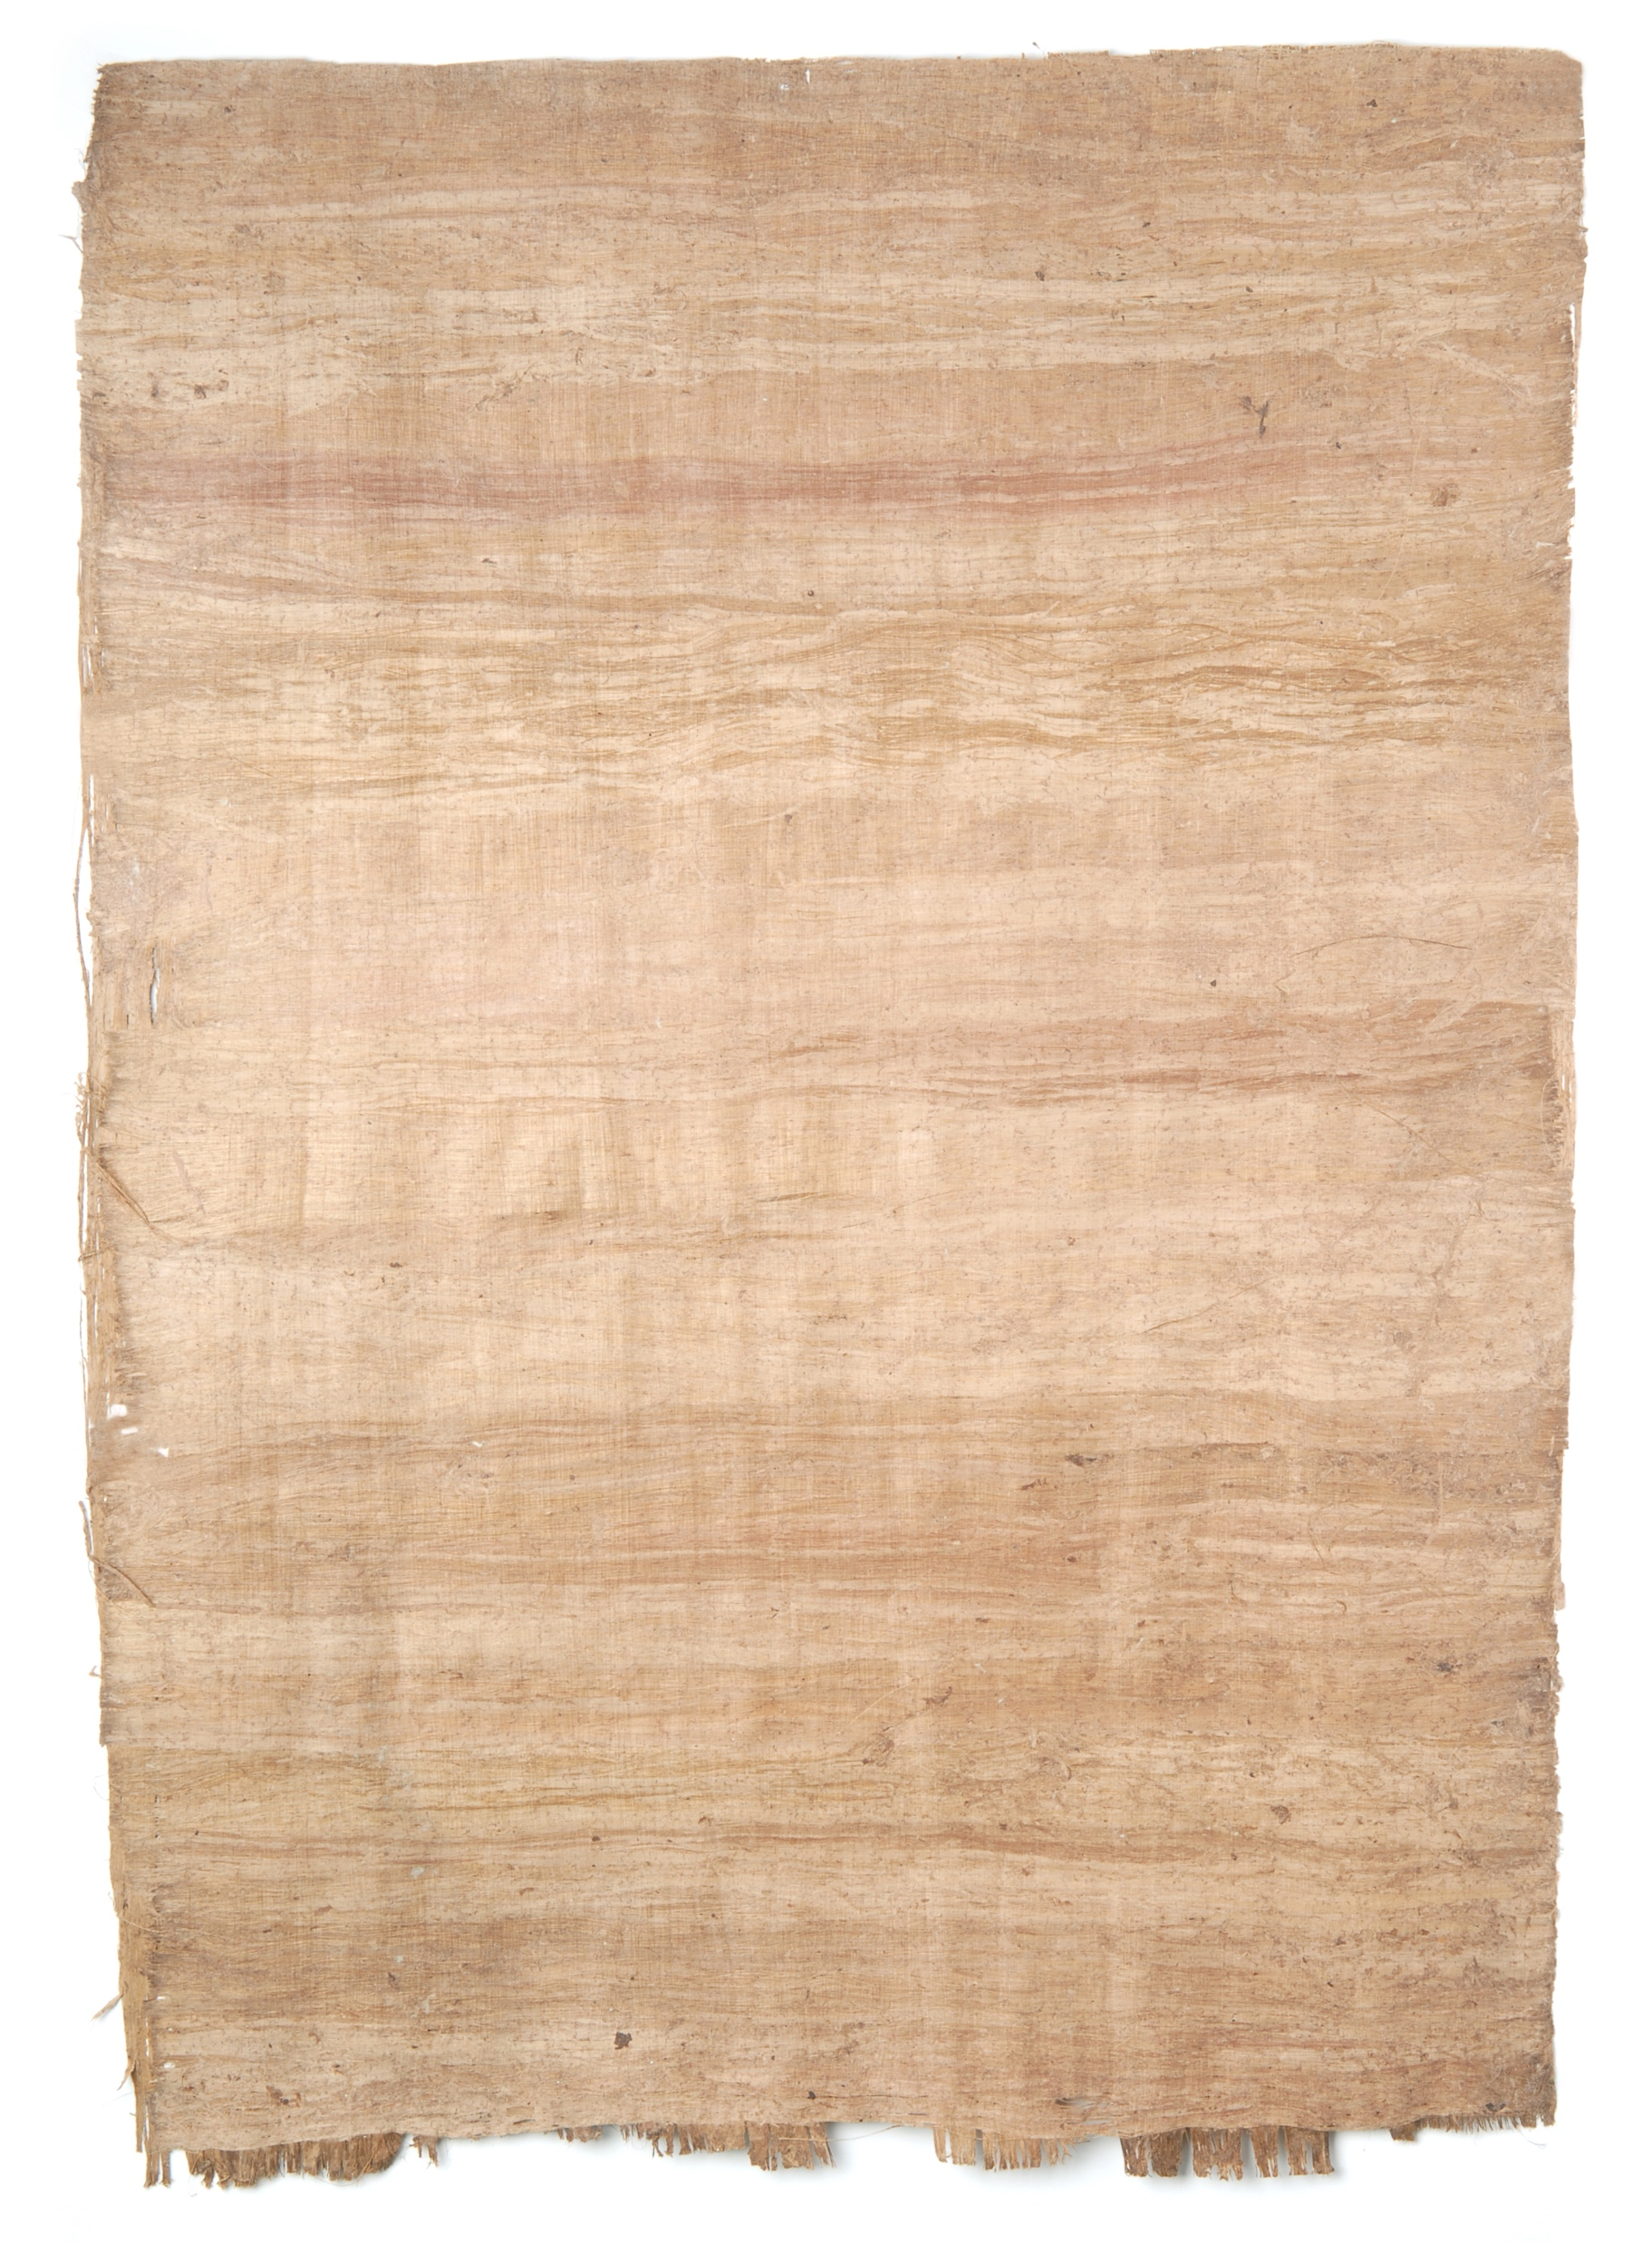
How did Cai Lun make paper?
He added new materials and invented a machine to make better paper.
1: Research
2: Plan and create
3: Present

Slide 8
What materials did he add?
Bark
1: Research
2: Plan and create
3: Present

Slide 9
What ingredients did he use?
Rags
1: Research
2: Plan and create
3: Present

Slide 10
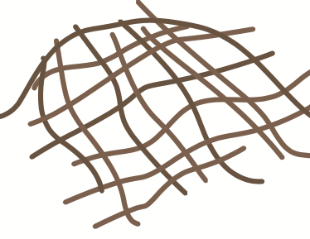
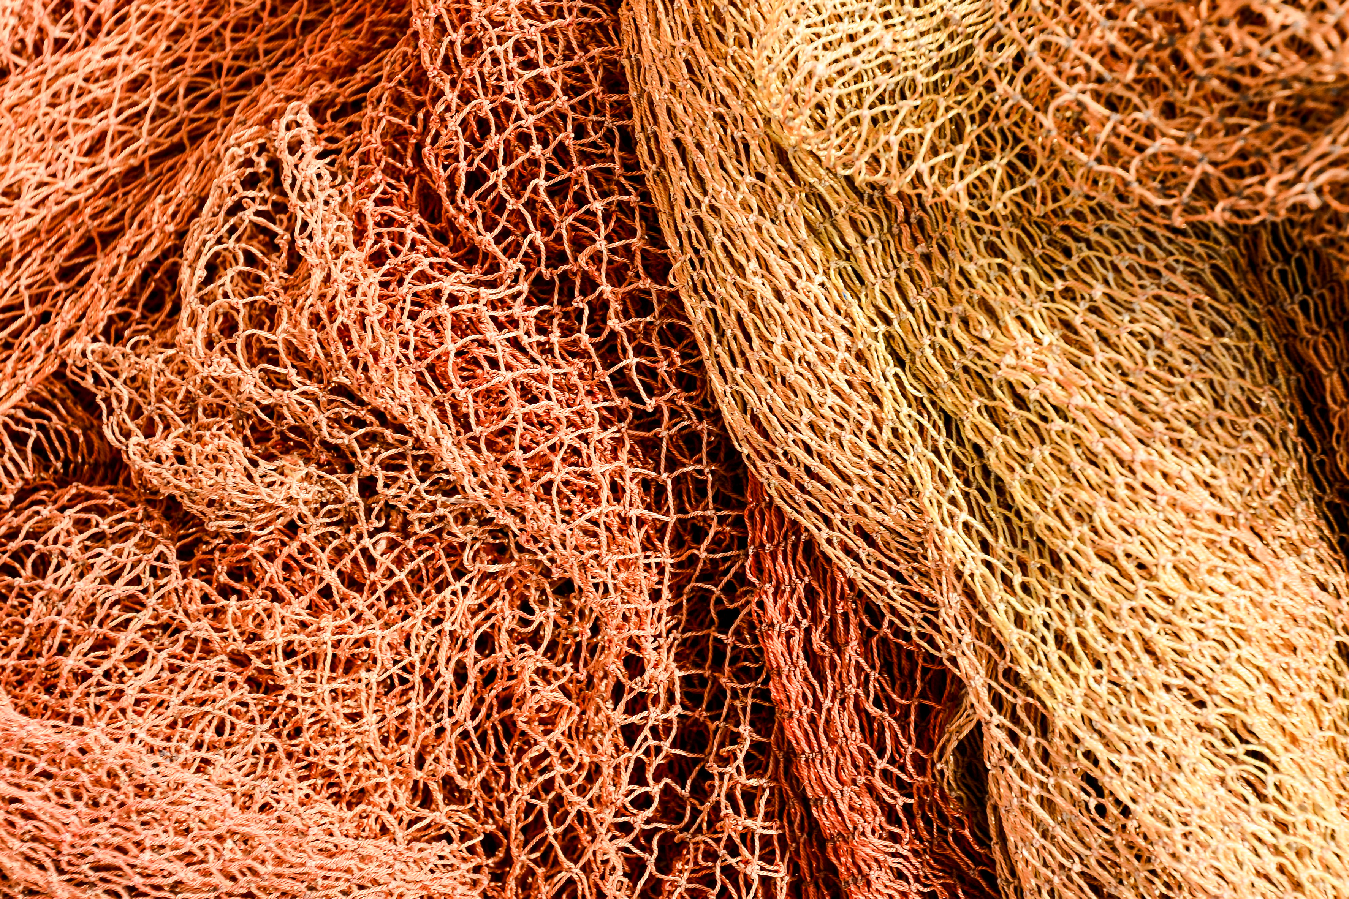
What ingredients did he use?
Old fishing net
1: Research
2: Plan and create
3: Present

Slide 11
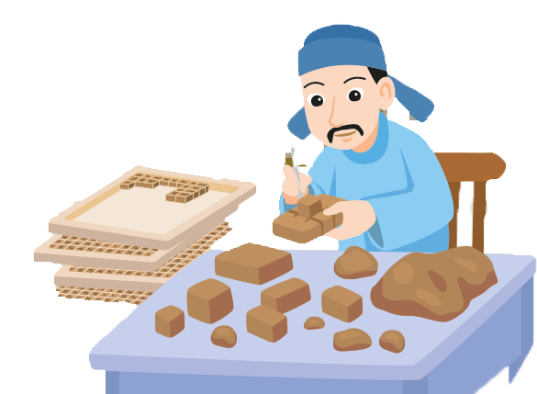
Printing
1: Research
2: Plan and create
3: Present

Slide 12
Who invented printing and when is it invented?
Printing
In the Song Dynasty,
Bi Sheng invented a new printing method.
1: Research
2: Plan and create
3: Present

Slide 13
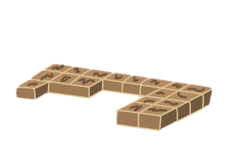
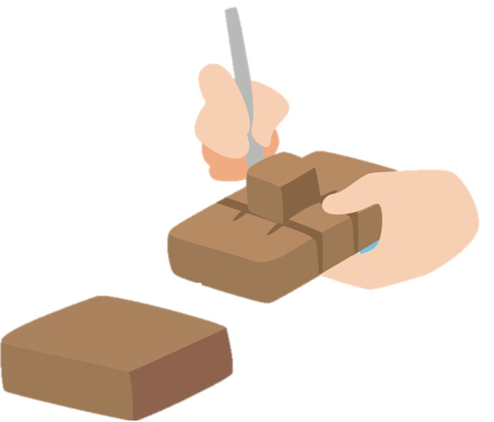
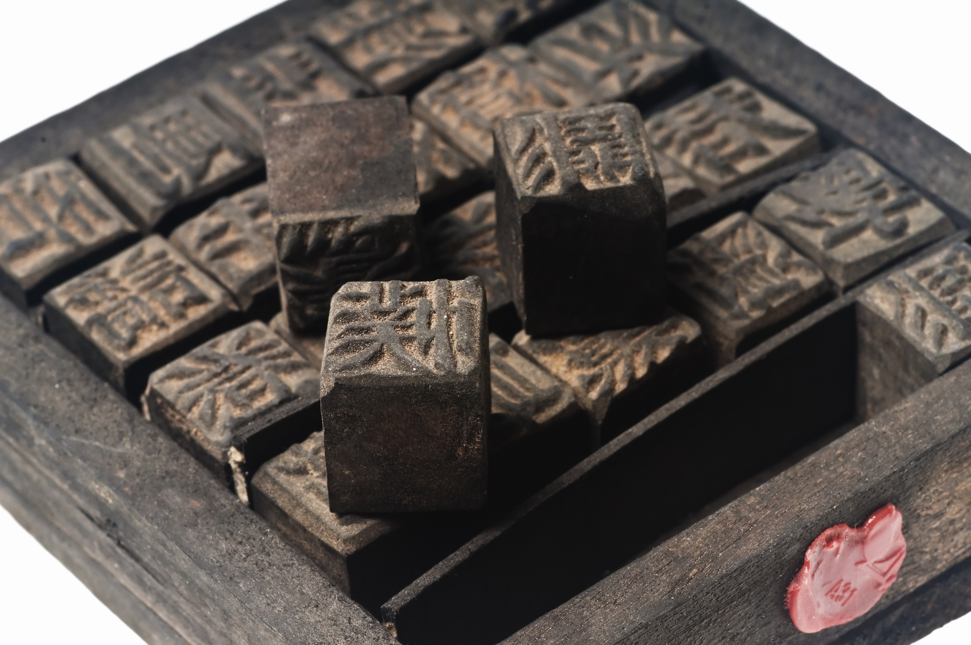
What materials did he use?
Type pieces
The type pieces are made of wood.
1: Research
2: Plan and create
3: Present

Slide 14
What is special about the type pieces?
The type pieces are also called ‘live words’ because they can be moved. People at that time arranged them to print the texts they needed.
1: Research
2: Plan and create
3: Present

Slide 15
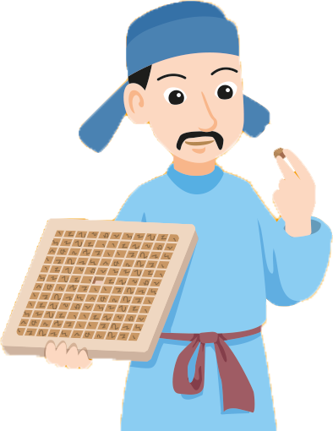
What materials did he use?
Iron plate
Cai Lun put the type pieces into the iron plate.
1: Research
2: Plan and create
3: Present

Slide 16
How did Cai Lun print books?
Printing
He made a type piece for each Chinese word and put the type pieces on an iron plate to print books.
1: Research
2: Plan and create
3: Present

Slide 17
Papermaking and printing
With the new methods of paper making and printing, it was easier and cheaper to print more books. This helped spread knowledge.
1: Research
2: Plan and create
3: Present

Slide 18
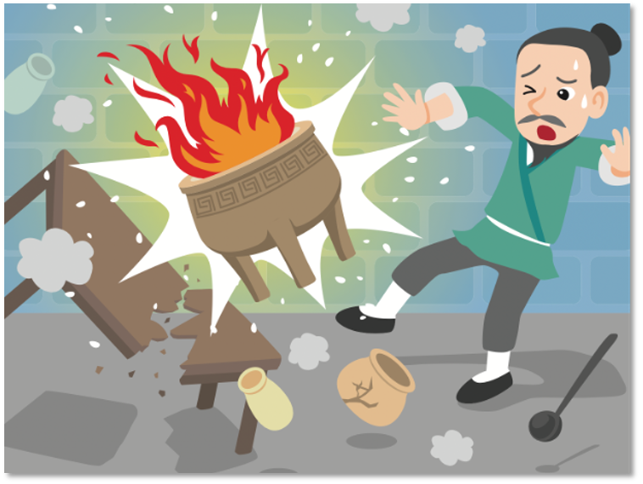
Gunpowder
1: Research
2: Plan and create
3: Present

Slide 19
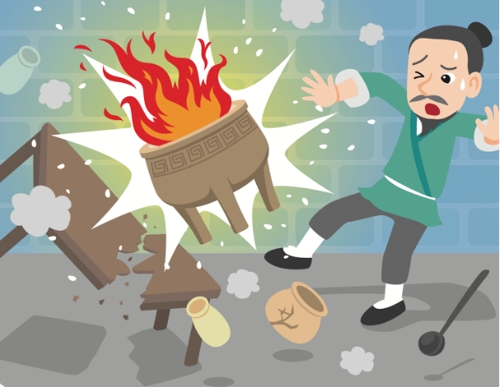
How was gunpowder invented?
Gunpowder
By accident, people made an explosive mixture when making medicines. Over time, they improved the mixture and invented gunpowder.
1: Research
2: Plan and create
3: Present

Slide 20
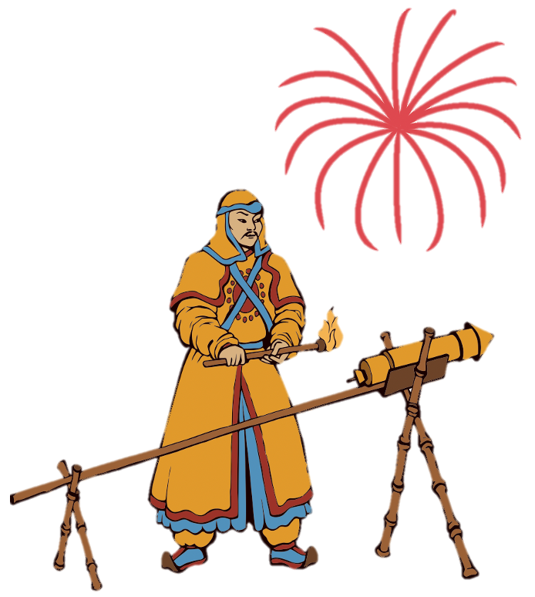
Usage
At first, people used gunpowder in making fireworks. Later, they used gunpowder in weapons.
1: Research
2: Plan and create
3: Present

Slide 21
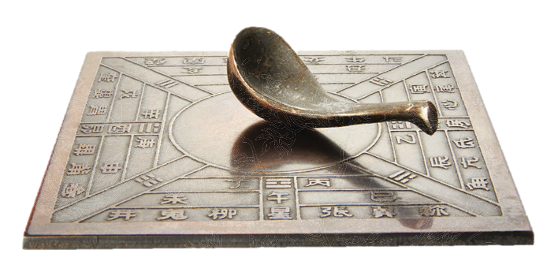
The compass
1: Research
2: Plan and create
3: Present

Slide 22
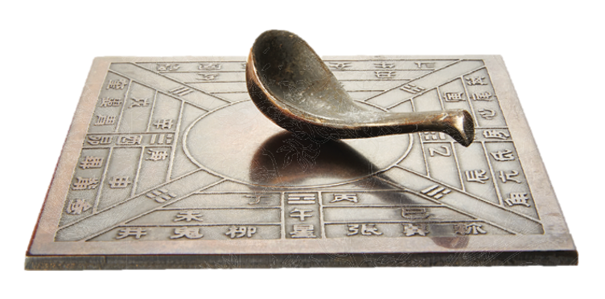
How was the compass invented?
The compass
People used magnets to make the first compass.
1: Research
2: Plan and create
3: Present

Slide 23
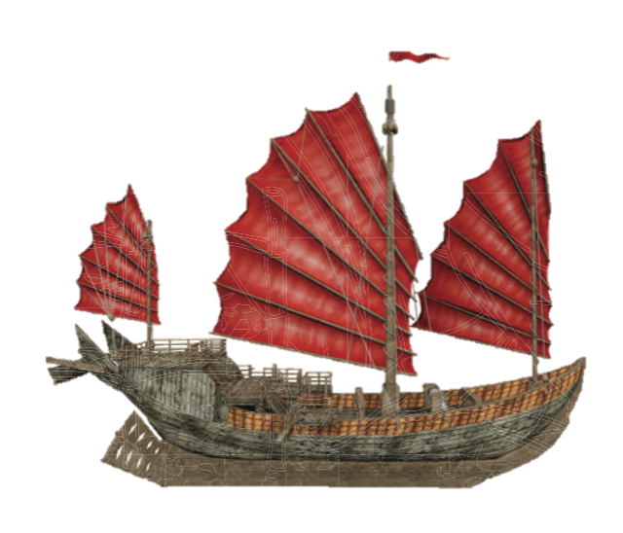
Usage
At first, people used the compass for studying stars and fortune telling. Later, they used the compass to find direction at sea.
1: Research
2: Plan and create
3: Present

Slide 24
1: Research
2: Plan and create
3: Present

Slide 25
I’m going to talk about papermaking today.
1: Research
2: Plan and create
3: Present

Slide 26
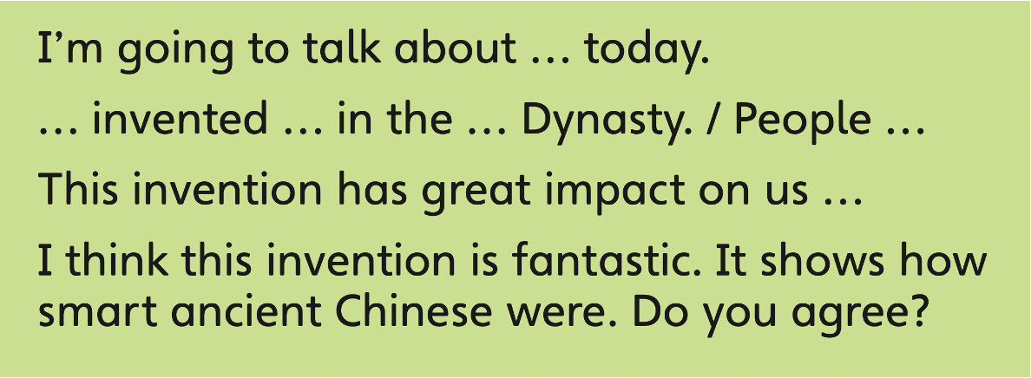
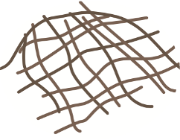
I’m going to talk about paper making today.
Paper making
is invented in the Han Dynasty.
Cai Lun added new materials
like bark, rags and old fishing net.
He invented a machine to
make better paper.
1: Research
2: Plan and create
3: Present

Slide 27
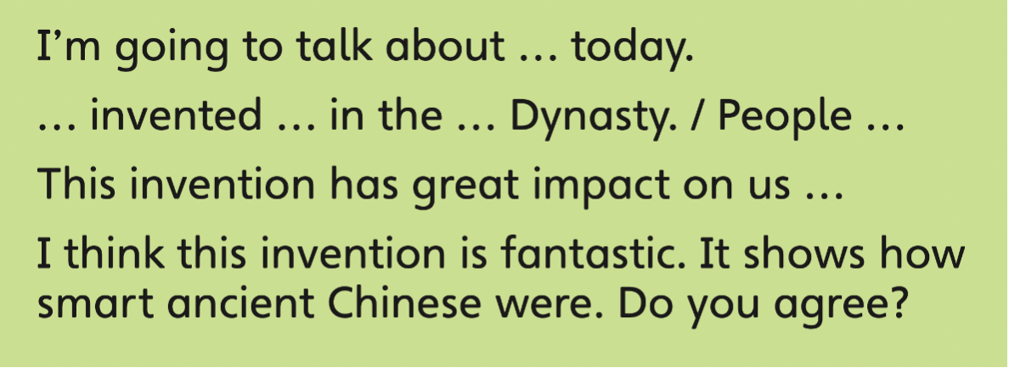
I’m going to talk about paper making today.
Paper making
Cai Lun added new materials
is invented in the Han Dynasty.
like bark, rags and old fishing net. He invented a machine to
make better paper.
This invention has great impact on us.
With the new method of paper making, it was easier and
cheaper to print more books. This helped spread knowledge.
1: Research
2: Plan and create
3: Present

Slide 28
I’m going to talk about paper making today.
Papermaking
Cai Lun added new materials
is invented in the Han Dynasty.
like bark, rags and old fishing net. He invented a machine to
make better paper.
This invention has great impact on us.
With the new method of paper making, it was easier and
cheaper to print more books. This helped spread knowledge.
I think this invention is fantastic. It shows how smart
ancient Chinese were. Do you agree?
1: Research
2: Plan and create
3: Present

Slide 29
1: Research
2: Plan and create
3: Present

Slide 30
How to start and end your presentation:
Start your presentation by greeting your audience.
Hi, my name is … Today I’m going to talk about …
Good morning / after everyone. I’d like to talk about … today.
Hi, I’m … I’m going to introduce to you some …
Don’t forget to thank your audience at the end!
Thank you for listening.
I hope you like my presentation.
That’s the end of my presentation. Thank you!
1: Research
2: Plan and create
3: Present

Slide 31
Tips for a good presentation:
1
2
Practise your speech in front of a mirror for a few times.
Look at your audience when you give your presentation.
If you are recording your presentation, look into the camera.
1: Research
2: Plan and create
3: Present

Slide 32
Tips for a good presentation:
3
4
Speaking slowly and clearly.
Pause between sentences.
I’m going to talk about food today. What’s your favourite food? Well, I like …
… … … …
Pause!
Pause!
Smile and enjoy yourself!
1: Research
2: Plan and create
3: Present

Slide 33
Acknowledgments
We are grateful to the following for permission to reproduce copyright photographs:
CHARTGRAPHIC. Shutterstock
lisheng2121. Shutterstock
komkrit Preechachanwate. Shutterstock
zhu difeng. Shutterstock
underworld. Shutterstock
demarcomedia. Shutterstock
hjochen. Shutterstock
Andrea Paggiaro. Shutterstock
Michael Rosskothen. Shutterstock
Khunying kai. Shutterstock
ArtMari. Shutterstock
NotionPic. Shutterstock
Naumova Marina. Shutterstock
Tatiana Arestova. Shutterstock
Olga1818. Shutterstock
Every effort has been made to trace copyright, but in the event of any accidental infringement, we shall be pleased to come to a suitable arrangement with the rightful owner.
© Pearson Education Asia Limited

