Slide 1
Chapter 4
Write a picture story
About Ben’s birthday

Slide 2
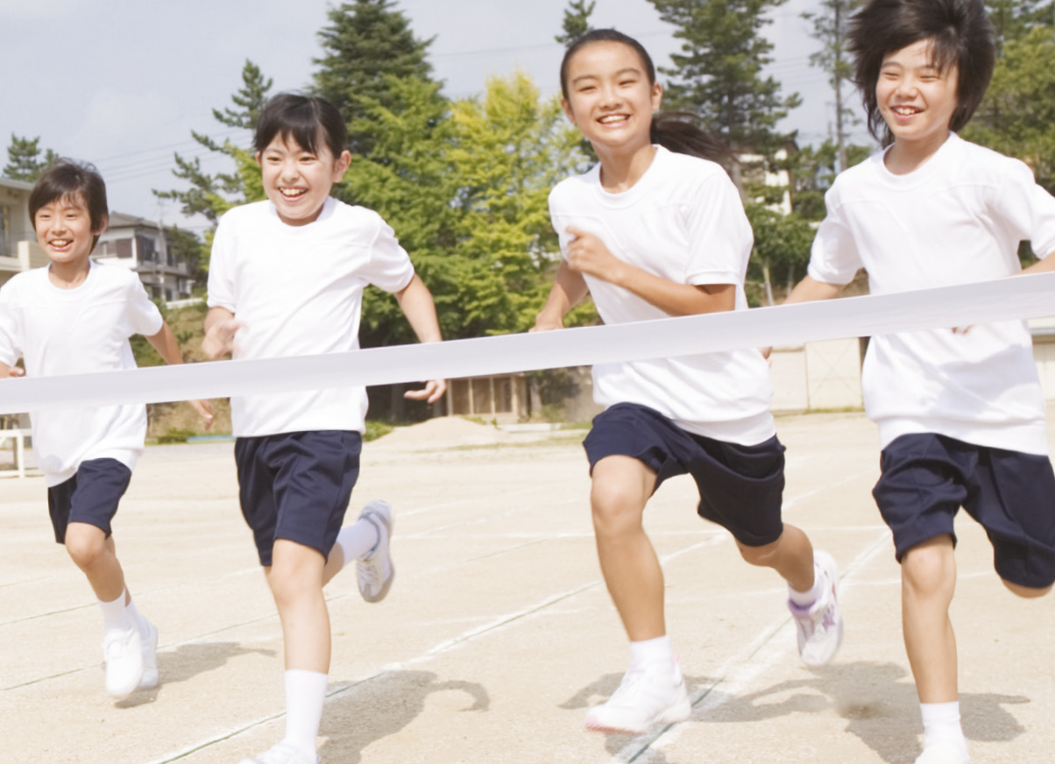
We are going to write a picture story about Ben’s birthday.
Let’s start!

Slide 3
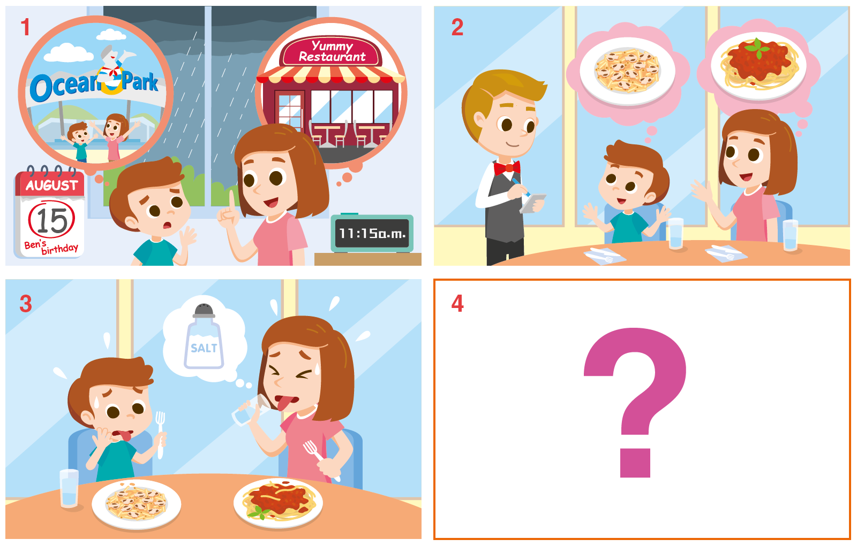
Look at the following pictures.
Can you write a story about them?

Slide 4
A story has three parts.

Slide 5
We can use 5W1H questions in a story map
to help us brainstorm ideas for the story.
What?
Who?
Why?
When?
How?

Slide 6
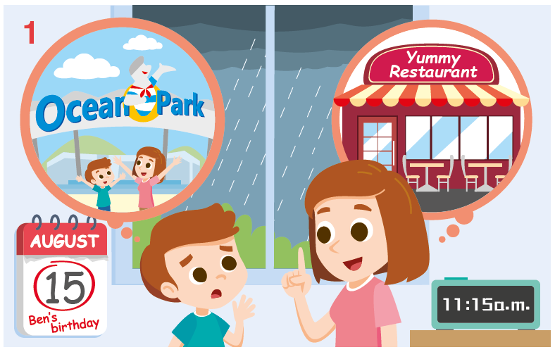
Let’s start with the beginning of the story.
What can we ask about this picture?

Slide 7
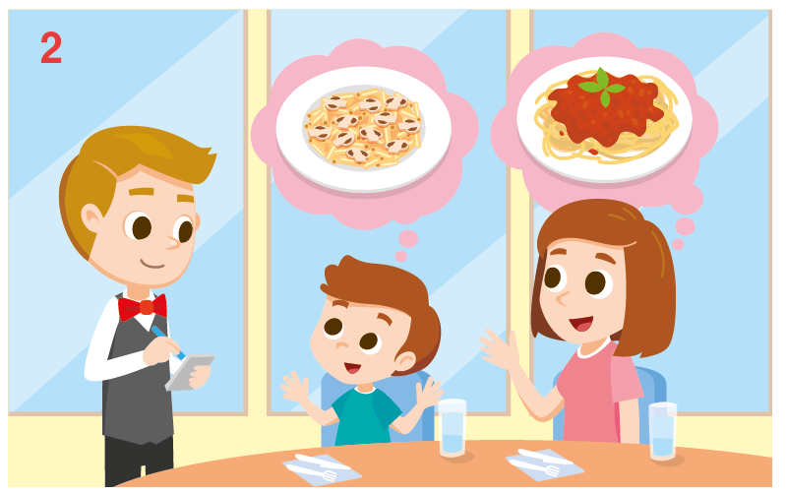
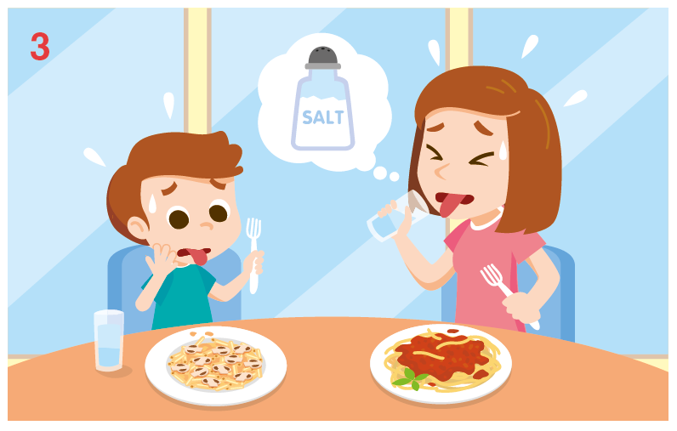
Pictures 2 and 3 form the middle of the story.
What can we ask about these pictures?
The middle of a story usually answers these questions:
What happened?
What did the characters do / say?
How did the characters feel?
Why?

Slide 8
You can create your own ending for the story.
Here are some ideas to guide you.
What happened in the end?
How did the characters feel?

Slide 9
Here are some more writing tips.

Slide 10
Let’s do some practice together.

Slide 11
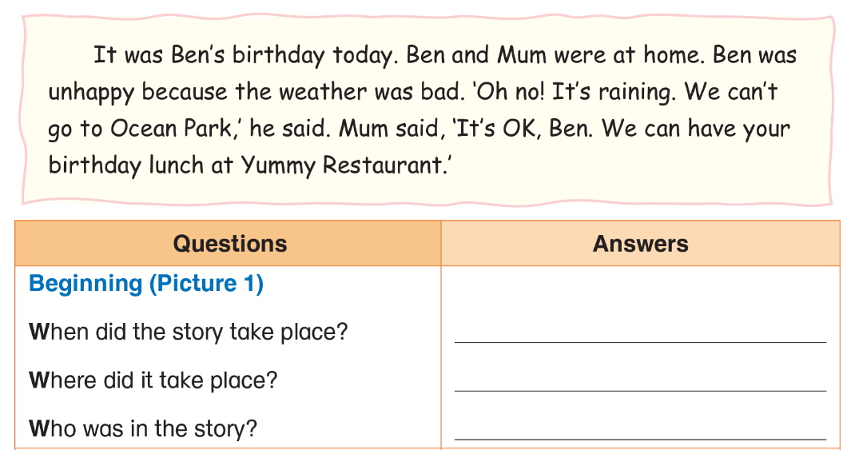
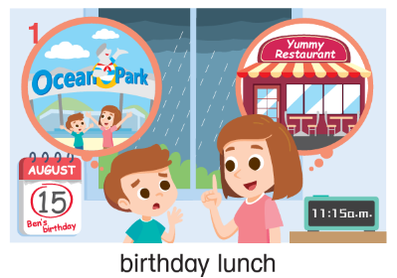
Read the beginning of the story.
Write the answers for Picture 1 in the table.
Ben’s birthday
Ben’s home
Ben and his mum

Slide 12
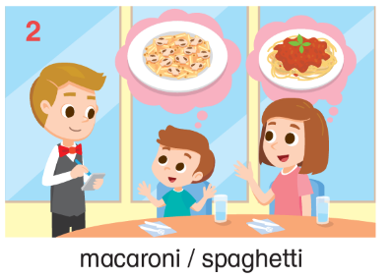
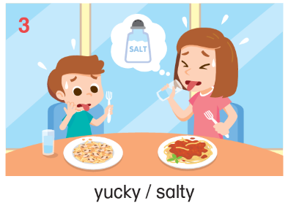
Now let’s brainstorm ideas for Pictures 2 to 3.
at Yummy Restaurant
macaroni and spaghetti
What would you like? / I’d like some macaroni. / I’d like some spaghetti.
It was too salty!

Slide 13
It is your turn to write the rest of the story.

Slide 14
Start by describing what is happening in picture 2.
Where were they?
What did they want to order?
Remember to use more dialogues.
What did the waiter and they say?

Slide 15
Start by describing what is happening in picture 3.
How was the food?
Remember to use more dialogues.

Slide 16
You may draw a picture for picture 4 first.
How is the story going to end?

Slide 17
We can use 5W1H questions to help us finish the story.
What?
Who?
Why?
When?
How?

Slide 18
These may be useful for your writing.
What happened in the end?
How did they celebrate Ben’s birthday?
Since picture 3 ends with a problem, we may need a solution in picture 4.
Where did Ben and Mum go?
How did Ben feel?
What did they say?

Slide 19
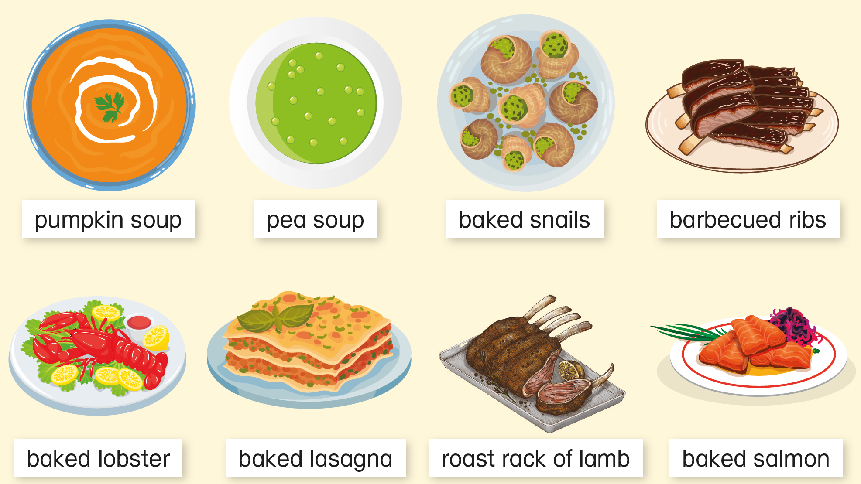
These may be useful for your writing.
There are some vocabularies of food on p.83:

Slide 20
These may be useful for your writing.
There are some vocabularies of food on p.84:

Slide 21
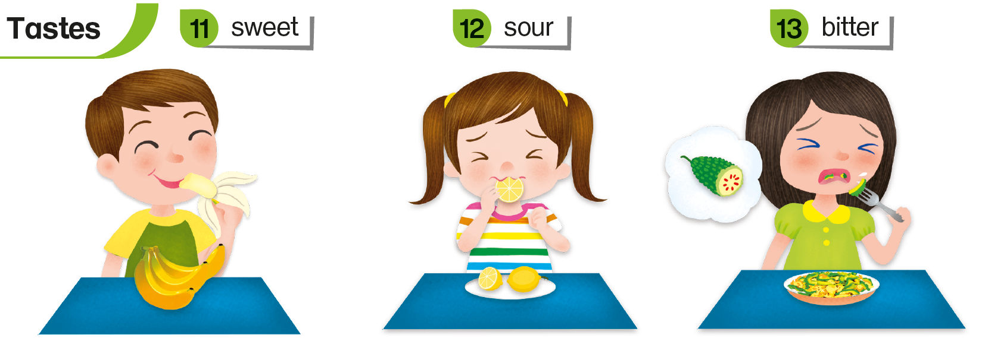
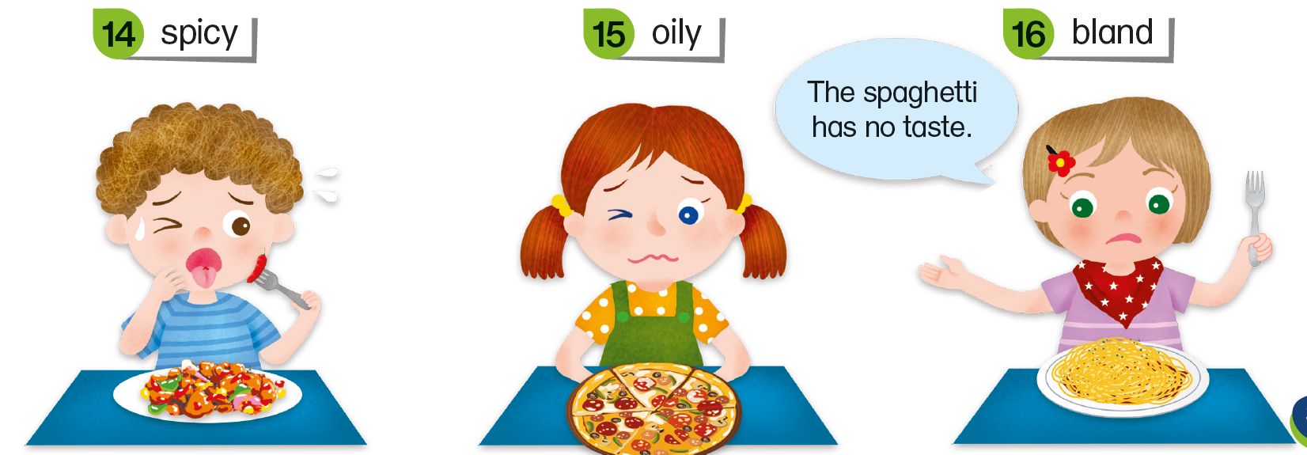
These may be useful for your writing.
There are some words to talk about tastes on pp.35-36:

Slide 22
Check your writing using the checklist below.
Tick ( ✓ ) or cross ( ✗ ).
Did you use the simple past tense for the story? e.g. It was Ben’s birthday today. Ben was unhappy.
Did you add dialogue to make your story interesting? e.g. ‘Oh no! It’s raining. We can’t go to the park!’, Ben said.
Did you use the correct punctuation for dialogues? e.g. ‘Oh no! It’s raining. We can’t go to the park!’, Ben said.

Slide 23
Check your writing using the checklist below.
Tick ( ✓ ) or cross ( ✗ ).
Did you use linking words to link your ideas? e.g. It didn’t taste good because it is too salty.
Did you spell all the words correctly? e.g. February ✓ Febuary ✗

Slide 24
Choose the best story in your group and act it out.
It was Ben’s birthday today. Ben and Mum …

Slide 26
Acknowledgements
We are grateful to the following for permission to reproduce copyright photographs: [TBC]
Bao zhonghui. Shutterstock
Every effort has been made to trace copyright, but in the event of any accidental infringement, we shall be pleased to come to a suitable arrangement with the rightful owner.

