Slide 1
Chapter 4
Part 1
What / Which would you like?
I’d like …
Part 2
better than / the best
worse than / the worst

Slide 2
Part 1
In this part, you will learn:
to ask and answer questions about what people would like to eat and drink
to use Which to find out people’s preferences

Slide 3
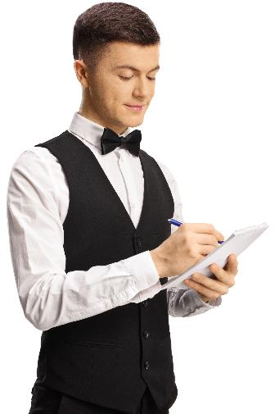
What would you like?
Jane is at a restaurant. How does she order her food?
What would you like?
Would like is the polite way of saying want.
I’d like Set A, please.
It’s not polite to say I want … here.

Slide 4
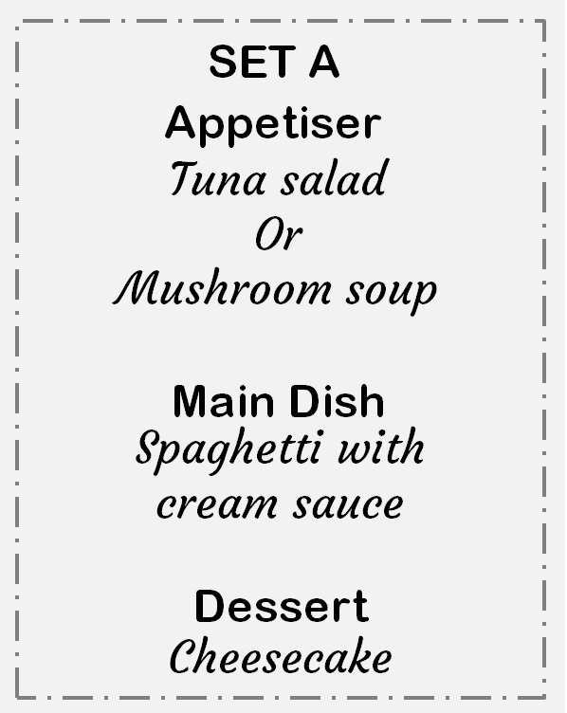
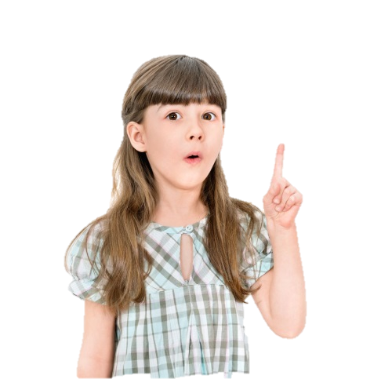
What would you like?
Jane is at a restaurant. How does she order her food?
What would you like?
Would like is the polite way of saying want.
There are two choices for the appetiser!
I’d like Set A, please.
It’s not polite to say I want … here.

Slide 5
What would you like?
Or Which one would you like …
Which would you like, salad or soup?
We use Which when there are limited choices.

Slide 6
What would you like?
Which would you like, salad or soup?
We use or to link the two choices.
I’d like salad, please.

Slide 7
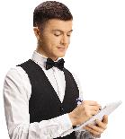
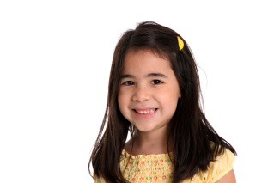
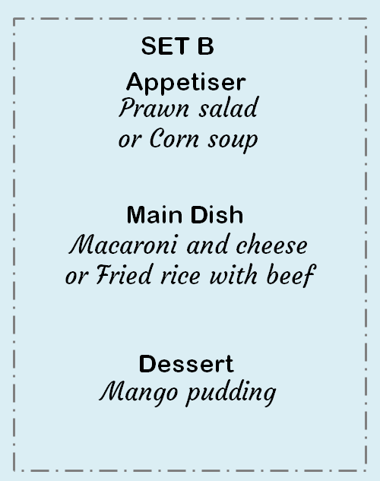
Review
W=
S=
Waiter
Sally
W:
S:
W:
S:
W:
S:
What would you like?
I’d like Set B, please.
Which would you like, salad or soup?
I’d like soup, please.
Which would you like, macaroni or fried rice?
I’d like fried rice, please.

Slide 8
Quick Check
1. There is one mistake in each sentence. Circle the mistakes and correct them.
What
Waiter : Which would you like?
Ben : I like beef curry with rice, please.
I’d

Slide 9
Quick Check
2. Fill in the blanks.
What would you
A: _____________ like?
B: _______ tuna salad and coffee, please.
I’d like

Slide 10
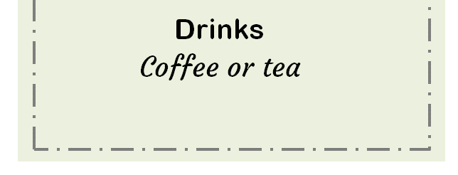
Quick Check
3. Fill in the blanks.
A: Would you like something to drink?
B: Yes, please.
A: ______________ like, coffee _____ tea?
B: _______________
Which would you
or
I’d like tea, please.

Slide 11
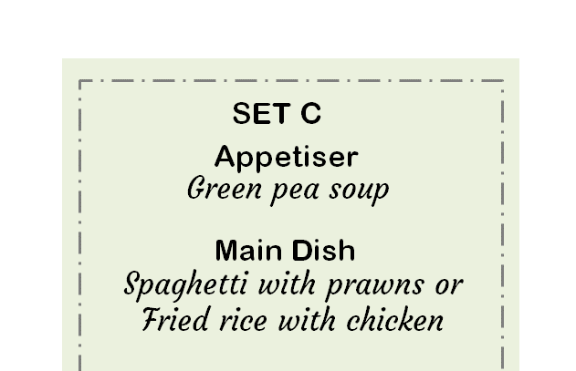
Quick Check
4. Fill in the blanks.
A: __________________
B: _______ Set C, please.
A: _________________, spaghetti _____ fried rice?
B: ____________________
What would you like?
I’d like
Which would you like
or
I’d like spaghetti, please.

Slide 12
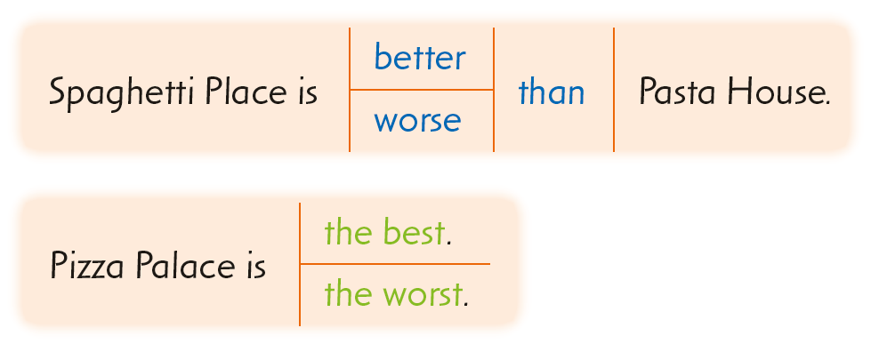
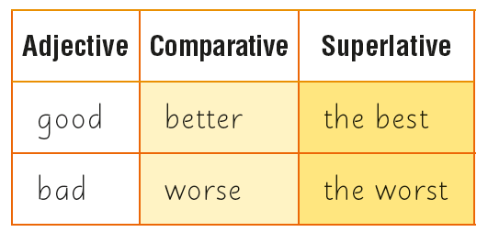
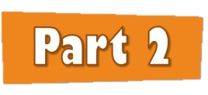
Part 2
In this part, you will learn to use the comparative and superlative forms of good and bad to make comparisons.

Slide 13
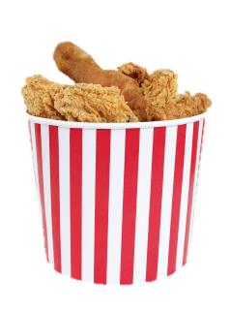
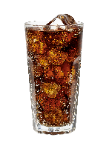
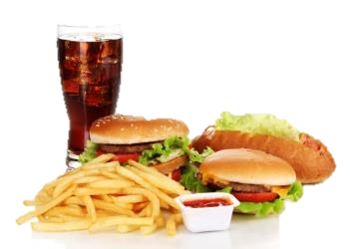
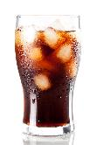
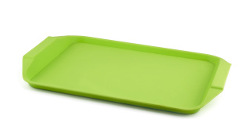
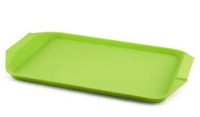
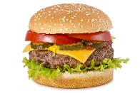
comparatives / superlatives
Do you remember how to use comparative and superlative adjectives to compare things?
Set A: $68
Set B: $55
Set C: $34
Set B is cheaper than Set A.
Set C is the cheapest.
We add er / est to cheap.

Slide 14
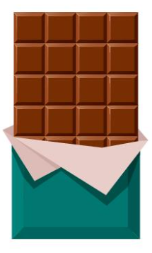
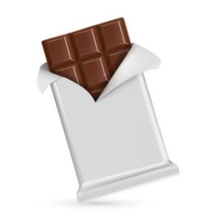
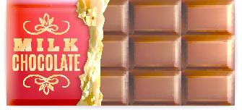
comparatives / superlatives
Let’s look at another example.
Happy Chocolate
Jolly Chocolate
Merry Chocolate
Happy Chocolate is delicious.
Jolly Chocolate is more delicious than Happy Chocolate.
We don’t change the word delicious.
Merry Chocolate is the most delicious.
We use more … than / the most + long adjectives.

Slide 15
good
Now let's use good to compare these restaurants.
#1
#2
#3
Dining Palace
Pizza World
Wayne’s Kitchen
Do we just add er and est to good ?
No!
Do we use more … than and the most with good ?
No!

Slide 16
good
Now let’s use good to compare these restaurants.
#1
#2
#3
Dining Palace
Pizza World
Wayne’s Kitchen
better = comparative form of good
Pizza World is better than Wayne’s Kitchen.
Dining Palace is the best.
best = superlative form of good

Slide 17
bad
What about the adjective bad?
Jade Corner
King’s Palace
Sky Court
worse = comparative form of bad
King’s Palace is worse than Jade Corner.
Sky Court is the worst.
worst = superlative form of bad

Slide 18
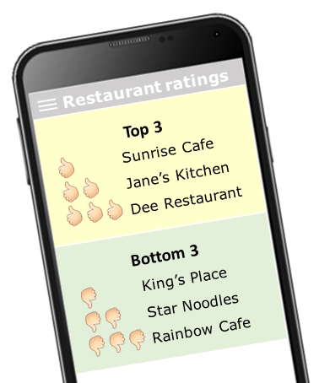
good / bad
Jane’s Kitchen is better than Sunrise Cafe.
Dee Restaurant is the best.
Star Noodles is worse than King’s Place.
Rainbow Cafe is the worst.

Slide 19
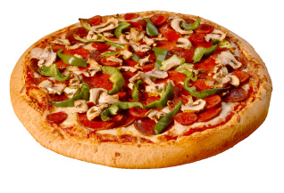
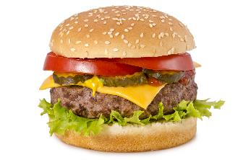
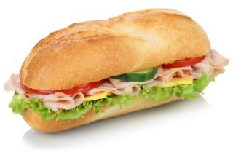
Quick Check
1. Fill in the blanks.
(good)
better than
The sandwich is ________________ the pizza.
The hamburger is _______________ .
(good)
the best

Slide 20
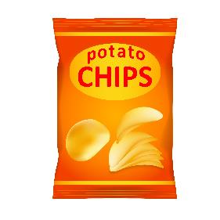
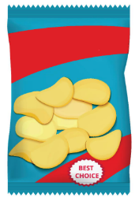
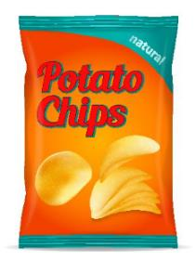
Quick Check
2. Fill in the blanks.
Momo
Chips
Lala Chips
Koko Chips
(bad)
worse than
Lala Chips is ________________ than Momo Chips.
Koko Chips is _______________ .
(bad)
the worst

Slide 21
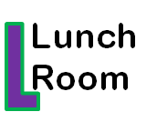
Quick Check
3. Fill in the blanks.
(good)
better than
Food Master is ___________ Lunch Room.
G’s Canteen is __________ .
(good)
the best

Slide 22
Quick Check
4. Fill in the blanks.
Rating
Price
Waterfall Cafe
$$$$$
Cliff House
$$
Rocky Room
$$$$
(bad)
worse than
Waterfall Cafe is __________ Cliff House.
Waterfall Cafe is ________________ .
(expensive)
the most expensive

Slide 23
Acknowledgments
We are grateful to the following for permission to reproduce copyright photographs:
Bloomicon. Shutterstock ukix21. Shutterstock
Gelpi JM. Shutterstock BearFotos. Shutterstock
Ljupco Smokovski. Shutterstock livestock. 123rf.com
Rob Marmion. Shutterstock
Richard Peterson. Shutterstock
Evgeny Karandaev. Shutterstock
M. Unal Ozmen. Shutterstock
Africa Studio. Shutterstock
Coprid. Shutterstock
michelaubryphoto. Shutterstock
vipman. Shutterstock
macrovector. 123rf.com
Mironova Iuliia. Shutterstock
Alhovik. Shutterstock
pilart. 123rf.com
Dancake. Shutterstock
Alaettin YILDIRIM. Shutterstock
Markus Mainka. 123rf.com
ARTvektor. Shutterstock
Dancake. Shutterstock
Every effort has been made to trace copyright, but in the event of any accidental infringement, we shall be pleased to come to a suitable arrangement with the rightful owner.

