Slide 1
Chapter 4
Eating out

Slide 2
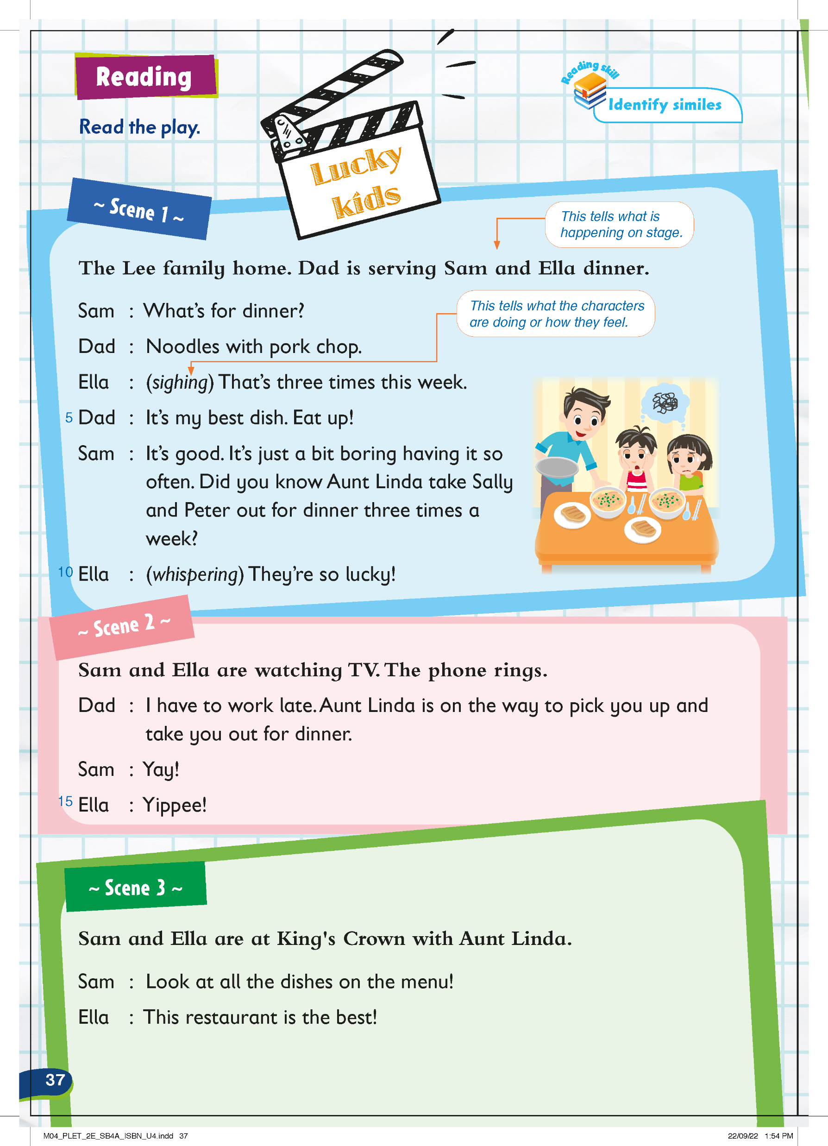
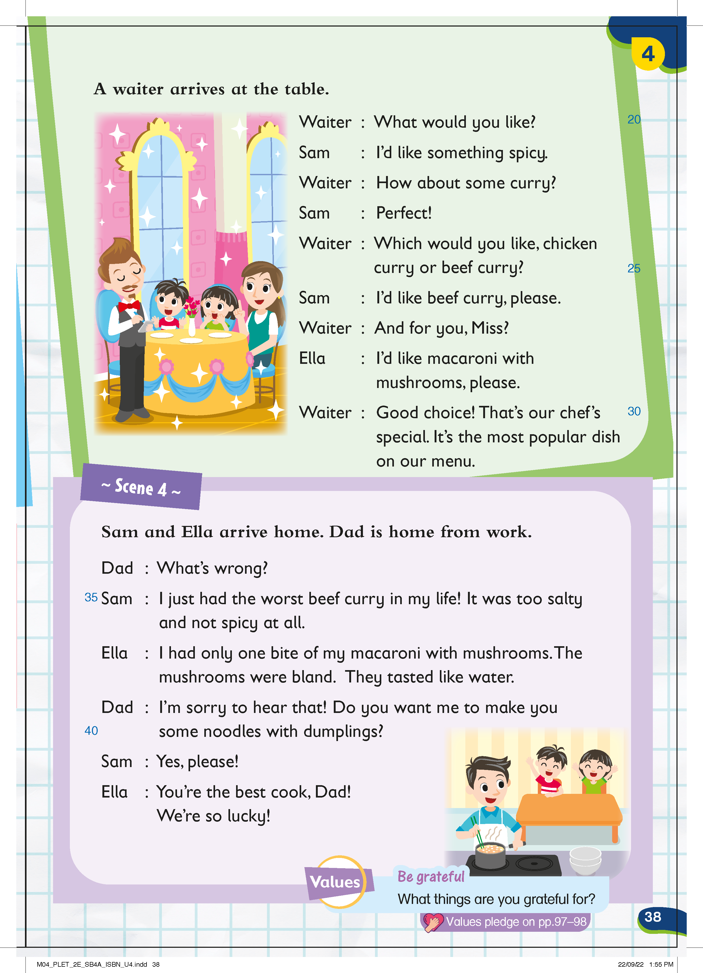
Today we’ll read a play about the Lee family.

Slide 3
Pre-reading
Here is a play about the Lee family. Let’s see what it is talking about!

Slide 4
What is the title of the play?
Pre-reading
Reading

Slide 5
A play has a different format from a story.
Pre-reading
Reading

Slide 6
It is divided into different scenes.
Pre-reading
Reading

Slide 7
In this play, there are four scenes.
Pre-reading
Reading

Slide 8
At the start of each scene, there is usually a description of what is happening on stage
Pre-reading
Reading

Slide 9
In a play, the names of the characters appear on the left,
and what they say appear on the right. This shows us who says what.
Pre-reading
Reading

Slide 10
Sometimes there are words in brackets. These are stage directions. They tell us what the characters are doing or how they feel.
Pre-reading
Reading

Slide 11
Look! This is the Lee family. This is Sam, Ella, and Dad.
Pre-reading
Reading

Slide 12
They are having dinner at home. What are they having?
Pre-reading
Reading

Slide 13
Do they look happy?
Pre-reading
Reading

Slide 14
How do they feel?
Pre-reading
Reading

Slide 15
Hmm, why aren’t they happy?
Can you guess? Do they want to eat at home?
Pre-reading
Reading

Slide 16
Look! Sam and Ella are out for dinner. Do they look happy?
Pre-reading
Reading

Slide 17
Why are they happy? Can you guess?
Do you think they had a good meal at the restaurant?
Pre-reading
Reading

Slide 18
Now Sam and Ella are at home for dinner. Do they look happy?
Pre-reading
Reading

Slide 19
They don’t look sad or bored anymore!
Pre-reading
Reading

Slide 20
What happened to Sam and Ella at the restaurant? Let’s read the play!
Pre-reading
Reading

Slide 21
Reading
Now let’s read the play to find out what happened at the restaurant.

Slide 22
What happened to Sam and Ella at the restaurant? Let’s read the play!
Pre-reading
Reading

Slide 23
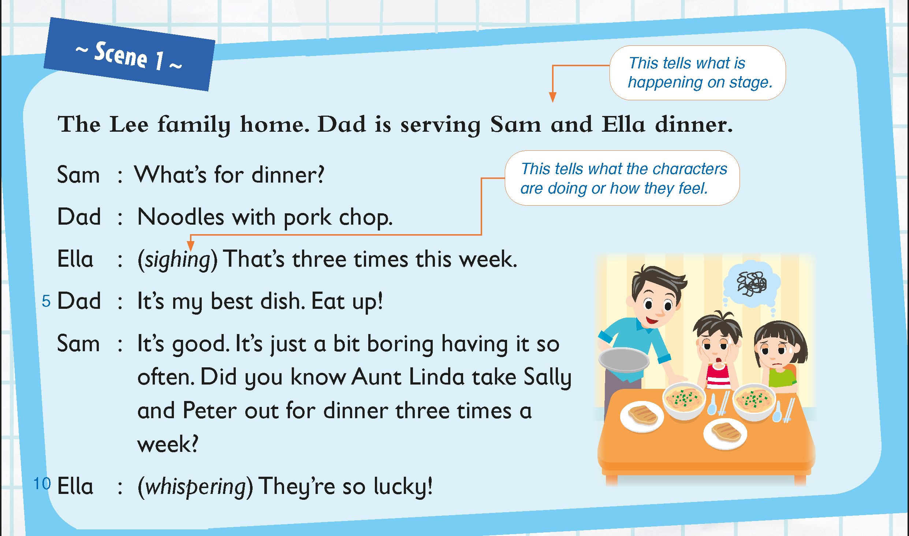
What are the Lee family having for dinner?
Pre-reading
Reading

Slide 24
It’s Dad’s best dish. Does it taste good?
Which sentence tells us this?
Pre-reading
Reading

Slide 25
But why aren’t Ella and Sam happy?
Pre-reading
Reading

Slide 26
How many times did they have the dish?
Pre-reading
Reading

Slide 27
What do they want to do instead?
Pre-reading
Reading

Slide 28
They think their cousins Sally and Peter are lucky, because
Aunt Linda takes them out for dinner three times a week!
Pre-reading
Reading

Slide 29
Sam and Ella say Yay! and Yippee! How do they feel?
Pre-reading
Reading

Slide 30
Why?
Pre-reading
Reading

Slide 31
Sam and Ella are at a restaurant now. They are happy!
Pre-reading
Reading

Slide 32
What is the restaurant called?
Pre-reading
Reading

Slide 33
What dish does Sam want to eat?
Pre-reading
Reading

Slide 34
Yes, he wants to eat something spicy. Beef curry is spicy!
Pre-reading
Reading

Slide 35
What other curry does the restaurant serve?
Pre-reading
Reading

Slide 36
What about Ella? What dish does she want to eat?
Pre-reading
Reading

Slide 37
The waiter says that’s a good choice. Why is that so?
Pre-reading
Reading

Slide 38
Did Sam and Ella had a good meal at the restaurant?
Pre-reading
Reading

Slide 39
Was the beef curry nice?
Pre-reading
Reading

Slide 40
It wasn’t spicy. Sam didn’t enjoy it at all!
Pre-reading
Reading

Slide 41
What does this mean? Very good or very bad?
Pre-reading
Reading

Slide 42
How about the macaroni with mushrooms?
Was it savoury and tasty?
Pre-reading
Reading

Slide 43
Ella says that the mushrooms tasted like water.
Does water have a taste?
Pre-reading
Reading

Slide 44
Water is tasteless. When Ella says that the mushrooms taste like water, she means that it is bland!
Pre-reading
Reading

Slide 45
Dad is sorry to hear that they had a bad meal at the restaurant. What does he want to cook for them?
Pre-reading
Reading

Slide 46
Do Sam and Ella want to eat it?
Pre-reading
Reading

Slide 47
Now, they know that Dad is the best cook! He makes the best food.
Pre-reading
Reading

Slide 48
It’s yummier than food at the restaurant.
How do Sam and Ella feel at the end of the story?
Pre-reading
Reading

Slide 49
Sam and Ella feel lucky to have Dad cook for them every day.
Pre-reading
Reading

