Slide 1
Chapter 2
Come on! Let’s exercise!

Slide 2
Pre-reading
Let’s read an article about science today!

Slide 3
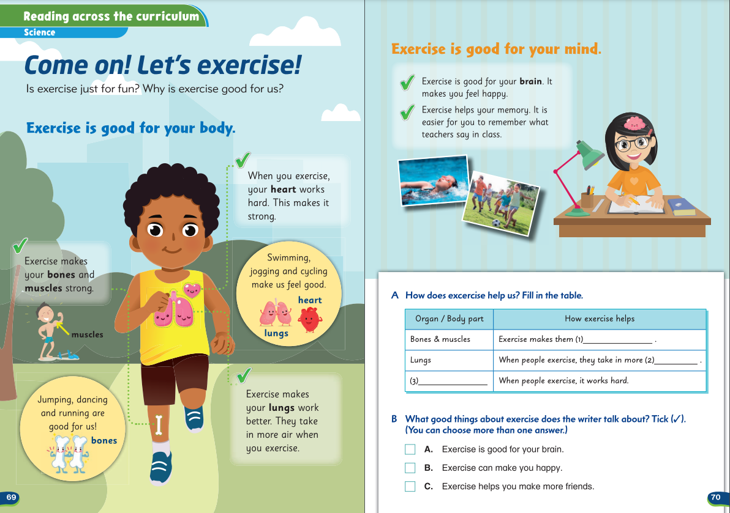
This is the article we’re reading today.
Pre-reading
Let’s read
Questions

Slide 4
What’s the title of the article?
Pre-reading
Let’s read
Questions

Slide 5
What’s the title of the article?
This article talks about exercise!
Pre-reading
Let’s read
Questions

Slide 6
What’s the title of the article?
Do you think it talks about …
different kinds of exercises?
✓
or the good things about doing exercises?
Pre-reading
Let’s read
Questions

Slide 7
How is exercise good for us?
Pre-reading
Let’s read
Questions

Slide 8
How is exercise good for us?
In what ways is exercise good for our body and mind?
Pre-reading
Let’s read
Questions

Slide 9
Let’s start reading to find out!
Pre-reading
Let’s read
Questions

Slide 10
Let’s read!
Let’s read the article in detail.
Pre-reading
Let’s read
Questions

Slide 11
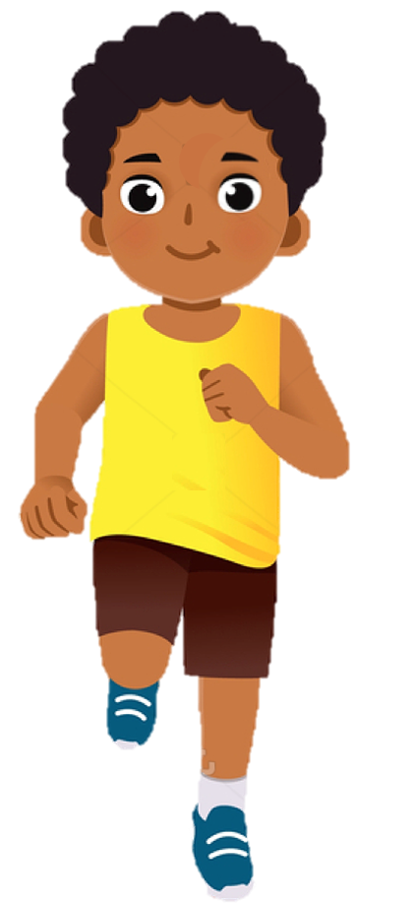
Pre-reading
Let’s read
Questions

Slide 12
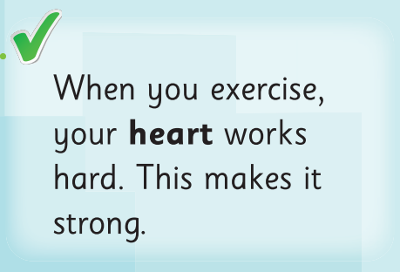
Pre-reading
Let’s read
Questions

Slide 13
How is exercise good for our heart?
Pre-reading
Let’s read
Questions

Slide 14
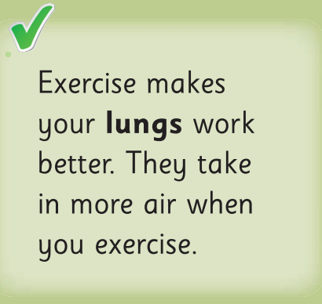
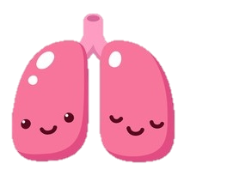
How is exercise good for our lungs?
Pre-reading
Let’s read
Questions

Slide 15
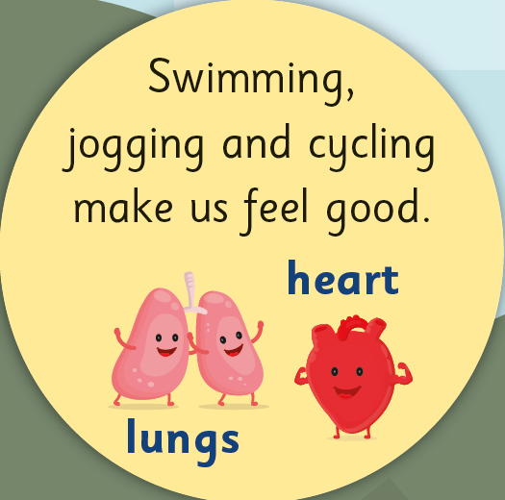
What exercise is good for our lungs and heart?
Pre-reading
Let’s read
Questions

Slide 16
What exercise is good for our lungs and heart?
Pre-reading
Let’s read
Questions

Slide 17
What exercise is good for our lungs and heart?
Pre-reading
Let’s read
Questions

Slide 18
What exercise is good for our lungs and heart?
Pre-reading
Let’s read
Questions

Slide 19
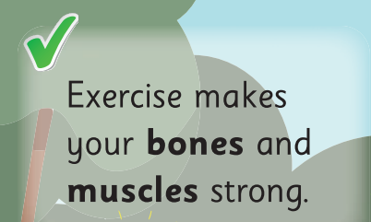
Pre-reading
Let’s read
Questions

Slide 20
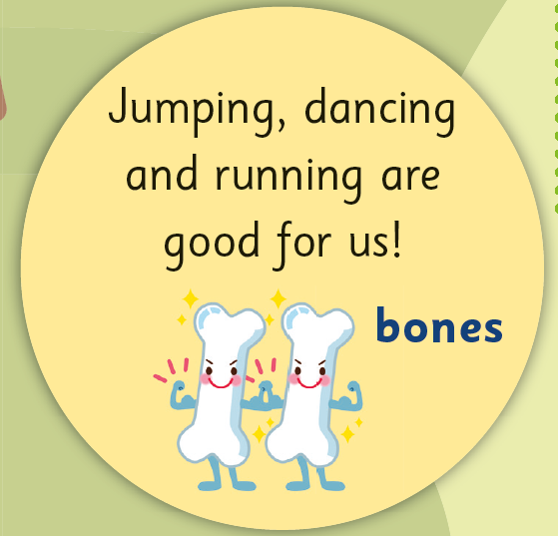
What exercise is good for our bones?
Pre-reading
Let’s read
Questions

Slide 21
What exercise is good for our bones?
Pre-reading
Let’s read
Questions

Slide 22
What exercise is good for our bones?
Pre-reading
Let’s read
Questions

Slide 23
What exercise is good for our bones?
Pre-reading
Let’s read
Questions

Slide 24
Pre-reading
Let’s read
Questions

Slide 25
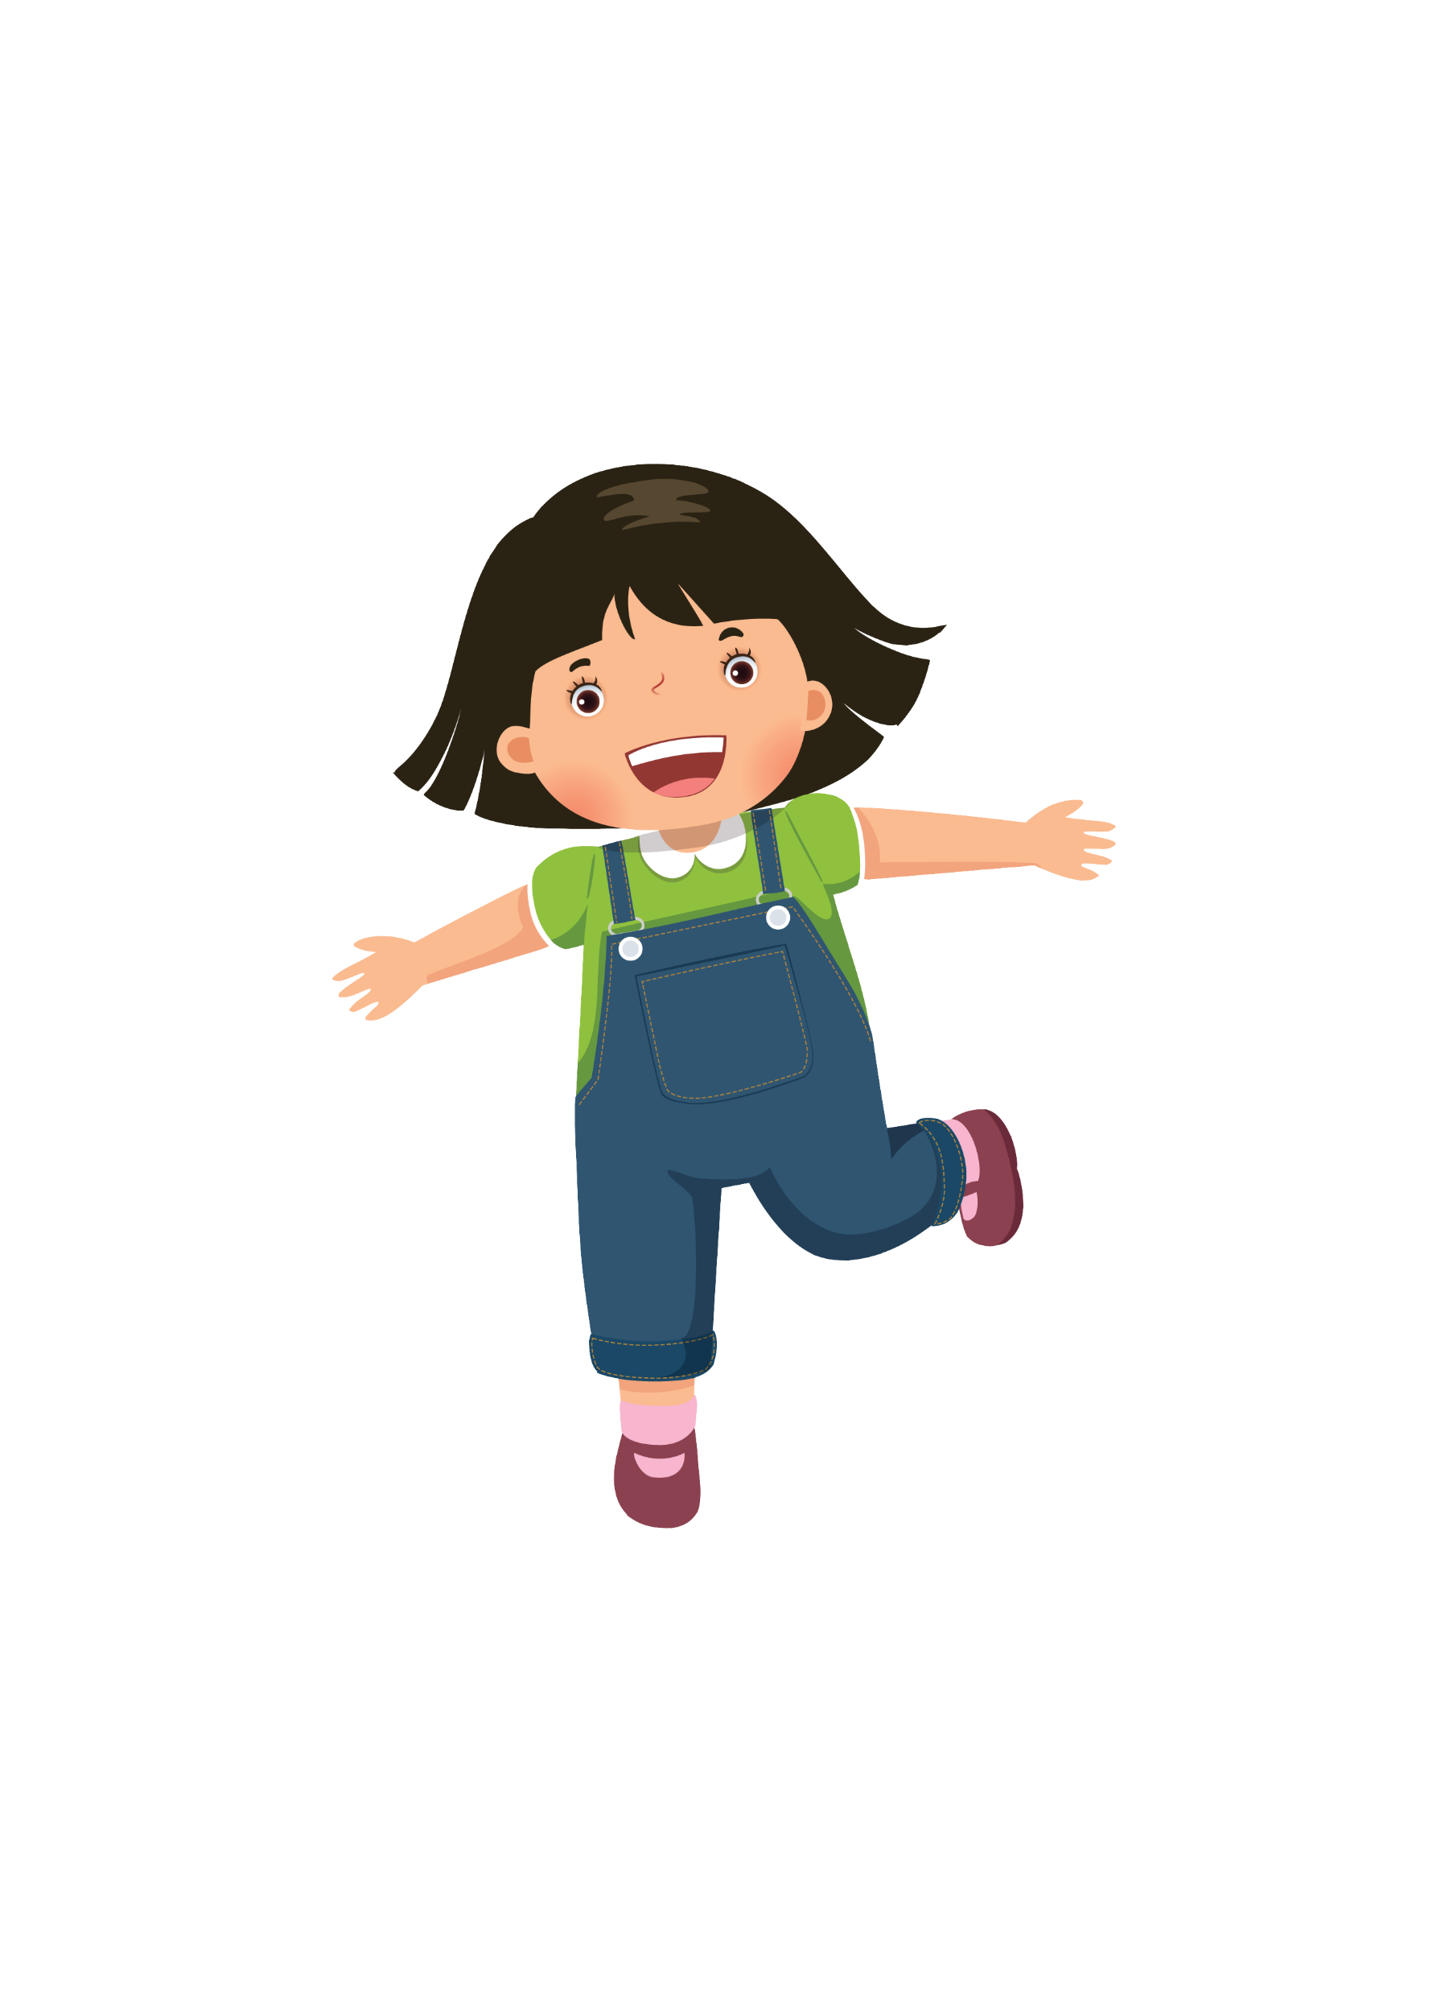
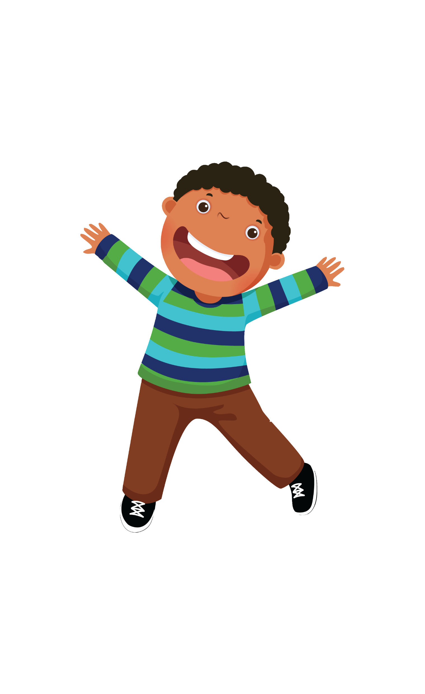

Slide 27
Let’s keep our body and mind healthy with doing more exercises!
Pre-reading
Let’s read
Questions

Slide 28
Questions
Can you answer these questions?
Pre-reading
Let’s read
Questions

Slide 29
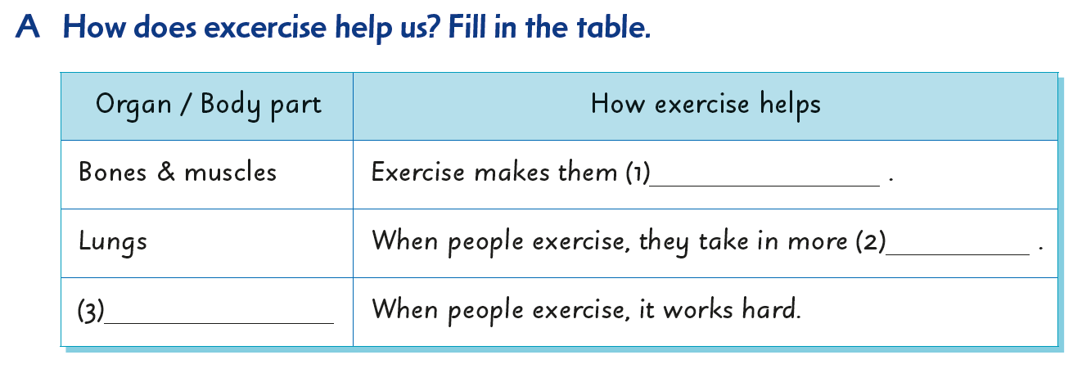
strong
Pre-reading
Let’s read
Questions

Slide 30
strong
air
Pre-reading
Let’s read
Questions

Slide 31
strong
air
Heart
Pre-reading
Let’s read
Questions

Slide 32
✓
Pre-reading
Let’s read
Questions

Slide 33
✓
✓
Pre-reading
Let’s read
Questions

Slide 34
✓
✓
The writer didn’t mention this.
Pre-reading
Let’s read
Questions

Slide 36
Acknowledgments
We are grateful to the following for permission to reproduce copyright photographs:
Colorfuel Studio. Shutterstock
Colorfuel Studio. Shutterstock
Colorfuel Studio. Shutterstock
Colorfuel Studio. Shutterstock
ClassicVector. Shutterstock
KanKhem. Shutterstock
Olga1818. Shutterstock
Every effort has been made to trace copyright, but in the event of any accidental infringement, we shall be pleased to come to a suitable arrangement with the rightful owner.

