Slide 1
Traditional Chinese food

Slide 2
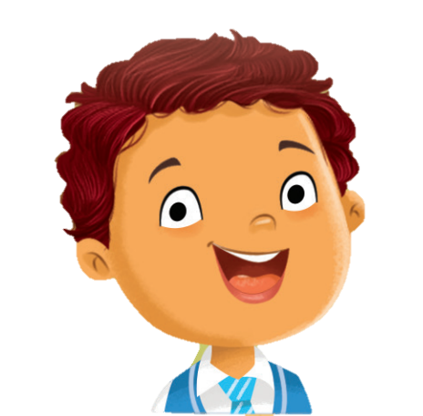
Chinese food is delicious.
How much do you know about Chinese food?
Let’s find out more today!

Slide 3
Step 1: Research
Step 2: Plan and create
Step 3: Present

Slide 4
1: Research
2: Plan and create
3: Present

Slide 5
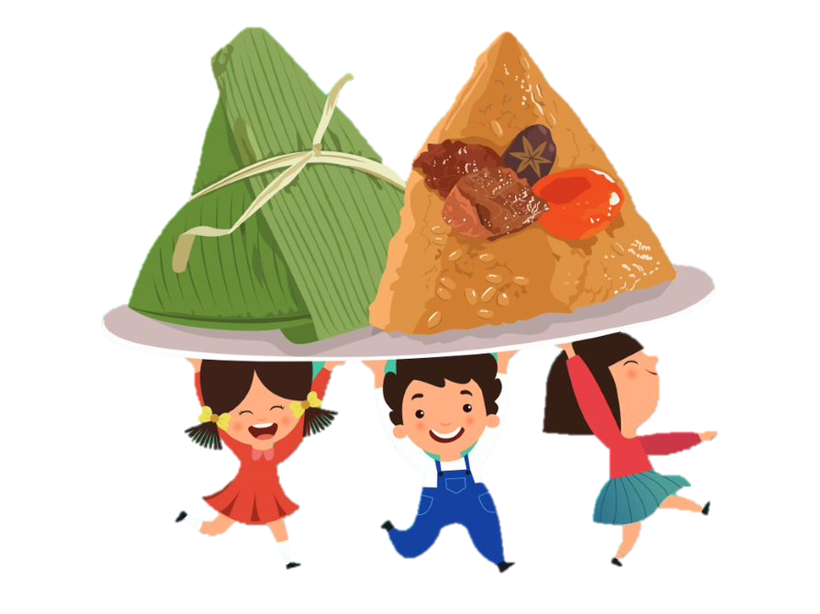
Rice dumplings (zongzi)
1: Research
2: Plan and create
3: Present

Slide 6
What is the food?
Rice dumplings (Zongzi)
Rice dumplings are also called sticky rice dumplings.
1: Research
2: Plan and create
3: Present

Slide 7
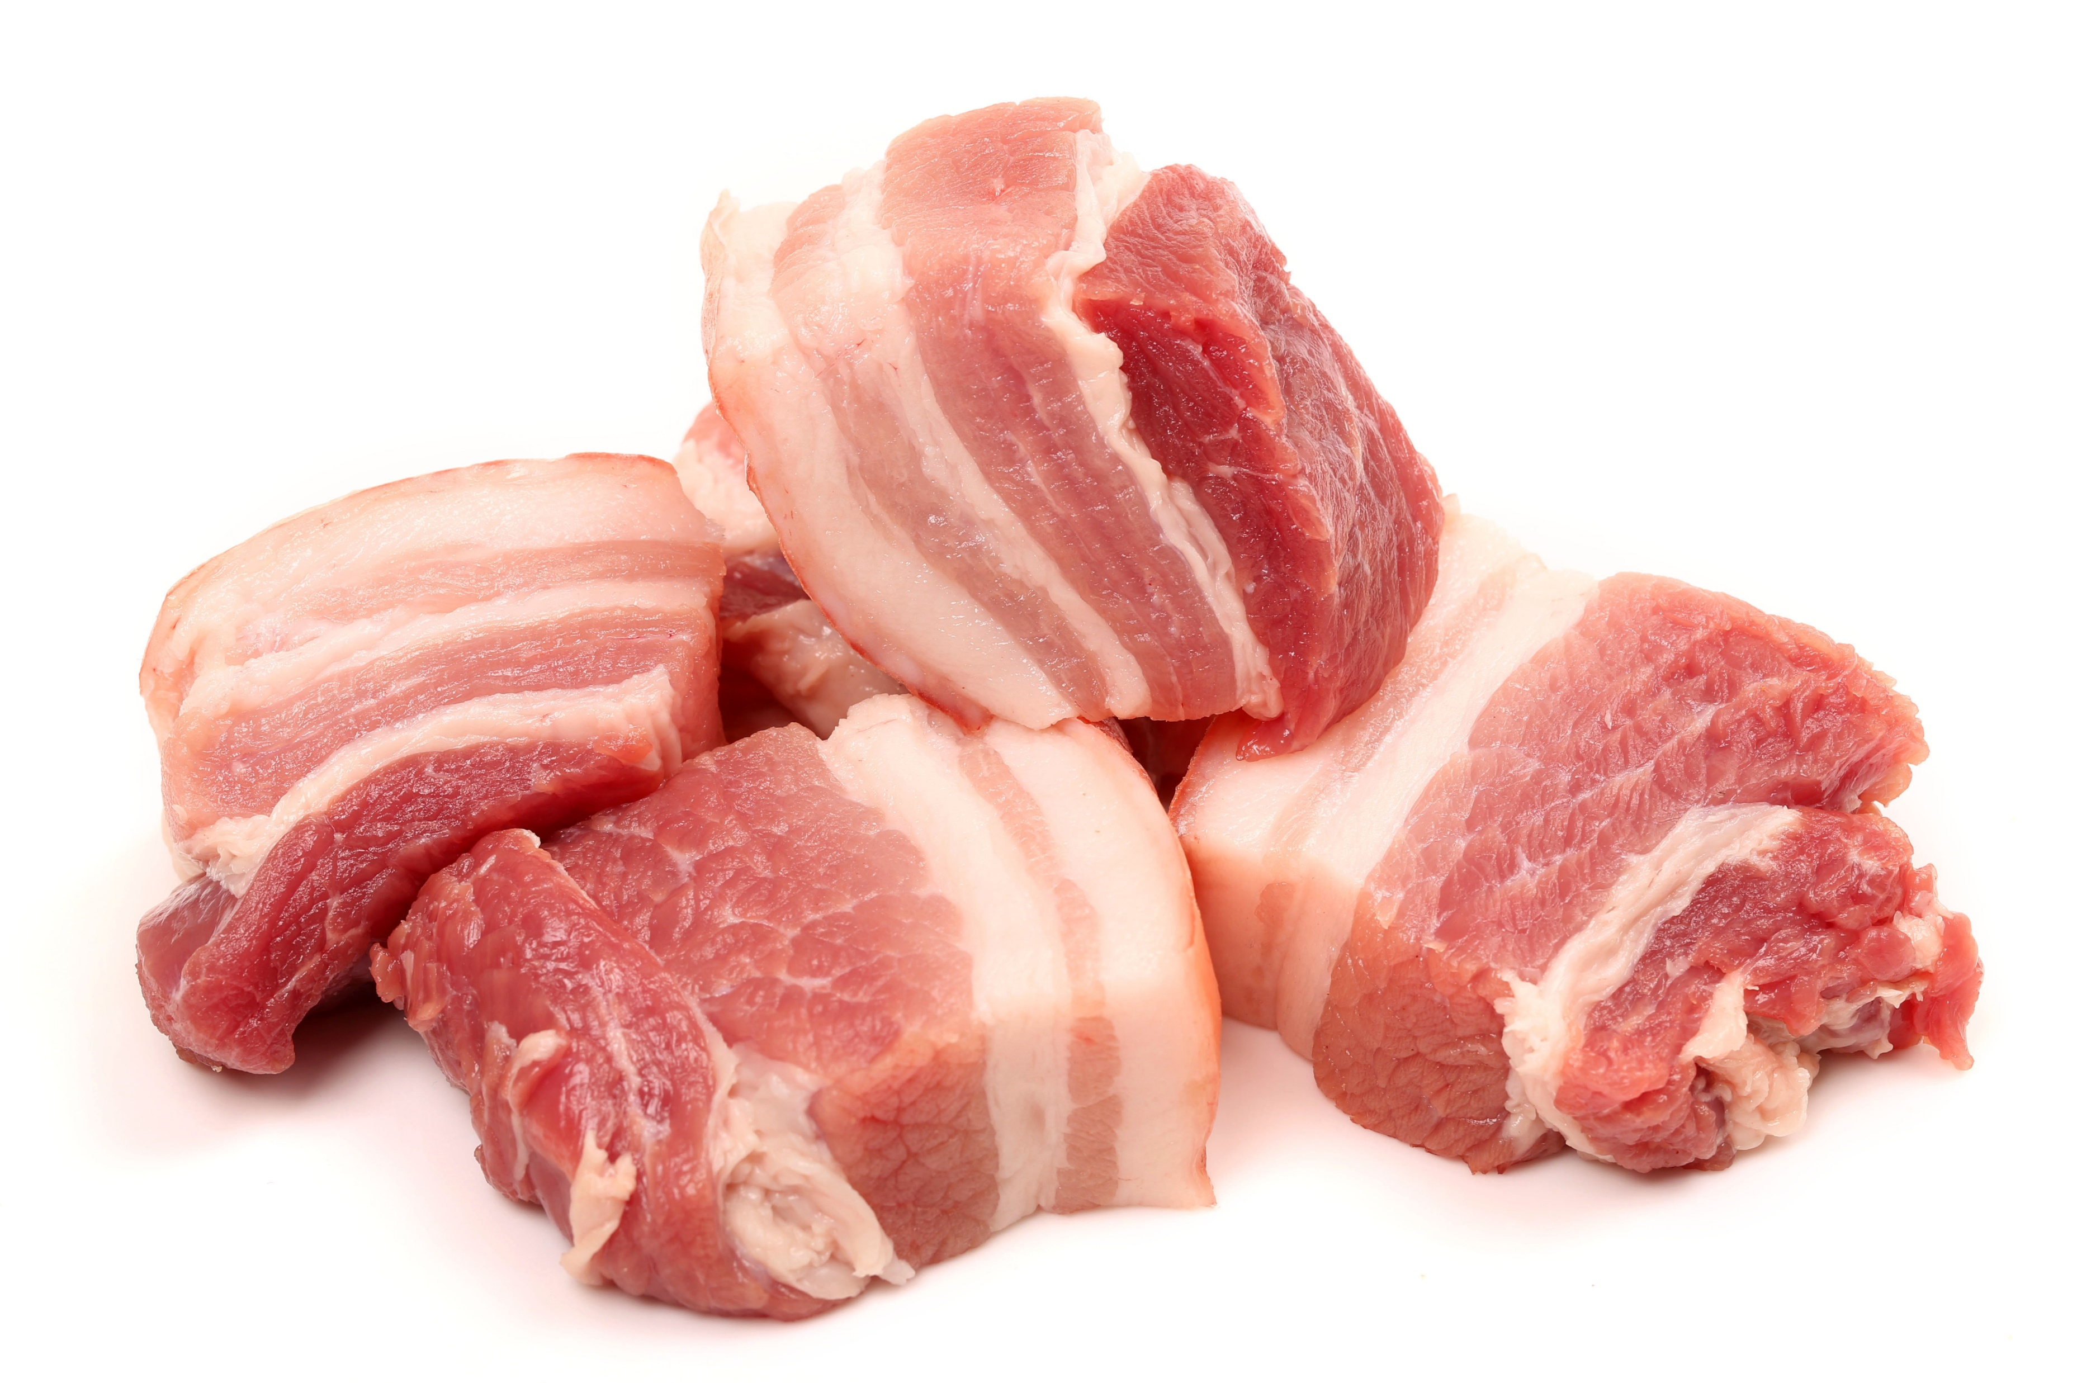
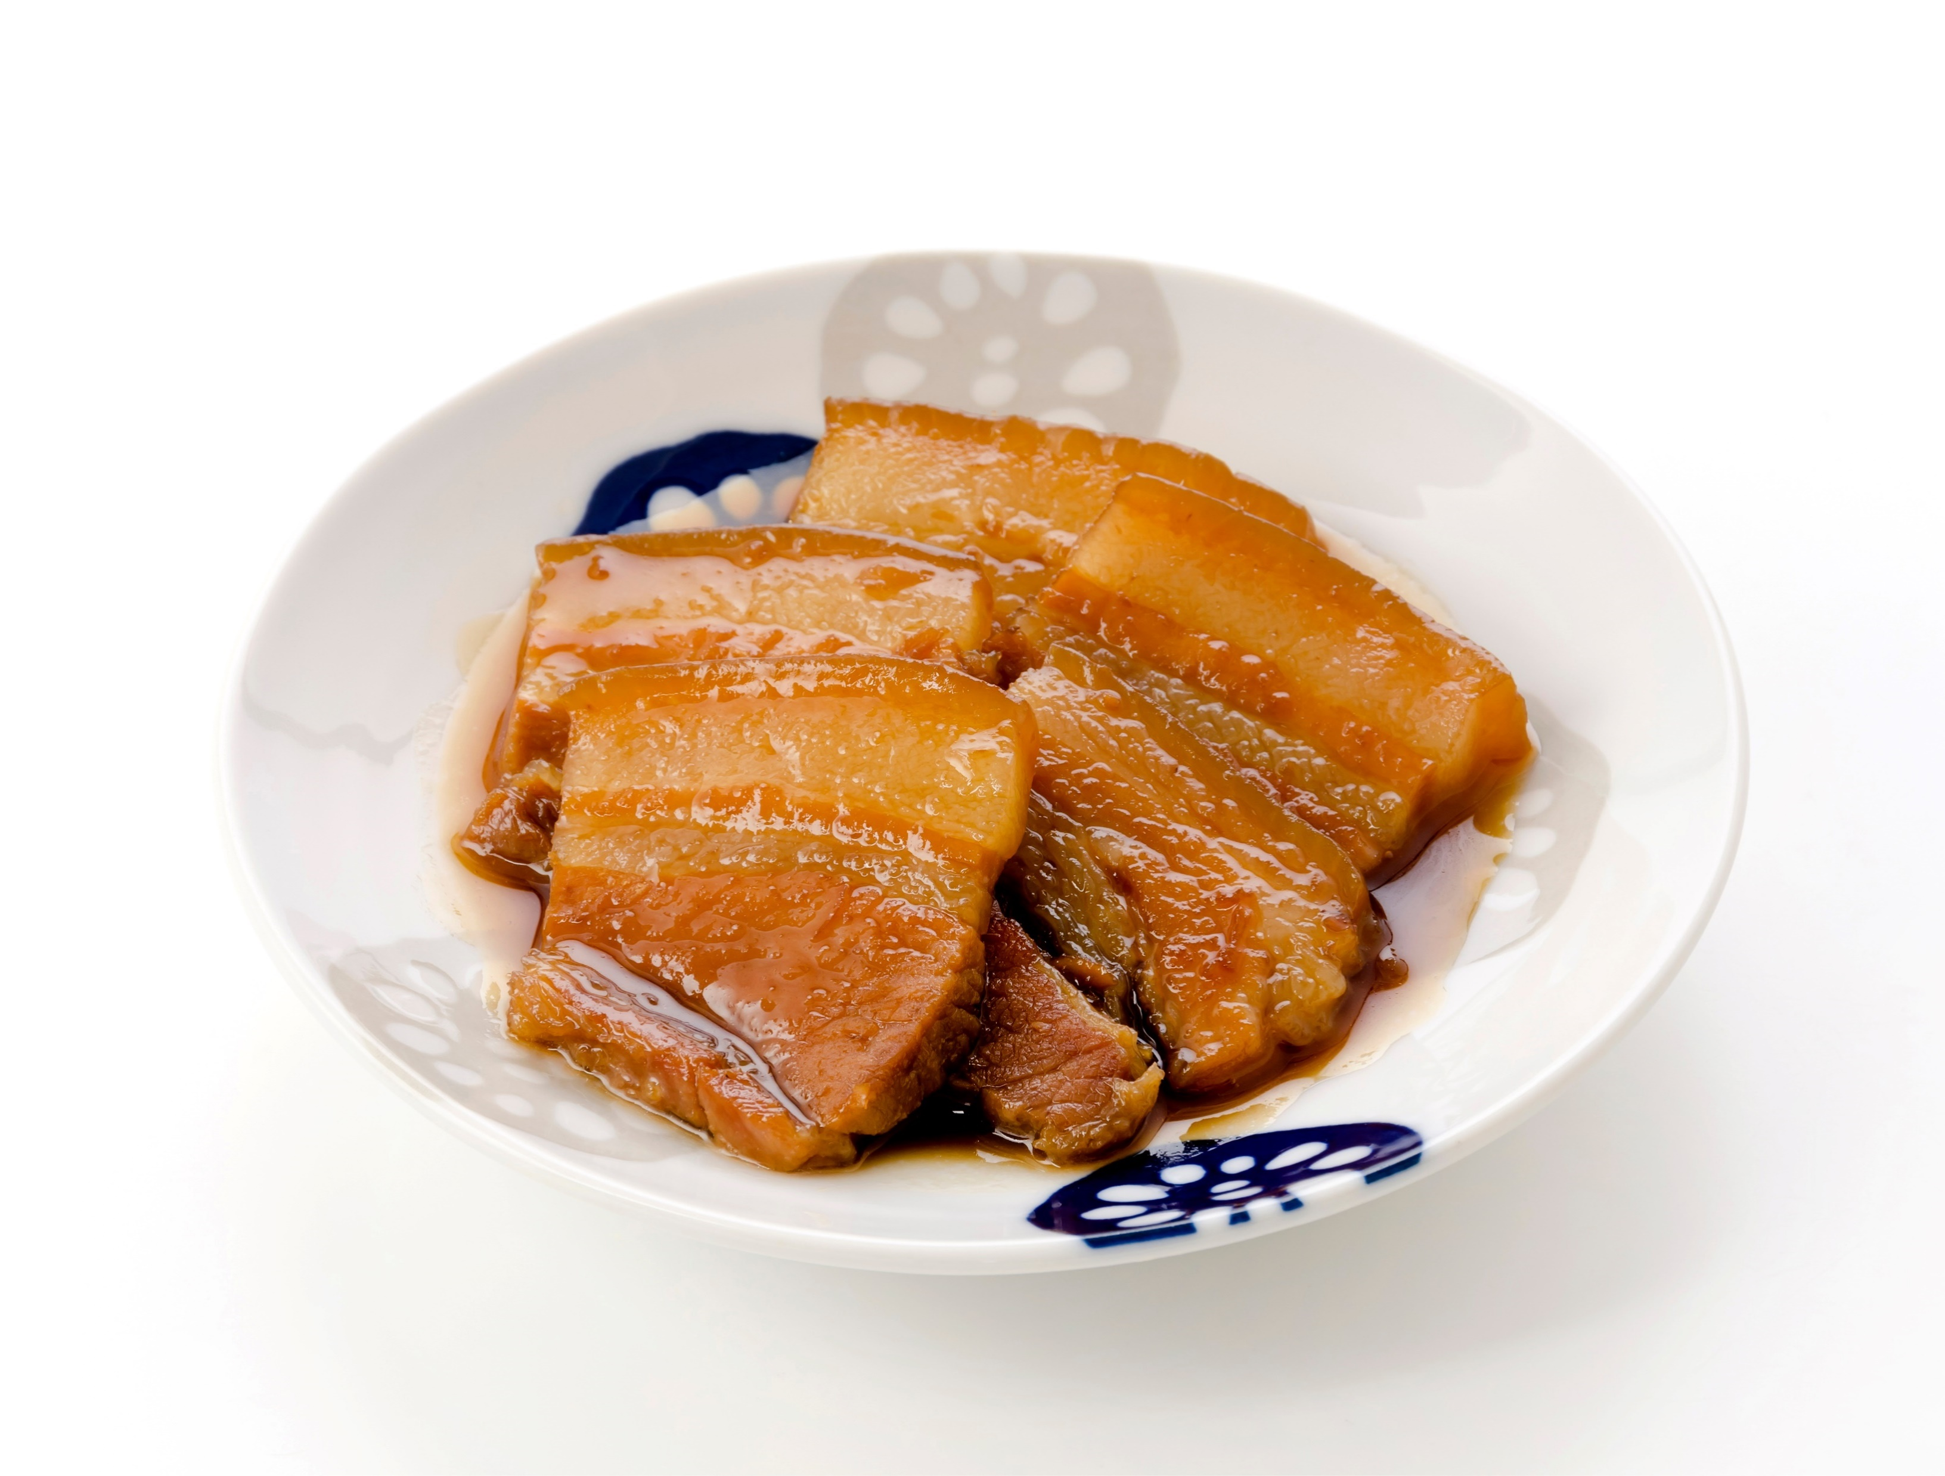
What ingredients do you need?
pork belly
1: Research
2: Plan and create
3: Present

Slide 8
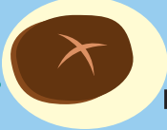
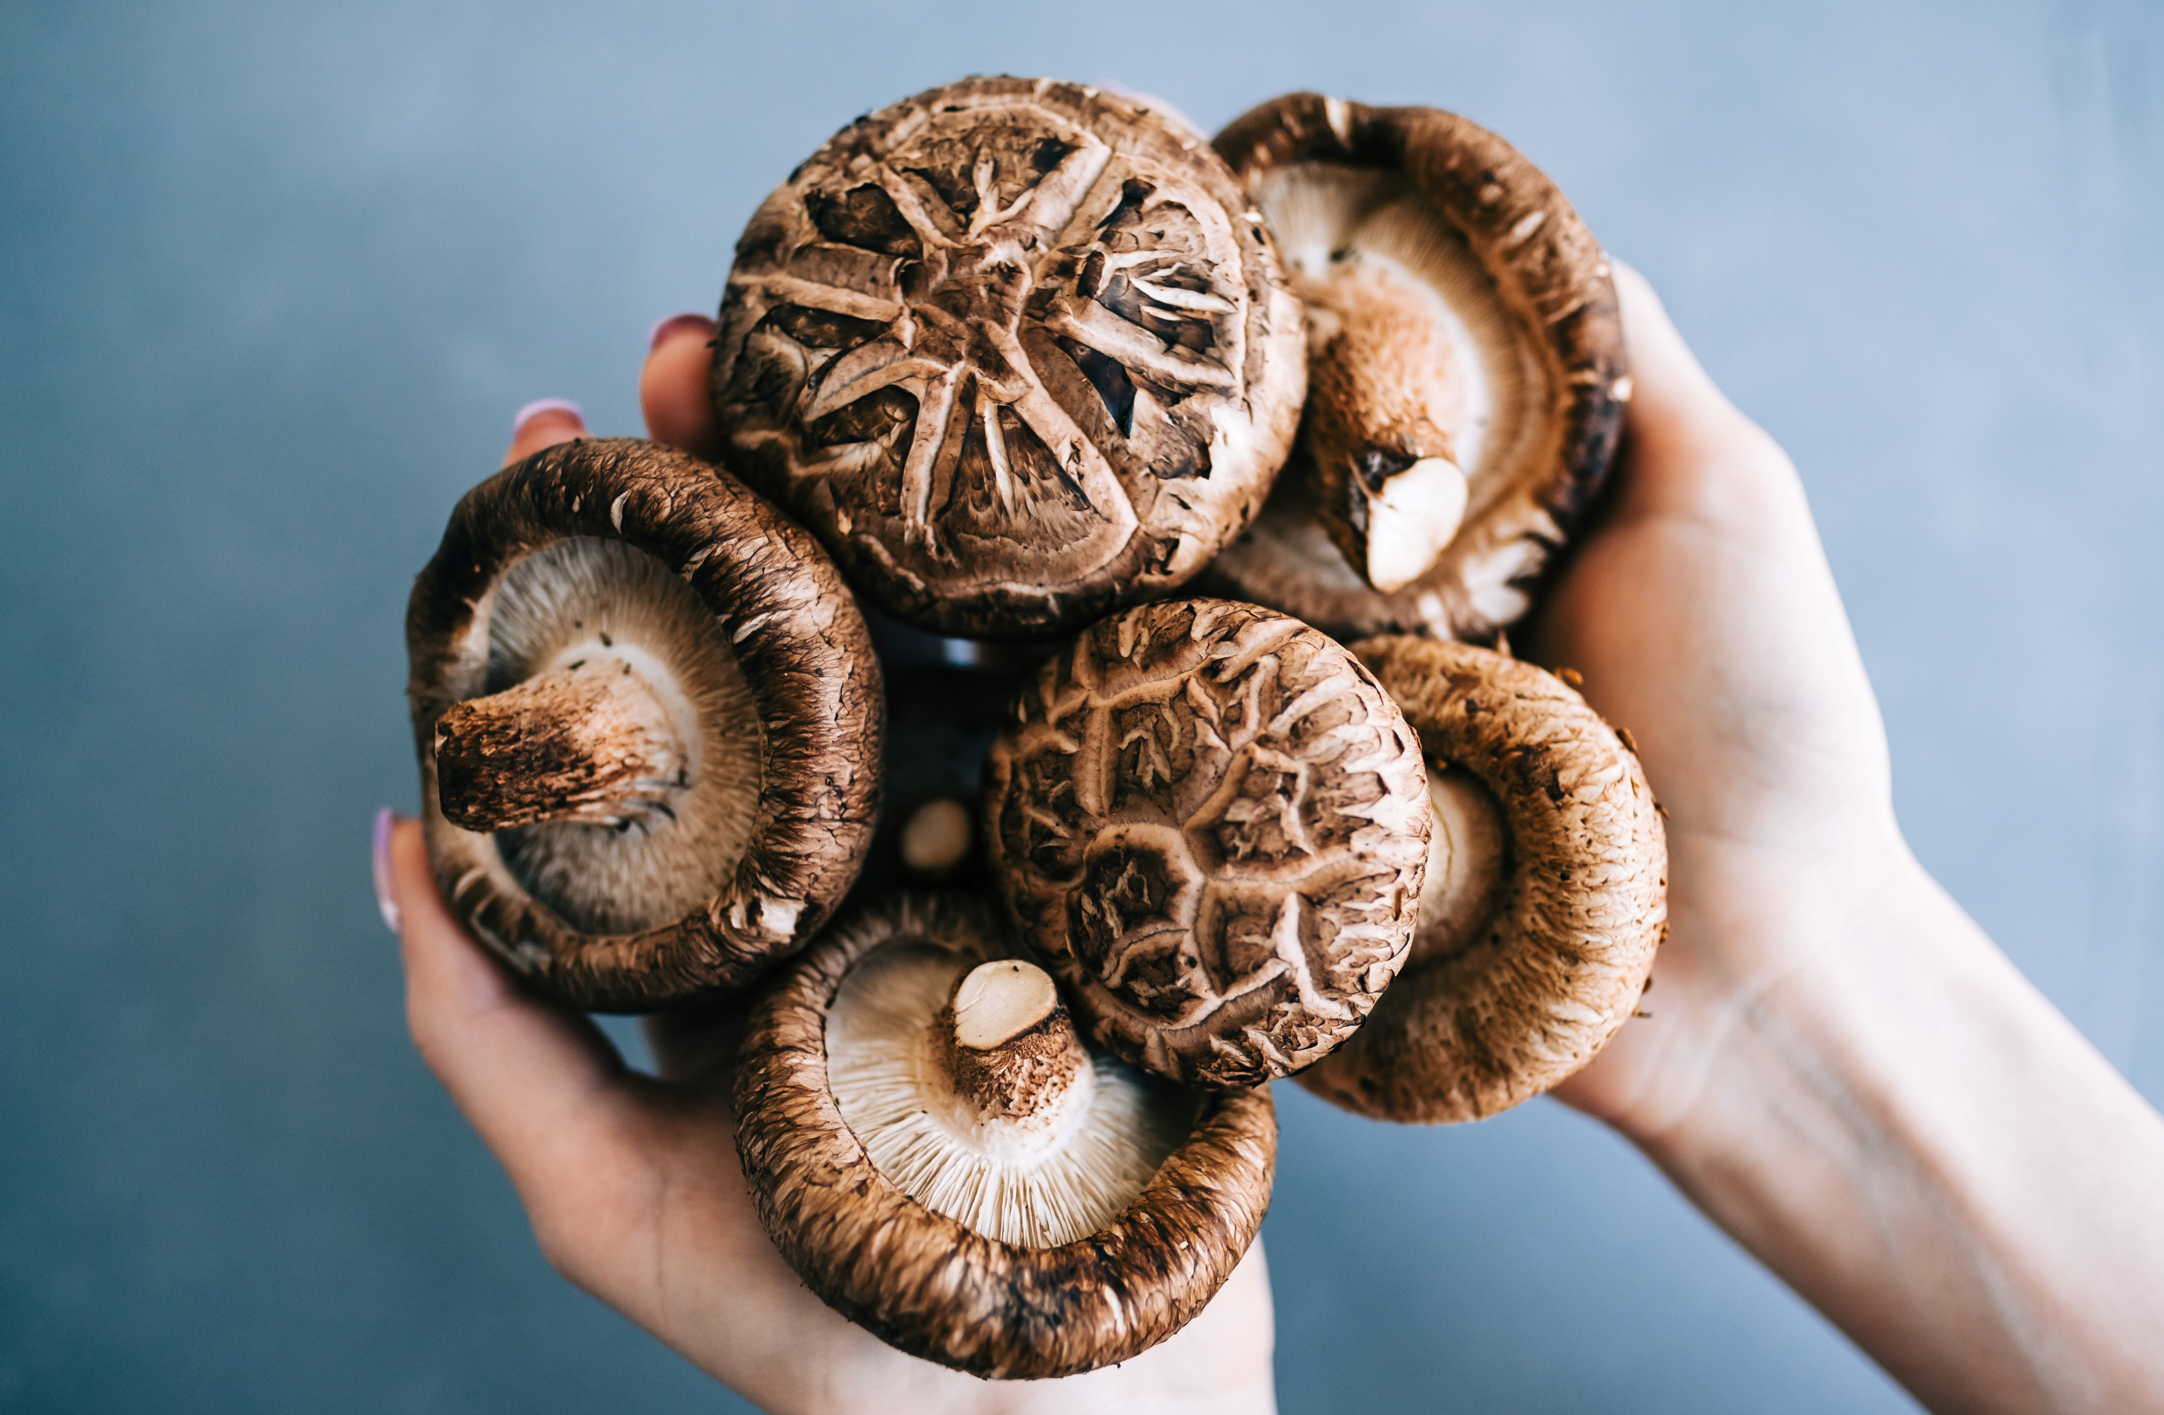
What ingredients do you need?
Chinese mushroom
1: Research
2: Plan and create
3: Present

Slide 9
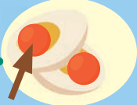
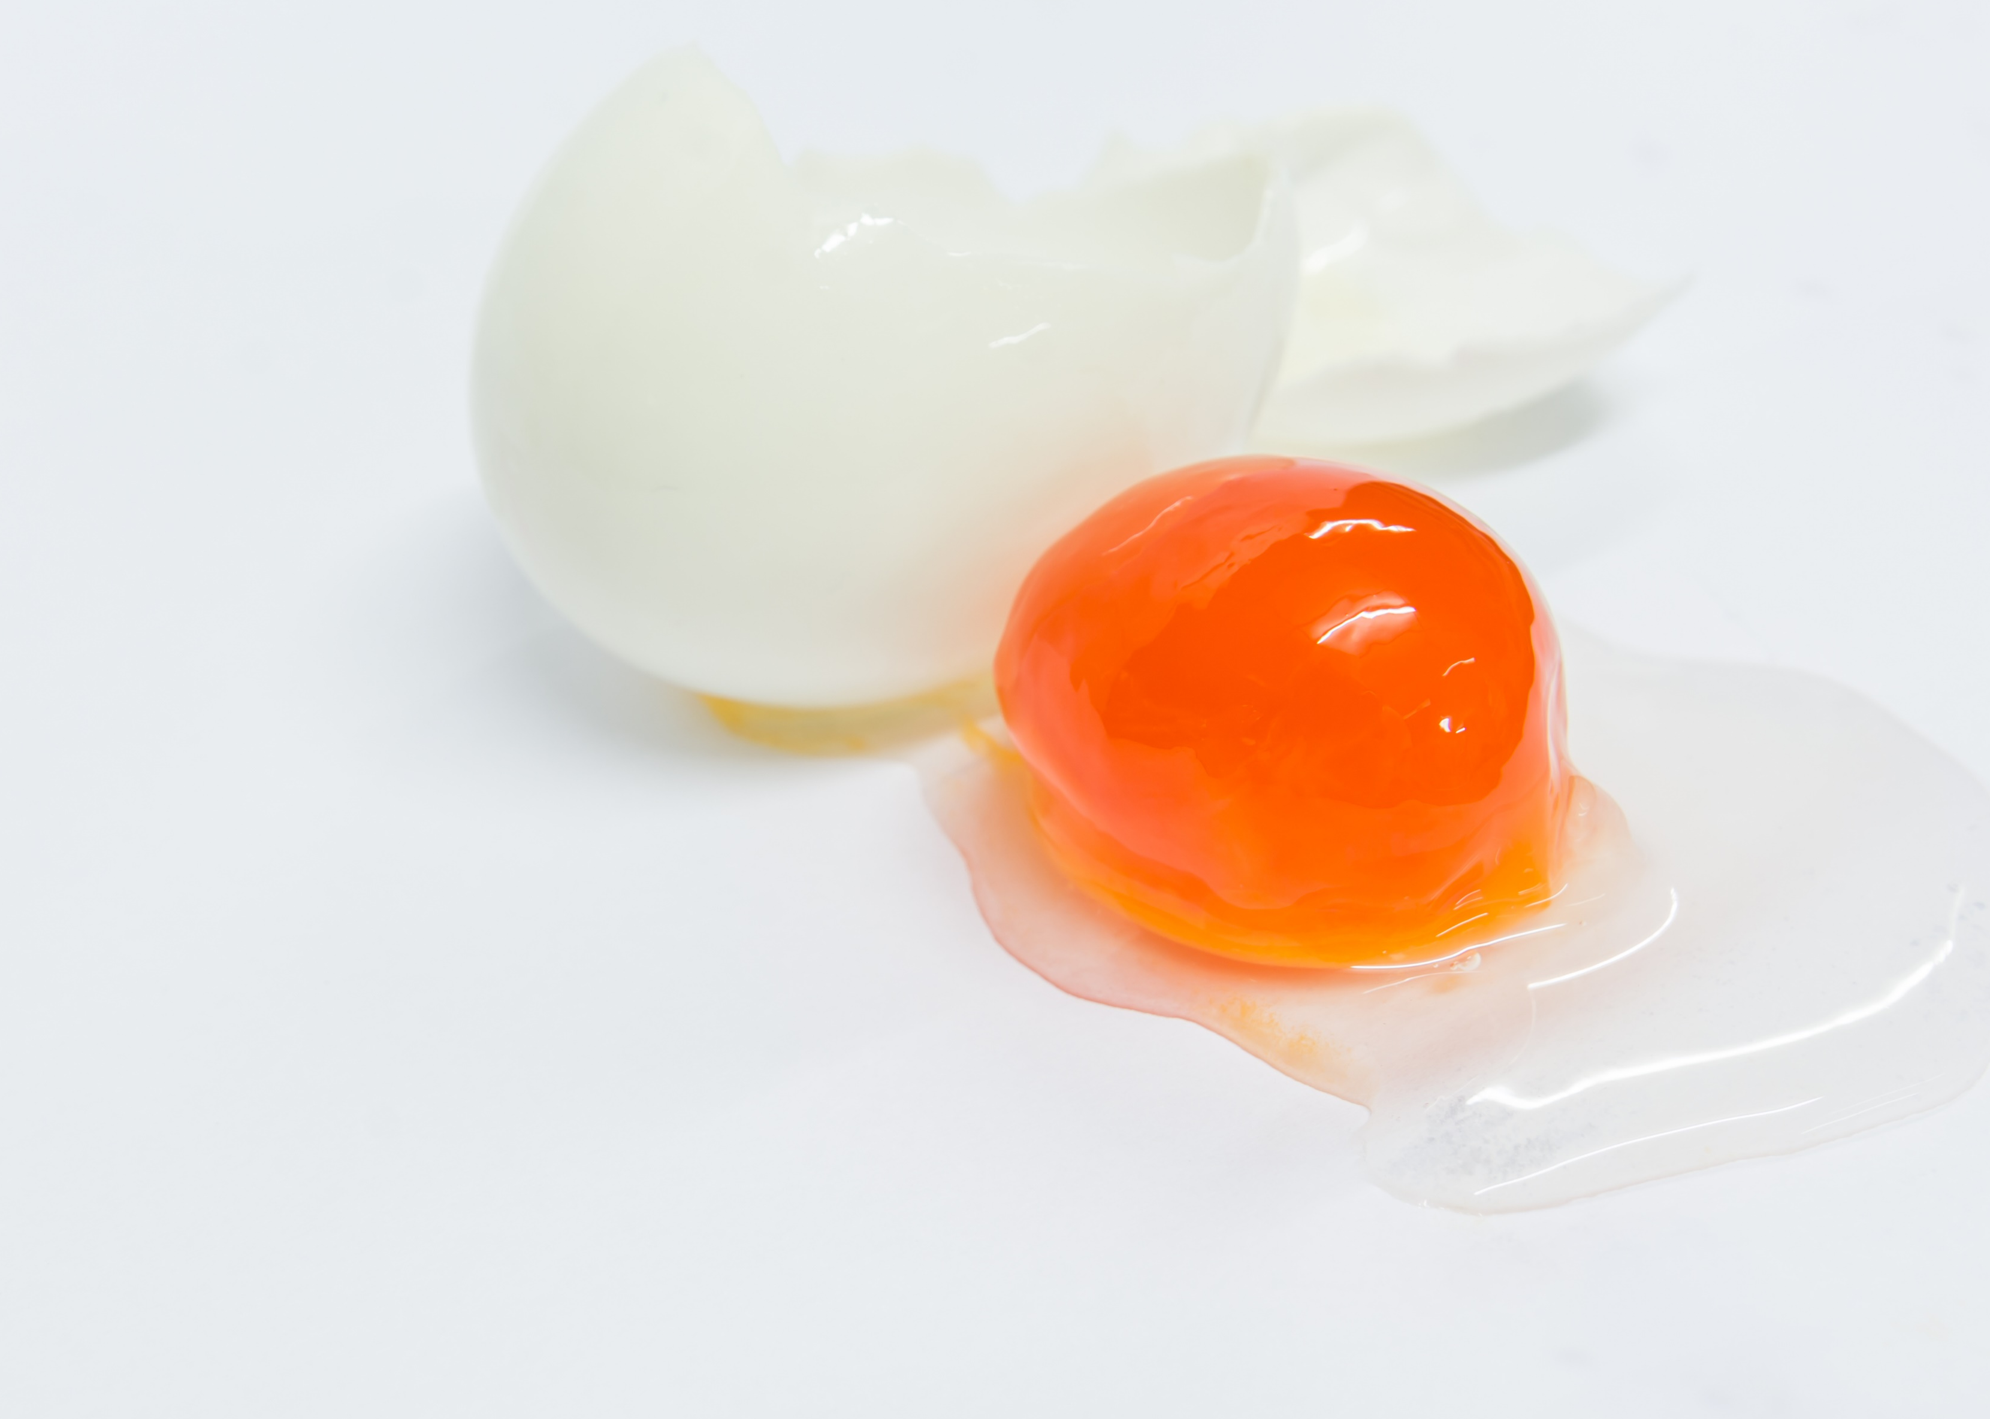
What ingredients do you need?
salted egg yolk
1: Research
2: Plan and create
3: Present

Slide 10
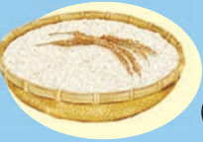
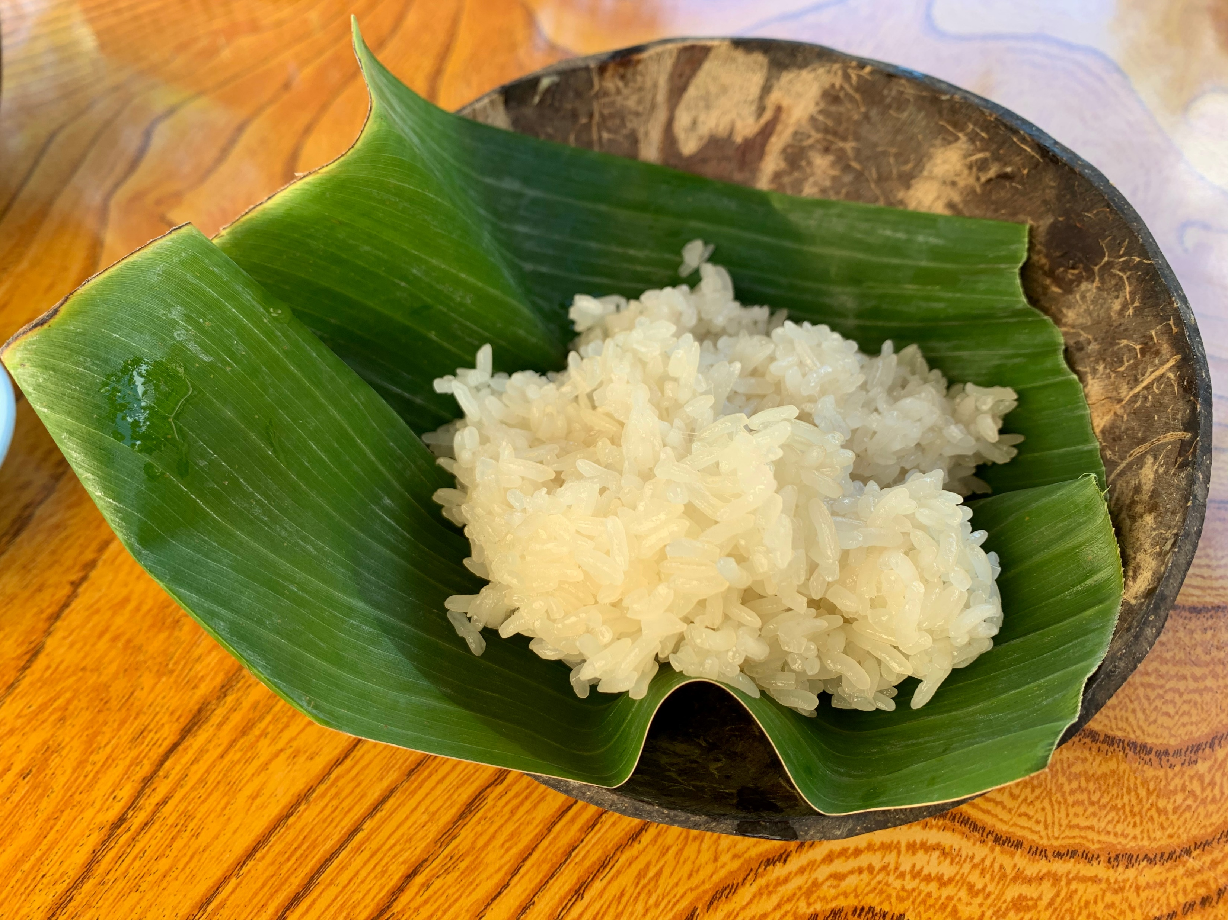
What ingredients do you need?
glutinous rice (or sticky rice)
1: Research
2: Plan and create
3: Present

Slide 11
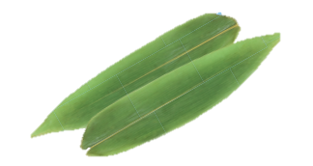
What ingredients do you need?
bamboo leaves
We don’t eat the bamboo leaves!
1: Research
2: Plan and create
3: Present

Slide 12
What ingredients do you need?
bamboo leaves
We stuff the glutinous rice with different ingredients and wrap them in bamboo leaves.
1: Research
2: Plan and create
3: Present

Slide 13
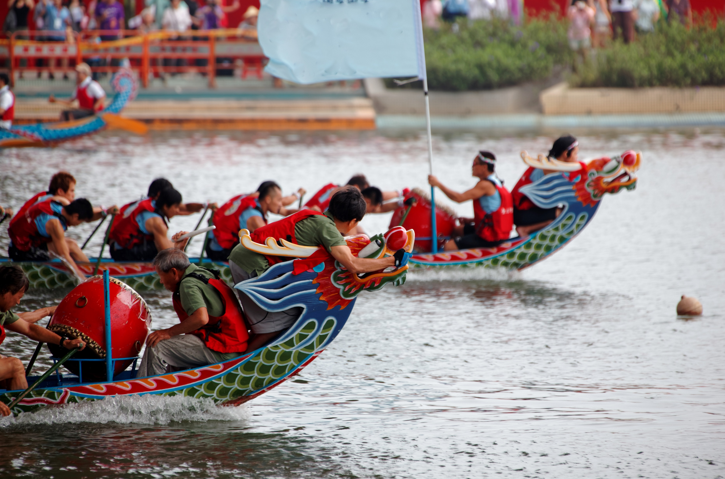
When do we usually eat rice dumplings?
People usually eat rice dumplings to celebrate Dragon Boat Festival.
1: Research
2: Plan and create
3: Present

Slide 14
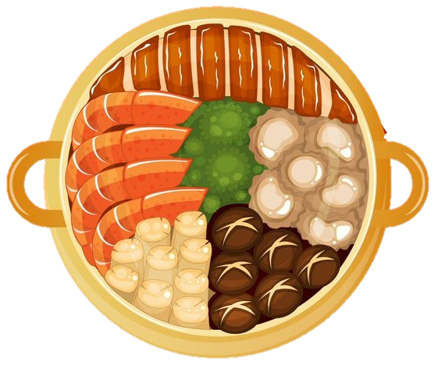
Lucky pot (poon choi)
1: Research
2: Plan and create
3: Present

Slide 15
What is the food?
Lucky pot (Poon choi)
This traditional dish has many layers ingredients in a large basin.
1: Research
2: Plan and create
3: Present

Slide 16
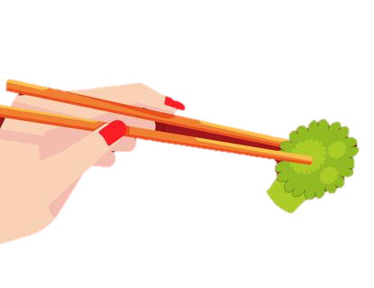
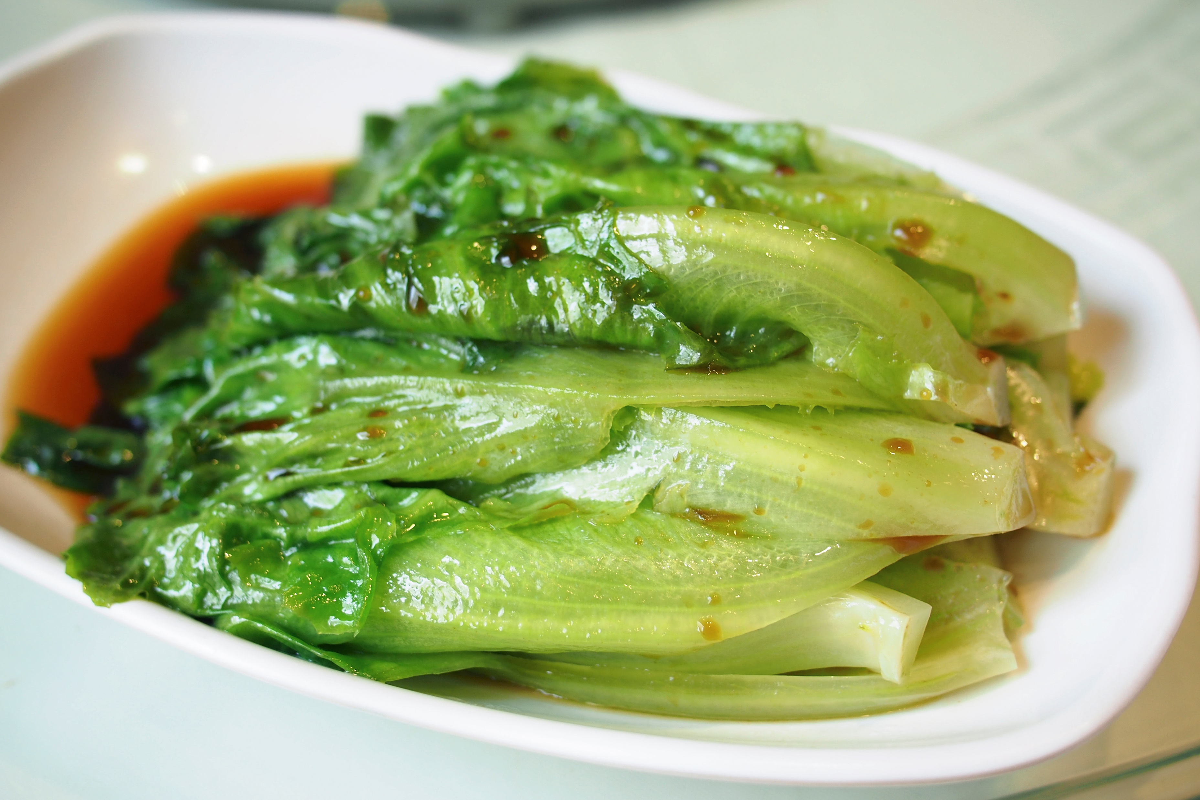
What ingredients do you need?
green vegetables
1: Research
2: Plan and create
3: Present

Slide 17
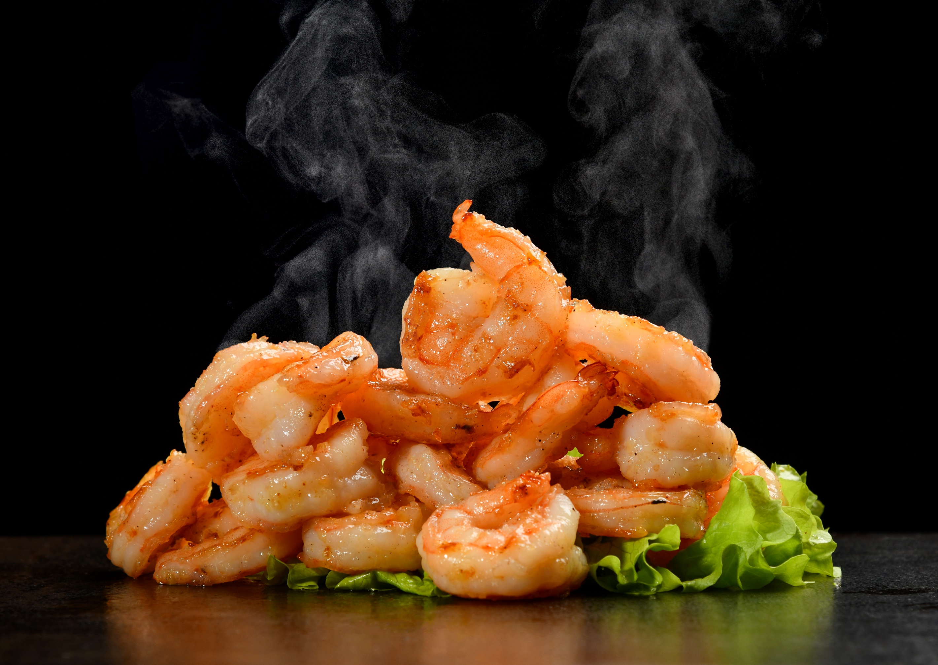
What ingredients do you need?
prawn
1: Research
2: Plan and create
3: Present

Slide 18
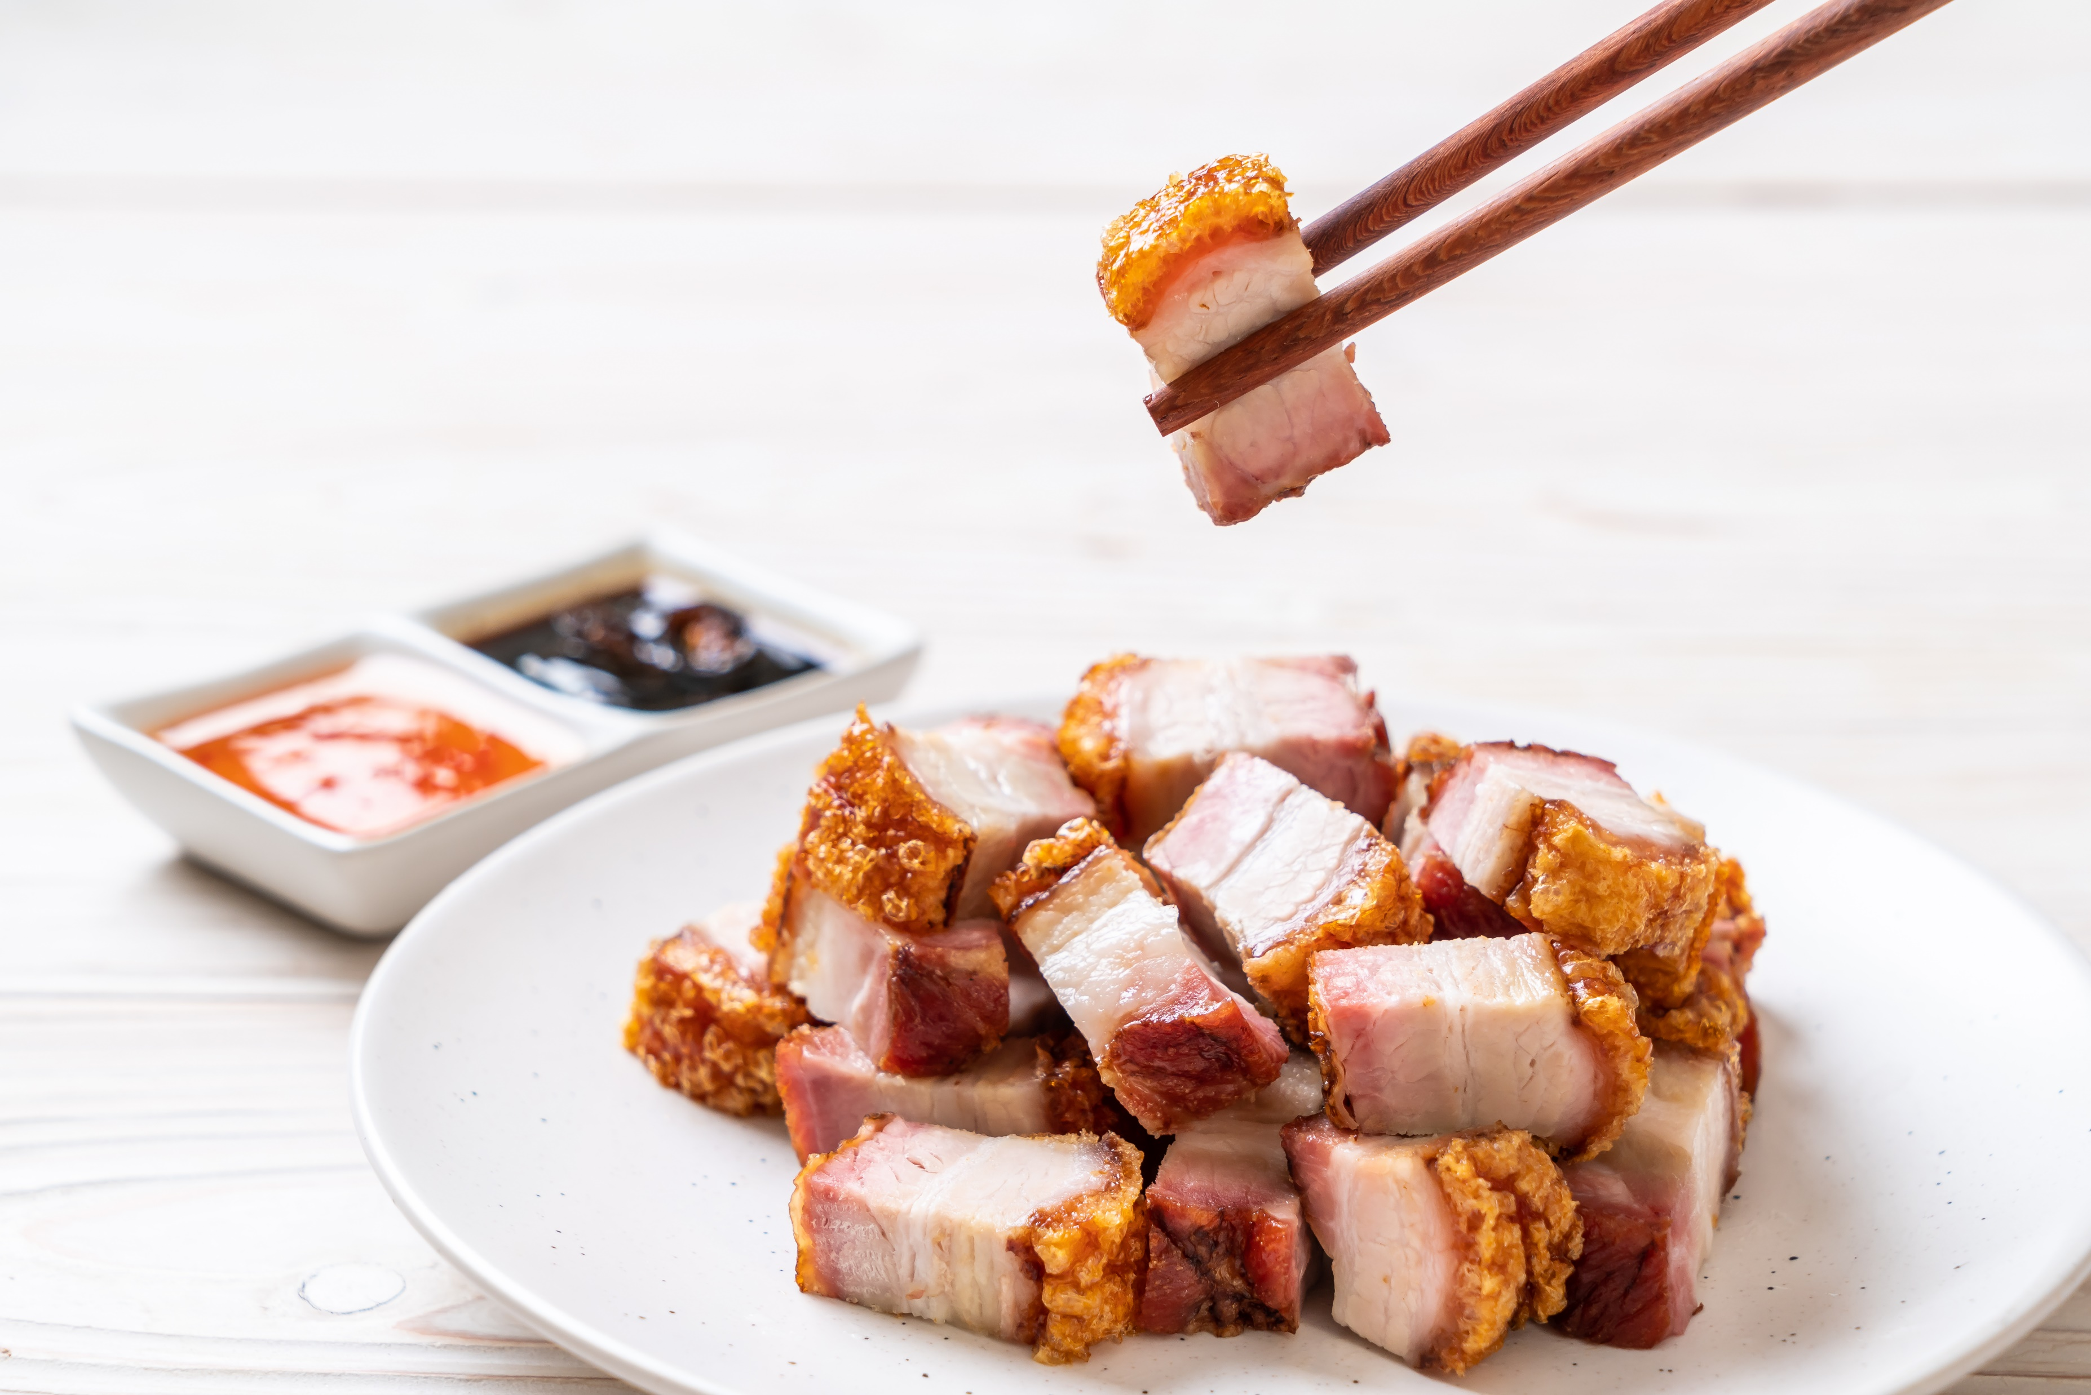
What ingredients do you need?
roasted pork
1: Research
2: Plan and create
3: Present

Slide 19
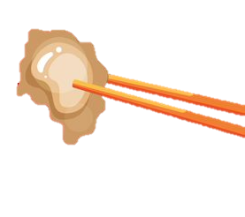
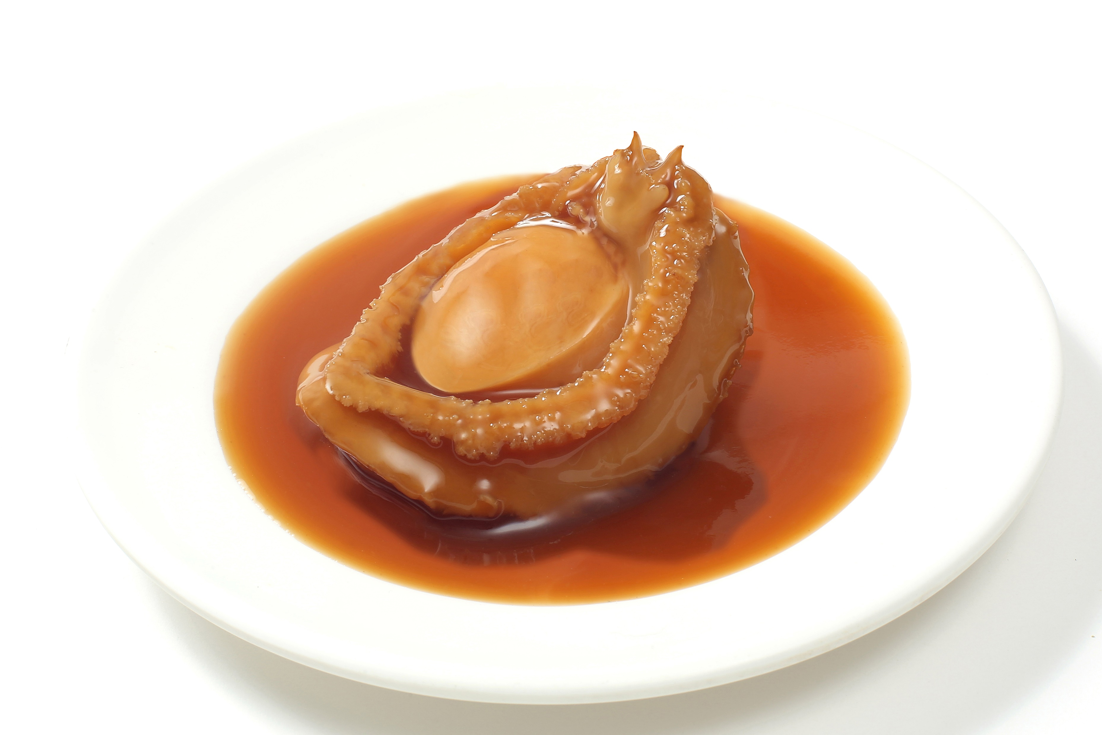
What ingredients do you need?
abalone
1: Research
2: Plan and create
3: Present

Slide 20
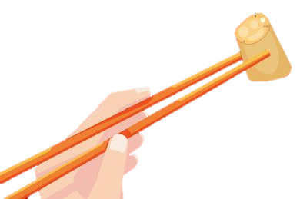
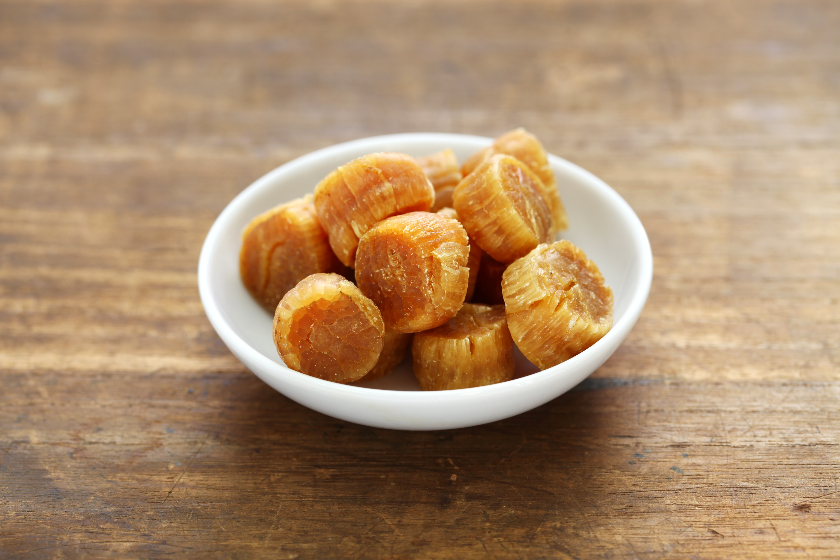
What ingredients do you need?
dried scallop
1: Research
2: Plan and create
3: Present

Slide 21
Does poon choi have a special meaning?
Poon choi is a symbol of unity and wealth.
1: Research
2: Plan and create
3: Present

Slide 22
Each ingredient has a special meaning!
Prawns mean joy and laughter in Cantonese.
1: Research
2: Plan and create
3: Present

Slide 23
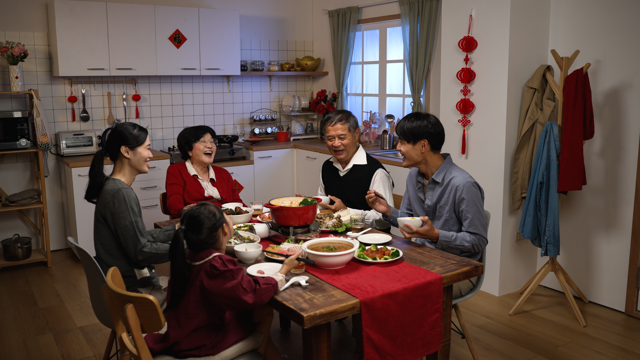
When do people usually eat poon choi?
Nowadays, we usually eat it at Chinese New Year family reunions.
1: Research
2: Plan and create
3: Present

Slide 24
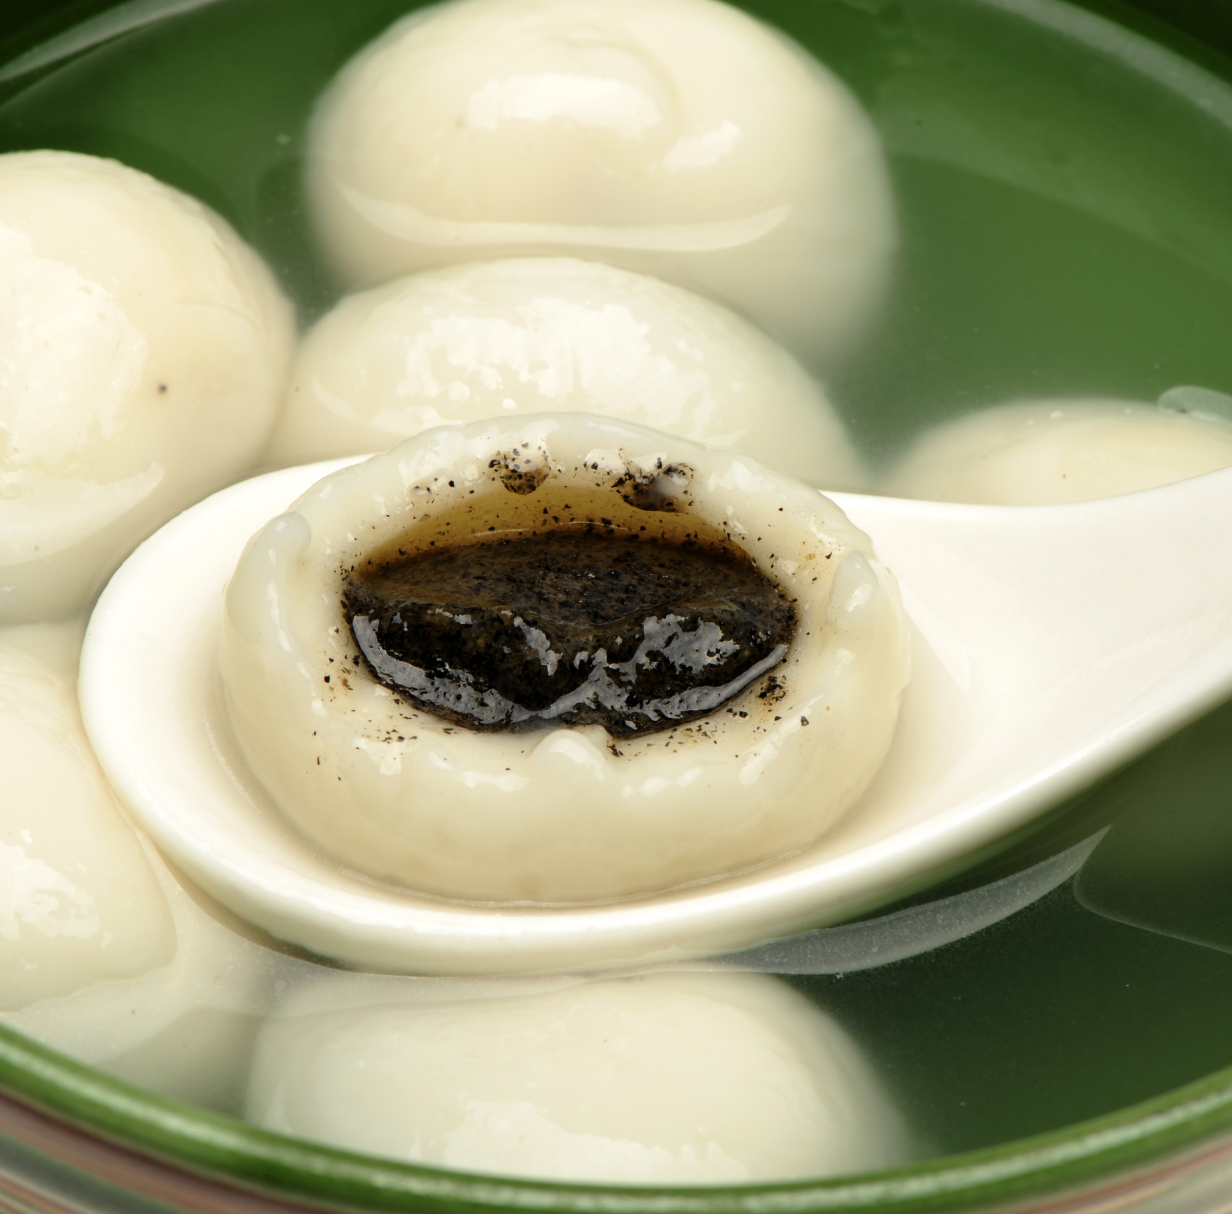
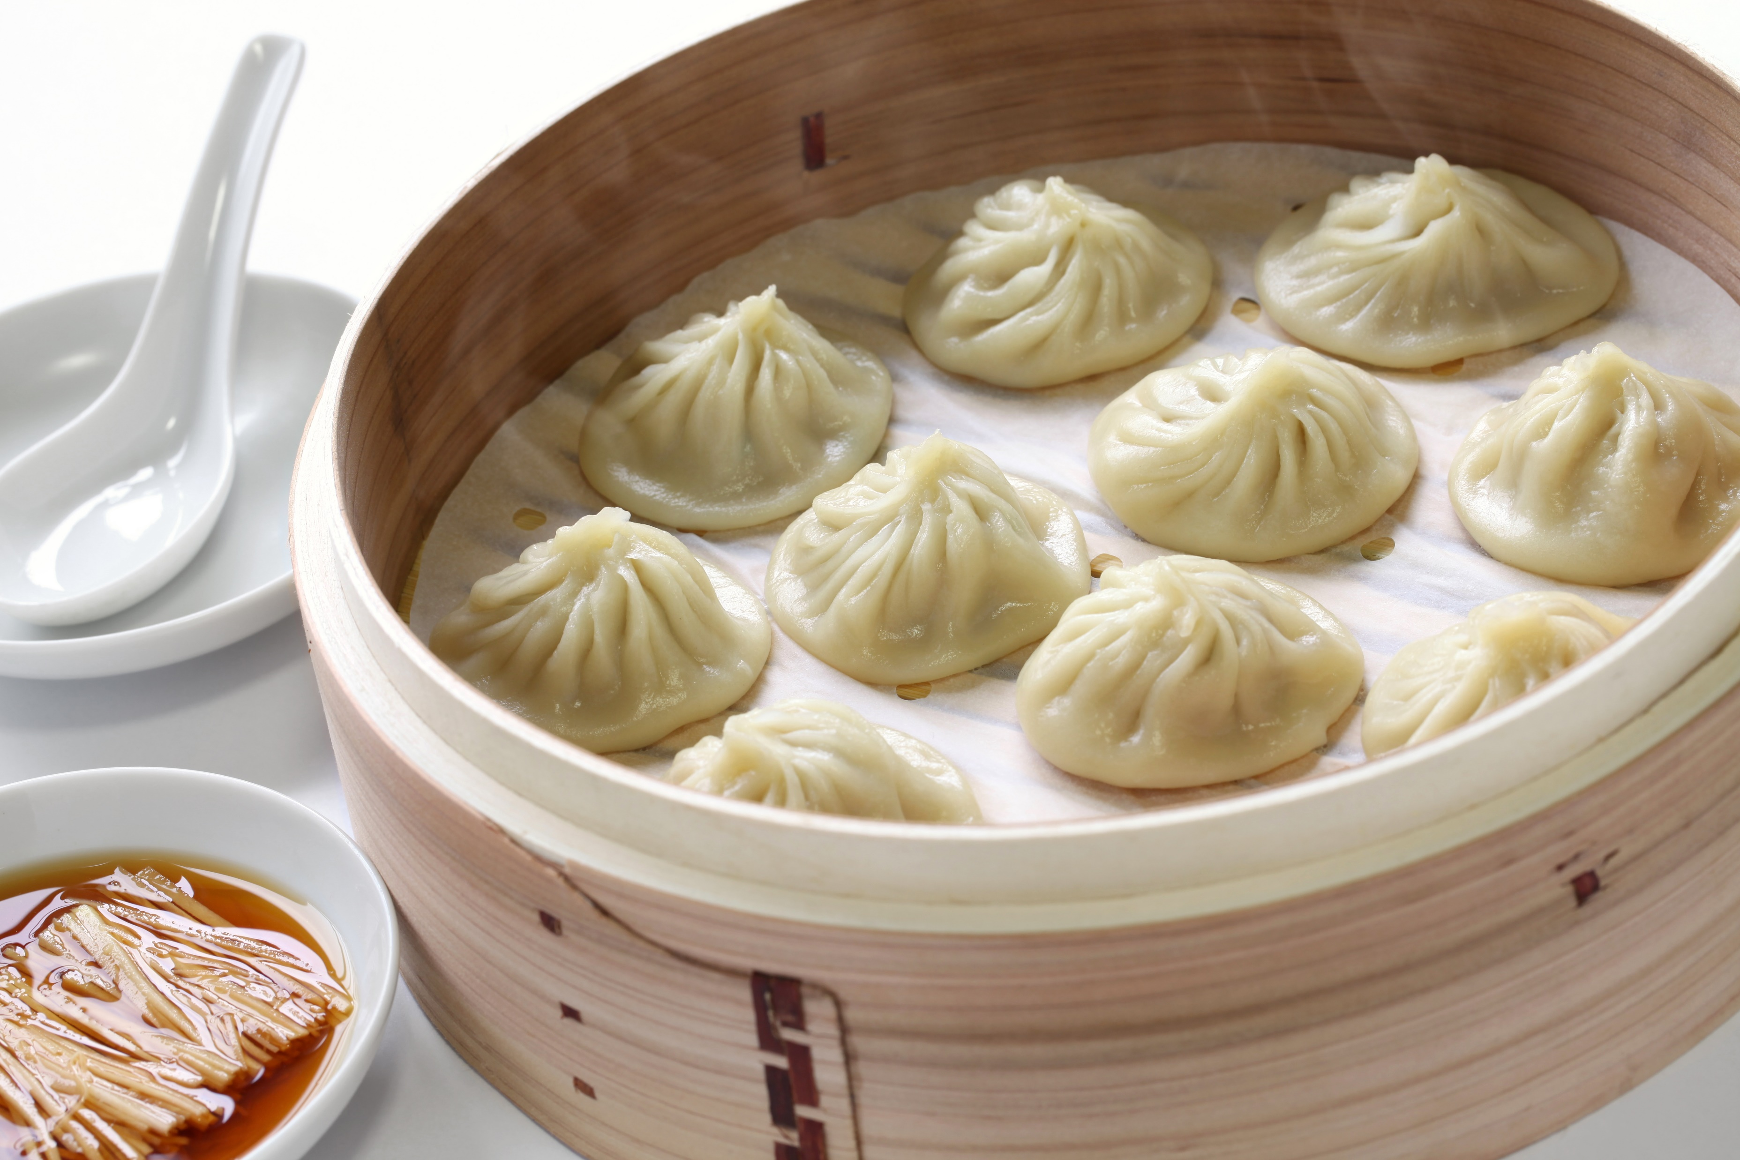
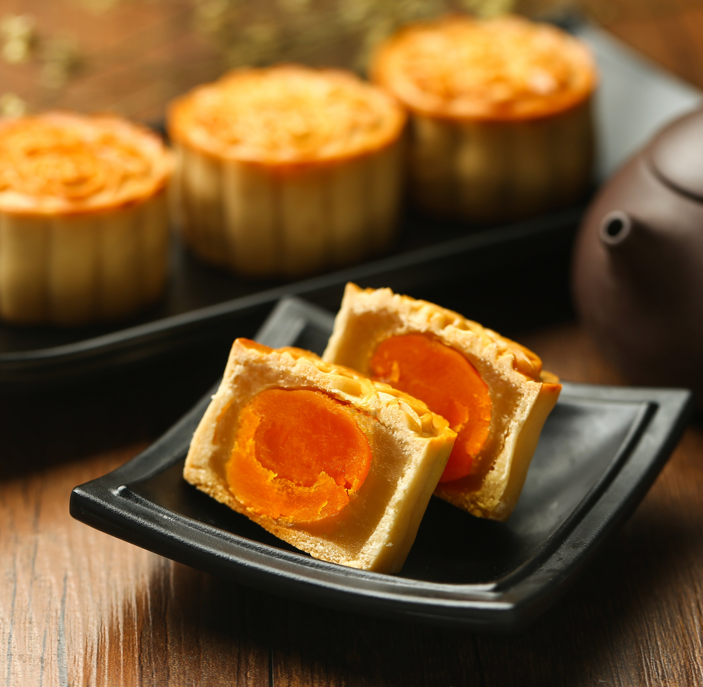
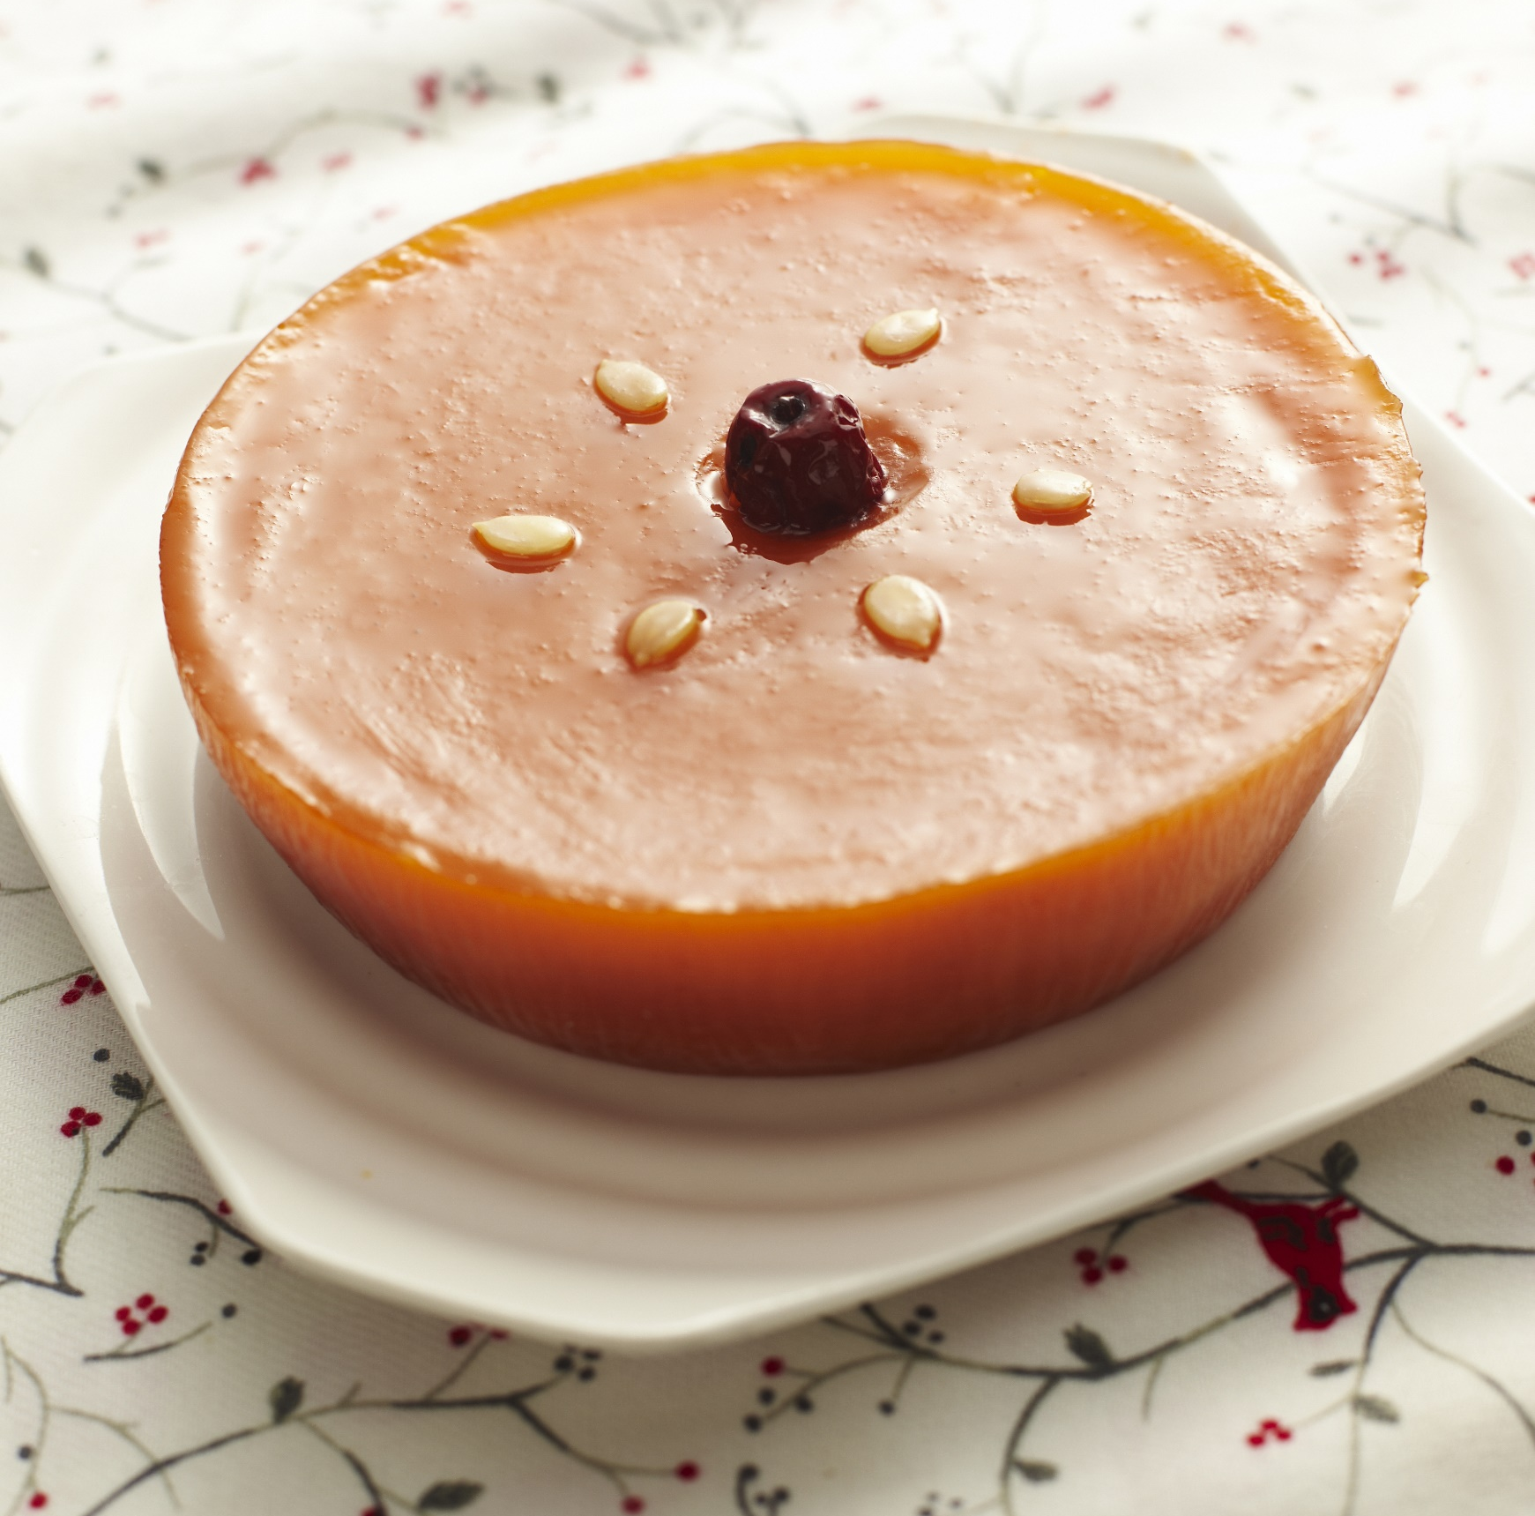
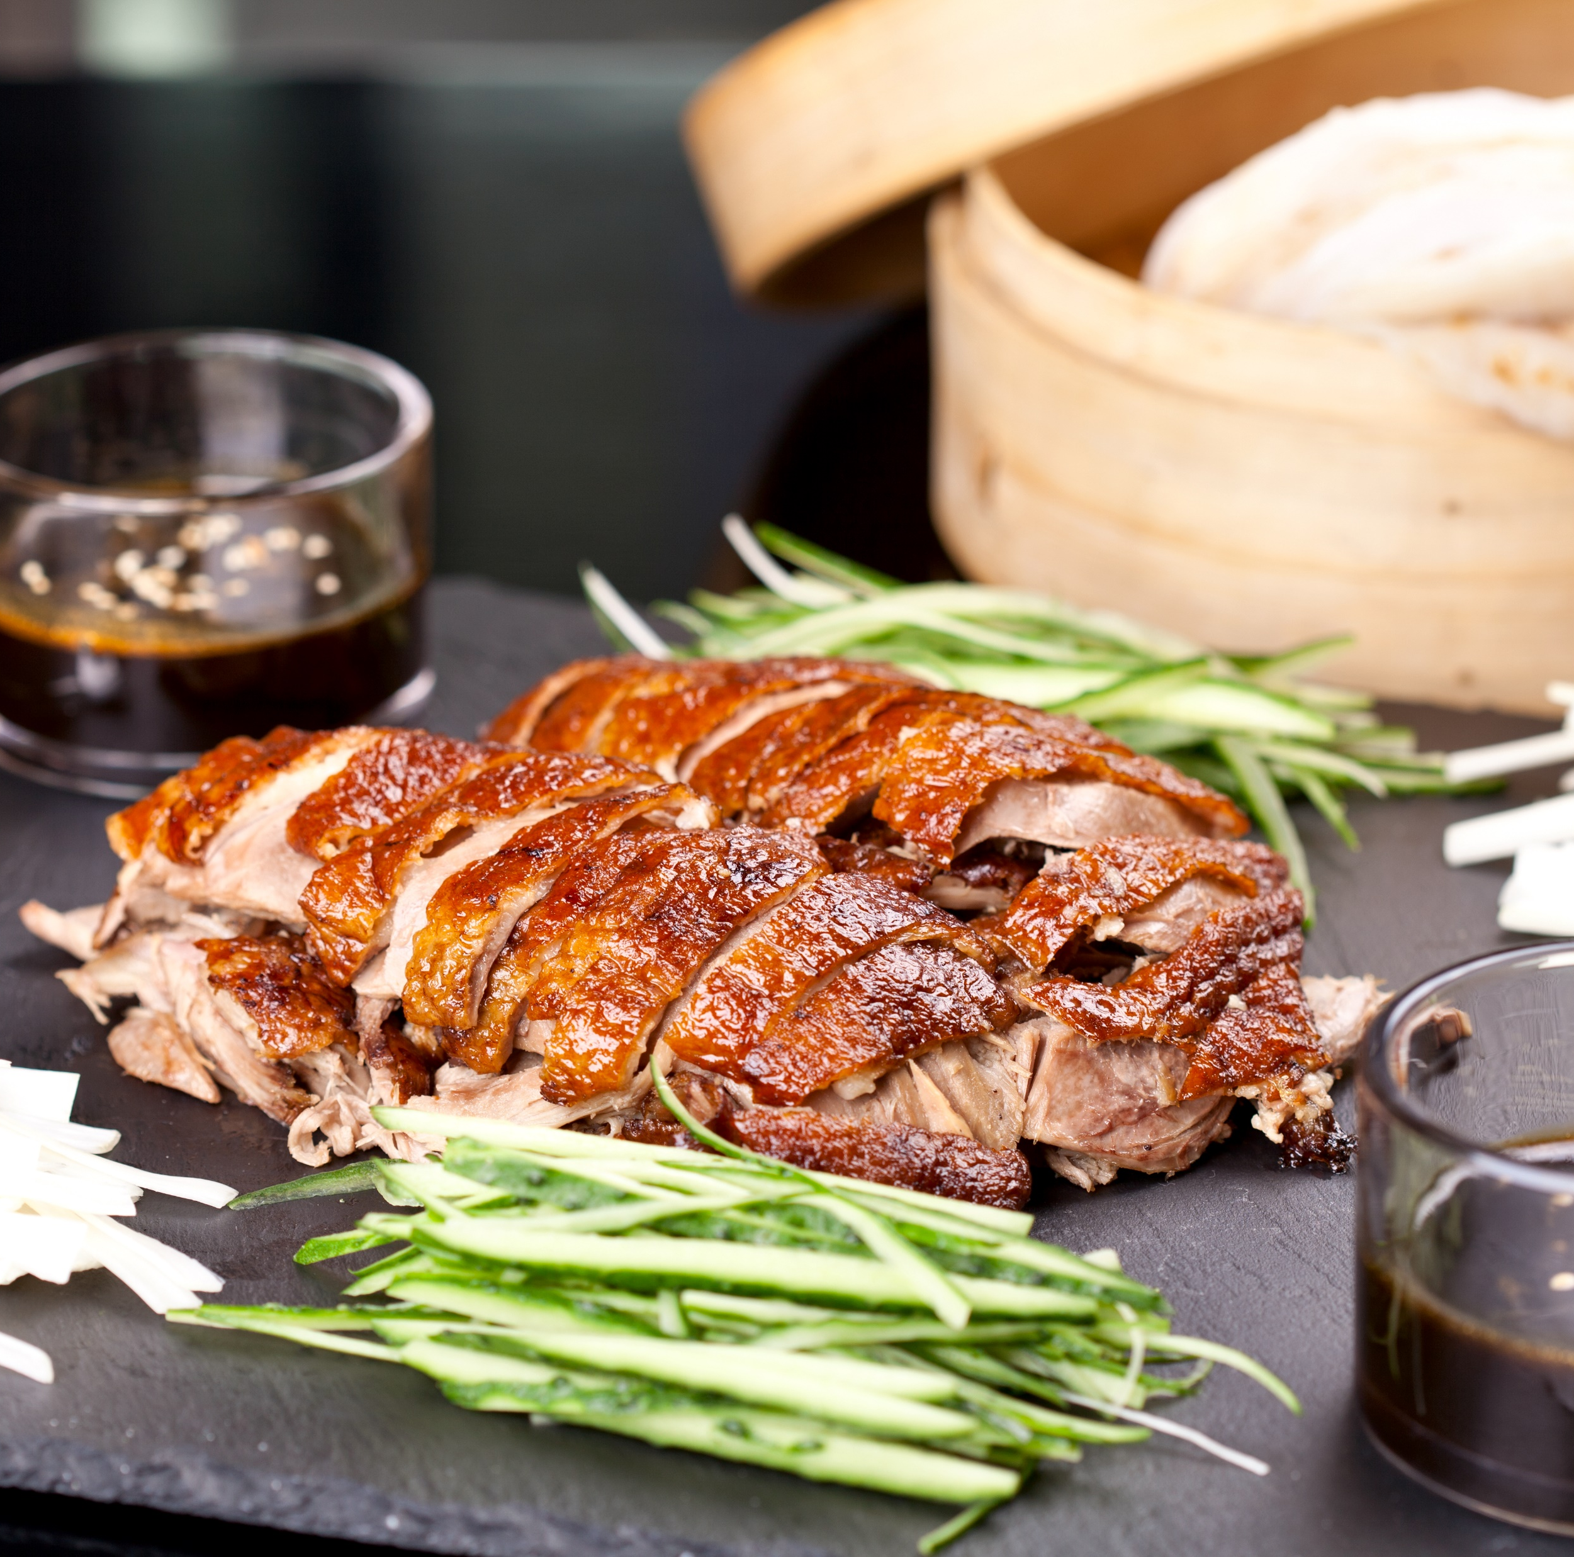
Choose one and do some research!
Here are more Chinese traditional food.
Soup dumplings (Xiaolong Bao)
Glutinous rice ball
Mooncake
Chinese rice cake
Peking duck
1: Research
2: Plan and create
3: Present

Slide 25
1: Research
2: Plan and create
3: Present

Slide 26
I’m going to talk about rice dumplings today.
1: Research
2: Plan and create
3: Present

Slide 27
I’m going to talk about rice dumplings today.
To make
rice dumplings, you need pork belly, Chinese mushroom,
salted egg yolk and glutinous rice.
1: Research
2: Plan and create
3: Present

Slide 28
I’m going to talk about rice dumplings today.
To make
rice dumplings, you need pork belly, Chinese mushroom,
salted egg yolk and glutinous rice.
You also need bamboo
leaves. We stuff the glutinous rice with different ingredients
and wrap them in bamboo leaves.
1: Research
2: Plan and create
3: Present

Slide 29
I’m going to talk about rice dumplings today.
To make
rice dumplings, you need pork belly, Chinese mushroom,
salted egg yolk and glutinous rice.
You also need bamboo
leaves. We stuff the glutinous rice with different ingredients
and wrap them in bamboo leaves.
We usually eat rice
dumplings at Dragon Boat Festival.
1: Research
2: Plan and create
3: Present

Slide 30
I’m going to talk about rice dumplings today.
To make
rice dumplings, you need pork belly, Chinese mushroom,
salted egg yolk and glutinous rice.
You also need bamboo
leaves. We stuff the glutinous rice with different ingredients
and wrap them in bamboo leaves.
We usually eat rice
dumplings at Dragon Boat Festival.
I like rice dumplings
a lot. I hope you like them too!
1: Research
2: Plan and create
3: Present

Slide 32
How to start and end your presentation:
Start your presentation by greeting your audience.
Hi, my name is … Today I’m going to talk about …
Good morning / after everyone. I’d like to talk about … today.
Hi, I’m … I’m going to introduce to you some …
Don’t forget to thank your audience at the end!
Thank you for listening.
I hope you like my presentation.
That’s the end of my presentation. Thank you!
1: Research
2: Plan and create
3: Present

Slide 33
Tips for a good presentation:
1
2
Practise your speech in front of a mirror for a few times.
Look at your audience when you give your presentation.
If you are recording your presentation, look into the camera.
1: Research
2: Plan and create
3: Present

Slide 34
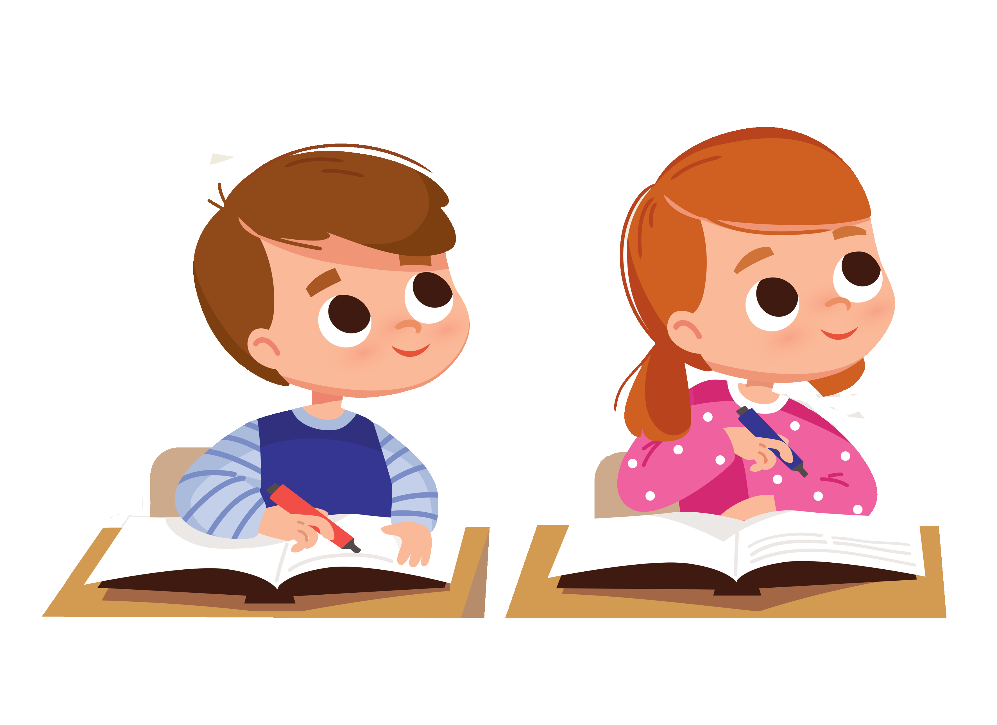
Tips for a good presentation:
3
4
Speaking slowly and clearly.
Pause between sentences.
I’m going to talk about food today. What’s your favourite food? Well, I like …
… … … …
Pause!
Pause!
Smile and enjoy yourself!
1: Research
2: Plan and create
3: Present

Slide 35
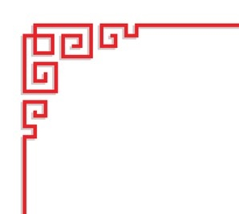
Sample presentation:
1: Research
2: Plan and create
3: Present

Slide 37
Acknowledgments
We are grateful to the following for permission to reproduce copyright photographs:
CHARTGRAPHIC. Shutterstock
Jiang Zhongyan. Shutterstock
kariphoto. Shutterstock
nikkimeel. Shutterstock
matter77. 123rf.com
kajeab_pongsiri. Shutterstock
CHEN MIN CHUN. Shutterstock
JoulyC. Shutterstock
Dmitry Lobanov. Shutterstock
gowithstock. Shutterstock
jongholee. Shutterstock
bonchan. Shutterstock
PRPicturesProduction. Shutterstock
Jinning Li. Shutterstock
bonchan. Shutterstock
JIANG HONGYAN. Shutterstock
LI CHAOSHU. Shutterstock
761233. Shutterstock
NotionPic. Shutterstock
Naumova Marina. Shutterstock
Tatiana Arestova. Shutterstock
Olga1818. Shutterstock
Every effort has been made to trace copyright, but in the event of any accidental infringement, we shall be pleased to come to a suitable arrangement with the rightful owner.

