Slide 1
Chapter 2
My school calendar

Slide 2
We are going to look at some photos of school events today.

Slide 3
There are different school events each year.

Slide 4
Do you want to know more about these events?

Slide 5
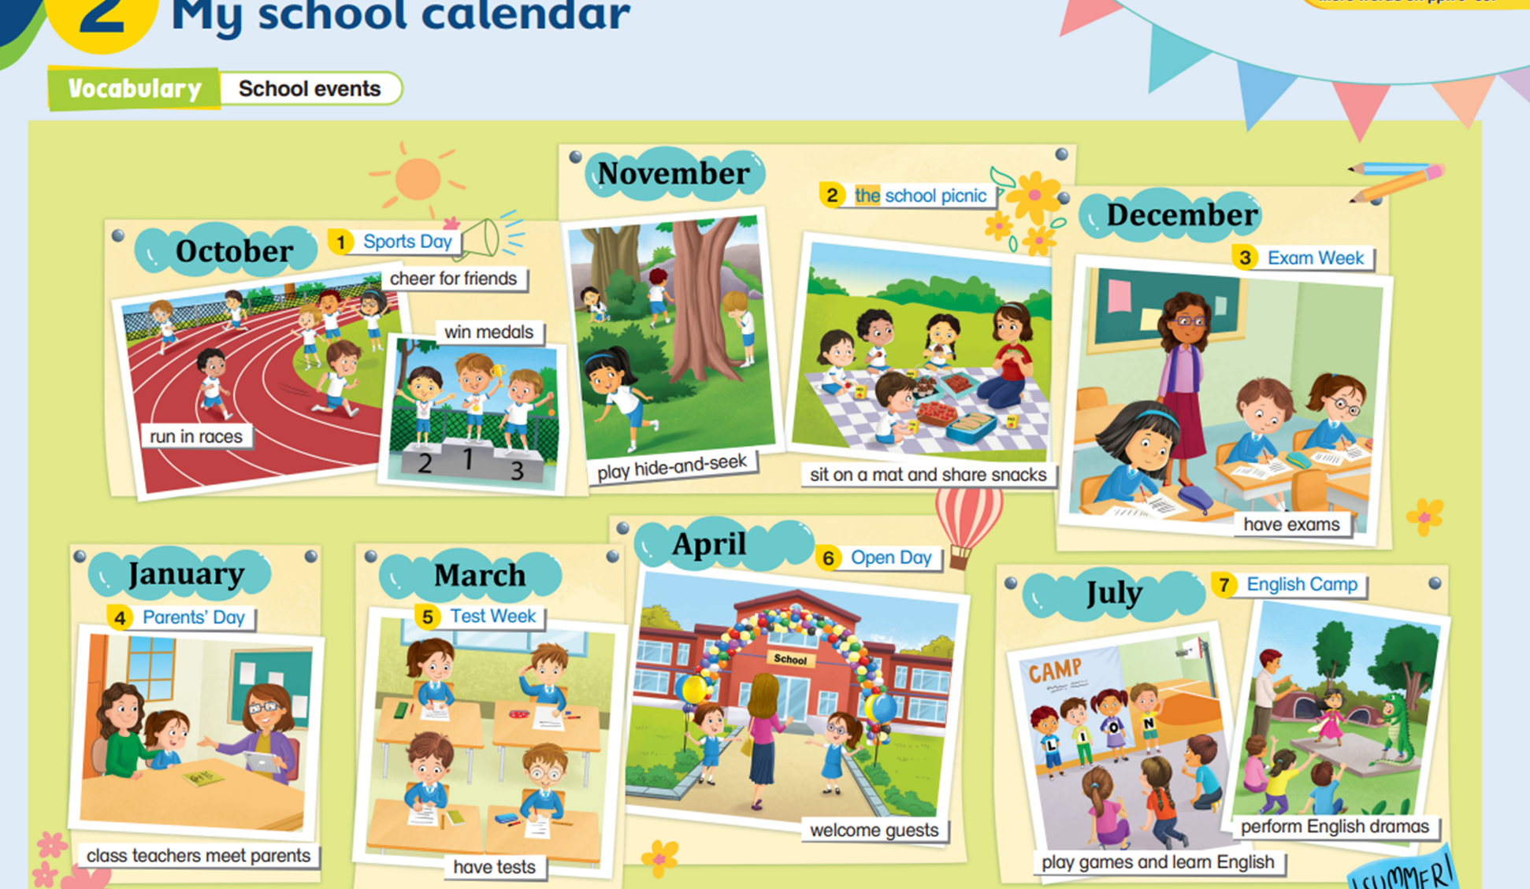
Let’s take a look at the first one.

Slide 6
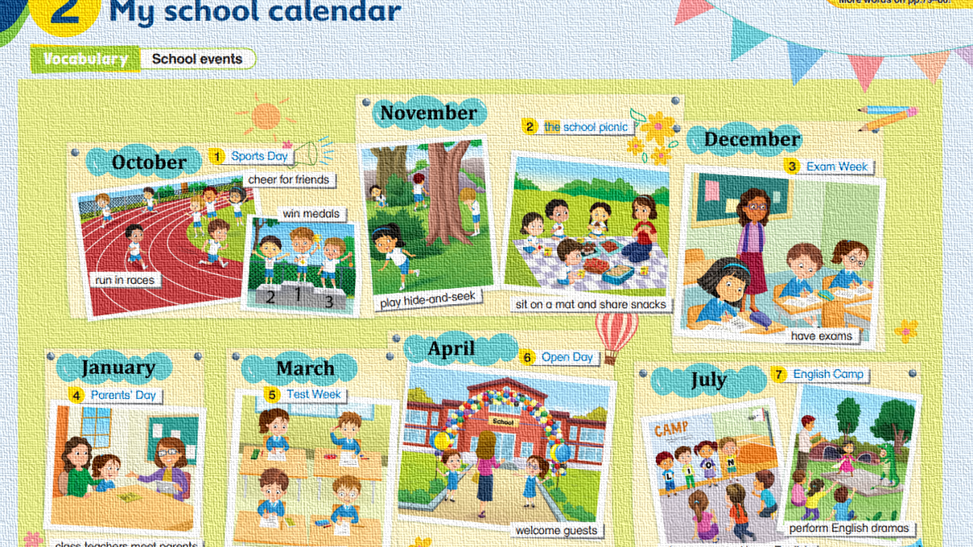
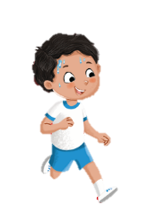
This is Sports Day.

Slide 7
It takes place in October.

Slide 8
Some students can run in races.

Slide 9
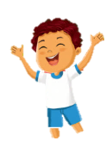
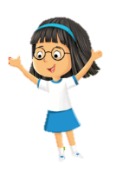
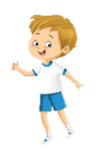
Other students can cheer for friends.

Slide 10
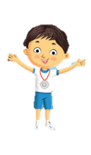
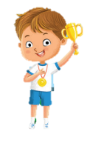
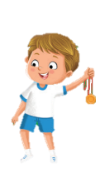
Look! These boys are happy!

Slide 11
They are the winners.

Slide 12
They can win medals!
Their medals are shiny!

Slide 13
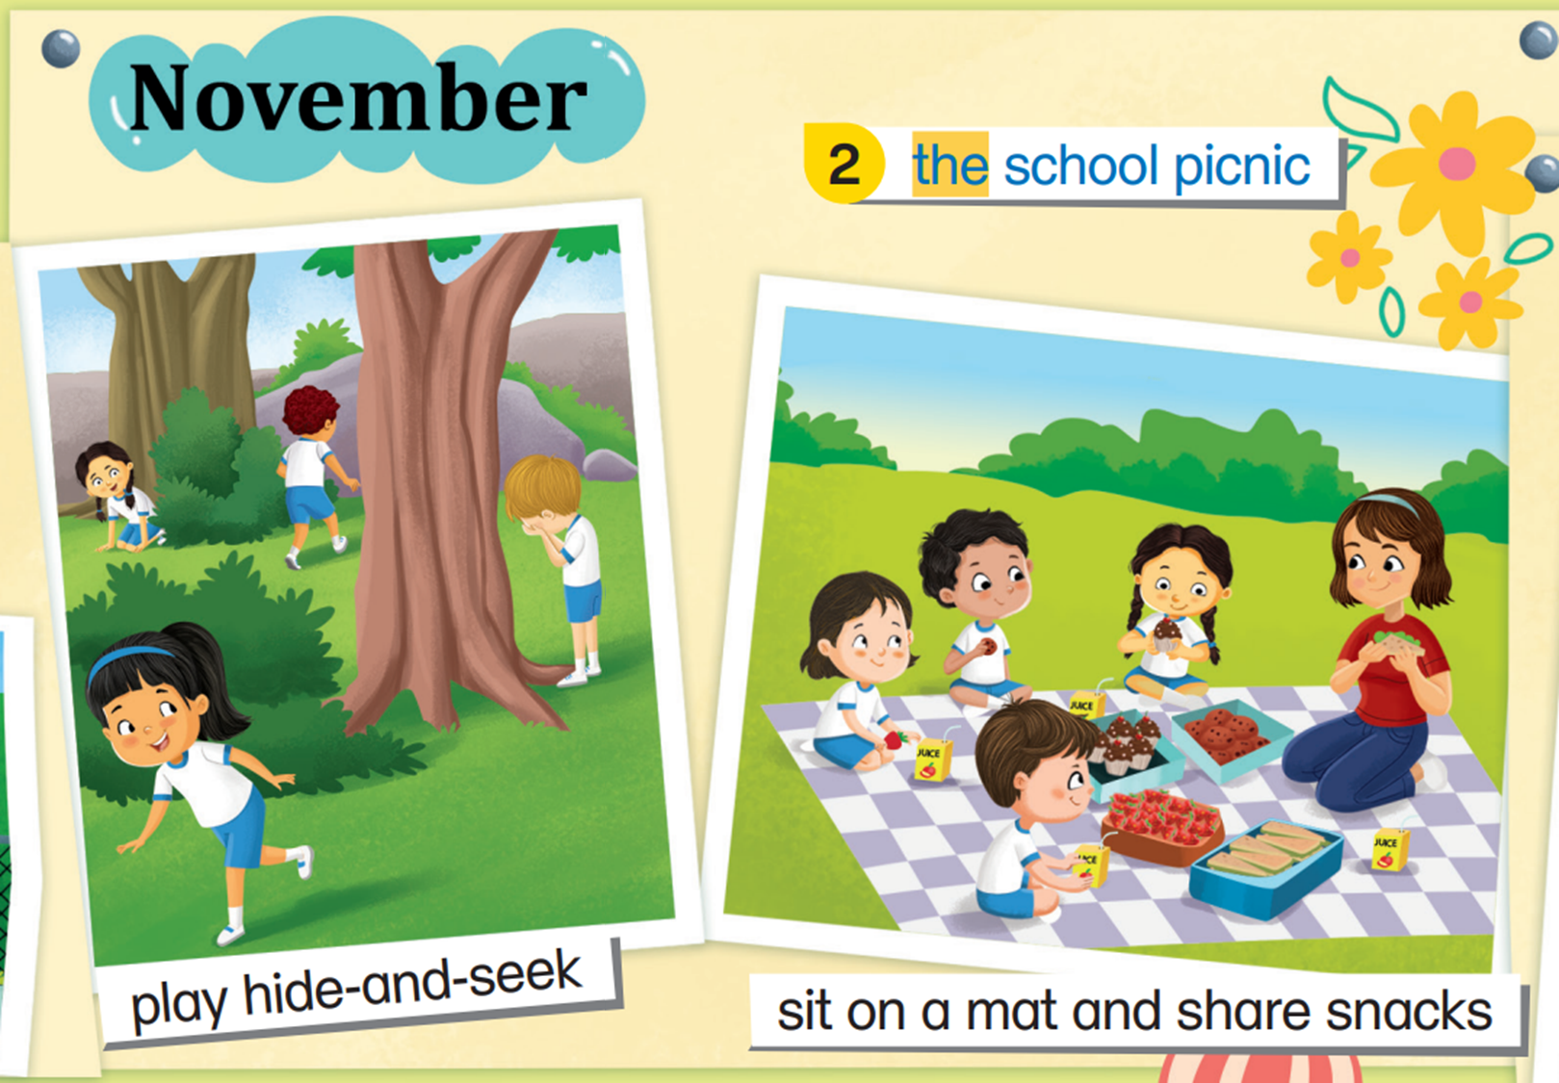
Let’s look at the next school event.

Slide 14
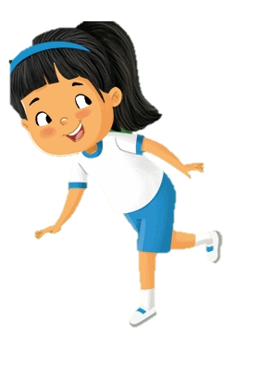
This is the school picnic.

Slide 15
It is in November.

Slide 16
Students can play hide-and-seek at the school picnic.

Slide 17
Do you think the boy can find his friends?

Slide 18
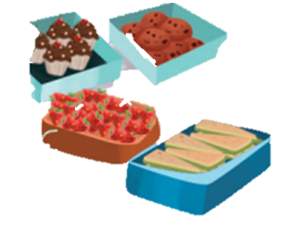
Other than games, they can also sit on a mat and share snacks.

Slide 19
The snacks look really delicious!

Slide 20
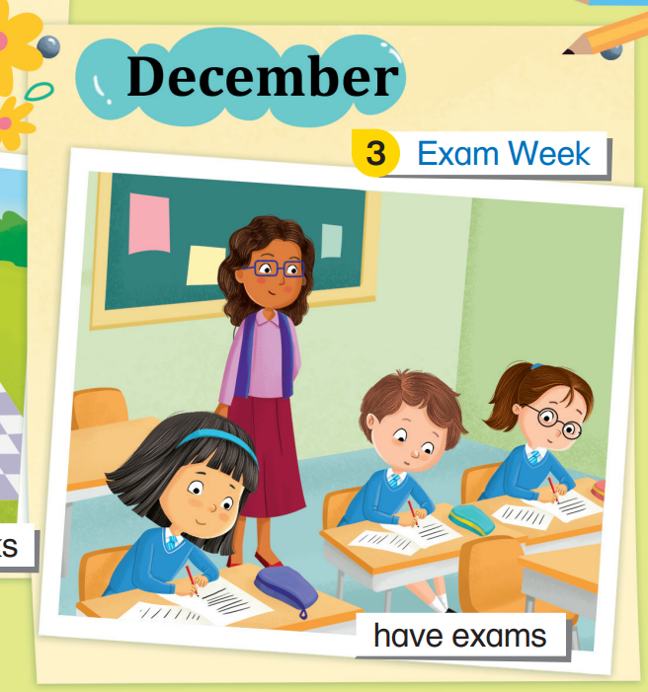
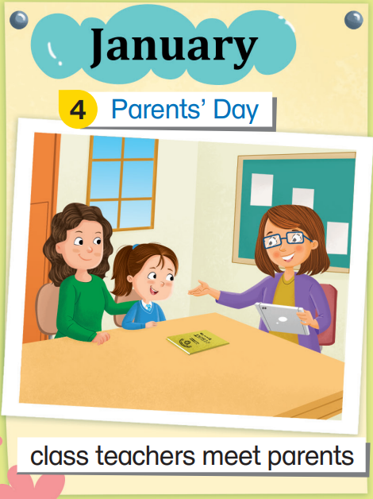
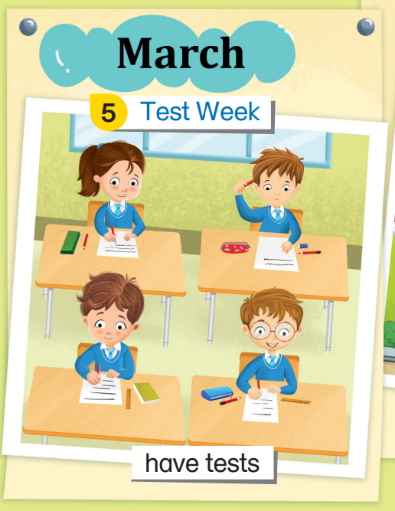
What happens in the coming months?

Slide 21
First, there is Exam Week in December.

Slide 22
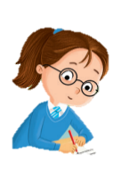
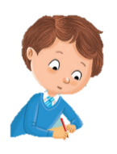
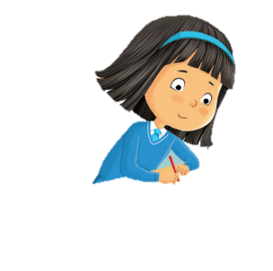
Students have exams during Exam Week.

Slide 23
Shh! Let’s be quiet and don’t disturb the students!

Slide 24
One month later in January, there is Parents’ Day.

Slide 25
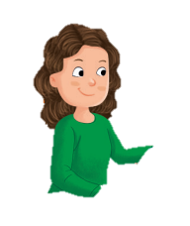
Class teachers meet parents on this day.

Slide 26
The teachers give out the students’ report cards.
They also talk to the parents.

Slide 27
In March, there is Test Week.

Slide 28
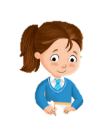
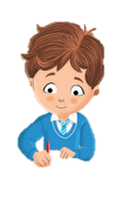
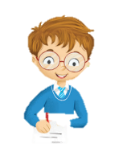
Students have tests during Test Week.

Slide 29
Good luck, boys and girls!

Slide 30
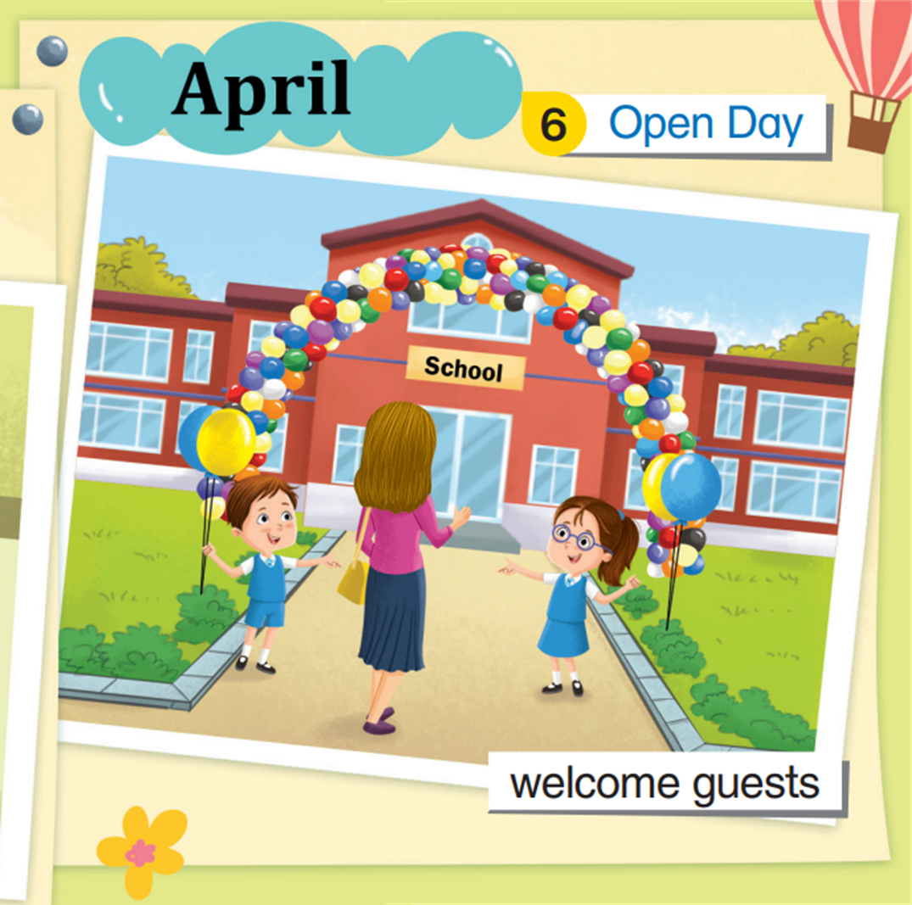
After some hard work, let’s have some fun!

Slide 31
It’s Open Day!
Open Day is in April.

Slide 32
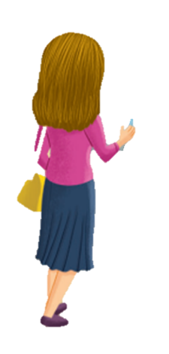
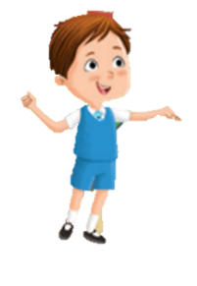
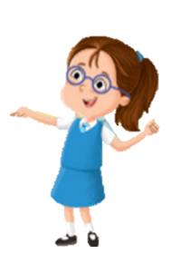
Look! There are so many balloons!
The decorations are beautiful!

Slide 33
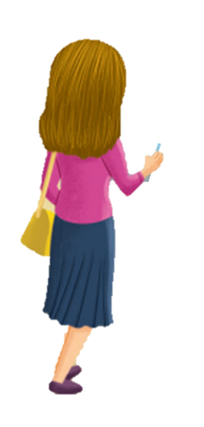
Some students stand at the school gate.
They welcome guests on this special day.

Slide 34
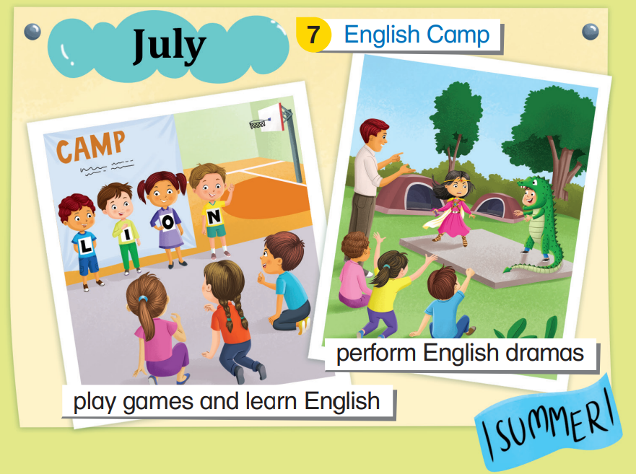
Before the summer holidays begin, let’s have one more school event!

Slide 35
Hurray! It’s English Camp!
All the children love English Camp.

Slide 36
English Camp is in July.

Slide 37
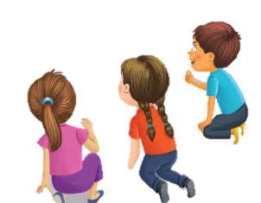
Children can play games and learn English in English Camp.

Slide 38
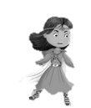
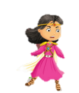
They can also perform English dramas.

Slide 39
I wonder what the drama is about!

Slide 40
What a busy and happy year for this primary school!

Slide 41
Which school event is your favourite one?

