Slide 1
Chapter 2
Part 1
Parents’ Day is on …
Test Week is from … to …
Part 2
When’s the school picnic?
It’s on the …

Slide 2
Part 1
In this part, you will learn to ask and answer questions about the dates of events and use prepositions to talk about dates.

Slide 3
Saying dates
Do you know how to say these dates?
JANUARY
8
It’s the eighth of January.
day
month
We use ordinal numbers for days of the month.
MARCH
17
It’s the seventeenth of March.
day
month

Slide 4
Saying dates
To form ordinal numbers, we usually add th to the numbers.
Some exceptions include first, second and third.
1st
first
2nd
second
3rd
third
4th
fourth
5th
fifth
← fiveth
6th
sixth
7th
seventh

Slide 5
Saying dates
← Just add h
← twentyth
← Drop the e
← twelveth

Slide 6
Saying dates
Let’s review months of the year.

Slide 7
Writing dates
Now that we know how to say dates, do you know how to write dates?
April
5
5th April
5 April
5/4

Slide 8
Using on
We can use on to talk about the date of an event.
NOV
18
Parents’ Day
Parents’ Day is on the eighteenth of November.

Slide 9
Using on
We can use on to talk about the date of an event.
APRIL
Music Camp is on the tenth of April.
10
What if the event takes place on more than one day?
Music Camp

Slide 10
Using from … to
When the event happens for a period of time, we can use from … to.
Exam Week
a period of time
Exam Week is from the third of December to the seventh of December.

Slide 11
Using from … to
When the event happens for a period of time, we can use from … to.
English Week is from the fifteenth of March to the nineteenth of March.
March
English Week
a period of time

Slide 12
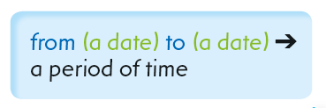
Using on and from … to
Let’s review the use of prepositions to talk about dates.
Games Day
Games Day is on the eighth of November.
English Camp is from the twentieth of November to the twenty-second of November.
English Camp

Slide 13
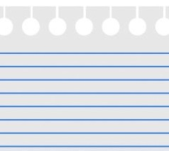
Quick Check
1. Say the dates.
23
the twenty-third of June
It’s ____________________ .
JUNE
It’s _________________ .
the ninth of October
9/10

Slide 14
Quick Check
2. Complete the sentence.
6th May
Mom’s birthday! Buy flowers!
on the sixth of May
Mom’s birthday is _________________ .

Slide 15
Quick Check
3. Complete the sentence.
APRIL
13 MON
Maths Camp is _________
___________________________________ .
from the
14 TUE
Maths Camp
thirteenth of April to the
15 WED
fifteenth of April
16 THU
17 FRI

Slide 16
Quick Check
4. Complete the sentence.
The school picnic is _________
_________________________ .
on the
the twenty-second of November

Slide 17
Part 2
In this part, you will learn to ask and answer questions about dates.

Slide 18
When’s …?
When we want to find out the date of an event, we use When in the question.
Sports Day
SEPTEMBER
When’s = When is
Joe:
Lisa:
When’s Sports Day?
It’s on the eleventh of September.

Slide 19
When’s …?
Parents’ Day
NOVEMBER
Joe:
Lisa:
When’s Parents’ Day?
It’s on the ninth of November.

Slide 20
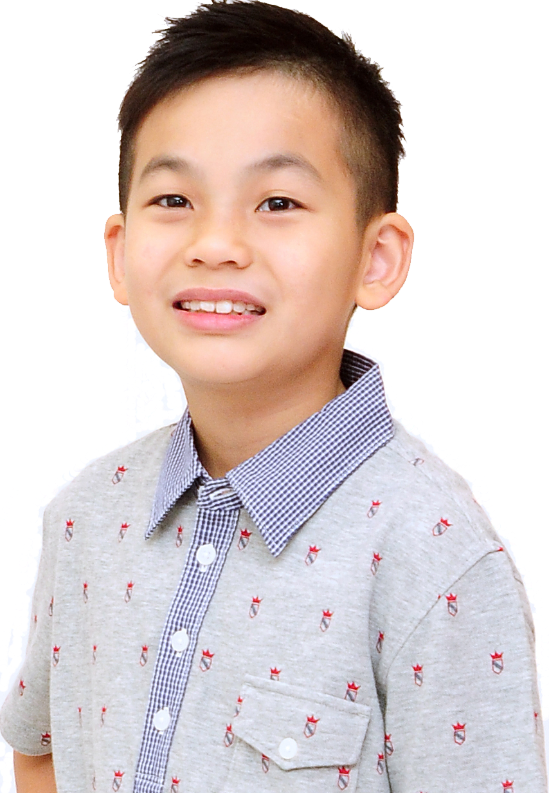
When’s …?
MAY
When’s Drama Week?
Drama Week
It’s from the first of May to the fifth of May.

Slide 21
Quick Check
1. Fill in the blanks.
Marcus: _______ Games Day?
Sarah: It’s __________________ .
When’s
on the twelfth of June
Games Day
12/6

Slide 22
Quick Check
2. Fill in the blanks.
Marcus: _______ Test Week?
Sarah: It’s ________________________ ____________________.
When’s
from the eighteenth of April to
the twenty-third of April
18/4 to 23/4

Slide 23
Quick Check
3. Fill in the blanks.
Eric: _______________?
Jane: ______________________ .
When’s Open Day
It’s on the third of October
Open Day

Slide 24
Quick Check
4. Fill in the blanks.
Nick: _________________ ?
Mom: ___________________________
___________________________ .
When’s Exam Week
1 JUNE
09:12
It’s from the twenty-fourth of
Reminder:
Nick’s Exam Week
24/6–28/6
June to the twenty-eighth of June

Slide 25
Acknowledgments
We are grateful to the following for permission to reproduce copyright photographs:
Mahesh Patil. Shutterstock
Natykach Nataliia. Shutterstock
Alexander Atkishkin. 123rf.com
drawn. 123rf.com
Kalmatsuy. Shutterstock
DenisNata. Shutterstock
lanych. Shutterstock
kak2s. Shutterstock
mimagephotography. Shutterstock
Credit Line is not needed
sergein. 123rf.com
Mega Pixel. Shutterstock
doomu. Shutterstock
Gelpi. Shutterstock
craftswoman. Shutterstock
More Images. Shutterstock
ekler. Shutterstock
Maxx-Studio. Shutterstock
Every effort has been made to trace copyright, but in the event of any accidental infringement, we shall be pleased to come to a suitable arrangement with the rightful owner.

